Slide 1
Odessa Disturbance – Inverter Based Resources (IBR) Task Force
ERCOT
Stephen Solis – Principal, System Operations Improvement
January 10, 2021

Slide 2
Background
Some Inverter Based Resources have in recent years demonstrated performance after disturbances that, if left unaddressed, will negatively affect reliability of the BES.
Inverter Based Resources are expected to and required to be able to ride through without tripping or reduction in capability for normal system disturbances that fall within predetermined criteria.
The below references are links to other disturbances similar in nature that have occurred in recent years.
Blue Cut Fire – 1200 MW PV reduction after fault
Canyon 2 Fire – 900 MW PV reduction after fault
San Fernando Disturbance – 1200 MW PV reduction after two faults
Odessa Disturbance – 1340 MW of PV and Wind IBRs reduction after fault
Additional guidelines published by NERC
https://www.nerc.com/comm/RSTC_Reliability_Guidelines/Inverter Based_Resource_Performance_Guideline.pdf
https://www.nerc.com/comm/PC/Pages/Inverter-Based-Resource-Performance-Task-Force.aspx

Slide 3
Event Overview
May 9, 2021, 1PH fault at Natural Gas unit 18/345-kV GSU and cleared in 3 cycles, unit was tripped accordingly (192 MW).
Several inverter-based resources tripped or temporarily reduced their MW output simultaneously from non-consequential interruption for loss of 1,148 MW of generation totaling a generation loss of approximately 1,340 MW.
18 solar, 3 wind projects and one combined cycle train either tripped or temporary experienced active power reduction and restored within few seconds to few minutes.
The affected combined cycle train was due to the fault and fault clearing that tripped one of the CTs of the train.
IBRs were tripped or experienced temporary MW reduction as they responded to the system disturbance

Slide 4
Overview of Impacted Solar Projects
Solar Unit (138)
Solar Unit (345)
Gas Unit 18/345 XFR 1PH Fault for 3 cycles at
Solar Unit (138)
Solar Unit (345)
Solar Unit (138)
Solar Unit (138)
Solar Unit (138)
Solar Unit (138)
3 Solar Units (138)
Solar Unit (138)
Solar Unit (138)
Solar Unit (345)
Solar Unit (138)
Solar Unit (138)
Solar Unit (69)
Solar Unit (345)
MW Restoration Time:
< 10s
10s~1min
1~5 mins
> 5 mins

Slide 5
Overview of Impacted Wind Projects
OECCS18/345 XFR 1PH Fault for 3 cycles at
Gas Unit 18/345 XFR 1PH Fault for 3 cycles at
Wind Unit (345)
Wind Unit(345)
Wind Unit (345)
MW Restoration Time:
< 10s
10s~1min
1~5 mins
> 5 mins

Slide 6
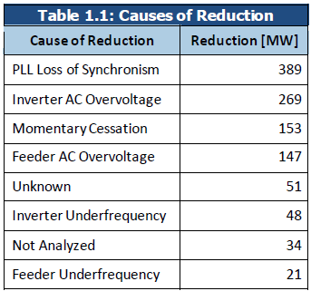
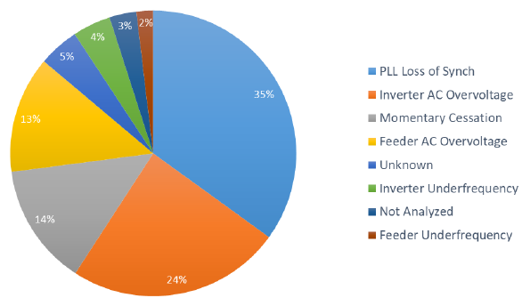
Cause of Solar PV reduction
*charts and tables from NERC Event Report - https://www.nerc.com/pa/rrm/ea/Documents/Odessa_Disturbance_Report.pdf

Slide 7
PLL Loss of Synchronism
Two solar units– reductions of 239 MW and 150 MW
Attributable to one inverter OEM
Identified in multiple prior events analyzed by NERC
Systemic concern for facilities with this inverter type
Existing facilities with this inverter OEM likely susceptible to tripping
Inverters issue fault code and shut down – function separate from “ride through settings”
Default setting of 10 degree voltage phase angle shift
Inverter OEM removing this trip function from inverters at existing facilities only upon request; shipping newer inverters with function disabled

Slide 8
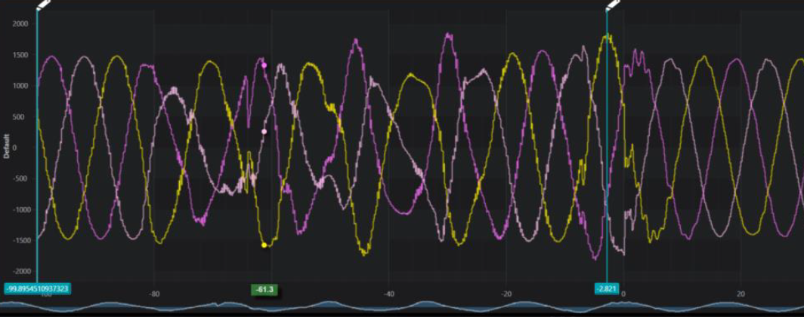
AC Overvoltage – Inverter-Level
POI high resolution data shows voltage within PRC-024-3 voltage “no trip” curve
Inverter experiences spikes (instantaneous peak) above 1.3 pu at terminals
1.3 pu threshold hard-coded by one OEM; separate from HVRT settings configurable by plant personnel.
Settings cannot be modified for any existing facilities
AC overvoltage tripping for this OEM will likely continue to occur in future
Identified in nearly all solar PV disturbances analyzed by NERC

Slide 9
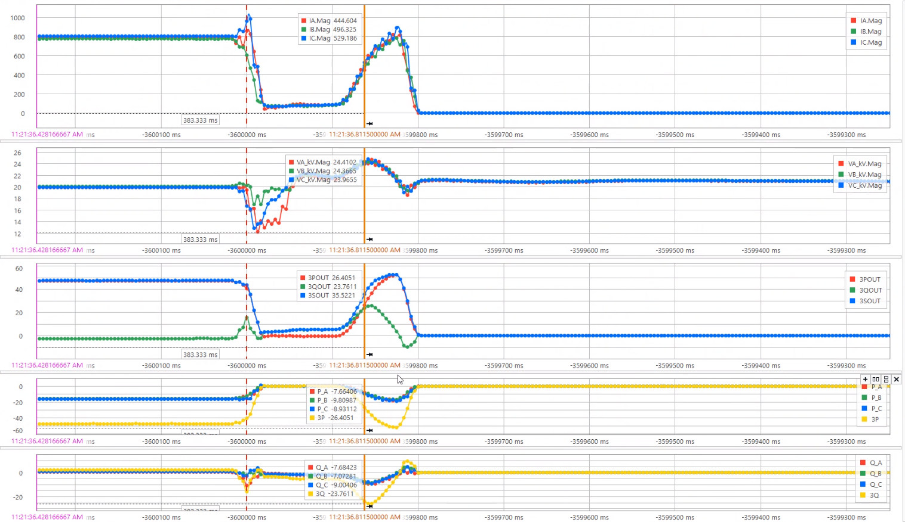
AC Overvoltage – Feeder-Level
Voltage driven high by abnormal inverter controls during and after fault
All feeder protection at one facility set to trip on inst phase ac overvoltage
Set at 1.2 pu – directly on PRC-024-3 curves
Review team questioned need for this feeder-level protection
Plant personnel unable to clarify what the voltage protection was protecting

Slide 10
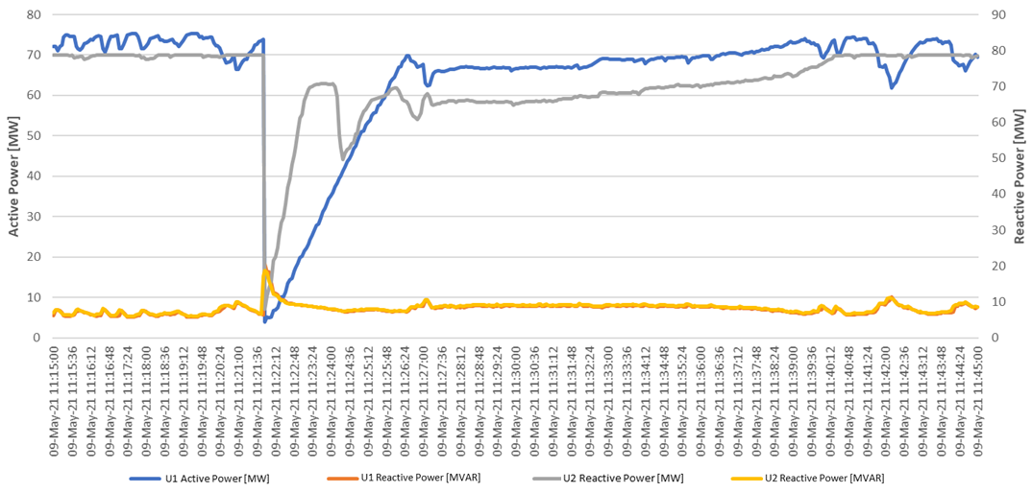
Momentary Cessation
Legacy inverters at one plant – momentary cessation below 0.9 pu voltage
Inverters should recover to predisturbance output relatively quickly when voltage recovers
Plant-level controller interactions – slowed recovery to BA ramp rate limits
Not appropriate use of these limits; negatively impacting system stability
Not meeting recommended performance in NERC reliability guidelines

Slide 11
Underfrequency – Inverter and Feeder
Inverter-Level:
One facility had all inverters trip on “grid underfrequency”
Grid frequency did not fall outside of the PRC-024-3 boundaries
Inverters likely erroneously tripped on a poorly measured or calculated frequency signal
Feeder Underfrequency:
One feeder-level relay operated
NERC followed up with relay OEM to perform root cause analysis
Newer relay version used at this facility, set with very fast measurement window
Relay OEM modifying adjustable window to eliminate problem; not systemic

Slide 12
Other
Unknown Cause (51 MW):
One facility had insufficient data to perform any useful root cause analysis; the cause of reduction remains unknown.
Not Analyzed (34 MW):
All other combined reductions in solar PV output (not meeting ERO Enterprise analysis threshold) accounted 34 MW

Slide 13
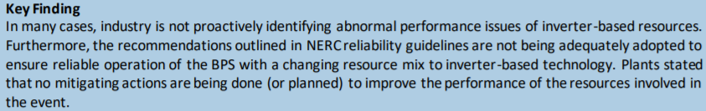
Additional Observations
Mainly solar projects were affected which could be due to the lack of understanding and experience of the transmission grid compared to wind developers.
Some solar units set default settings with IEEE 1547 (Distribution System) settings.
Ride through performance is at Point Of Interconnection (POI) but settings are based at terminal.
Having raw and filtered Digital Fault Recorder (DFR) or Phasor Measurement Unit (PMU) or relay data was very helpful in troubleshooting. SCADA alone was often insufficient to identify the issues.
May be some potential handoff issues between the inverter controllers and the Power Plant Controller (PPC).
Generators that utilize shunts to meet their minimum required reactive capability are not always switching in shunts to maintain capability at the POI.

Slide 14
Solar Growth in ERCOT
May 9th, 2021: 7,200 MW solar PV resources in ERCOT
November 21st, 2021: Over 10,000 MW solar PV resources in ERCOT
Up to 25,000 MW of new solar PV resources may connect in ERCOT by end of 2023
Risk or impact of similar disturbances must be reduced to maintain reliability and prevent more severe consequences.
The tentative schedule of the ongoing IEEE P2800 is Q2 2022. May not be in time to address ERCOT’s need.

Slide 15
ERCOT specific Recommendations from NERC
Adoption of applicable Reliability Guideline Content
Follow-Up with all Solar PV Resources in Texas Interconnection
Detailed Model Quality Review
System Model Validation Effort
Gap Analysis of Interconnection Study Process

Slide 16
Adoption of applicable Reliability Guideline Content
ERCOT should ensure that the recommendations contained within the NERC reliability guidelines are comprehensively reviewed and adopted to ensure mitigating actions are put in place to prevent these types of issues in the future. Many of the performance issues in this event could have been mitigated if appropriate performance requirements were established for these resources and interconnection studies were performed to ensure conformance with those requirements.

Slide 17
Follow-Up with all Solar PV Resources in Texas Interconnection
ERCOT should conduct outreach and education for all GOs and GOPs with solar PV resources in the Texas Interconnection. This should include follow-ups with the affected facilities to develop mitigating measures for any abnormal performance issues identified in this event. The follow-up should also include an educational outreach effort (e.g., workshop, webinar series, etc.) that provides the details of this analysis, understanding of ERCOT performance requirements and expectations, ERCOT planning and modeling requirements, and key areas of focus for newly interconnecting resources.
ERCOT believes this should not be limited to solar but for all Inverter Based Resources.

Slide 18
Detailed Model Quality Review
ERCOT should conduct a detailed model quality review for all inverter-based resources connected to the ERCOT system. This should include both positive sequence and EMT model quality checks against as-built settings, specification sheets, one-line diagrams, and any other information provided to validate that the model is a suitable representation of the installed facility. Models should include any control or protection function that can trip the facility, including (but not limited to) all the protections identified in this disturbance report and all others published by NERC related to solar PV reductions.
ERCOT has already proposed model quality improvement requirements (PGRR075 effective 5/1/2020 and PGRR085 effective 3/1/2021).

Slide 19
System Model Validation Effort
ERCOT should conduct a system-wide model validation effort using both positive sequence and EMT models to ensure that those models do not include any deficiencies and can accurately recreate system events. This activity will help ensure that the models can identify future performance issues on the ERCOT system, both for balanced and unbalanced phenomena.

Slide 20
Gap Analysis of Interconnection Study Process
ERCOT should conduct a comprehensive gap analysis of its interconnection study process to identify areas of improvement to address the shortcomings identified in this report. As stated, the interconnection study process should ensure reliable performance from all interconnecting plants and any performance requirements not met should have mitigating actions before proceeding in the interconnection queue. With the growing level of inverter-based resources, particularly in Texas, this should include detailed EMT modeling for ride - through assessments. Clear interconnection requirements should be in place such that any plant performance issues for facilities not meeting those requirements can be mitigated through effective means

Slide 21

Questions?
Notes:
Ryan

