Slide 1
NPRR 1096 Sustained Duration for ECRS and Non-Spin Ancillary Services
ERCOT Staff
January 06, 2022
ROS Meeting

Slide 2
NPRR 1096 - ERCOT Proposal Background
NPRR1096 proposes that ECRS be provided with a capacity that is capable of being sustained for two consecutive hours and Non-Spin be provided with a capacity that is capable of being sustained for four consecutive hours.
ECRS and Non-Spin are both ancillary services that can be expected to be utilized to cover risks associated with net load forecast errors.
ECRS and Non-Spin may be also be deployed to replenish Regulation and RRS.
Non-Spin may also be used to cover risks associated with intra-day forced outages of thermal resources.
In the above situations, Non-Spin deployment would be needed to last until other units can be brought online.
Note that the proposed
two consecutive hour limit for ECRS will help meet the NERC Contingency Reserve restoration requirement and sufficiently provide ramping flexibility to cover short duration net load ramps; And
four consecutive hour limit for Non-Spin will cover risks during most of the periods with sustained large net load up ramps and sustained large net load forecast errors.
A duration limit on the capacity that is used to provide ECRS and Non-Spin is needed under today’s market constructs. This is because,
In Real Time, during a failure to provide situation, SASM is the only tool available and SASM has a two-hour lead time for procurement.
Current DAM and RUC process do not take an ESR’s state-of-charge and/or energy capability into account. A 1-hour ESR could be awarded a particular A/S for all 24 hours in a day.
Future design changes to market tools to consider state of charge for ESRs or the implementation of RTC could lead to a reassessment of the proposed duration limits. Ex. RTC NPRR1011 had one hour limit for ECRS and Non-Spin.
Notes:
ECRS: ERCOT Contingency Reserve Service
RRS: Responsive Reserve Service
Non-Spin: Non-Spinning Reserve Service
DAM: Day-Ahead Market
RUC: Reliability Unit Commitment
RTC: Real-Time Co-Optimization
ESRs: Energy Storage Resources

Slide 3
NPRR 1096 - ERCOT Proposal System Changes
NPRR 1096 proposes to implement the duration limit as a part of the qualification process for ECRS and Non-Spin. Along with the qualification procedure change,
To appropriately monitor available A/S in Real Time from ESRs, ECRS and Non-Spin capacity calculations for ESRs will be changed to account for capacity that can be sustained for two and/or four hours respectively based on real time telemetered state of charge.
A new test form will be included in NDCRC to track workflows associated with tracking unannounced ECRS and Non-Spin Capability test.
This approach allows for the quickest implementation of NPRR1096 and allows ERCOT to resume qualification of ESRs to provide Non-Spin.
Notes:
ECRS: ERCOT Contingency Reserve Service
RRS: Responsive Reserve Service
Non-Spin: Non-Spinning Reserve Service
DAM: Day-Ahead Market
RUC: Reliability Unit Commitment
RTC: Real-Time Co-Optimization
ESRs: Energy Storage Resources

Slide 4
NPRR 1096 - Hunt Energy 11/1 Comments
These comments propose that
ECRS be sustained at a specified level for the number of consecutive hours the service is provided up to two consecutive hours and two consecutive hours if the service is provided for greater than two consecutive hours.
Non-Spin be provided at a specified output level for the number of consecutive hours the service is provided up to four consecutive hours and at least four consecutive hours if the service is provided for greater than four consecutive hours.
The above proposal allows one-hour ESR to provide its full capacity as ECRS or Non-Spin for every alternate hour throughout the day.
It is worth noting that during emergency conditions, there are restrictions on when an ESR is able to charge. For long-drawn events, a one-hour ESR assuming was deployed in hour no. 1 may not be able to meet its ECRS or Non-Spin obligation for hour no. 3, 5, etc.

Slide 5
NPRR 1096 - Hunt Energy 11/1 Comments System Changes
In order to appropriately support this proposal, the following additional system changes may be needed
DAM award updates such that an ESR is awarded A/S based on its capability, so that an ESR is awarded ECRS or Non-Spin based on its capability and the consecutive hours for which it is awarded the service.
EMS’s Real Time ECRS and Non-Spin capability calculations will need to be updated to account for not just the real time state of charge but also the Current Operating Plans of respective ESRs.
This involves additional EMS/MMS integration work that does not exist currently.
This also complicates the overall unannounced capability test procedure; the Operator will need to know how many consecutive hours the ESR is carrying ECRS and Non-Spin in it COPs.
This is a complicated approach that is highly reliant on QSEs setting the ECRS and Non-Spin responsibilities correctly across their ESR fleet and sending changes (be it telemetry or COPs) in a timely manner. An unannounced test alone is not sufficient, if this approach is desired, a new monitoring report that on an ongoing basis measures an ESR’s capability to reserve sufficient state of charge to provide the ECRS and Non-Spin responsibilities being carried in Real Time should also be instituted.

Slide 6
Summary
ERCOT recommends moving forward with NPRR1096 with ERCOT 11/3 comments as an interim step. ERCOT will continue to work with stakeholders to develop a longer-term solution that may involve broader system changes.

Slide 7
Appendix
Slides presented at Nov 12, 2021 PDCWG
Notes:
https://www.ercot.com/files/docs/2021/11/11/NPRR_1096_Update_11042021_v9.pptx

Slide 8
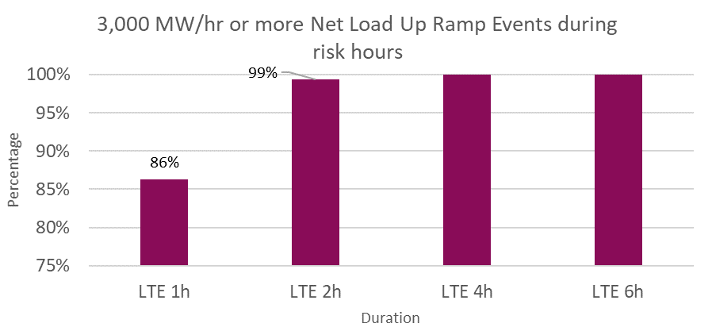
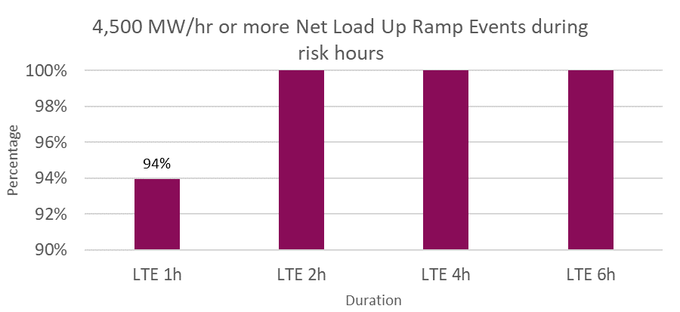
Sustained Net Load Up Ramp Analysis
In analyzing historical* sustained net load up ramps that were
3,000 MW/hr or more in magnitude,
~99% events occurred during high risk hours** and lasted 2 hours or less
All events that occurred during high risk hours and lasted 4 hours or less.
4,500 MW/hr or more in magnitude,
All events that occurred during high risk hours and lasted 2 hours or less.
*Between January 1, 2018 and July 31, 2021; excludes February 15 – 19, 2021.
**High risk hours are hours where the risk of net load up ramp is high. These are computed using a methodology that is consistent with the current Non-Spin methodology.
*Excludes Feb 15 – Feb 19, 2021

Slide 9
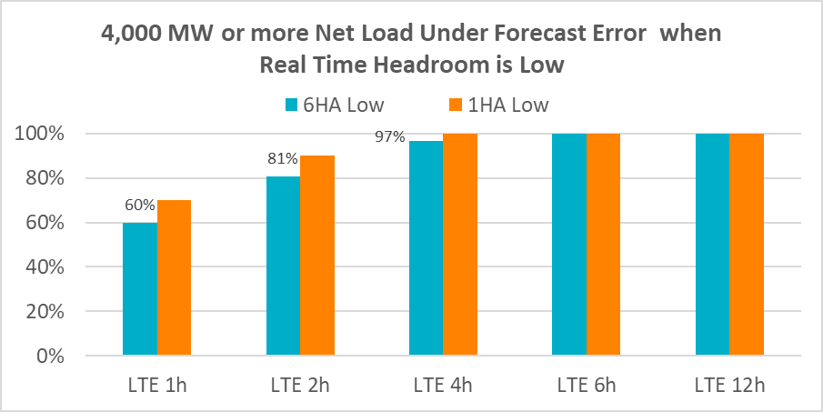
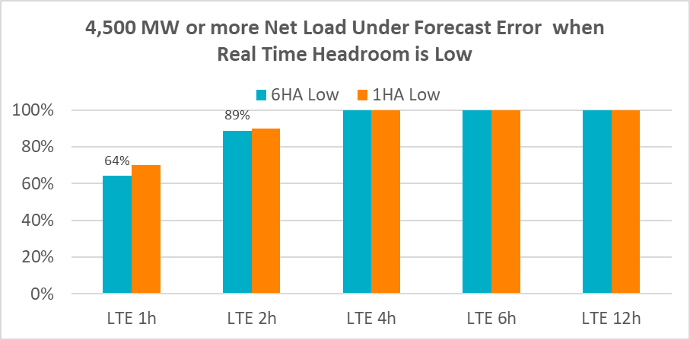
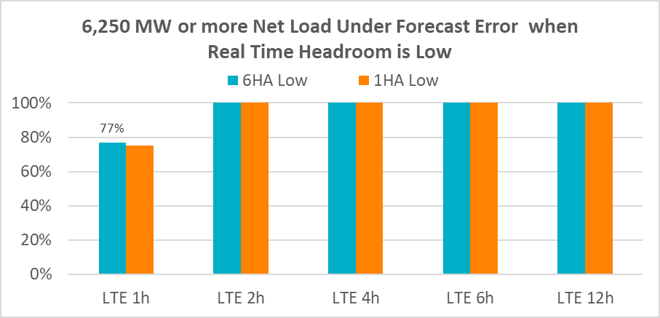
Sustained Net Load Under Forecast Error Analysis
In analyzing historical* sustained net load up under forecast errors that were
4,000 MW or more in magnitude
~81% events occurred during times when Real Time headroom** was low*** and lasted 2 hours or less
~97% events occurred during times when Real Time headroom was low and lasted 4 hours or less.
All events occurred that during times when Real Time headroom was low and lasted 6 hours or more.
4,500 MW or more in magnitude
~89% events occurred during times when Real Time headroom was low and lasted 2 hours or less.
All events that occurred during times when Real Time headroom was low and lasted 4 hours or less.
6,250 MW or more in magnitude
All events that occurred during times when Real Time headroom was low and lasted 2 hours or less.
*Between January 1, 2018 and December 31, 2020
**Real Time Headroom = Total Online HSL + Offline Non-Spin – Actual Load
***Real Time headroom less than 5,000 MW

Slide 10
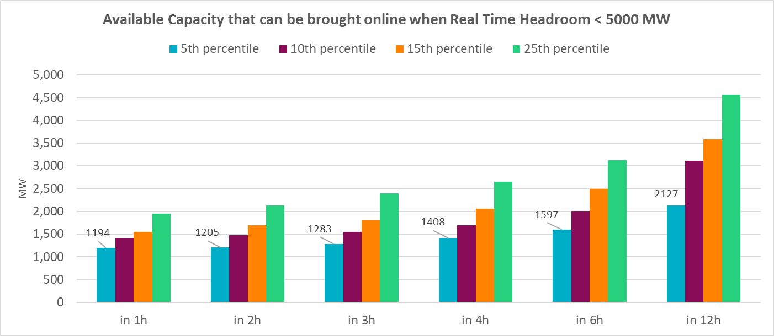
Available Offline Capacity Analysis
In analyzing historical* available offline capacity during conditions when Real Time headroom** was low,
~1,408 MW could be brought online in 4 hours about 95% of the time
~1,597 MW could be brought online in 6 hours about 95% of the time
*Between Jan 1, 2020 and October 27, 2021; Excludes Feb 15 – Feb 19, 2021
**Real Time Headroom = Total Online HSL + Offline Non-Spin – Actual Load
***Real Time headroom less than 5,000 MW

Slide 11
As a result, for ECRS….
Knowing that,
ECRS was designed to primarily meet the frequency recovery metrics under North American Electric Reliability Council (NERC’s) BAL-002, Disturbance Control Standard – Contingency Reserve for Recovery from a Balancing Contingency Event Standard. This standard also requires ERCOT’s Physical Responsive Capability (PRC) to be recovered within 90 minutes.
ECRS will also provide ERCOT a targeted mechanism for addressing future ramping and variability on the ERCOT grid as ERCOT’s PhotoVoltaic (PV) generation fleet grows.
And noting that,
~99% of historic sustained net load up ramps that were 3,000MW/hr or more in magnitude during high-risk hours have lasted 2 hours or less; AND
all of historic sustained 6 hours ahead net load forecast errors that were 6,250 MW or more in magnitude during times when Real Time headroom** was low*** have lasted 2 hours or less,
ERCOT is proposing a two-hour duration limit for ECRS. This limit will help meet the NERC Contingency Reserve restoration requirement and sufficiently provide ramping flexibility to cover short duration net load ramps.
**Real Time Headroom = Total Online HSL + Offline Non-Spin – Actual Load
***Real Time headroom less than 5,000 MW

Slide 12
And for Non-Spin….
Knowing that
Similar to ECRS, Non-Spin can be utilized to cover risks associated with sustained net-load under-forecast forecast errors and may also be deployed to replenish Regulation Up Service (Reg-Up) and Responsive Reserve (RRS).
Non-Spin may also be used to cover risks associated with intra-day Forced Outages of thermal Resources.
Upon deployment in these situations, the Non-Spin deployment would be needed to last until other Resources can be brought On-Line.
And noting that,
all historic sustained net load up ramps that were 3,000 MW/hr or more in magnitude during high-risk hours have lasted 4 hours or less; AND
all of historic sustained 6 hours ahead net load forecast errors that were 4,500 MW or more in magnitude during times when Real Time headroom** was low*** have lasted 4 hours or less; AND
95% of the time in the past ~1,408 MW of offline capacity could be brought online in 4 or more hours during times when Real Time headroom was low***,
ERCOT is proposing a four-hour duration for Non-Spin. This limit will cover risks during most of the periods with sustained net load up ramps and sustained net load forecast errors.
**Real Time Headroom = Total Online HSL + Offline Non-Spin – Actual Load
***Real Time headroom less than 5,000 MW

