Slide 1
PDCWG Report to ROS
Chair: Chad Mulholland, NRG
Vice Chair: Jimmy Jackson, CPS
ROS
January 06, 2022

Slide 2
Report Overview & Notes
Report Overview
Meeting Minutes
BAL-001-TRE-2 FMEs and IMFR
1 FME in the month of November
Frequency Control Report

Slide 3
Meeting Minutes
PDCWG Meeting 12/8/2021
Reviewed two non-FMEs that occurred on
11/15/2021
11/17/2021
Reviewed one FME
11/1/2021
Regulation and Frequency Control Reports

Slide 4
Frequency Measurable Events Performance

Slide 5
Frequency Measurable Events
There was 1 FME in November
11/1/2021 4:57:04
Loss of 540 MW generation
Interconnection Frequency Response: 771 MW/0.1 Hz
39 Resources were evaluated. These includes,
37 Generation Resources
2 Controllable Load Resources
0 Energy Storage Resources
10 of 37 Evaluated Generation Resources had less than 75% of their expected Initial Primary Frequency Response.
7 of 37 Evaluated Generation Resources had less than 75% of their expected Sustained Primary Frequency Response.

Slide 6
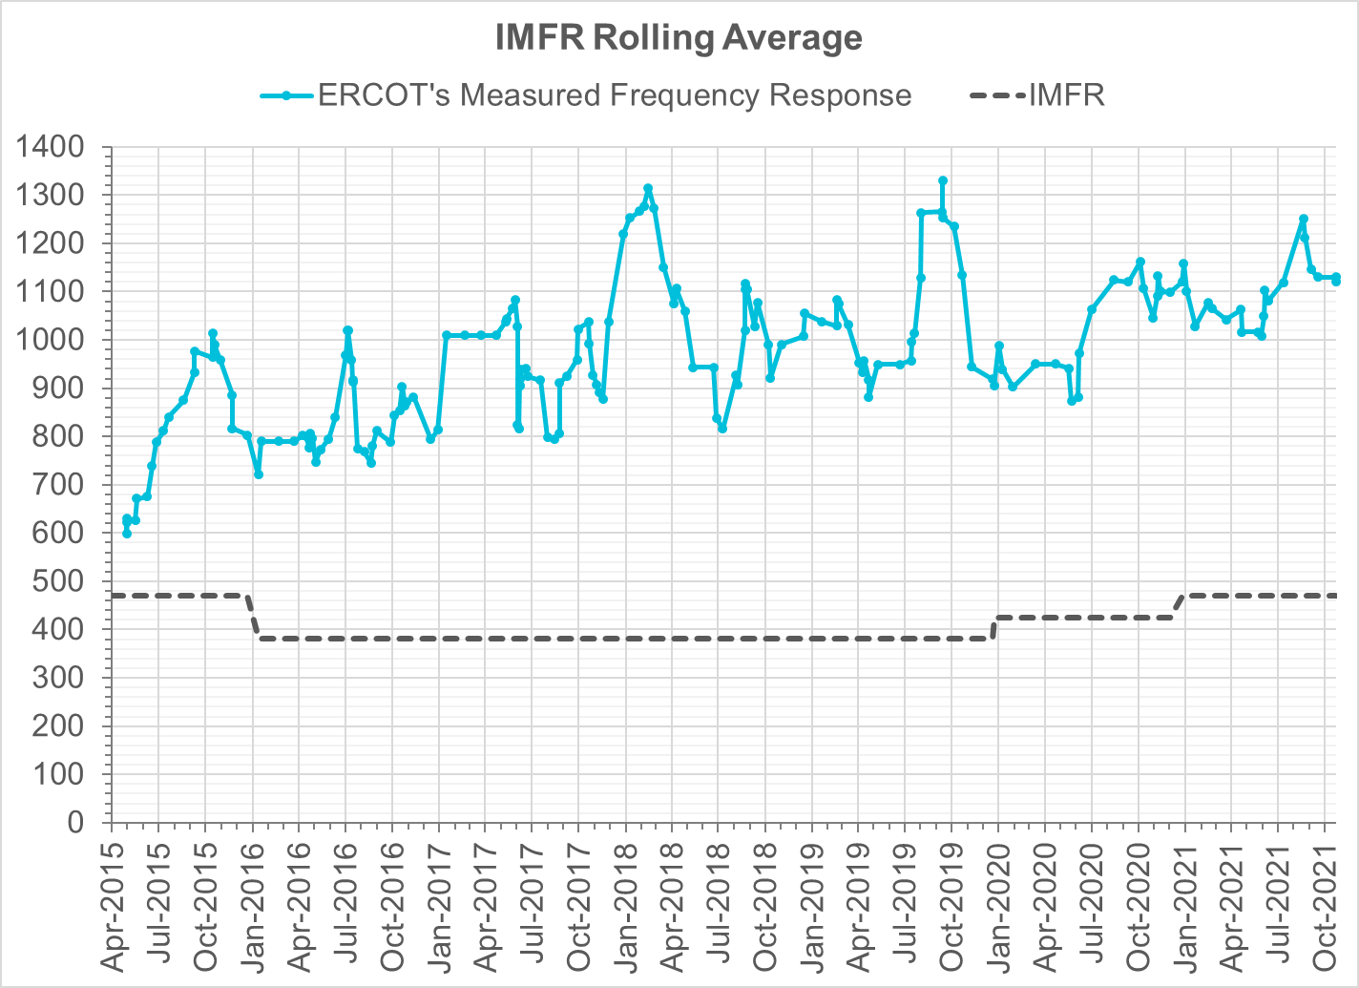
Interconnection Minimum Frequency Response (IMFR) Performance
IMFR Performance currently
1120.7 MW/0.1HZ
Frequency Response Obligation (FRO): 471 MW/0.1 Hz

Slide 7
Questions?

Slide 8
Frequency Control Report
November 2021

Slide 9
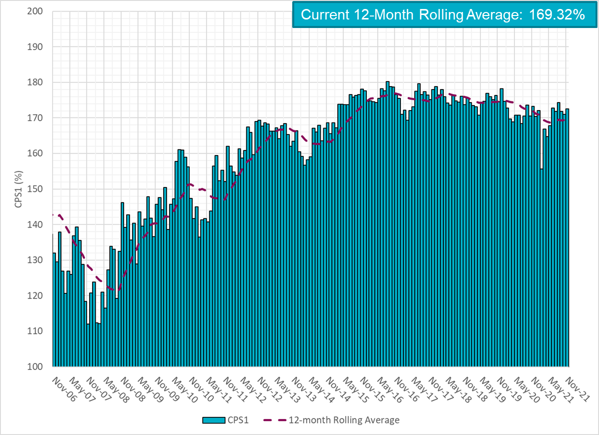
CPS1 Performance

Slide 10
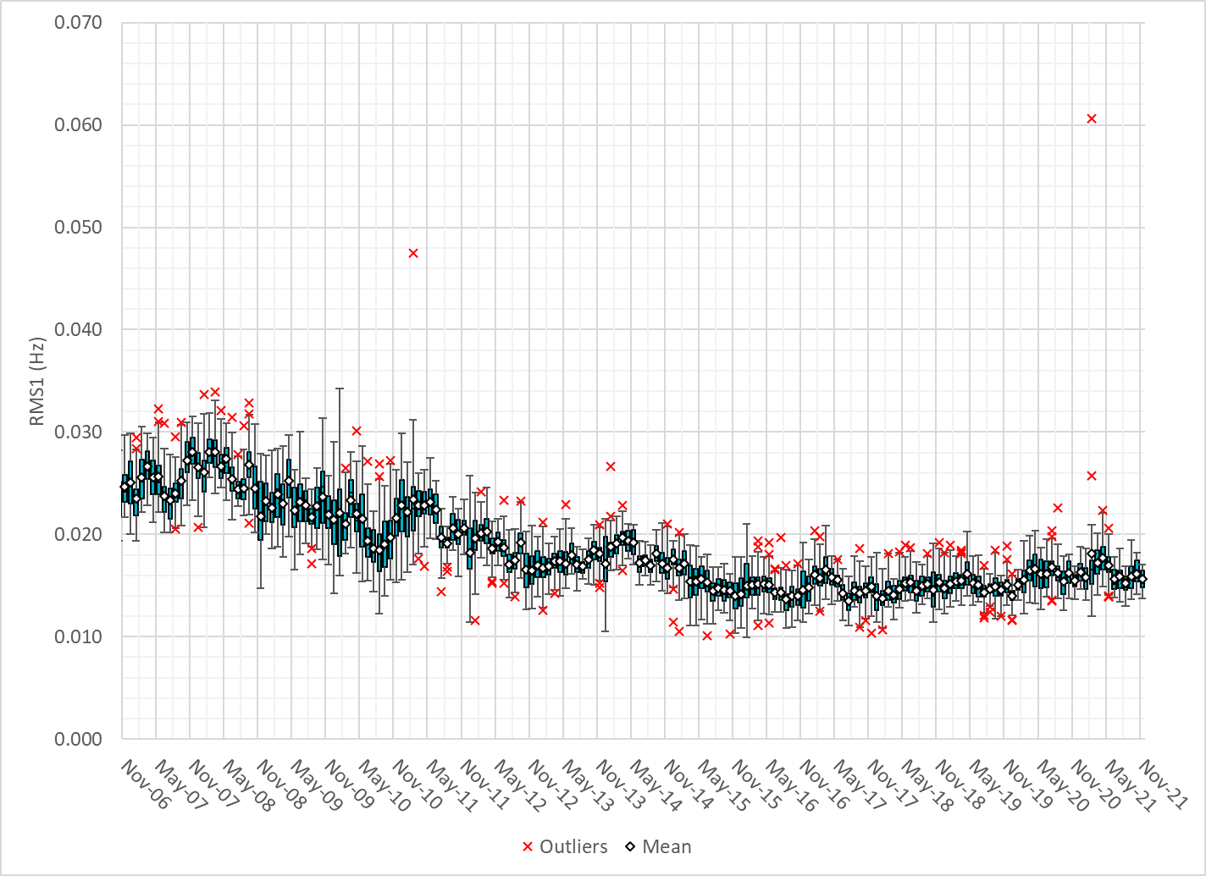
RMS1 Performance of ERCOT Frequency

Slide 11
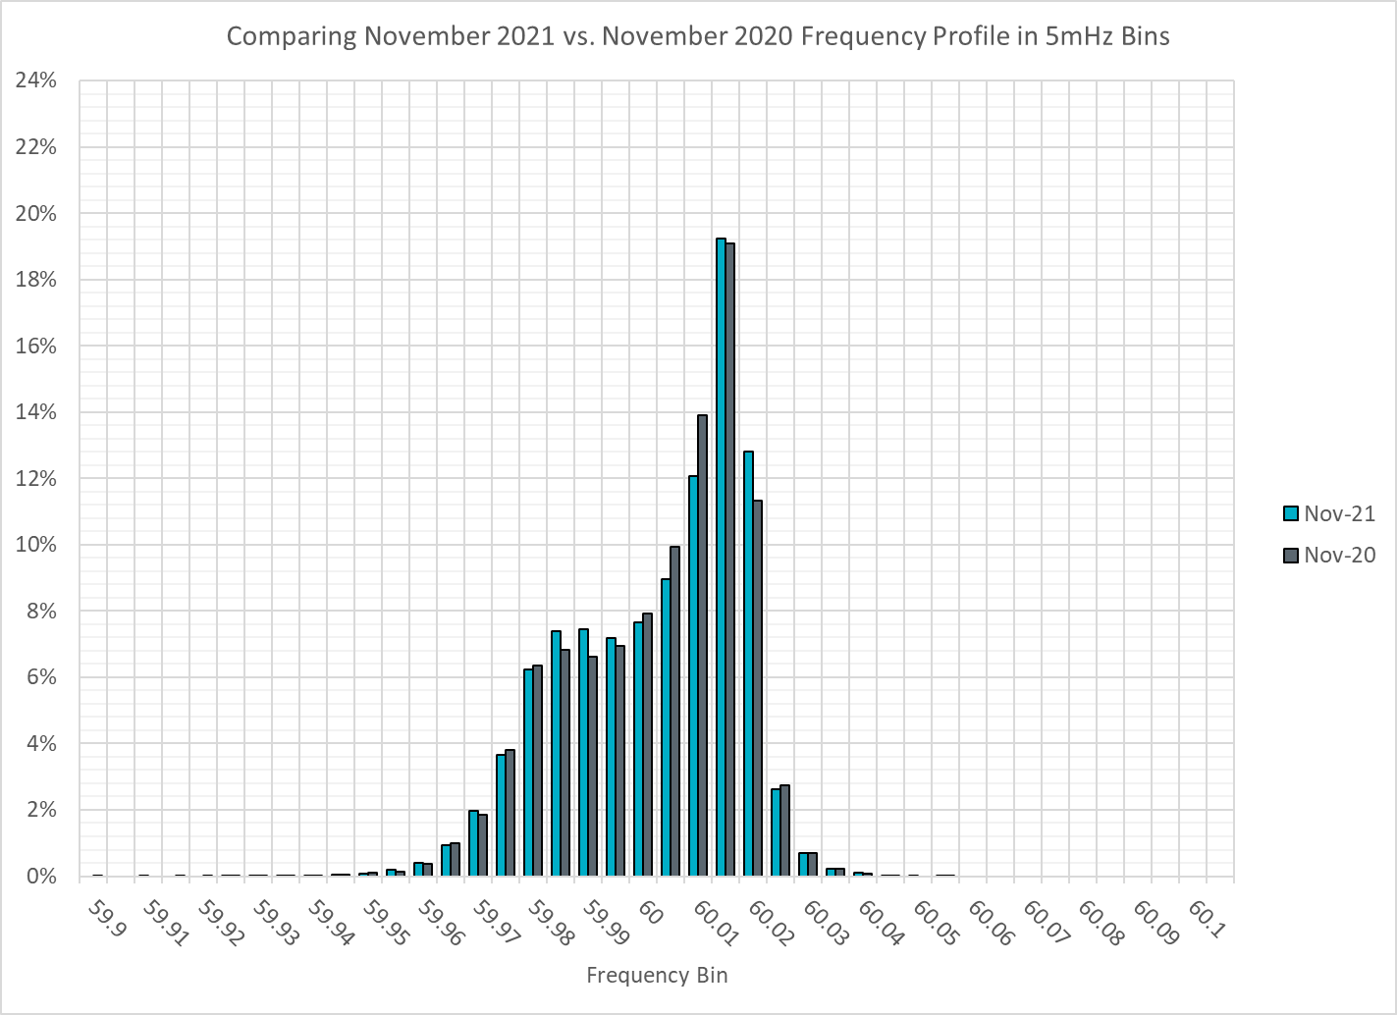
Frequency Profile Analysis

Slide 12
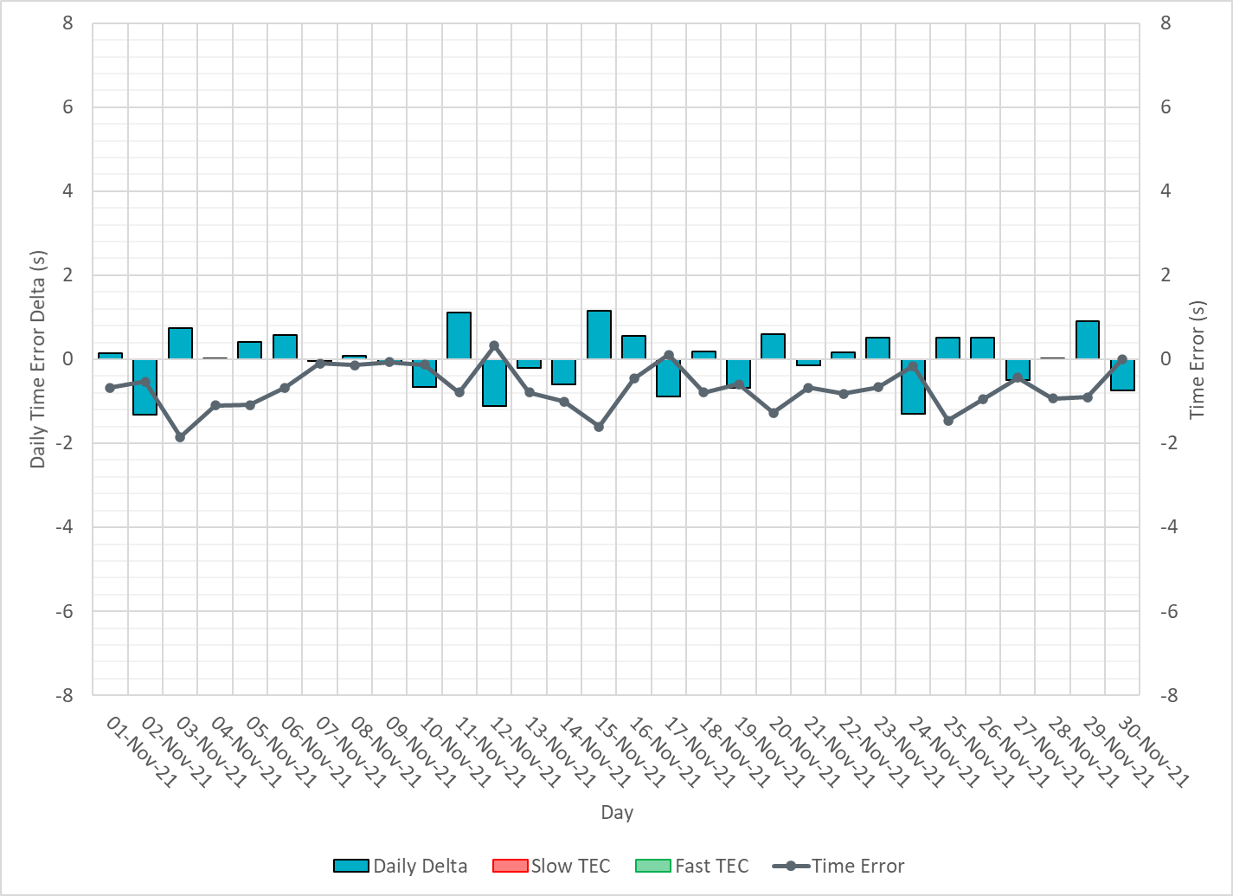
Time Error Corrections

Slide 13
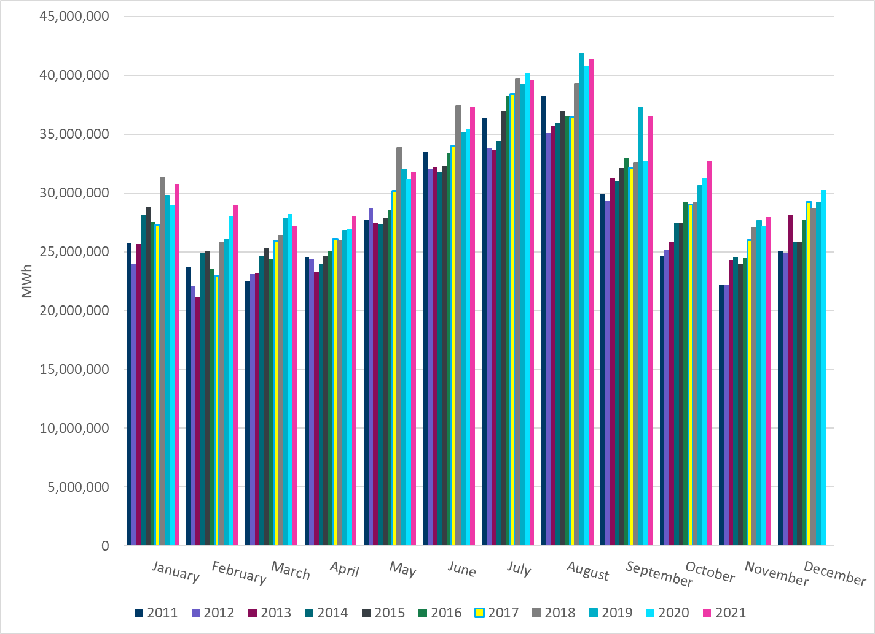
ERCOT Total Energy
Notes:
27,968,176MWh

Slide 14
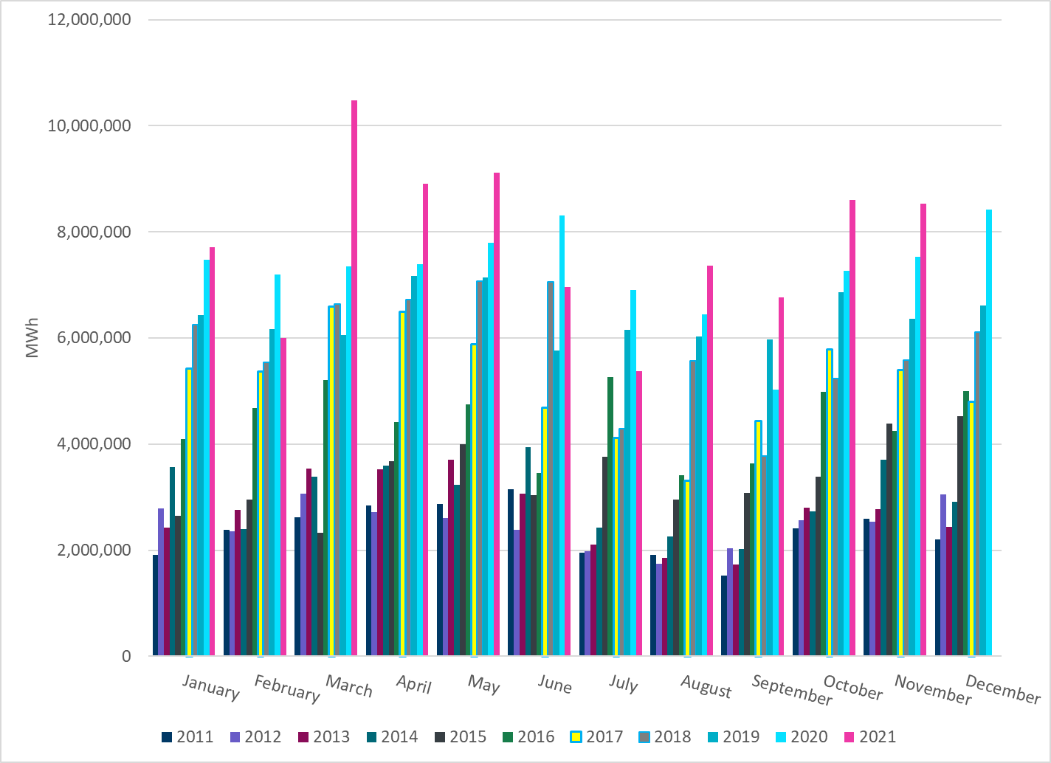
ERCOT Total Energy from Wind Generation
Notes:
8,537,442 MWh

Slide 15
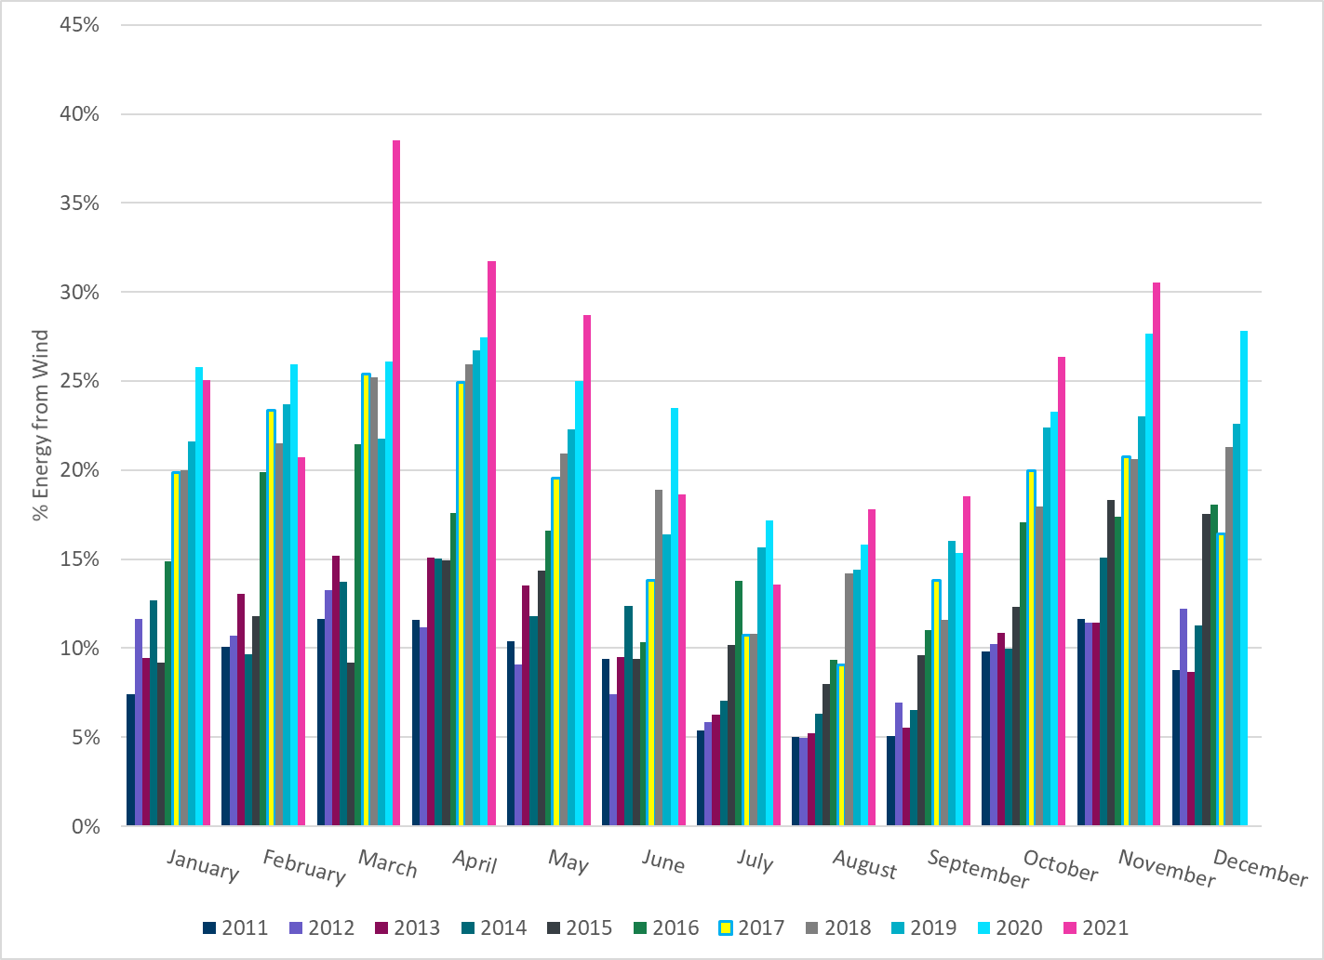
ERCOT % Energy from Wind Generation
Notes:
30.53%

Slide 16
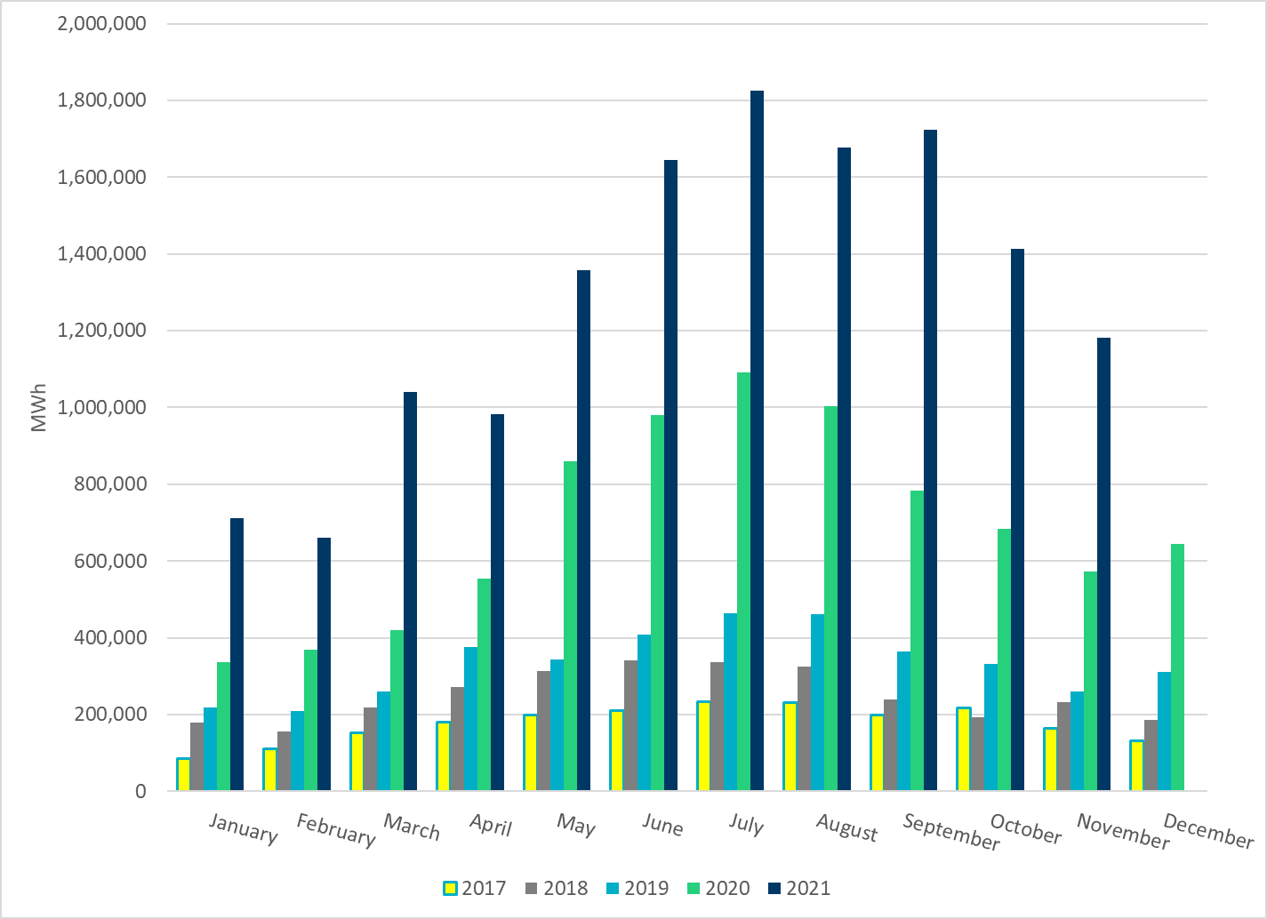
ERCOT Total Energy from Solar Generation
Notes:
1,182,376 MWh

Slide 17
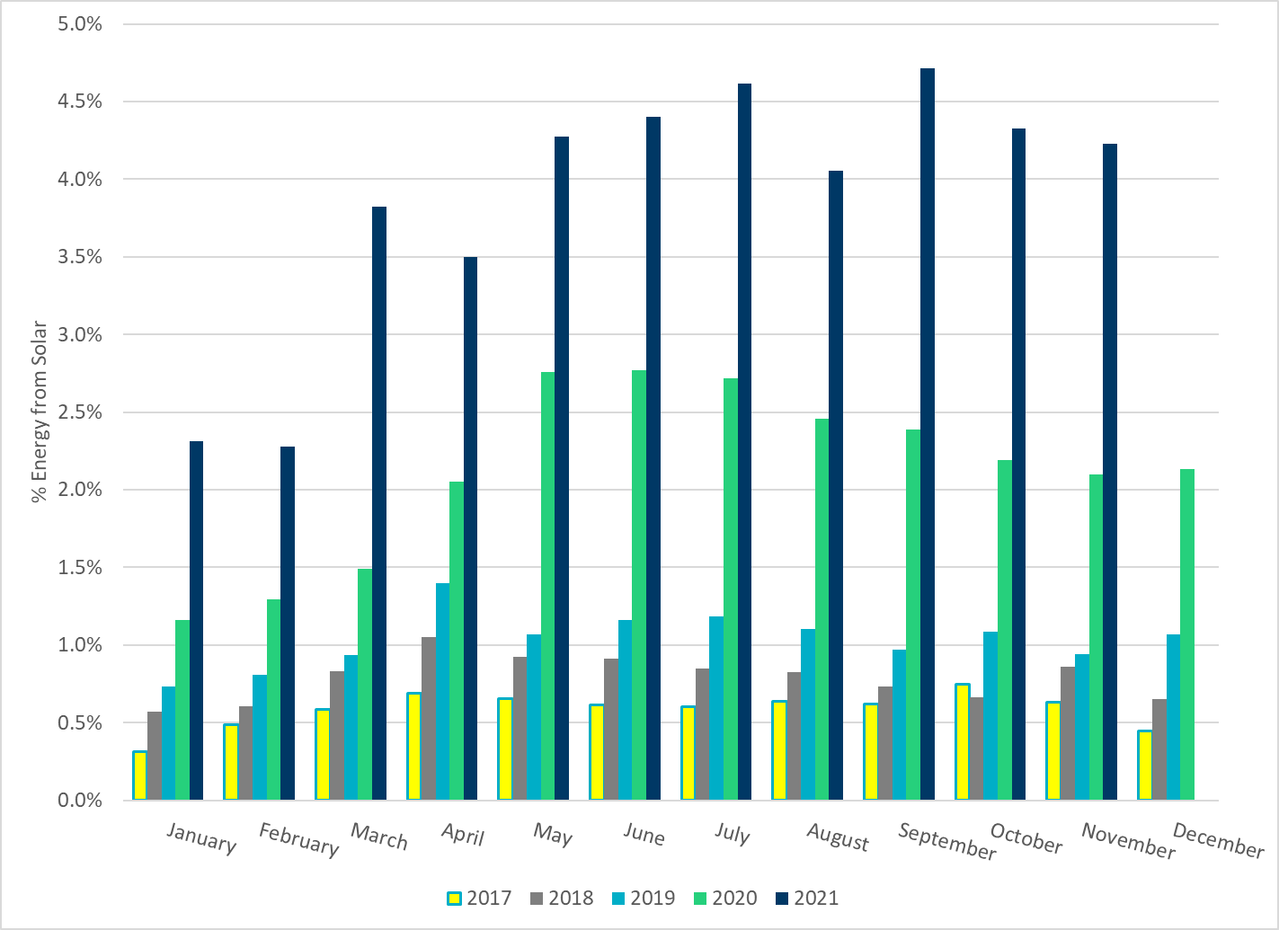
ERCOT % Energy from Solar Generation
Notes:
4.23%

