Slide 1
Maximum Daily Planned Resource Outage Capacity for next 60 months
Dan Woodfin & Pengwei Du
ERCOT
Dec. 17, 2021

Slide 2
Background
NPRR 1108 is being filed with an urgent status on Nov. 9, 2021 to define a process for ERCOT:
To review, coordinate, and approve or reject all Planned Outages, including those that are submitted more than 45 days prior to the planned start of the Outage
To allow ERCOT to meet the requirements of SB 3 which requires ERCOT to approve or reject all Planned Outages of electric generation
As proposed in NPRR1108, ERCOT would be required to calculate the Maximum Daily Planned Resource Outage Capacity that would be allowed for each day of the next rolling 60 months based on a capacity assessment
ERCOT has developed a methodology to calculate such a Maximum Daily Planned Resource Outage Capacity for next 60 months for non-IRR resources.
This presentation provides more details on this methodology and preliminary quantities calculated.

Slide 3
Maximum Daily Planned Resource Outage Capacity
Definition: The aggregate maximum MW of Planned Outages that will be approved by ERCOT for any time period within a given day, calculated pursuant to Section 3.1.6.13, Maximum Daily Planned Resource Outage Capacity.
Protocol 3.1.6.13: ERCOT shall calculate a maximum capacity of Resource Outages that should be allowed on each day of the next 60 months.
(a) For days more than seven days ahead of the Operating Day, the calculation of this Maximum Daily Planned Resource Outage Capacity will be based on seasonal assumptions and the long-term load forecast.
(b) For days that are seven days or less prior to the Operating Day, the calculation of this Maximum Daily Planned Resource Outage Capacity will be based on the inputs used for the planning assessment for an Outage Adjustment Evaluation (OAE).

Slide 4
Considerations in Methodology Development
It is desirable to have a robust method to provide QSEs/REs flexibility to schedule their planned outage while allowing ERCOT to limit the number of AAN/OAEs that would be required (two conflicting objectives)
Key Variables:
Thermal unplanned outages
IRR power output forecasts
Long-term load forecast
Addition or retirement of thermal/IRR resources
The Maximum Daily Planned Resource Outage Capacity for the next 60 months will be updated at the beginning of each season (when SARA data is updated) and posted on the ERCOT website

Slide 5
Maximum Daily Planned Resource Outage Capacity (PROC) Evaluated for Peak Hours for Non-IRR and Non-PUN Resources
1st Step: Maximum Daily PROC (raw) = Projected Thermal/Hydro Unit Capacity – Forced Rate of Thermal Units + IRR Expected Output + DC Tie Import + PUN Capacity + Load Resource (Typical Value) – Long Term Load Forecast – Expected Ancillary Service Requirement + Others
 | Max Daily PROC (>7days) | Source of Data
Projected Thermal/Hydro Unit Capacity (non-IRR and non-PUN) | + | Vary by season (from Seasonal Assessment of Resource Adequacy (SARA)*)
Forced Rate of Thermal Units (High Unplanned Outage scenario) | - | Vary by season (from SARA)
IRR Output (Low Renewable Outage scenario) | + | Vary by season (from SARA)
DC Tie Import | + | Vary by season (from SARA)
PUN Capacity | + | Vary by season (from SARA)
Load Resource (Typical Value) | + | 1400 MW
Daily Max Long Term Load Forecast (P50) | - | Vary by day (From 2021 ERCOT Hourly Forecast)
Expected Ancillary Service Requirement | - | ~5000 MW
Others | + | Switchable Capacity Total-Less Switchable Capacity Unavailable to ERCOT + Available Mothballed Capacity (from SARA)
(*) Seasonal assumption in SARA is produced based on the historical data from those peak hours of the same season for the past 3 years.

Slide 6
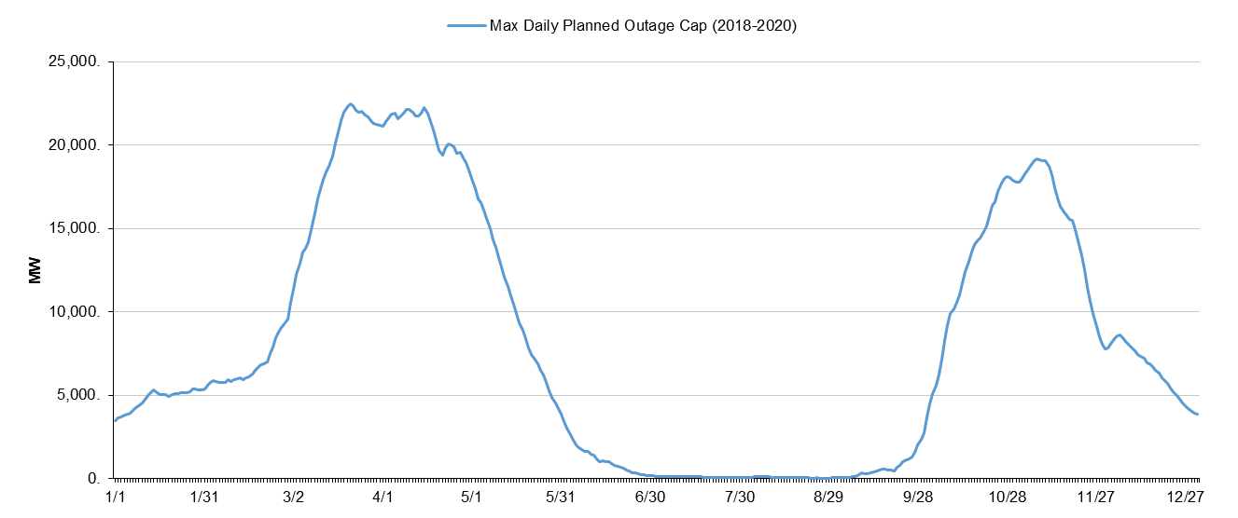
Methodology (continued)
2nd Step: Maximum Daily PROC(raw) is subject to a cap, which is defined as 20% (*) above the daily maximum of actual planned outage in the last 3 years
To primarily limit the allowed planned capacity for Winter/Summer Season
ERCOT will review this 20% (*) rule at Stakeholders meetings in the future if needed

Slide 7
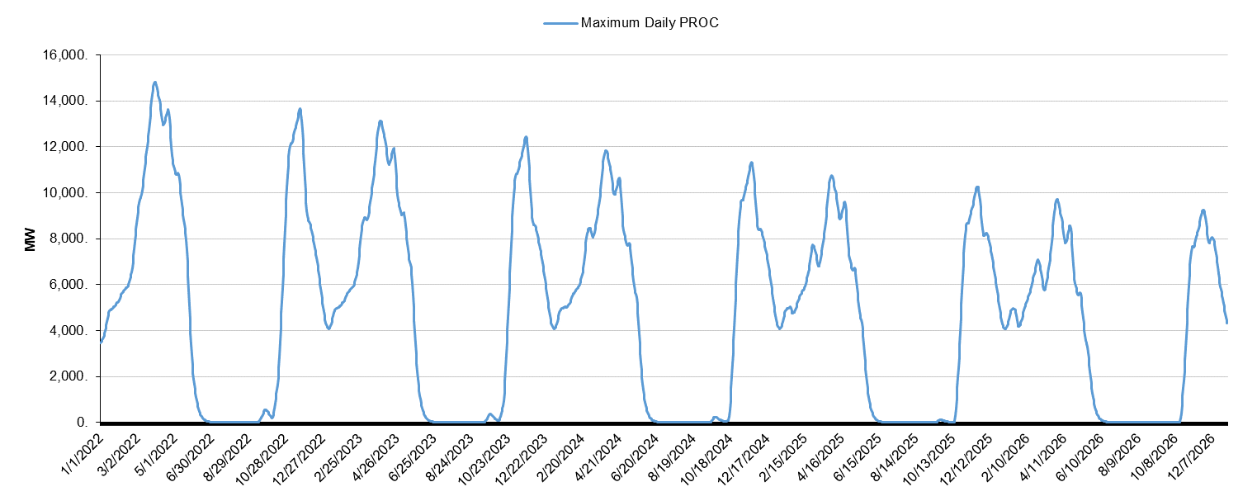
2022-2026
Considerations for including addition/retirement of thermal/IRR resource capacity
The capacity of new resources will be only captured in the incoming season
For further-out seasons, when and how much new resources will be commercialized is less certain
Excluding future resources has the effect of limiting the amount of planned resources that are approved out into the future (as opposed to only approving a % of the daily max outages for future years)

Slide 8
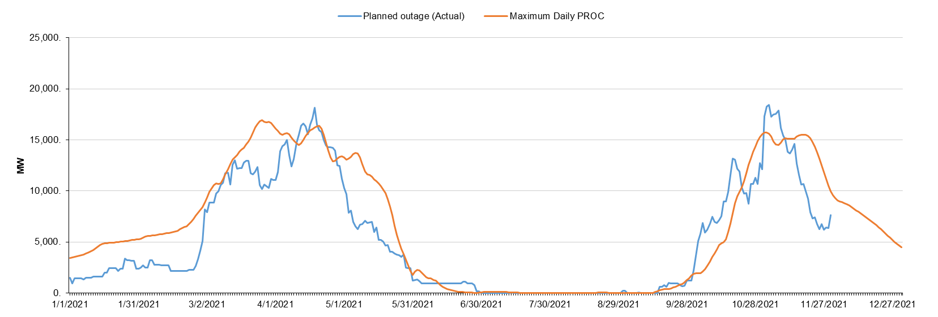
Back-Calculation for 2021
(2) May still need to issue AAN around Oc. 25, 2021
(1) Maximum Daily PROC will be revised for the 7-day ahead to allow for more flexibility to schedule planned outage
(*) The orange line was updated when the new SARA data was available.

Slide 9
Summary
The Maximum Daily Planned Resource Outage Capacity for Non-IRR resources for the next 60 months will be updated at the beginning of each season and be posted on the ERCOT website
It utilizes seasonal assumption (High Unplanned Outage scenario and Low Renewable Outage scenario) and long-term load forecast (P50).
A cap is applied, which is defined as 20% (*) above the daily maximum of actual planned outage in the last 3 years to limit the allowed planned capacity for Winter/Summer Season.
The capacity of new thermal/IRR resources is reflected in the latest SARA report and therefore captured for the incoming season.

Slide 10
Next Step
ERCOT plans to file a comment to NPRR 1108 to provide more clarifications on how Maximum Daily Planned Resource Outage Capacity will be applied.
Suggestions or comments regarding the methodology developed here to calculate Maximum Daily Planned Resource Outage Capacity for Non-IRR resources for the next 60 months can be directed to pengwei.du@ercot.com.

