Slide 1
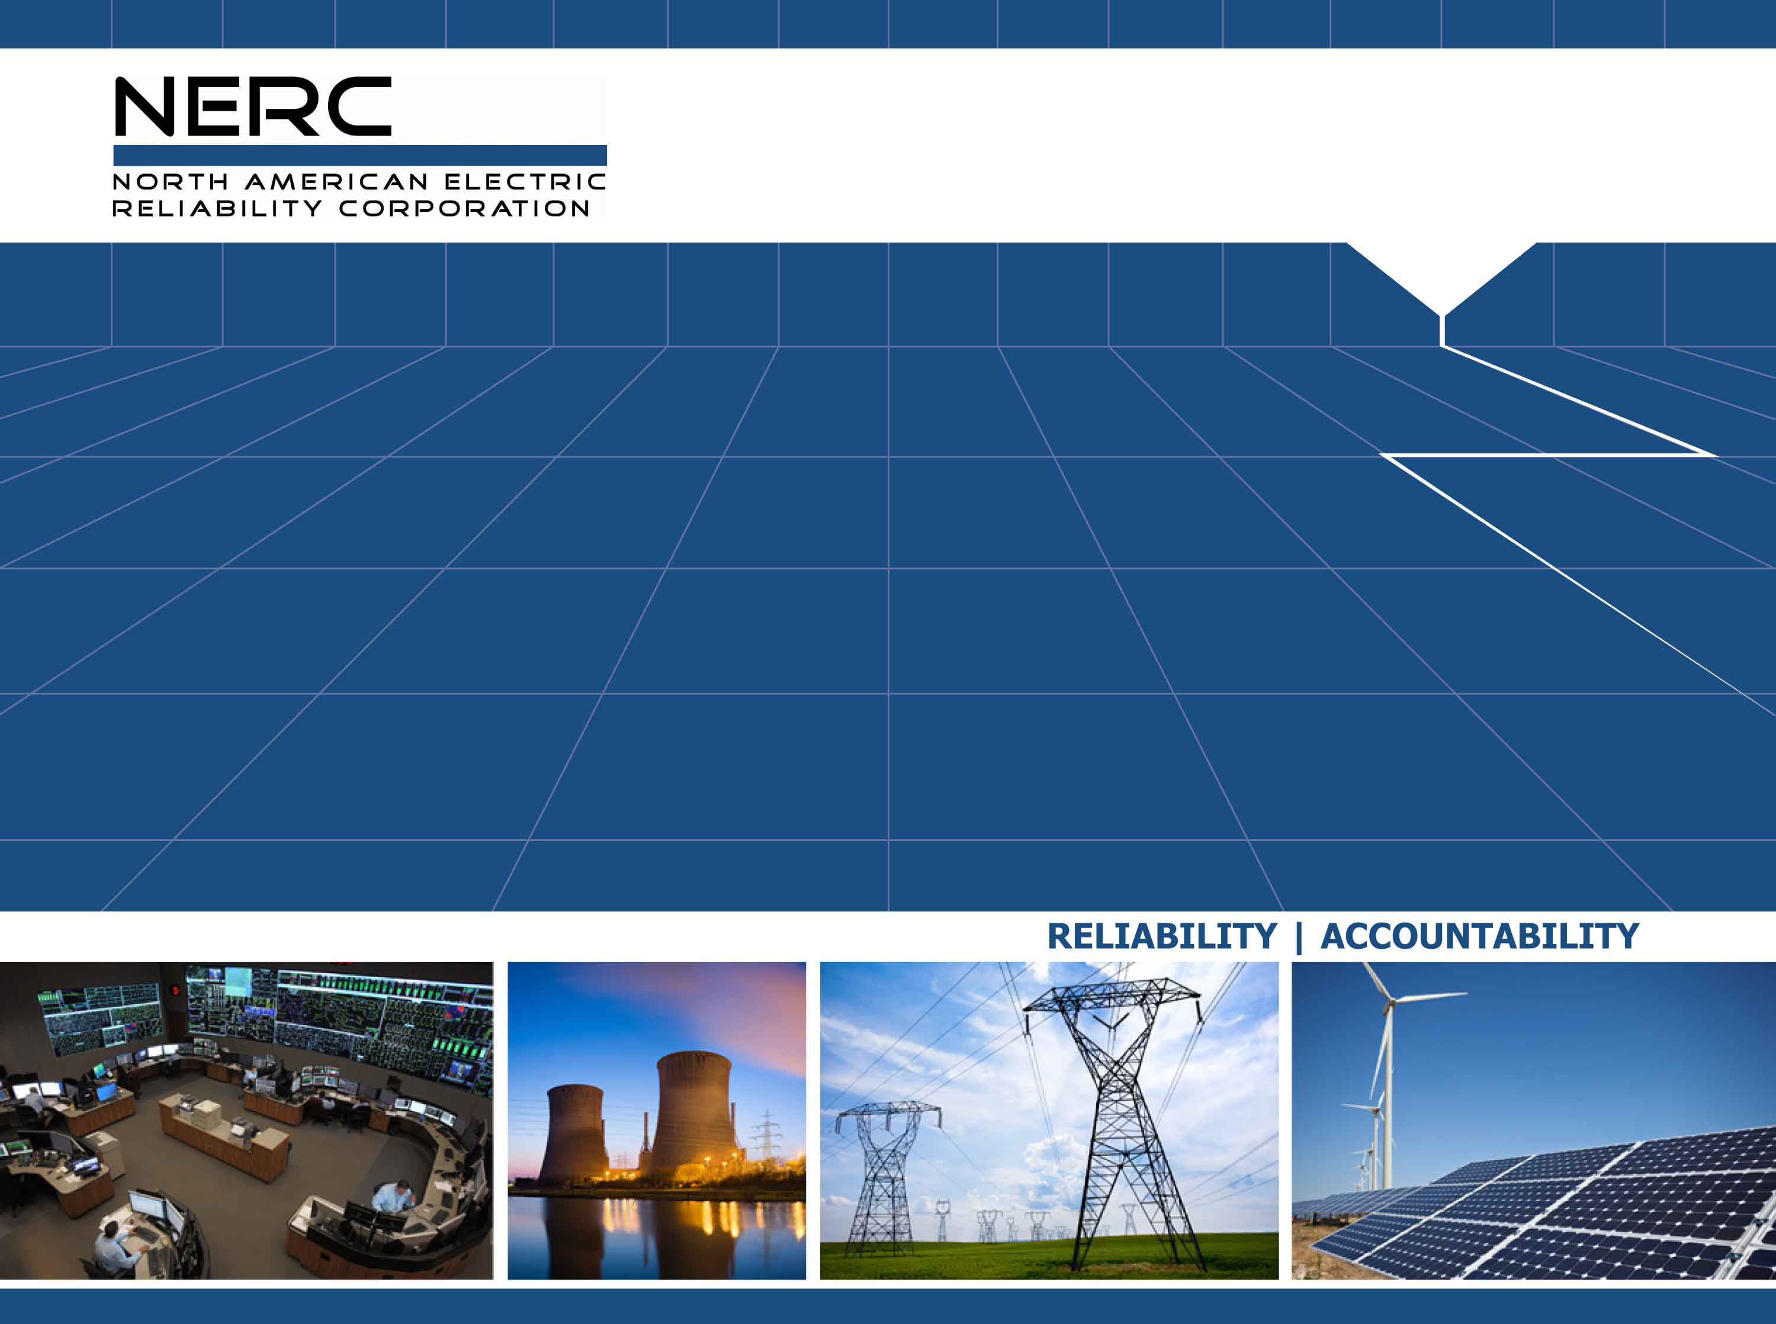
The February 2021 Cold Weather Outages in Texas and the South Central United States – Gas and Electric Interdependencies
Presentation given to ERCOT – December 17, 2021
Thomas Coleman, Chief Technical Advisor

Slide 2
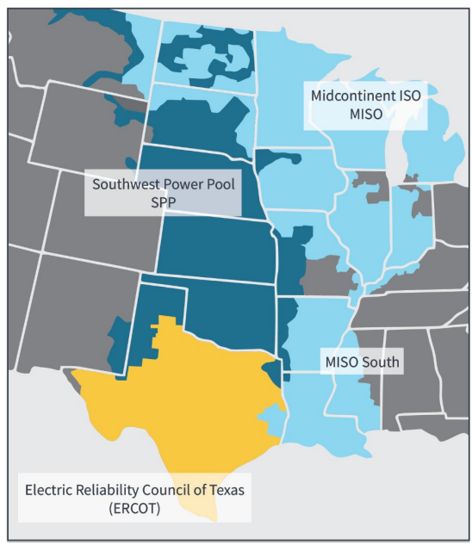
The Event
Event occurred between February 8 and February 20, 2021
Significantly impacted South Central U.S.
Deteriorating conditions would lead to lowest temperatures of the event on February 15th & 16th
Unprecedented 65,622 MW of unplanned generation outages.

Slide 3
The Event
  Significant impacts on natural gas production
  Largest firm load shed event in U.S. history (23,418 MW), third largest in quantity of outaged MW of load (August ’03 and August ‘96 blackouts).
  Fourth cold weather event in the past 10 years which jeopardized bulk-power system reliability.
Notes:
Extreme cold weather has jeopardized the reliable operation of the BES four times in the past 10 years, including the Event. From February 1 to 5, 2011, an arctic cold front impacted the southwest U.S. and resulted in numerous generation outages, natural gas facility outages and emergency power grid conditions and caused 6,886 MW of firm customer load shed in ERCOT, El Paso Electric and Salt River Project. The January 2014 Polar Vortex event affected Texas, the Central and Eastern U.S., and resulted in generation outages, natural gas availability issues and less than 300 MW of firm load shed. And in January 2018, an arctic high-pressure system and below average temperatures in the South Central U.S. resulted in many generation outages, and no firm load shed, but required voluntary load shed emergency measures SPP experienced weather-related generation outages and decreased natural gas supply, and several entities within SPP declared EEA Levels 1 to 3, but none shed firm load.

Slide 4
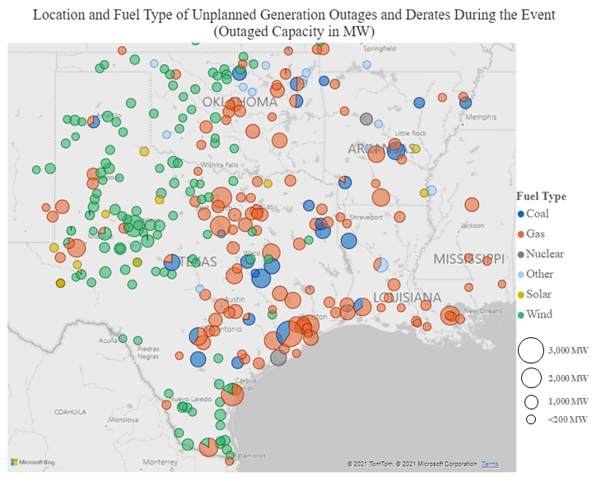
Significant Natural Gas Unit Outages

Slide 5
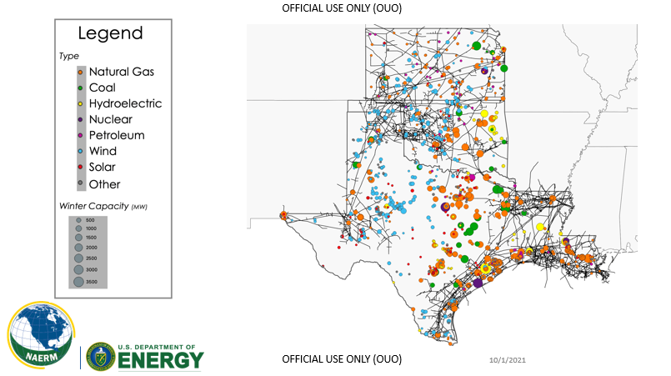
Electric/Gas Interdependency Texas and S Central United States

Slide 6
Natural Gas Preparation
Winterization
Line Pack
Storage
Operational Flow Orders
Black-Start testing of natural gas fired units

Slide 7
ISO-NE Gas Utilization Tool
The Gas Utilization Tool developed in-house by ISO-NE staff, allows ISO-NE operations personnel to monitor the New England regional interstate pipeline system and provides real-time gas-electric system interface situational awareness by incorporating publicly-available interstate pipeline EBB data, gas schedules for individual generating units (nominations and long/short positions) and other pertinent information.

Slide 8
ISO-NE Gas Utilization Tool

Slide 9
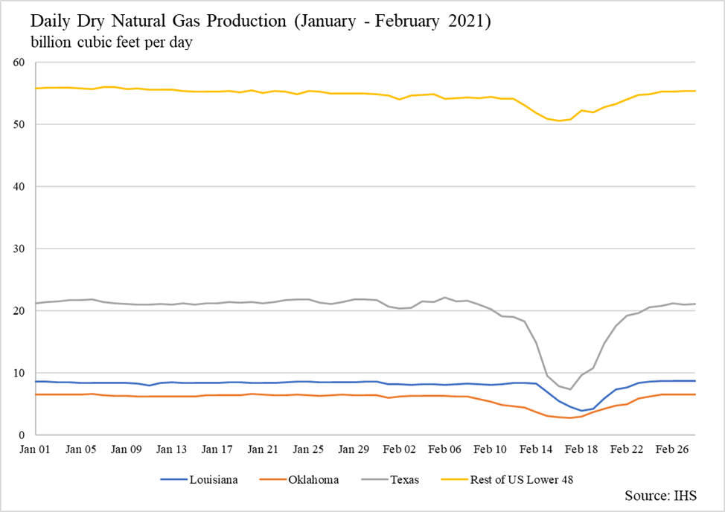
Decline in Natural Gas Production

Slide 10
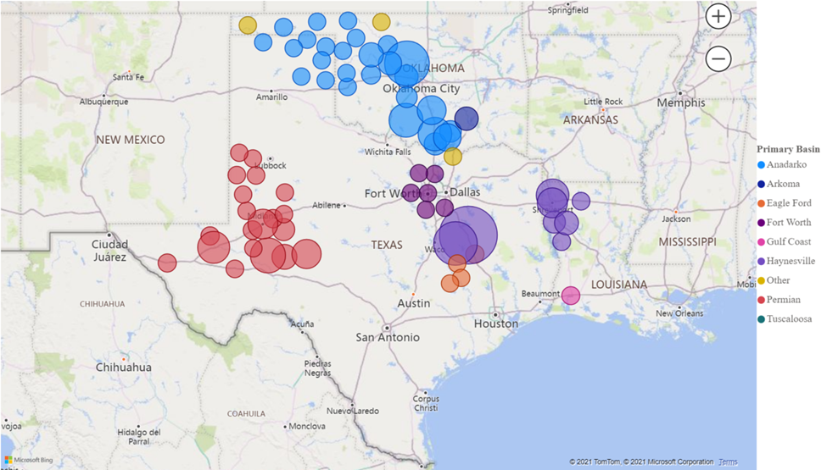
Production Outages by Basin

Slide 11
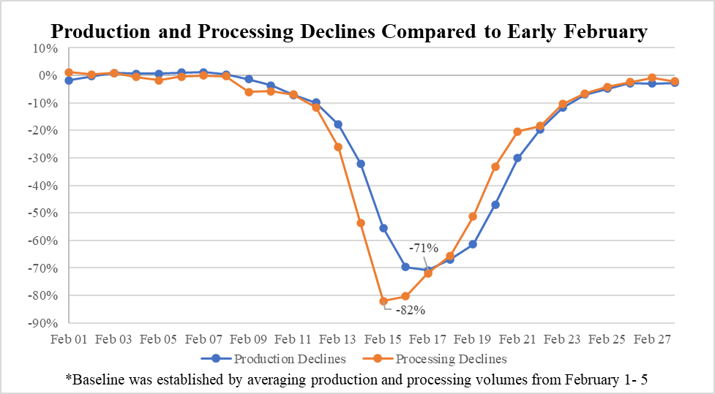
Production Declines

Slide 12
Natural Gas Consumption

Slide 13
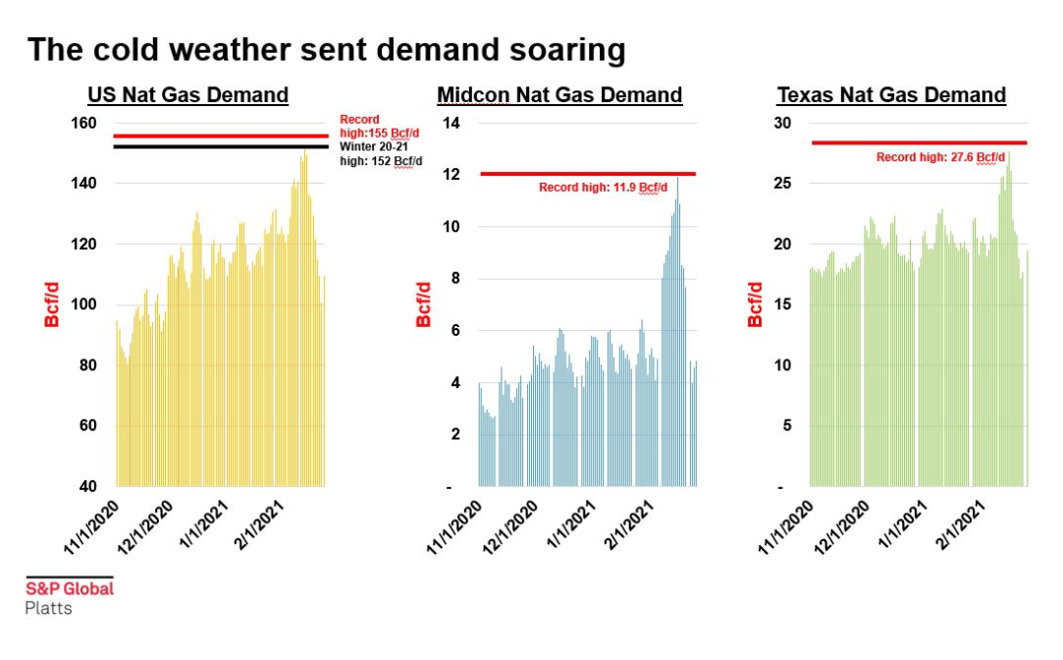
Increased Natural Gas Demand

Slide 14
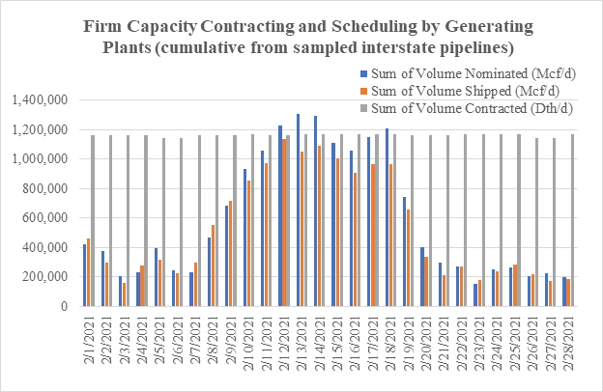
Firm Capacity Vs Scheduling

Slide 15
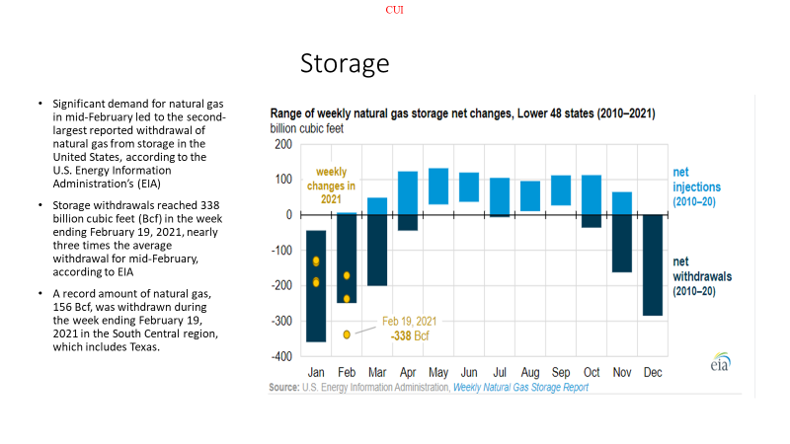
Storage Withdrawals

Slide 16
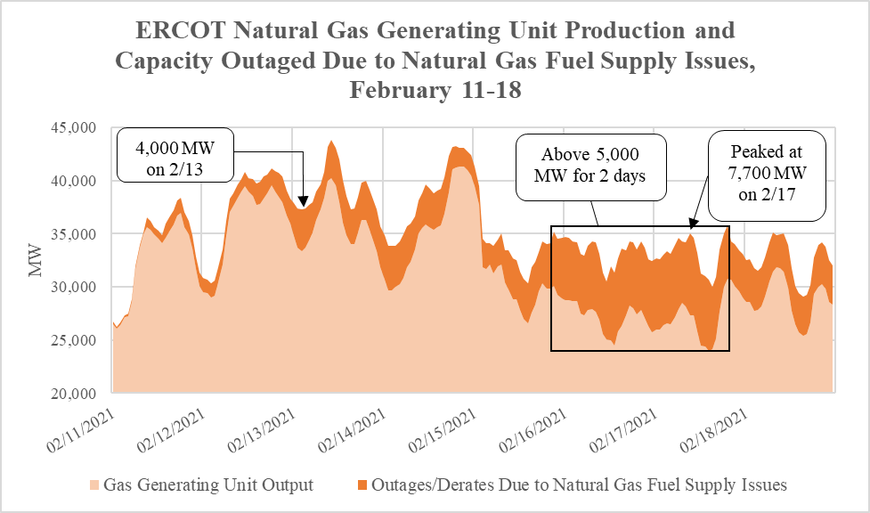
ERCOT Natural Gas Outages

Slide 17
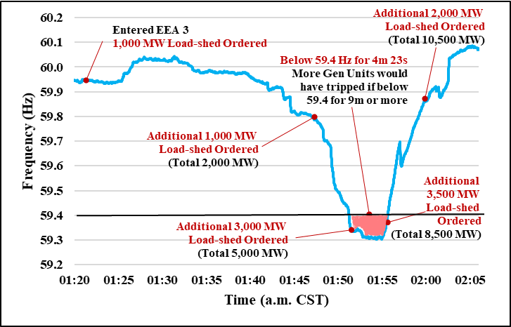
ERCOT System Frequency

Slide 18
Texas SB 3
Development of a new “power outage alert” (with coordination among several agencies including the PUCT and Department of Transportation (to use its highway messaging signs).
Creation of a new “Texas Energy Reliability Council,” with the purpose of fostering better communication between the natural gas and electric industries. Its members include the Chairs of the Texas Railroad Commission and PUCT, ERCOT, and members from the natural gas and electric industries, as well as other energy and industrial sectors.
Creation of a committee to map the electricity supply chain “in order to designate priority electricity service needs during extreme weather events” (and update said map yearly).

Slide 19
Texas SB 3 Continued
Requiring gas supply chain facilities identified on the electricity supply chain map and directly serving natural gas generating units to “implement measures to prepare to operate during a weather emergency,”
Develop a communication system between critical infrastructure sources, the PUCT and ERCOT to ensure that electricity and natural gas supplies in the electricity supply chain are prioritized to those sources during an extreme weather event.
Requiring the PUCT and RRC to collaborate on rules for designating natural gas facilities and entities as critical electric customers or critical gas suppliers.

Slide 20
Texas SB 3
Requiring that utilities provide retail customers with information about involuntary load shedding, and how to apply to become a critical care retail customer or other protected class of retail customer.
Adding new rules regarding how to conduct firm load shedding, including that the PUCT examine whether entities complied with their load shed plans, and providing for at least one load shed drill each in the summer and winter.
Requiring procurement of competitive “ancillary or reliability services” to ensure reliability during extreme heat and extreme cold weather and during times of low wind or solar; winter resources required to include on-site fuel storage, dual-fuel capability or “fuel supply arrangements to ensure winter performance for several days.”

Slide 21
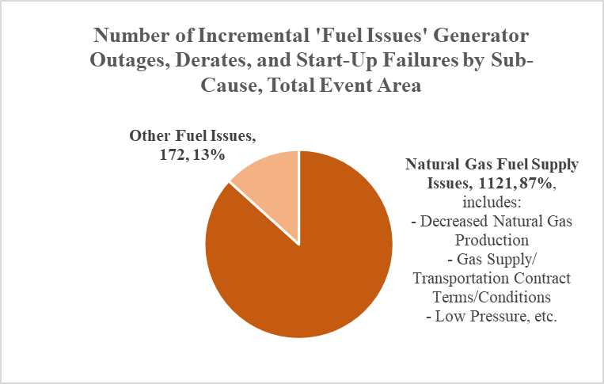
Natural Gas Related Issues

Slide 22
Key Recommendations
Reliability Standards should be revised to address cold weather issues
Markets should develop appropriate cost recovery mechanisms
Technical Conference on improving Winter readiness
Mandatory winterization for natural gas infrastructure
Forum with natural gas industry to ensure reliability of natural gas system for BES reliability
Generators should convey limitations (ie FT v IT) to Balancing Authorities
Reserve margins should be reconsidered
Upgrading SCADA controls

Slide 23
Key Recommendations Cont’d
Enhance Emergency Centers
Evaluate intermittent resource forecasting improvements
Demand Side Management and Energy Efficiency

Slide 24
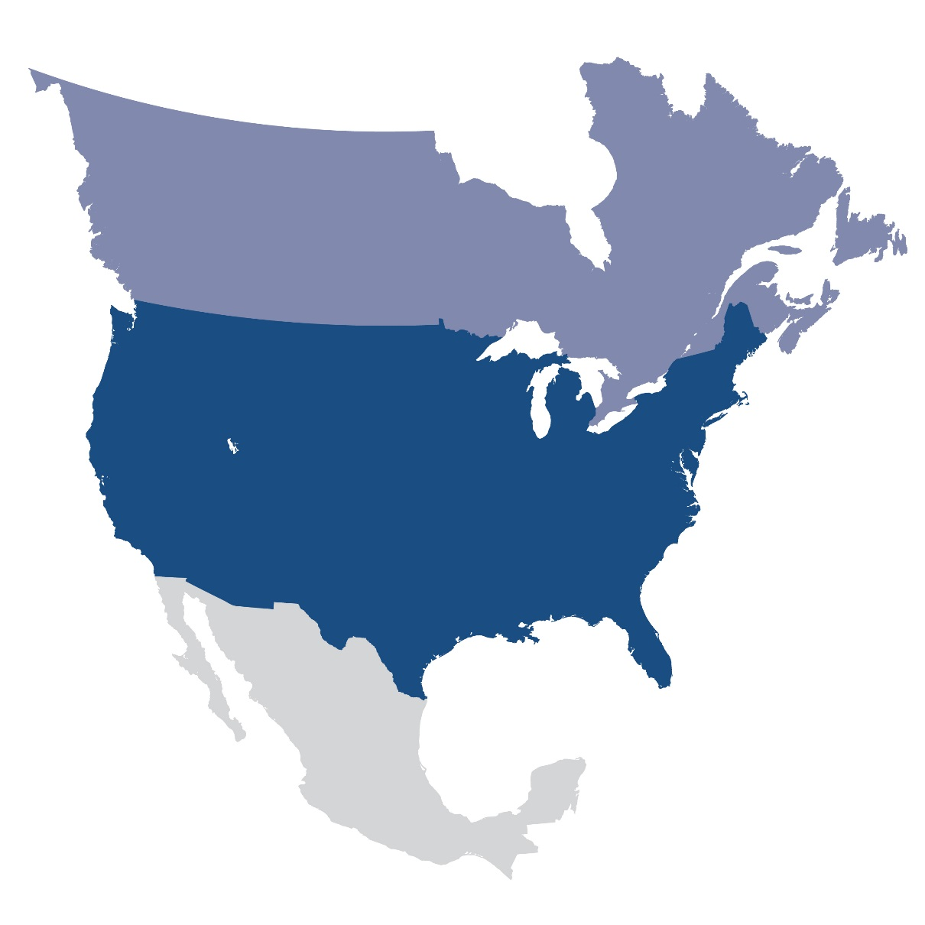
Questions and Answers

