Slide 1
IRR Outage Reporting
Forecasting Impacts and Recent Issues
Raymund Lee
Resource Forecasting and Analysis
12/10/2021

Slide 2
Summary
Intro to IRR Forecasting
Recent Issues: Solar Resource Outage Updates
Recent Remedies and Changes

Slide 3
Intro to IRR Forecasting
The goal of IRR forecasts is to predict future wind and solar potential power generation.
ERCOT receives IRR forecasts from third-party vendors
Two wind forecast vendors
One solar forecast vendor (procuring a second one by next summer)
Inputs
Forecast Algorithm
Outputs
ERCOT Sends Forecast Providers:
Resource Telemetry
MW, HSL, IRAD/MPH, Temperature
Resource Model Data
Equipment Make/Model, Ratings, Lat/Long coordinates
Outage Scheduler Information
Effective Start/End Time
Derate Amount
Vendors Make Predictions Using:
ERCOT Input Data
Weather Models
Historical Data
Forecast Vendors Provide
“Hourly” Forecast for each resource for next 168-hr at hourly resolution, updated hourly
Intra-hour Forecast for each resource for next 2-hr, at 5-min resolution, updated every 5-min
Notes:
1.ERCOT will automatically populate cop hsl from latest forecast.
2. QSE have opportunity to override.

Slide 4
How ERCOT Uses Forecasts
Hourly Forecasts
Puts an upper limit on Current Operating Plan (COP) HSL for Wind & Solar resources. The COP is used in:
Day Ahead Market
Reliability Unit Commitment (DRUC, HRUC)
Ops support day-ahead study
The 6 hour-ahead forecast accuracy determines the amount of non-spin procured each year
Intra-hour Forecast (5-min)
Calculate 5 minute solar and wind ramp, used to determine SCED’s generation to be dispatched
All forecasts are visualized in the control room, giving operators situational awareness
As IRR capacity grows, ERCOT forecasts become more important
Notes:
1.ERCOT will automatically populate cop hsl from latest forecast.
2. QSE have opportunity to override.

Slide 5
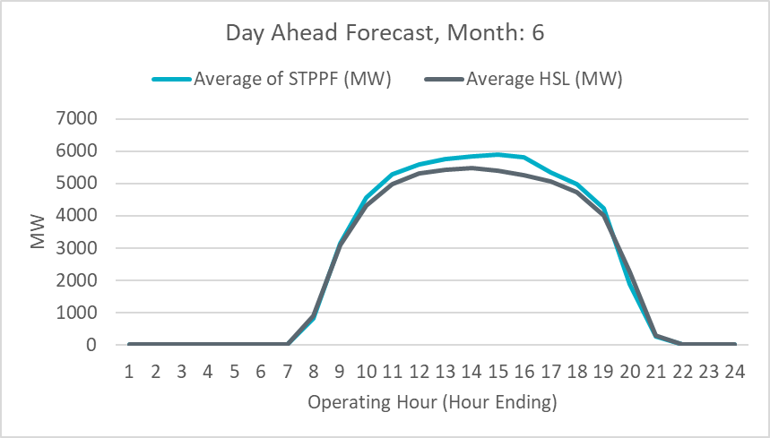
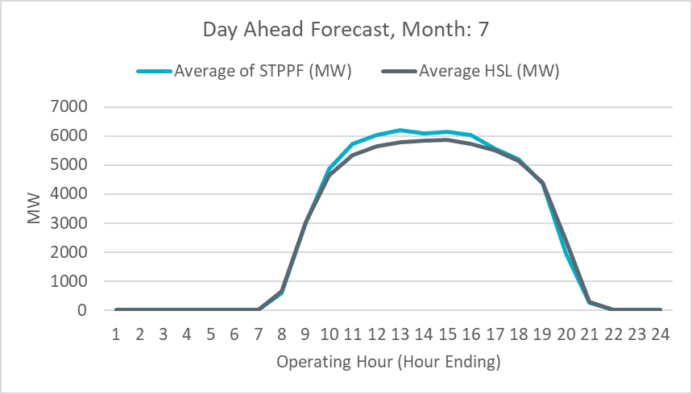
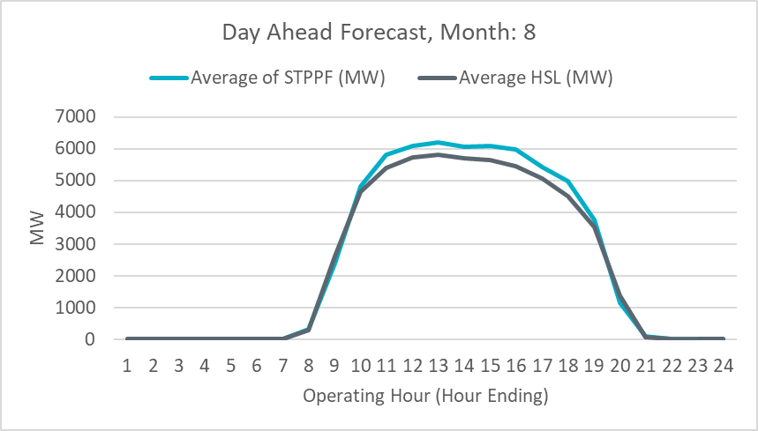
Recent Solar Forecast Issues
At the WMS meeting in September, ERCOT received some questions regarding an over-forecast bias in ERCOT’s hourly active Solar forecast for June, July, and August 2021.
ERCOT has analyzed individual resource forecasts and sent RFI’s to resources to understand the underlying cause for this issue.
Identified 14 out of 70 solar units that consistently contributed to the overforecast errors during the summer.
The root cause for the errors of all 14 units was related to unreported derates.

Slide 6
Example: Systematic Reduction in Capability
If a derate is never reported, there will be a consistent overforecast as shown below
MW

Slide 7
Recent Changes and Remedies
The Resource Integration Commissioning Checklist has been modified. Resources are required to have submitted accurate derates for each stage of approval.
Internal tools at ERCOT have been developed to identify resources whose reported availability is inconsistent with their actual availability.
Notes:
1.ERCOT will automatically populate cop hsl from latest forecast.
2. QSE have opportunity to override.

Slide 8
Conclusion and Main Takeaways
Accurate IRR forecasts are important to ERCOT because it has significant reliability and market implications
In the summer, ERCOT identified 14 solar units which contributed to a large overforecast bias due to improper outage submissions
To reduce the overforecast errors, efforts are being made to enforce these requirements and educate resources
Notes:
1.ERCOT will automatically populate cop hsl from latest forecast.
2. QSE have opportunity to override.

Slide 9
Questions & Discussion

Slide 10
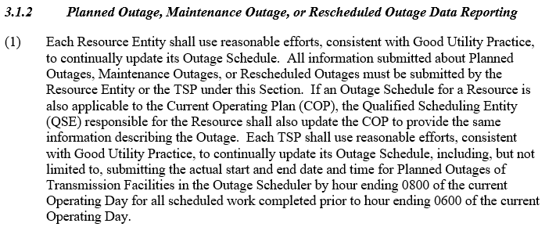
Protocols
Notes:
1.ERCOT will automatically populate cop hsl from latest forecast.
2. QSE have opportunity to override.

Slide 11
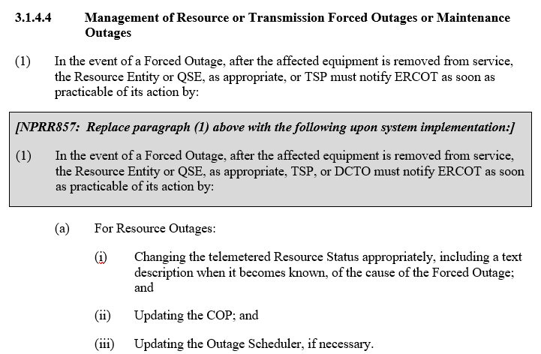
Protocols
Notes:
1.ERCOT will automatically populate cop hsl from latest forecast.
2. QSE have opportunity to override.

Slide 12
Protocols
Notes:
1.ERCOT will automatically populate cop hsl from latest forecast.
2. QSE have opportunity to override.

Slide 13
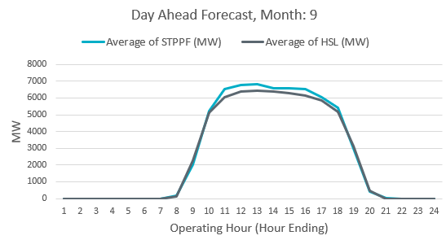
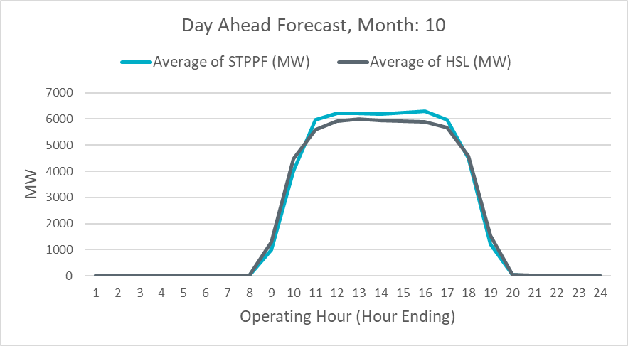
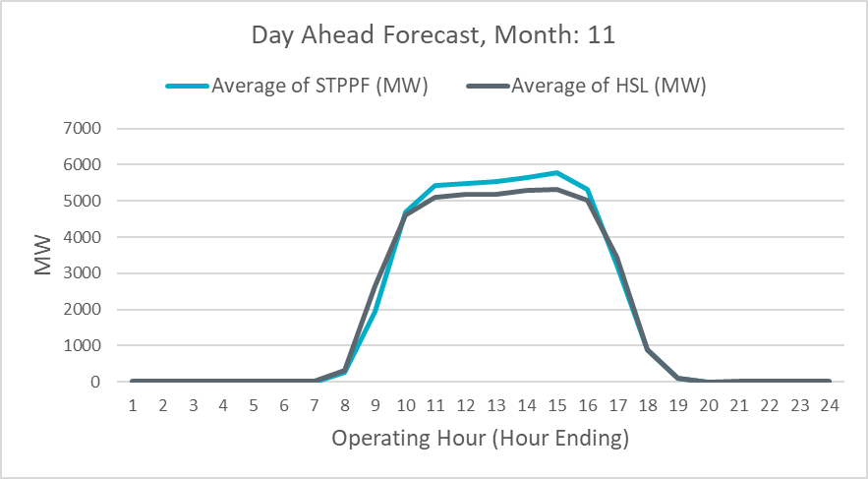
Post-Summer Analysis
Notes:
ERCOT Nodal Protocols Section 3.1.2 “Each Resource Entity shall use reasonable efforts, consistent with Good Utility Practice, to continually update its Outage Schedule.”

