Slide 1
ERCOT Frequency Events
November 2021
ERCOT
Operations Planning
PDCWG | December 8th, 2021

Slide 2
11/1/2021 04:57:04 (FME)
Notes:
Three combined cycles tripped offline for a combined loss of 540 MW
Starting Frequency: 60.006 Hz
Minimum Frequency: 59.905 Hz
A-C Time: 6 seconds
Recovery Time (back to deadband): 8 minutes and 36 seconds
RRS Deployed: 403.33 MW
Trip Reason: Unknown at this time
Contextual Information: A total of 406 MW of regulation up was deployed during the event.

Slide 3
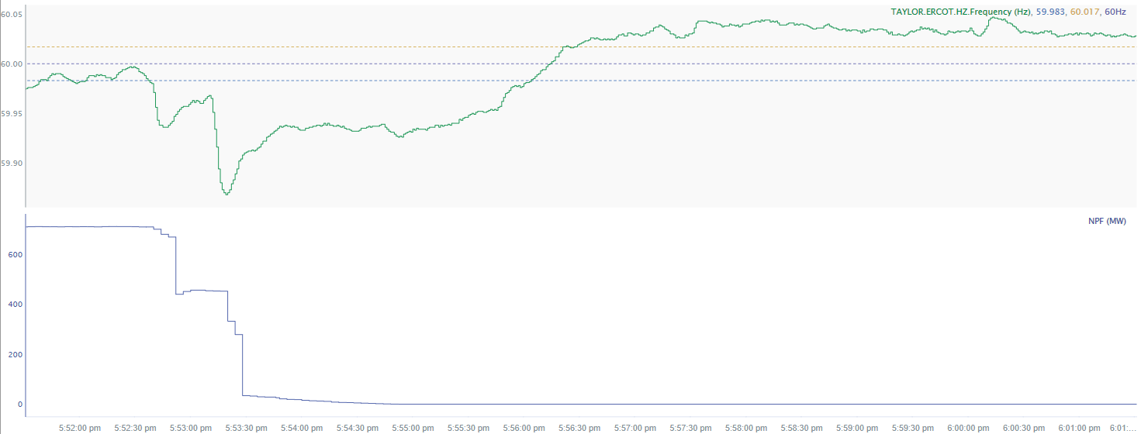
11/15/2021 17:53:11(NON-FME)
Notes:
Unit tripped offline while carrying 710 MW
Starting Frequency: 59.98 Hz (initial trip) ; 59.965 Hz (Second trip)
Minimum Frequency: 59.838 Hz
A-C Time : 8 seconds (second trip)
Recovery Time(back to deadband): 3 minutes and 24 seconds
RRS Deployed: 721.89 MW
Trip Reason: vacuum breaker fault
Contextual Information: A total of 387 MW of regulation up was deployed during the event.
No Selection Reason: The unit trip is not clean

Slide 4
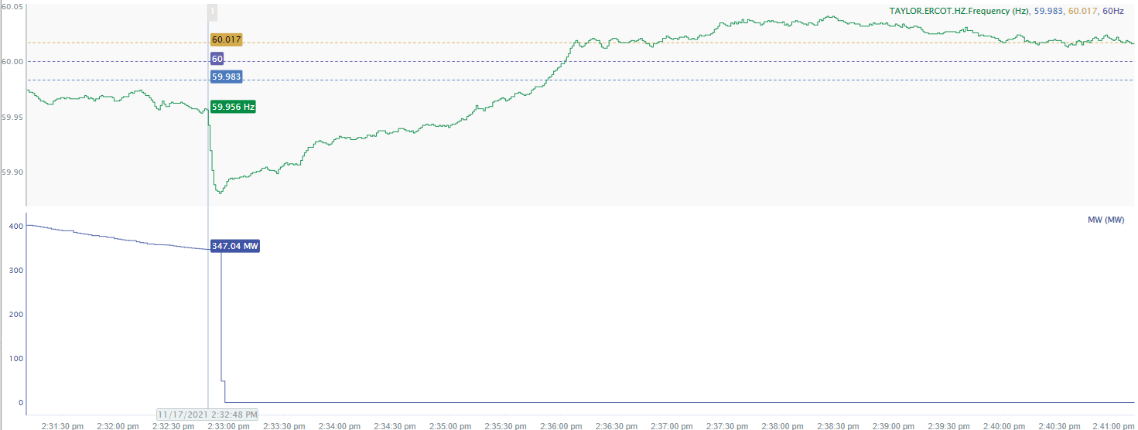
11/17/2021 14:32:48(NON-FME)
Notes:
Unit experienced runback and tripped while carrying 347 MW
Starting Frequency: 59.956 Hz
Minimum Frequency: 59.88 Hz
A-C Time : 7 seconds
Recovery Time(back to deadband): 3 minutes
RRS Deployed: 767.83 MW
Trip Reason: Tube leak
Contextual Information: A total of 306 MW of regulation up was deployed and 500 MW of manual offset was applied during the event.
No Selection Reason: The starting frequency fell below low deadband

Slide 5
Questions?
Thank you!

