Slide 1
Docket No. 51387 – Supply Chain Impacts
Review with RMS
December 7, 2021

Slide 2
AT&T 3G Sunset
On February 21, 2019, AT&T notified TNMP of their intentions to turn down the 3G network in February 2022.
Early discussions suggested that there was some “fluidity” to that date, however since then, TNMP has not received confirmation of any timing adjustment.
TNMP Management has had numerous discussions with AT&T counterparts, so far to no avail.
TNMP has made a formal request for a date extension.

Slide 3
3G Meters Deployed
As of February 2020, there were 173,737 meters deployed on the AT&T 3G network throughout TNMP service territory, which is consistent with filings under Docket No. 51387.
As of October 2021, there are 146,293 meters deployed on the AT&T 3G network.

Slide 4
Supply Chain Impacts
On July 16, 2021, TNMP’s AMI vendor notified TNMP of potential supply chain disruptions due to COVID-19.
While the notice did not quantify the impact, TNMP has experienced a significant shortfall of meters to support the NextGen rollout.
TNMP had initially planned to receive and install NextGen meters to replace all 173,737 3G prior to the turndown.
TNMP now expects to receive and install approximately 31,000 NextGen meters prior to the 3G turndown.
TNMP expects to lose the ability to communicate with approximately 115,000 AMI meters beginning in March 2022.

Slide 5
Mitigation
TNMP is currently working with utility service provider(s) to implement a manual meter reading process in the interim.
Current guidance, projects that TNMP will not receive enough meters to fully remediate the 3G turndown, until EOY 2022.

Slide 6
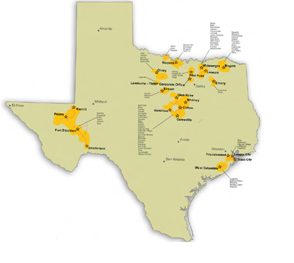
TNMP Service Territory
North Texas
3G – 50,781
4G – 27,016
Total customer base of 262,646 in four operating areas within Texas, covering 7,100 square miles.
262,415* TNMP customers are AMI-enabled:
3G – 146,293
4G – 116,122
* As of Oct 2021
Central Texas
3G – 20,295
4G – 5,781
West Texas
3G – 9,880
4G – 9,474
Gulf Coast
3G – 65,337
4G – 73,851

