Slide 1
Fast-Frequency Response Advancement (FFRA) Project
Technical Workshop
ERCOT Staff Presenting
Matt Mereness Nitika Mago
Nathan Smith Brian Brandaw
Jamie Lavas Venkat Tirupati
(and others)
12/7/2021

Slide 2
Outline
Purpose
Ensure technical understanding of changes for MPs/Vendors
Re-posted Oct 27 materials in zip file for business details
Introduction to FFRA Project
Technical documentation library of changes for FFRA
Market submission changes in User Interface
Market submission changes in XML
Telemetry/ICCP changes
Reports/Extract changes
Next steps (looking forward into 2022)
DGR/NPRR1016 Release in R1-2022
NPRR1093 Release is TBD
Technology Working Group being proposed
Appendix
List of Acronyms
FFRA Protocol Sections

Slide 3
Introduction
PR325-01 FFR Advancement (FFRA) project is the second in a series of projects that are being used to implement changes associated with NPRR 863.
Following is a high-level list of the changes that are being made as a part of the FFRA project.
Upon the full implementation of FFR as a part of this project, for any operating hour in the Day Ahead Market (DAM),
An ESR-Gen and ESR-CLR will be able to offer, get awarded and provide* (conventional) Regulation, RRS-PFR, and (online) Non-Spin simultaneously with RRS-FFR (assuming the ESR-Gen or ESR-CLR is qualified for the AS or AS sub-type it is offering or providing).
A NCLR will be able to offer, get awarded and provide** either RRS-FFR or RRS-UFR (assuming the NCLR is qualified for the RRS sub-type it is offering or providing).
RRS Offers in & Awards from DAM/SASM, RRS AS Obligation in COPs and Self-Arranged RRS AS submissions will split by subtype namely, RRS-PFR, RRS-FFR and RRS-UFR.
In Real Time, new telemetry will be setup to send Ancillary Service Responsibility and Ancillary Service Schedule for RRS-FFR.
The existing Ancillary Service Responsibility and Ancillary Service Schedule telemetry will continue to be used for telemetering RRS-PFR and RRS-UFR.
*ESR-Gen will be required to use ONFFRRRS resource status to provide RRS-FFR in Real Time.
** NCLR will be required to use ONFFRRRSL resource status to provide RRS-FFR or ONRL resource status to provide RRS-UFR in Real Time.
3

Slide 4
Introduction, continued…
For CLRs including ESR-CLRs and Generating Units operating in synchronous condenser fast response mode, RRS-PFR Awards from DAM/SASM, RRS-PFR COP submissions, and RRS-PFR Responsibility & Schedule telemetry in Real Time for CLRs will be limited by their corresponding RRS-MW-Limit (%) or tested MW as applicable.
For all Resources providing RRS-FFR, RRS-FFR Awards from DAM/SASM, RRS-FFR COP submissions and RRS-FFR Responsibility & Schedule telemetry in Real Time will be limited by their respective FFR Qualified MWs.
There will be changes to several reports primarily to include information breakdown by RRS subtype.

Slide 5
Library of FFRA Requirement Changes
MarketSubmissionValidationRules_NP4-450
External Web Services XSD V1.21
EIP External Interfaces Specification v1.21 (FFR & DGR)
ERCOT_Nodal_ICCP_Communications_Handbook_v3_11_Change_Upd
Current Day Reports XSD v6.xx –Excerpt for workshop
Disclosure Reports Column Definitions Guide

Slide 6
Market Submission User Interface (MMS UI) Changes
Walk-through of changes in the Market Manager User Interface applicable to FFRA
COP
AS Offer
AS Trade
AS Self-Arrangement
AS Awards

Slide 7
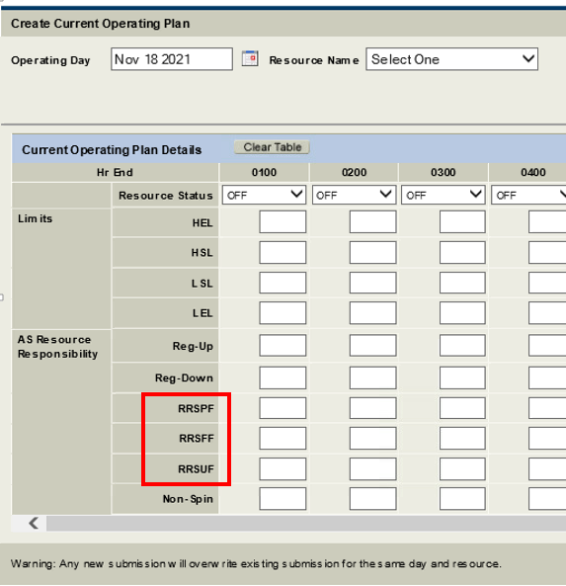
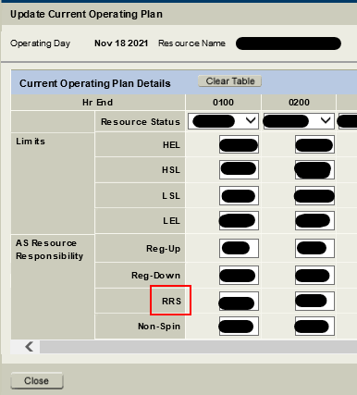
MMSUI – COP Changes
Separate MW Responsibility Values for each RRS sub-type
FFRA
Current

Slide 8
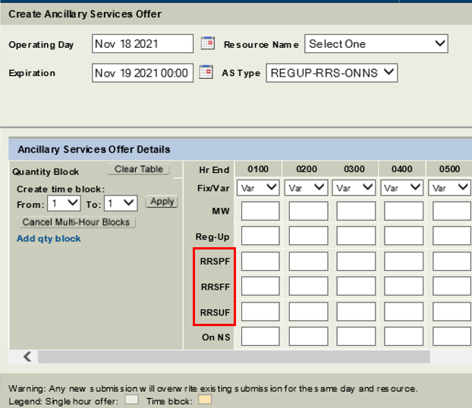
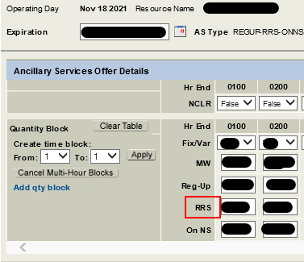
MMSUI – AS Offer Changes
Current RRS offer price is replaced by separate offer prices for RRSPF, RRSFF, and RRSUF.
Current
FFRA

Slide 9
MMSUI – AS Trade Changes
Current AS RRS sub-types are replaced by new FFRA RRS sub-types.
Current
FFRA

Slide 10
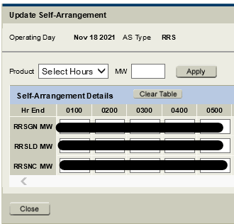
MMSUI – AS Self Arrangement Changes
MW values of current AS RRS sub-types are replaced by new FFRA RRS sub-types.
Current
FFRA

Slide 11
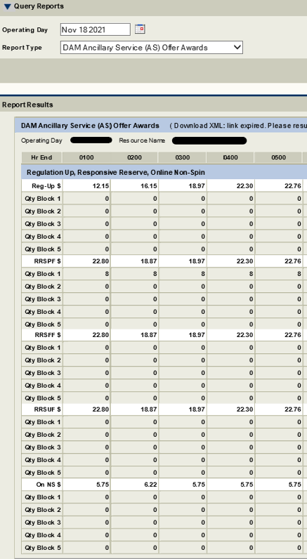
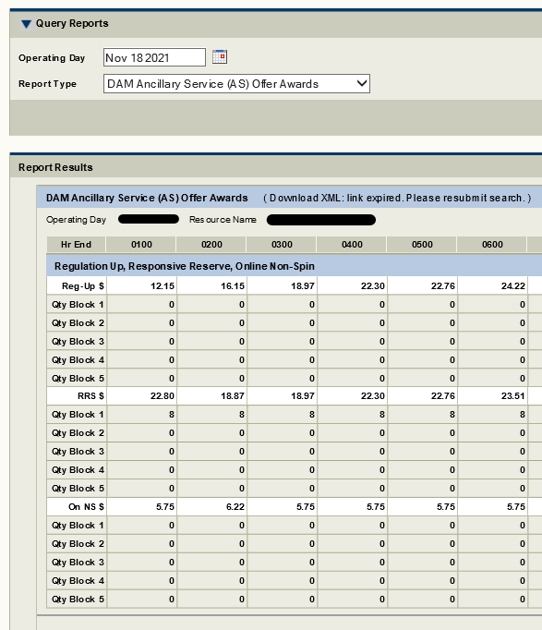
MMSUI – DAM AS Awards Report Changes
RRS awards will be reported
by new RRS sub-type. All use same RRS MCPC.
FFRA
Current
Mock-Up

Slide 12
Market Submission: External web services impacts (XML)
FFRA impacts External Web Services (EWS) in four different ways
Changes to ASTypes
Market Transactions: ASTrade
Market Information: AwardedAS, TotalASOffers, and AggregatedASOfferCurves
New elements for MW values for FFR AS
Market Transactions: COP
New elements for price values for FFR AS
Market Transactions: ASOffer, SelfArrangedAS
nonControllableLoadFlag element removed from AASPriceCurve
Market Information: AwardedAS
All of these changes are documented in the latest version of the External Web Services Specification and XSDs

Slide 13
ASTypes
Three new values have been added to the ASType enumeration:
RRSUF - High-set under-frequency relays
RRSPF - Primary Frequency Response
RRSFF - Fast Frequency Response resources
Three values have been removed
RRSGN
RRSLD
RRSNC
asType is defined in ErcotCommonTypes.xml and referenced in
ErcotTransactionTypes.xsd, ErcotInformationTypes.xsd, and ErcotAwardTypes.xsd

Slide 14
ASType defined in ErcotCommonTypes

Slide 15
Example XML using ASType

Slide 16
MW Values
Three new elements used for MW values
rrsPF, rrsFF, and rrsUF
Each correspond to the new values in ASTypes
Defined in ASCapacity type (ErcotTransactonTypes.xsd)

Slide 17
MW values defined in ErcotTransactionTypes

Slide 18
Example XML using MW values

Slide 19
Price Values
New elements to represent prices for the new ASTypes are defined in two different ways:
SelfArrangedAS removes the three elements of rrs_values and creates three new elements (SelfArrangedAS complexType in ErcotTransactionTypes.xsd)
ASOffer removes the existing element RRS from OnlineReserves and adds three new elements (ASOffer complexType in ErcotCommonTypes.xsd)
New element’s naming scheme and types follow the same format as the elements that were removed

Slide 20
Price values for ASOffer

Slide 21
Price Values for SelfArrangedAS

Slide 22
Example XML for ASOffer

Slide 23
Example XML for SelfArrangedAS

Slide 24
ICCP Telemetry Changes
Walk-through of Telemetry/ICCP Changes being made for FFRA

Slide 25
ICCP Changes for FFR AS Responsibility and Schedule
New ICCP tags to telemeter RRS-FFR Ancillary Service Responsibility and RRS-FFR Ancillary Service Schedule have been included for ESR-Gen, ESR-CLR and NCLRs.
Note that, for all Resources providing RRS-FFR, RRS-FFR Responsibility & Schedule telemetry in Real Time will be limited by their respective FFR Qualified MWs.

Slide 26
ICCP Changes related to FFR provision by NCLRs
New Resource Status code for ONFFRRRSL (i.e. RST = 263) has been included for NCLRs to provide RRS-FFR in Real Time.
New telemetry has been included for NCLRs to provide status of FFR deployment (and recall).

Slide 27
Reports and Extracts
Walk-through of changes to Reports and Extracts applicable to FFRA

Slide 28
CDR Report Impact Summary - FFR
Report | Change Summary
NP4-179-CD Total Ancillary Service Offers | Report: Remove "RRS" column and add subtype columns "RRSPFR”, “RRSFFR”, and “RRSUFR” XSD: Removal of <xs:element name= “RRS”
NP6-655-CD Total Ancillary Service Procured in SASM | Report: Update RRS filter XSD: Remove "ASType" <xs:simpleType> tag values of “REGUP”, “”RRS”, REGDN”, “ONNS” and “OFFNS”
NP6-913-CD SASM Aggregated Ancillary Service Offer Curve | Report: Update RRS filter XSD: remove "AncillaryType”<xs:simpleType> tag values (“REGUP”, ”RRSGN”, “RRSNC”, “RRSLD”, REGDN”, “NSPIN”, “ONNS” , “OFFNS”)
NP4-19-CD Aggregated Ancillary Service Offer Curve | Report: Update RRS filter XSD: Remove enumeration values “RRSGN”, “RRSNC” and “RRSLD”; Add enumeration values “RRSPF”, “RRSUF” and “RRSFF
NP8-143-CD QSE Ancillary Service Capacity Monitor | Report: Addition of RRS subtype column(s) "RRS_FFR" XSD: Addition of element name “RRS_FFR”

Slide 29
ISM Report Impact Summary - FFR
Report | File(s) within zip | Change Summary
NP3-989-ER 7-Day Event Trigger Posting When MCPC Exceeds 50xFIP |  | Remove RRS column and replace with subtype columns
NP3-990-EX 60-Day SASM | SASM Generation Resource AS Offers SASM Load Resource AS Offers SASM Generation Resource AS Offer Awards SASM Load Resource AS Offer Awards | Remove RRS column and replace with subtype columns
NP3-966-ER 60-Day DAM Disclosure Reports | NP3-975-EX 60D DAM Generation Resource Data NP3-976-EX 60D Generation Resource AS Offers in DAM NP3-978-EX 60D Load Resource AS Offers in DAM NP3-974-EX 60D QSE Specific Self-Arranged AS in DAM NP3-977-EX 60 Day Load Resource Data in DAM | Remove RRS columns and replace with subtype columns
NP3-991-EX 60D Current Operating Plan *Updated name: 60-Day COP All Updates |  | Remove RRS column and replace with subtype columns Name Change
NP1-301 60D Complete COP *Updated name: 60-Day COP Adjustment Period Snapshot |  | Remove RRS column and replace with subtype columns Name Change
NP3-915-EX 3-Day Highest Price AS Offer Selected |  | Addition of RRS Subtypes
NP3-911-EX 2-Day Ancillary Services Disclosure | NP3-959-EX 2D Aggregate AS Offers NP3-961-EX 2D Cleared DAM AS NP3-960-EX 2D Self-Arranged AS | NP3-959-EX: Remove 'RRSGN', 'RRSLD', 'RRSNC', 'RRSLOAD' reports NP3-959-EX: Add 'RRSPF', 'RRSUF','RRSFF' reports NP3-960-EX and NP3-961-EX: Remove 'RRSGEN','RRSLOAD' reports NP3-960-EX and NP3-961-EX: Add 'RRSPFR', 'RRSUFR','RRSFFR' reports
NP3-965-ER 60D SCED Disclosure Report | NP3-967-EX QSE self arranged AS NP3-968-EX Generation Resource Data NP3-969-EX Load Resource Data | NP3-967-EX: Removal of 'RRSGN', 'RRSLD', 'RRSNC' columns NP3-967-EX: Addition of 'RRSPF', 'RRSUF','RRSFF’ columns NP3-968-EX: Addition of ‘Ancillary Service RRSFFR’ column NP3-969-EX: Addition of ‘AS Responsibility for RRSFFR’ column
NP8-501-ER Monthly Generation Resource Energy Deployment Performance Report |  | Add ONFFRRRS filter for regulation responsibility

Slide 30
Total Ancillary Service Offers
NP4-179-CD Total Ancillary Service Offers (Report Type ID 12327)
Report Changes:
Removal of column “RRS”
Addition of subtype columns “RRSPFR”, “RRSFFR”, and “RRSUFR”
Column Order: DeliveryDate, HourEnding, REGDN, REGUP, RRSPFR, RRSFFR, RRSUFR, NSPIN, DSTFlag
XSD Changes:
Removal of <xs:element name= “RRS”
Addition of subtypes <xs:element name= “RRSPFR”, “RRSFFR”, and “RRSUFR”
<xs:element name="TotalASOffers">
<xs:annotation>
<xs:documentation>NP4-179: TotalASOffers</xs:documentation>
</xs:annotation>
<xs:complexType>
<xs:sequence>
<xs:element name="TotalASOffer" minOccurs="0" maxOccurs="unbounded">
<xs:complexType>
<xs:sequence>
<xs:element ref="DeliveryDate"/>
<xs:element ref="HourEnding"/>
<xs:element name="REGDN" type="xs:decimal" nillable="false" minOccurs="0"/>
<xs:element name="REGUP" type="xs:decimal" nillable="false" minOccurs="0"/>
<xs:element name="RRSPFR" type="xs:decimal" nillable="false" minOccurs="0"/>
<xs:element name="RRSFFR" type="xs:decimal" nillable="false" minOccurs="0"/>
<xs:element name="RRSUFR" type="xs:decimal" nillable="false" minOccurs="0"/>
<xs:element name="NSPIN" type="xs:decimal" nillable="false" minOccurs="0"/>
<xs:element name="ONNS" type="xs:decimal" nillable="false" minOccurs="0"/>
<xs:element name="OFFNS" type="xs:decimal" nillable="false" minOccurs="0"/>
<xs:element ref="DSTFlag"/>
</xs:sequence>
</xs:complexType>
</xs:element>
</xs:sequence>
</xs:complexType>
</xs:element>

Slide 31
Total Ancillary Service Procured in SASM
NP6-655-CD Total Ancillary Service Procured in SASM (Report Type ID 12343)
XSD Changes:
Remove <xs:simpleType> tag values of “REGUP”, “”RRS”, “REGDN”, “ONNS” and “OFFNS” from <xs:element name="ASType"
<xs:element name="TotASProcureds">
<xs:annotation>
<xs:documentation>NP6-655: TotASProcureds</xs:documentation>
</xs:annotation>
<xs:complexType>
<xs:sequence>
<xs:element name="TotASProcured" minOccurs="0" maxOccurs="unbounded">
<xs:complexType>
<xs:sequence>
<xs:element name="DeliveryDate"/>
<xs:element ref="HourEnding"/>
<xs:element name="SASMID" type="xs:string" nillable="false" minOccurs="0"/>
<xs:element name="ASType" minOccurs="0"/>
<xs:element name="QTYProcured" type="xs:float" nillable="false" minOccurs="0"/>
<xs:element ref="DSTFlag"/>
</xs:sequence>
</xs:complexType>
</xs:element>
</xs:sequence>
</xs:complexType>
</xs:element>

Slide 32
SASM Aggregated Ancillary Service Offer Curve
NP6-913-CD SASM Aggregated Ancillary Service Offer Curve (Report Type ID 12350)
XSD Changes:
Remove <xs:simpleType> tag values of “REGUP”, “”RRSGN”, “RRSNC”, “RRSLD”, REGDN”, “NSPIN”, “ONNS” and “OFFNS” from <xs:element name="AncillaryType”
<xs:element name="SASMASAGGOFFERS">
<xs:annotation>
<xs:documentation>NP6-913: SASMASAGGOFFERS</xs:documentation>
</xs:annotation>
<xs:complexType>
<xs:sequence>
<xs:element name=" SASMASAGGOFFERS" minOccurs="0" maxOccurs="unbounded">
<xs:complexType>
<xs:sequence>
<xs:element name="DeliveryDate"/>
<xs:element ref="HourEnding"/>
<xs:element name="SASMID" type="xs:string" nillable="false" minOccurs="0"/>
<xs:element name="AncillaryType" minOccurs="0"/>
<xs:element name="Price" type="xs:decimal" nillable="0" minOccurs="0"/>
<xs:element name="Quantity" type ="xs:decimal" nillable="0" minOccurs="0"/>
<xs:element ref="DSTFlag"/>
</xs:sequence>
</xs:complexType>
</xs:element>
</xs:sequence>
</xs:complexType>
</xs:element>

Slide 33
Aggregated Ancillary Service Offer Curve
NP4-19-CD Aggregated Ancillary Service Offer Curve (Report Type ID 12330)
XSD Changes:
Remove enumeration values “RRSGN”, “RRSNC” and “RRSLD”
Add enumeration values “RRSPF”, “RRSUF” and “RRSFF
<xs:element name=“DAMASAGGOFFERS">
<xs:annotation>
<xs:documentation>NP4-19: DAMASAGGOFFERS</xs:documentation>
</xs:annotation>
<xs:complexType>
<xs:sequence>
<xs:element name=" DAMASAGGOFFERS" minOccurs="0" maxOccurs="unbounded">
<xs:complexType>
<xs:sequence>
<xs:element name="DeliveryDate"/>
<xs:element ref="HourEnding"/>
<xs:element name="AncillaryType" minOccurs="0"/>
<xs:simpleType>
<xs:restriction base="xs:string">
<xs:enumeration value="REGUP"/>
<xs:enumeration value="RRSPF"/>
<xs:enumeration value="RRSUF"/>
<xs:enumeration value="RRSFF"/>
<xs:enumeration value="REGDN"/>
<xs:enumeration value=“ONNS"/>
<xs:enumeration value=“OFFNS"/>
<xs:restriction>
<xs:simpleType>
<xs:element>
<xs:element name="Price" type="xs:decimal" nillable=“false" minOccurs="0"/>
<xs:element name="Quantity" type ="xs:decimal" nillable=“false" minOccurs="0"/>
<xs:element ref="DSTFlag"/>
</xs:sequence>
</xs:complexType>
</xs:element>
</xs:sequence>
</xs:complexType>
</xs:element>

Slide 34
QSE Ancillary Services Capacity Monitor
NP8-143-CD QSE Ancillary Services Capacity Monitor (Report Type ID 11025)
Addition of Report Column and XSD Changes
Report Changes:
Addition of RRS Subtype column “RRS_FFR”
Column Order:
DATE_TIME, DATE_TIME_DST, QSE_ID, QSE_DUNS, QSE_TEID, RRS_GEN_RES, RRS_LOAD_RES_WO_CLR, RRS_CLR, RRS_FFR, RRS_SUM_RES_RESPONSIBILITY, RRS_QSE_RESPONSIBILITY, RRS_RESPONSIBILITY_MET, NSRS_ONLINE_GEN_RES_W_EOC, NSRS_ONLINE_GEN_RES_W_OS, NSRS_OFFLINE_GEN_RES, NSRS_UNDEPLOYED_LOAD_RES , NSRS_SUM_RES_RESPONSIBILITY, NSRS_QSE_RESPONSIBILITY, NSRS_RESPONSIBILITY_MET, UNDEPLOYED_REG_UP, REG_UP_SUM_RES_RESPONSIBILITY, REG_UP_QSE_RESPONSIBILITY, REG_UP_RESPONSIBILITY_MET, UNDEPLOYED_REG_DOWN, REG_DOWN_SUM_RES_RESPONSIBILITY, REG_DOWN_QSE_RESPONSIBILITY, REG_DOWN_RESPONSIBILITY_MET, CAP_CLR_INCREASE_BP_Energy_Consumption, CAP_CLR_DECREASE_BP_Energy_Consumption, CAP_W_EO_INCREASE_BP, CAP_W_EO_DECREASE_BP, CAP_WO_EO_INCREASE_BP, CAP_WO_EO_DECREASE_BP, PRC_QSE
XSD Changes:
Addition of element name “RRS_FFR”
Updated XSD layout continued on next slide

Slide 35
QSE Ancillary Services Capacity Monitor
<xs:element name=“ASCapacityMonitors">
<xs:annotation>
<xs:documentation>NP8-143: ASCapacityMonitors </xs:documentation>
</xs:annotation>
<xs:complexType>
<xs:sequence>
<xs:element name=" ASCapacityMonitors " minOccurs="0" maxOccurs="unbounded">
<xs:complexType>
<xs:sequence>
<xs:element name="DeliveryDate"/>
<xs:element name="DATE_TIME_DST" type="xs:string"/>
<xs:element name="QSE_ID" type="xs:string"/>
<xs:element name="QSE_DUNS" type="xs:positiveInteger"/>
<xs:element name="QSE_TEID" type="xs:decimal"/>
<xs:element name="RRS_GEN_RES" type="xs:decimal" minOccurs="0"/>
<xs:element name="RRS_LOAD_RES_WO_CLR" type="xs:decimal" minOccurs="0"/>
<xs:element name="RRS_CLR" type="xs:decimal" minOccurs="0"/>
<xs:element name="RRS_FFR" type="xs:decimal" minOccurs="0"/>
<xs:element name="RRS_SUM_RES_RESPONSIBILITY" type="xs:decimal" minOccurs="0"/>
<xs:element name="RRS_QSE_RESPONSIBILITY" type="xs:decimal" minOccurs="0"/>
<xs:element name="RRS_RESPONSIBILITY_MET" type="xs:string" minOccurs="0"/>
<xs:element name="NSRS_ONLINE_GEN_RES_W_EOC" type="xs:decimal" minOccurs="0"/>
<xs:element name="NSRS_ONLINE_GEN_RES_W_OS" type="xs:decimal" minOccurs="0"/>
<xs:element name="NSRS_OFFLINE_GEN_RES" type="xs:decimal" minOccurs="0"/>
<xs:element name="NSRS_UNDEPLOYED_LOAD_RES" type="xs:decimal" minOccurs="0"/>
<xs:element name="NSRS_SUM_RES_RESPONSIBILITY" type="xs:decimal" minOccurs="0"/>
<xs:element name="NSRS_QSE_RESPONSIBILITY" type="xs:decimal" minOccurs="0"/>
<xs:element name="NSRS_RESPONSIBILITY_MET" type="xs:string" minOccurs="0"/>
<xs:element name="UNDEPLOYED_REG_UP" type="xs:decimal" minOccurs="0"/>
<xs:element name="REG_UP_SUM_RES_RESPONSIBILITY" type="xs:decimal" minOccurs="0"/>
<xs:element name="REG_UP_QSE_RESPONSIBILITY" type="xs:decimal" minOccurs="0"/>
<xs:element name="REG_UP_RESPONSIBILITY_MET" type="xs:string" minOccurs="0"/>
<xs:element name="UNDEPLOYED_REG_DOWN" type="xs:decimal" minOccurs="0"/>
<xs:element name="REG_DOWN_SUM_RES_RESPONSIBILITY" type="xs:decimal" minOccurs="0"/>
<xs:element name="REG_DOWN_QSE_RESPONSIBILITY" type="xs:decimal" minOccurs="0"/>
<xs:element name="REG_DOWN_RESPONSIBILITY_MET" type="xs:string" minOccurs="0"/>
<xs:element name="CAP_CLR_INCREASE_BP_Energy_Consumption" type="xs:decimal" minOccurs="0"/>
<xs:element name="CAP_CLR_DECREASE_BP_Energy_Consumption" type="xs:decimal" minOccurs="0"/>
<xs:element name="CAP_W_EO_INCREASE_BP" type="xs:decimal" minOccurs="0"/>
<xs:element name="CAP_W_EO_DECREASE_BP" type="xs:decimal" minOccurs="0"/>
<xs:element name="CAP_WO_EO_INCREASE_BP" type="xs:decimal" minOccurs="0"/>
<xs:element name="CAP_WO_EO_DECREASE_BP" type="xs:decimal" minOccurs="0"/>
<xs:element name="PRC_QSE" type="xs:decimal" minOccurs="0"/>
</xs:sequence>
</xs:complexType>
</xs:element>
</xs:sequence>
</xs:complexType>
</xs:element>

Slide 36
Next Steps
Upcoming DGR Changes
Upcoming Preliminary NPRR1093 Changes
Technology Forum being considered

Slide 37
Upcoming DGR Changes
NPRR1016 includes DGR Change to Outage Scheduler
2022 Release1 (Early Feb 2022)
NPRR1016, Clarify Requirements for Distribution Generation Resources (DGRs) and Distribution Energy Storage Resources (DESRs);
NOGRR212, Related to NPRR1016, Clarify Requirements for Distribution Generation Resources (DGRs) and Distribution Energy Storage Resources (DESRs);
MOTE release 1/10/2022
Adds new Outage Resource Type
<xs:simpleType name="ResourceType"> <xs:restriction base="xs:string"> <xs:enumeration value="UN"/> <xs:enumeration value="LR"/> <!-- NPRR1016: Added DESR and DGR --> <xs:enumeration value="DESR"/> <!-- Distribution Energy Storage Devise --> <xs:enumeration value="DGR"/> <!-- Distribution Generation Resources --> </xs:restriction> </xs:simpleType>

Slide 38
Upcoming NPRR1093 Changes
Preliminary
MMS Submission Changes:
AS Self Arrangement Changes: replace current Non-Spin AS type with new Non-Spin subtypes
NSRSS-Non-Spin provided by SCED dispatchable Resources
NSRSM-Non-Spin provided by non-SCED dispatchable Resources
AS Trade Changes: replace current Non-Spin AS type with new Non-Spin subtypes
NSRSS
NSRSM
Includes both MMSUI and XSD changes
MMS Validation Changes:
NCLR may simultaneously offer RRS and Non-Spin in a DAM or SASM and be awarded RRS and Non-Spin for the same Operating Hour but will not be allowed to provide RRS and Non-Spin on the same Load Resource simultaneously in Real-Time
NCLR can use ONRL status to provide RRS or Non-Spin in the COP if the NCLR is qualified for RRS or Non-Spin
NCLR can’t provide both RRS and Non-Spin in the COP for the same Operating Hour
For NSRSS self-arrangement
Allow over self-arrangement but total Non-Spin self-arrangement including all the subtypes shall not be greater than 100MW in excess of the QSE’s Non-Spin AS Obligation
Allow negative self-arrangement but shall not be less than -500MW
For NSRSM self-arrangement
Not allow over self-arrangement for NSRSM, NSRSM shall be limited to the QSE’s Load Ratio Share of the capacity allowed to be provided by NCLR
Not allow negative self-arrangement

Slide 39
Upcoming NPRR1093 Changes- Cont.
Preliminary
MIS Report Changes
add a new report for Day-Ahead Grouping of NCLR and Off-Line Generation Resources Providing Non-Spin
Add RTNCLRNSCAP column to Real-Time ORDC and Reliability Deployment Price Adders and Reserves by SCED Interval (13221)
Add RTNCLRNSCAP column to Historical Real-Time ORDC and Reliability Deployment Price Adders and Reserves (13231)
60 Day SCED disclosure – NP3-965-ER QSE self arranged AS
2 Day Ancillary Services Disclosure for NSRS self-arrangement
60-day DAM disclosure-for QSE self-arrangement
Ancillary Service Deployment Manager(ASM) Changes
ERCOT will deploy Non-Spin from NCLR and Off-Line Generation Resources through ASM
ASM will send XML Non-Spin dispatch instructions to the NCLRs

Slide 40
Technology Working Group (TWG)
Information sharing about IT/OT Systems and Applications between MP's and ERCOT
Improve communication with MP's, IT/OT groups and vendors
Membership to include MPs IT/OT representatives and vendors
Open Session - complementary to existing committees and groups
Leadership (Chair from ERCOT/ Vice-Chair from MPs)
Part of “Other Groups” family of Committees & Groups
Meets every two months.

Slide 41
Questions and any further discussion
Any subsequent questions after workshop can be sent to ClientServices@ercot.com

Slide 42
APPENDIX
List of Acronyms
FFRA Protocol Sections

Slide 43
Acronyms
AS - Ancillary Service
BP - Base Point
BPM – Business Practice Manual
COP - Current Operating Plan
DAM - Day Ahead Market
ESR - Energy Storage Resource
ESR-Gen – ESR Generation Resource
ESR-CLR – ESR Controllable Load Resource
FFR/FF - Fast Frequency Response
HASL - High Ancillary Service Limit
HDL - High Dispatch Limit
HSL - High Sustained Limit
ICCP - Inter-Control Center Protocol
LSL - Low Sustained Limit
NCLR - Non-Controllable Load Resource
OBD – Other Binding Document
QSE - Qualified Scheduling Entity
PFR/PF – Primary Frequency Response
RRRS - Responsive Reserve Responsibility
RRS - Responsive Reserve
RRSC - Responsive Reserve Schedule
RST - Resource Status
SASM - Supplementary
SCED - Security Constrained Economic Dispatch
UDBP - Updated Desired Base Point
UFR/UF - Under-frequency Relay

Slide 44
Protocol Sections to be Un-Gray Boxed in FFRA
The following table contains a list of Nodal Protocol sections that will be un-gray boxed in this phase. In cases where only a portion of a section is being un-gray boxed, specific references have been included in parentheses.
Revision Request | Section | Notes / Comments
NPRR863 | 3.9.1​ | Management Activities for the ERCOT System
NPRR863 | 6.5.7.5 (1) (m) (PRC3) (type agnostic)​ | Adjustment Period and Real-Time Operations
NPRR863 | 6.5.9.4.2 | Adjustment Period and Real-Time Operations
NPRR1015 | 3.9.1 | Management Activities for the ERCOT System
NPRR1015 | 4.4.7.1 (9) | Day-Ahead Operations
NPRR1015 | 4.4.7.2 (3) | Day-Ahead Operations
NPRR1015 | 4.4.7.3 (4) | Day-Ahead Operations
NPRR1015 | 4.4.7.3.1 (1f) | Day-Ahead Operations
NOGRR187 | NOG 2.3.1.2 (8) for ONRR | System Operations and Control Requirements
NPRR1079 | Replaces NPRR1015 3.2.5 (3) (e) (f) (g) | Needed for the reporting clarification for NPRR1015
NPRR1015 | This Section removed from scope of FFR 3.2.5 (3) (e) (f) (g) Will be included in the ECRS project | Will remain grey boxed for FFR and will be done with ECRS project
Notes:
NPRR863, Creation of ERCOT Contingency Reserve Service and Revisions to Responsive Reserve (ERCOT Board Approved on October 9, 2019)
NPRR1015, Clarification of DAM implementation of NPRR863 Phase 2 (ERCOT Board Approved on August 11, 2020)
NPRR1079, Day-Ahead Market RRS / ECRS 48-Hour Report Clarification (ERCOT Board Approved on August 9, 2021)
NOGRR187, Related to NPRR863, Creation of ERCOT Contingency Reserve Service and Revisions to Responsive Reserve (ERCOT Board Approved on October 9, 2019)

