Slide 1
TDTMS Update
RMS
December 7th, 2021

Slide 2
TDTMS
Update
RMGRR166 – Revised Timing for Switch Hold Extract Availability – VOTE
RMGRR 167 – Switch Hold Removal Documentation Clarification –11/1 enforcement date
SCR 817 – MarkeTrak Validation Revisions aligning with TXSET 5.0 – Impact Analysis
SCR 815 – MarkeTrak Administrative Enhancements – planned for Q3/Q4 2022 – clarified questions for ERCOT developers
Retail 2022 SLOs for Market Data Transparency & MarkeTrak Systems - VOTE
MARKETRAK UPGRADE
GO LIVE is expected Q3 2022 (early June 2022)
Training and visibility goal late May 2022
Refresh will require a longer outage – coordinating with planned SLOs and release weekends

Slide 3
TDTMS
Monthly IAG Report (July 2021)
Observations
1.3 overall percentage is trending higher
Wider margin on > 1% and < 1% indicating same higher contributors
Fewer REPs with 12 months on graph – improvement indicator
Fewer REPs with 12 months on Rescission – improvement indicator
Widening gap on IALs vs IAGs
Overall volumes of IAS higher
Temporary drop in volumes due to pandemic

Slide 4
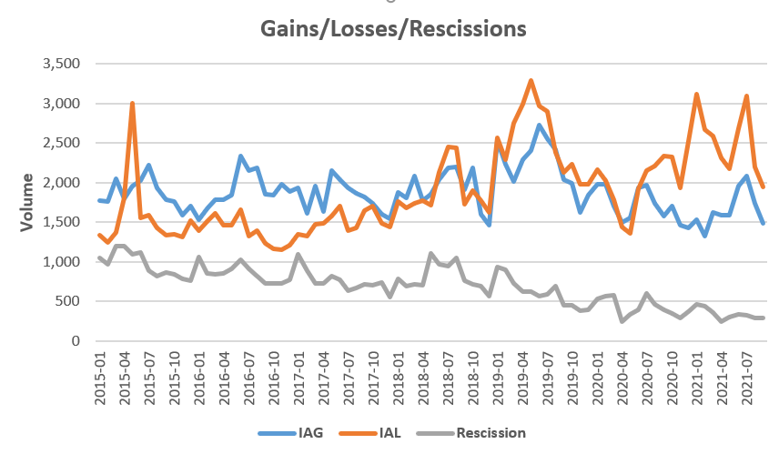
TDTMS
Monthly IAG Report (July 2021)

Slide 5
TDTMS
Teams worked off-line to review proposed unexecutable reasons to be placed in drop-downs for the following subtypes:
Missing Enrollment Transactions
Usage & Billing – Missing
Usage & Billing – Dispute
AMS LSE Missing
AMS LSE Dispute
MarkeTrak - Unexecutable Reasons
Responsible market participant would have the following choices when unexecuting any of the above subtypes:
Select the unexecutable reason from the drop-down choices ---OR---
Comments would be required BEFORE the MarkeTrak could be transitioned back to the submitter

Slide 6
TDTMS
Next Meeting – December 8th, Wednesday @ 1:30 WebEx
On the Agenda:
System instances and MarkeTrak Monthly Performance Review
Status of proposed SCRs and RMGRRs
MarkeTrak Upgrade status
SCR817 – MT Validation Revisions – common list of Unexecutable Reasons
Goals 2022/Accomplishments 2021

