Slide 1
Market Credit Working Group update to the Wholesale Market Subcommittee
Brenden Sager, Austin Energy, Chair
Seth Cochran, DC Energy, Vice Chair
1 Dec 2021

Slide 2
MCWG update to WMS
General Update
11 Nov 2021 Joint MCWG/CWG WEBEX Meeting
Six NPRRs reviewed for their credit impacts
Four considered having no credit impacts
1091NPRR Changes to Address Market Impacts of Additional Non-Spin Procurement.
1101NPRR Create Non-Spin Deployment Groups made up of Generation Resources Providing Off-Line Non-Spinning Reserve and Load Resources that are Not Controllable Load Resources Providing Non-Spinning Reserve.
1105NPRR Option to Deploy Distribution Voltage Reduction Measures Prior to Energy Emergency Alert (EEA).
1106NPRR Deployment of Emergency Response Service (ERS) Prior to Declaration of Energy Emergency Alert (EEA).

Slide 3
MCWG update to WMS
Two NPRR’s supported by the group
1103NPRR Securitization – PURA Subchapter M Default Charges.
The Credit WG believes this NPRR will provide positive credit impacts which established processes for assessment and collection of Default Charges and Default Escrow Deposits to Qualified Scheduling Entities (QSEs) and Congestion Revenue Right (CRR) Account Holders as reflected in the Debt Obligation Order (DOO) issued in PUCT Docket No. 52321, Subchapter M, of PURA.
1104NPRR As-Built Definition of Real Time Liability Extrapolated (RTLE).
This Nodal Protocol Revision Request (NPRR) corrects the definition of Real Time Liability Extrapolated (RTLE) to include market activity for Entities that have no Load or generation but have Real-Time exposure. It has come to ERCOT’s attention that the current definition of RTLE is erroneously tied to Qualified Scheduling Entities (QSEs) that represent Load or generation, and conflicts with the implementation of RTLE in ERCOT’s credit system
The Credit WG believes this NPRR will provide positive credit impacts and appropriately reflects forward risk, aligns protocol language with credit systems.

Slide 4
MCWG update to WMS
Continue to discuss NPRR 1067
Market Entry Qualifications, Continued Participation Requirements, and Credit Risk Assessment
Continuing discussion around PUL, uplift
Continuing discussion around FAF, forward adjustment factors
Above items will be reviewed in 2022
December 2021 meeting cancelled

Slide 5
MCWG update to WMS
Market-wide average TPE increased from $ 802.6 million in September to $ 826.17 million in October
TPE increased mainly due to higher Real-Time and Day-Ahead Settlement Point prices in October than in September
Discretionary Collateral is defined as Secured Collateral in excess of TPE,CRR Locked ACL and DAM Exposure
Average Discretionary Collateral decreased from $1,721.0 million to $1,562.1 million
The decrease in Discretionary Collateral is largely due to decrease in Secured Collateral, and increase in TPE
No unusual collateral call activity

Slide 6
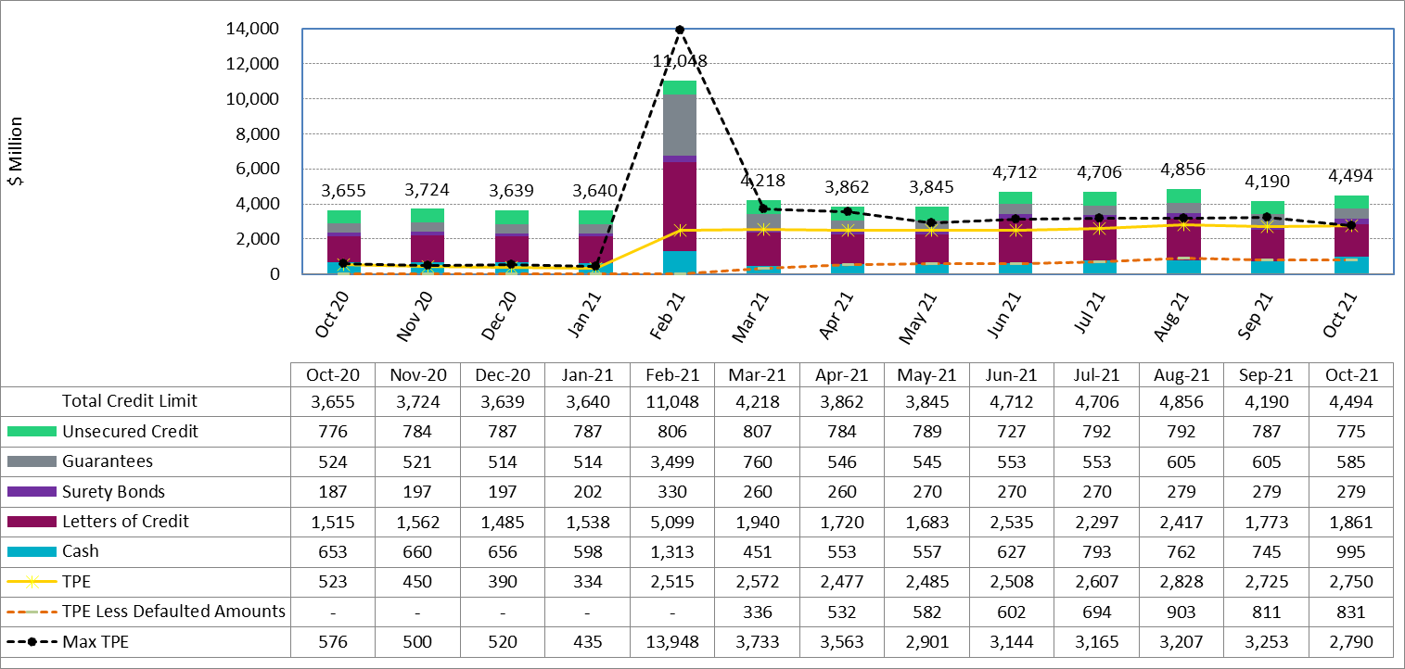
Collateral by Type vs TPE

Slide 7
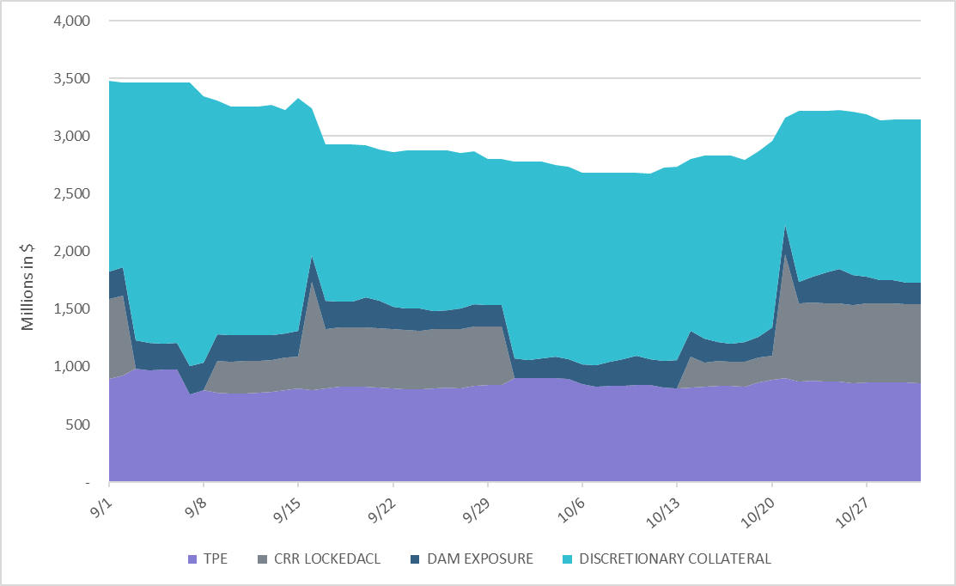
Discretionary Collateral

