Slide 1
PDCWG Report to ROS
Chair: Chad Mulholland, NRG
Vice Chair: Jimmy Jackson, CPS
ROS
December 02, 2021

Slide 2
Report Overview & Notes
Report Overview
Meeting Minutes
BAL-001-TRE-2 FMEs and IMFR
0 FME in the month of October
Frequency Control Report

Slide 3
Meeting Minutes
PDCWG Meeting 11/12/2021
ERCOT Ancillary Service Methodology Follow-up Discussion
Review of TAC emergency conditions list
Review NPRR1096
ERCOT reports

Slide 4
Frequency Measurable Events Performance

Slide 5
Frequency Measurable Events
There was 0 FME in October

Slide 6
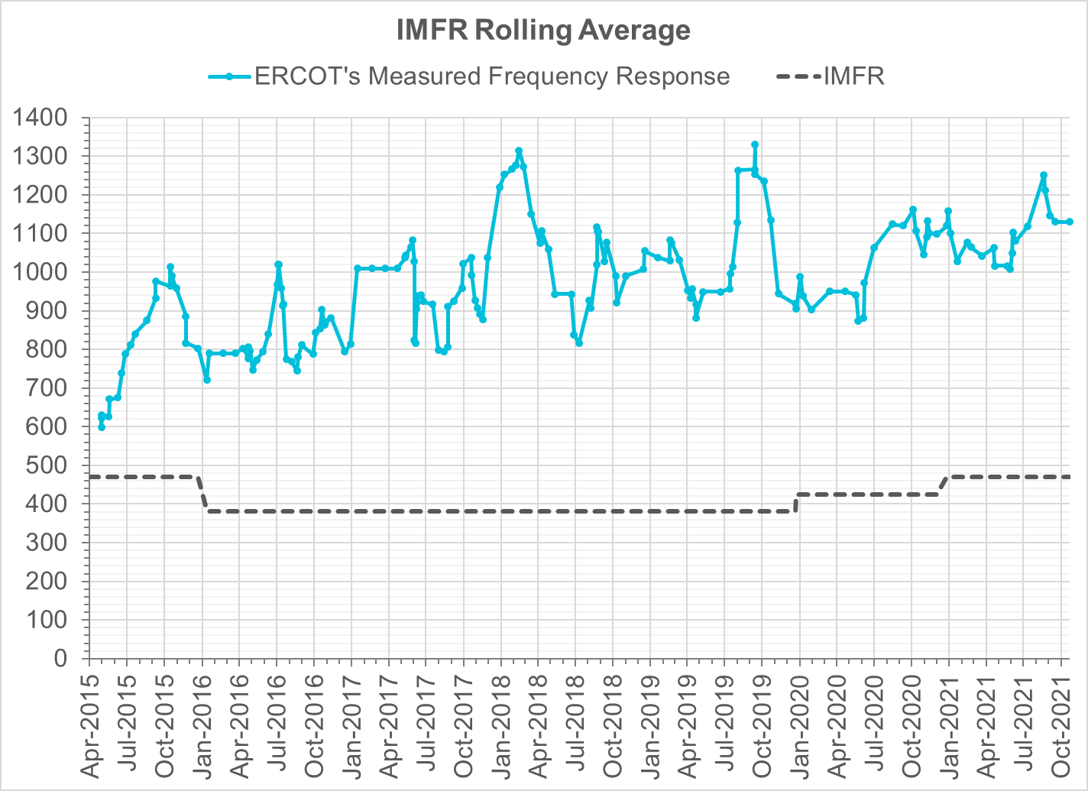
Interconnection Minimum Frequency Response (IMFR) Performance
IMFR Performance currently
1130.5 MW/0.1HZ
Frequency Response Obligation (FRO): 471 MW/0.1 Hz

Slide 7
Questions?

Slide 8
Frequency Control Report
October 2021

Slide 9
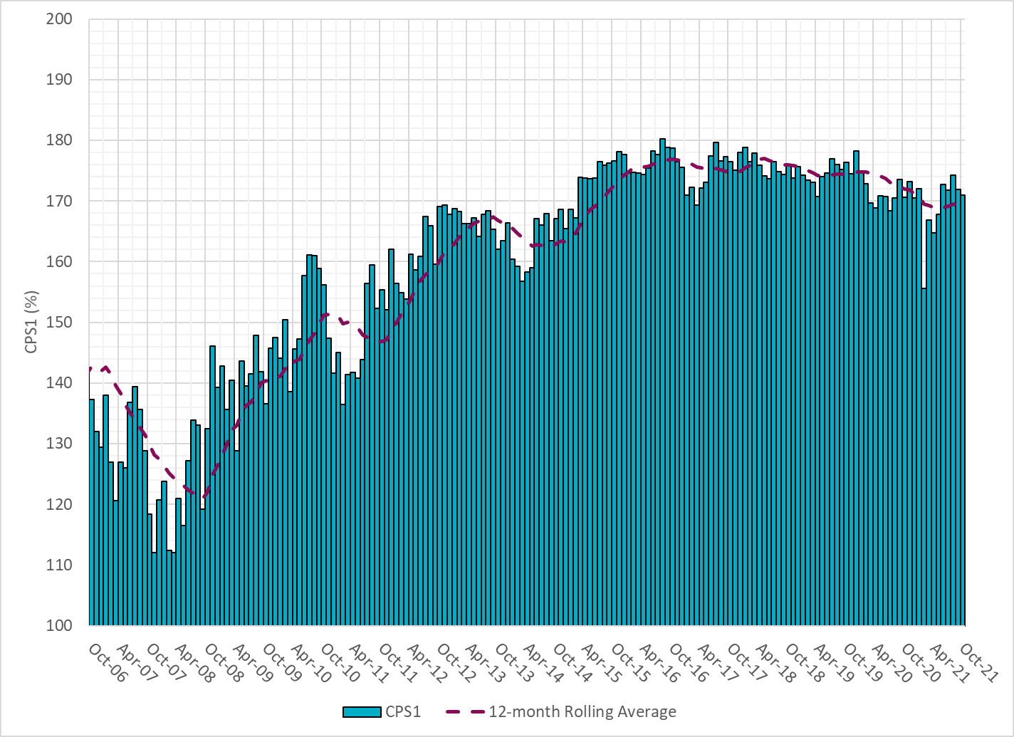
CPS1 Performance
Current 12-Month Rolling Average: 169.37%

Slide 10
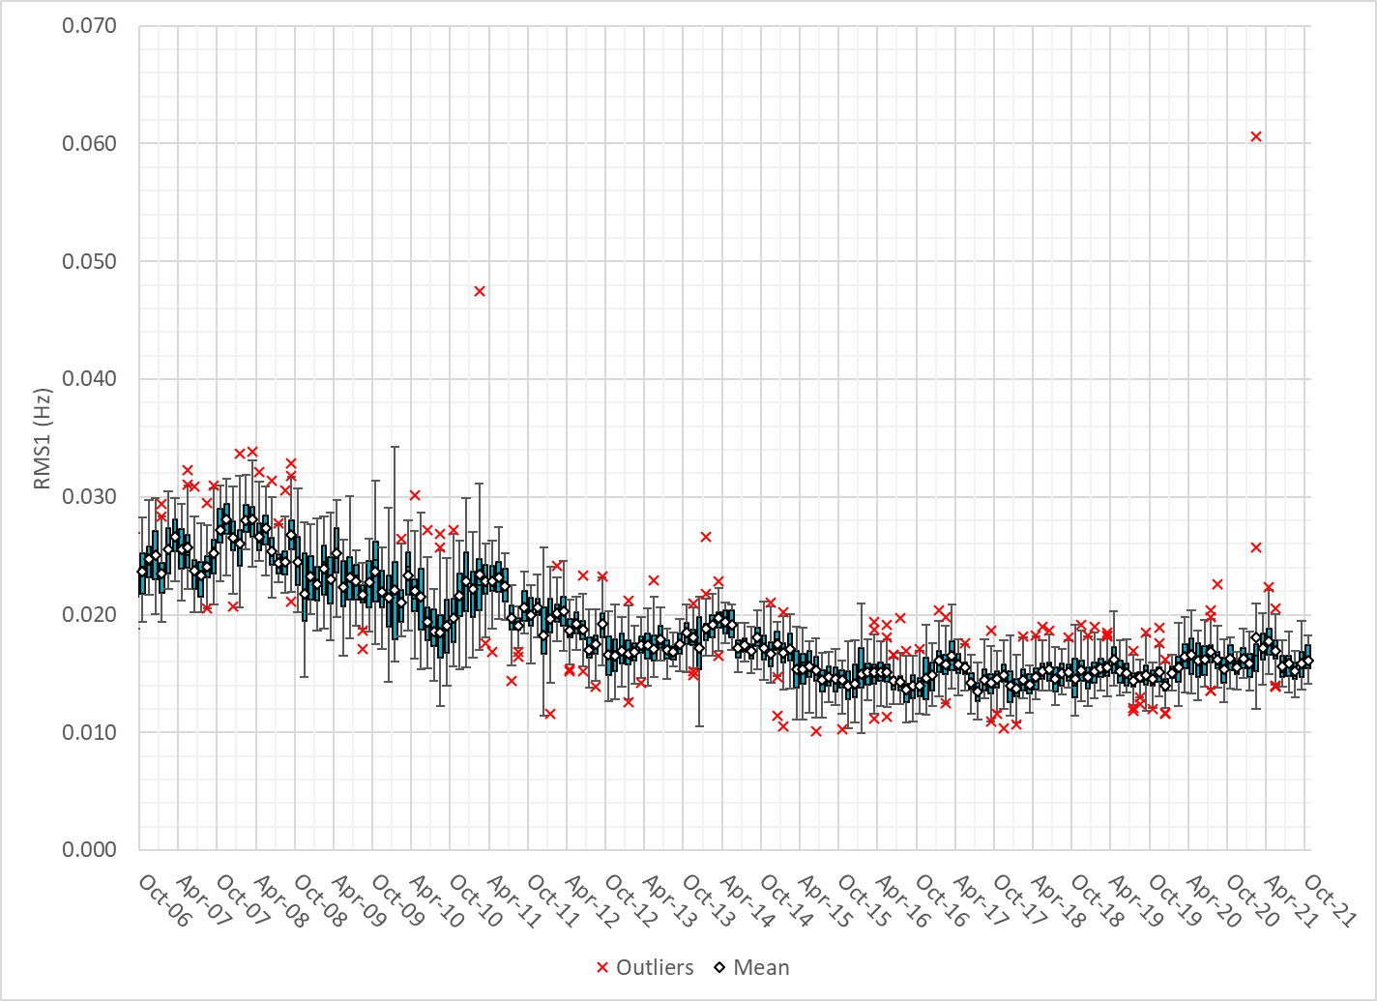
RMS1 Performance of ERCOT Frequency

Slide 11
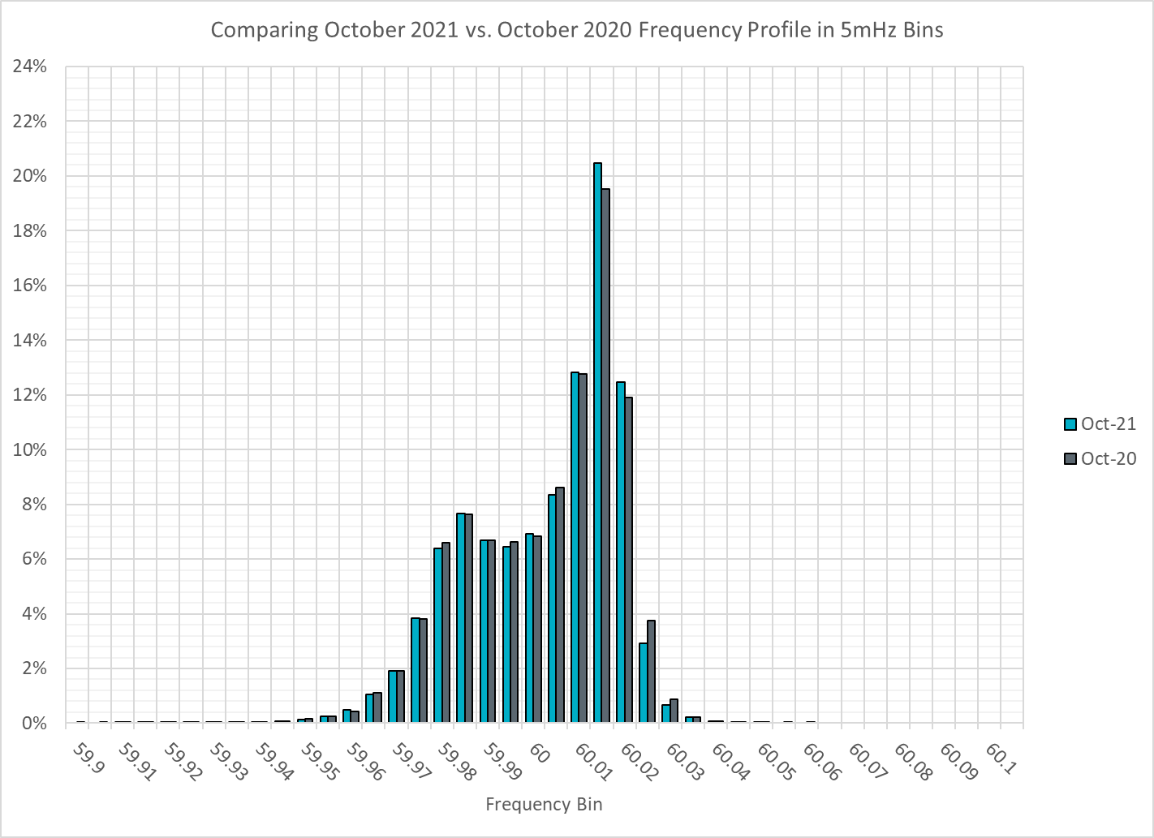
Frequency Profile Analysis

Slide 12
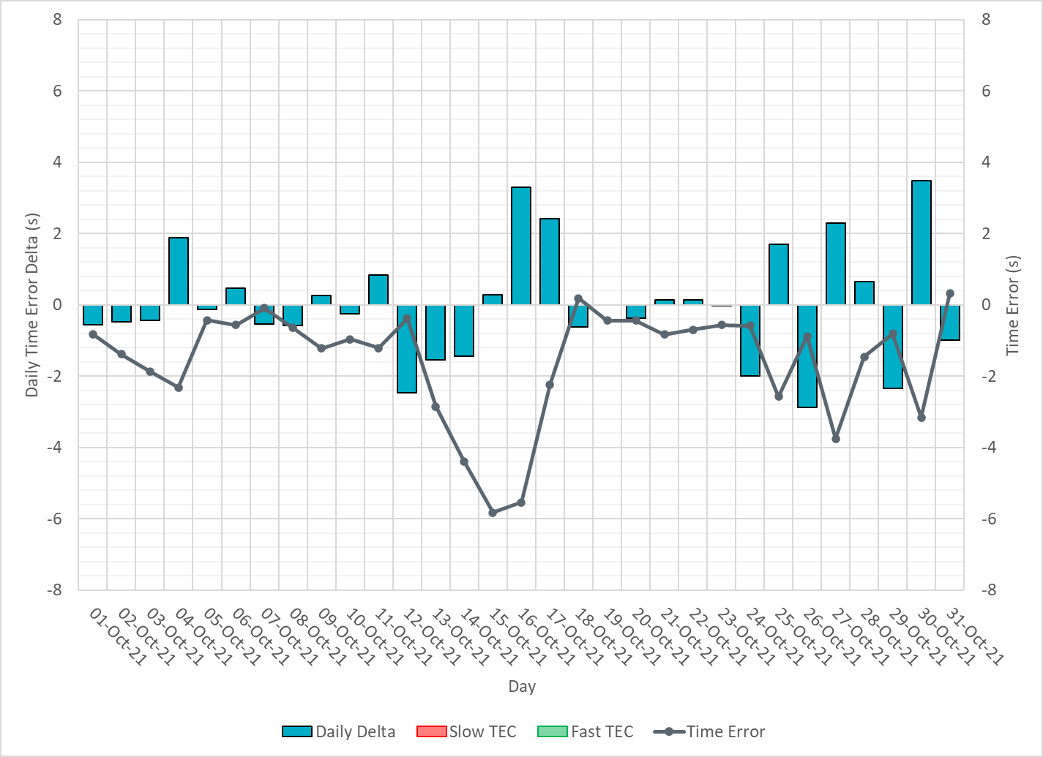
Time Error Corrections

Slide 13
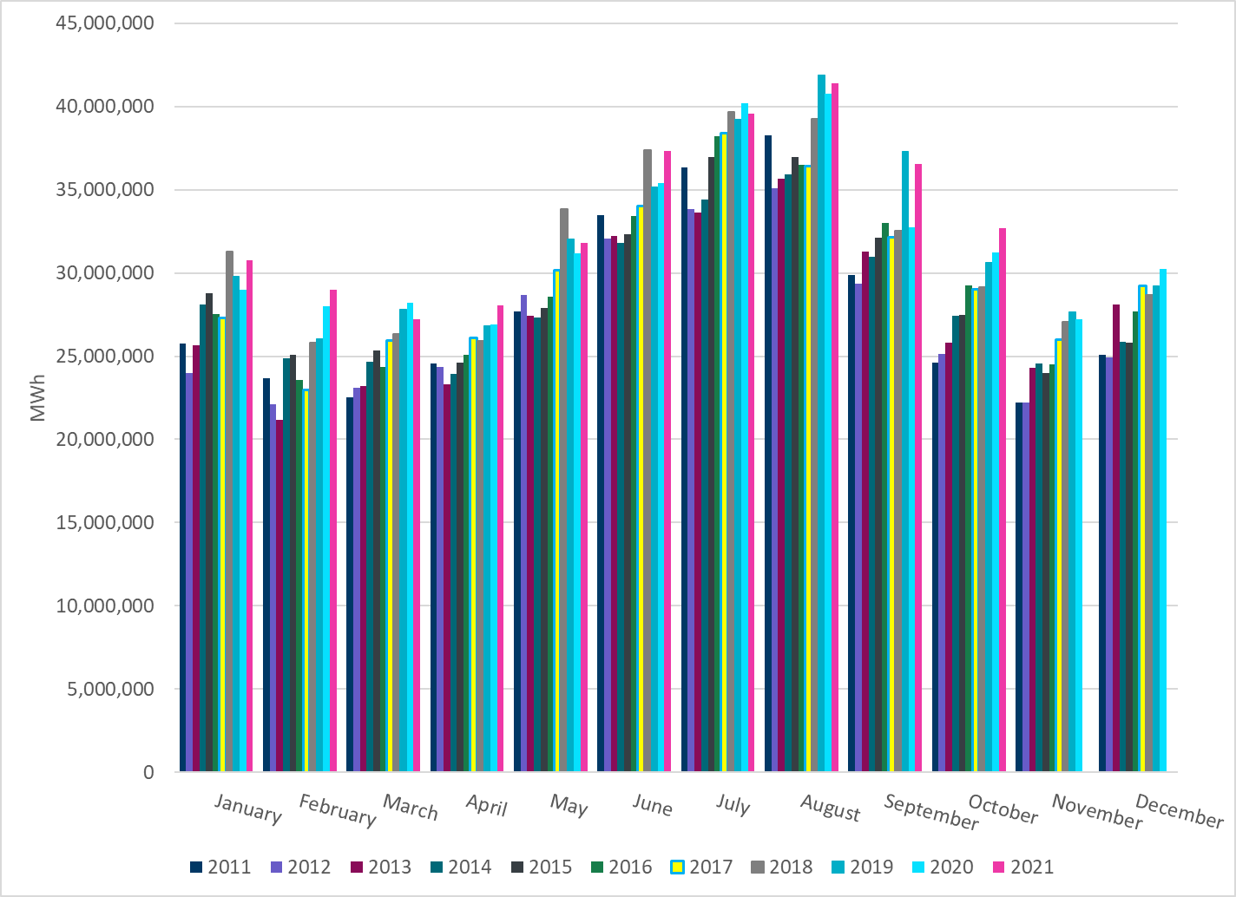
ERCOT Total Energy
Notes:
32,664,264MWh

Slide 14
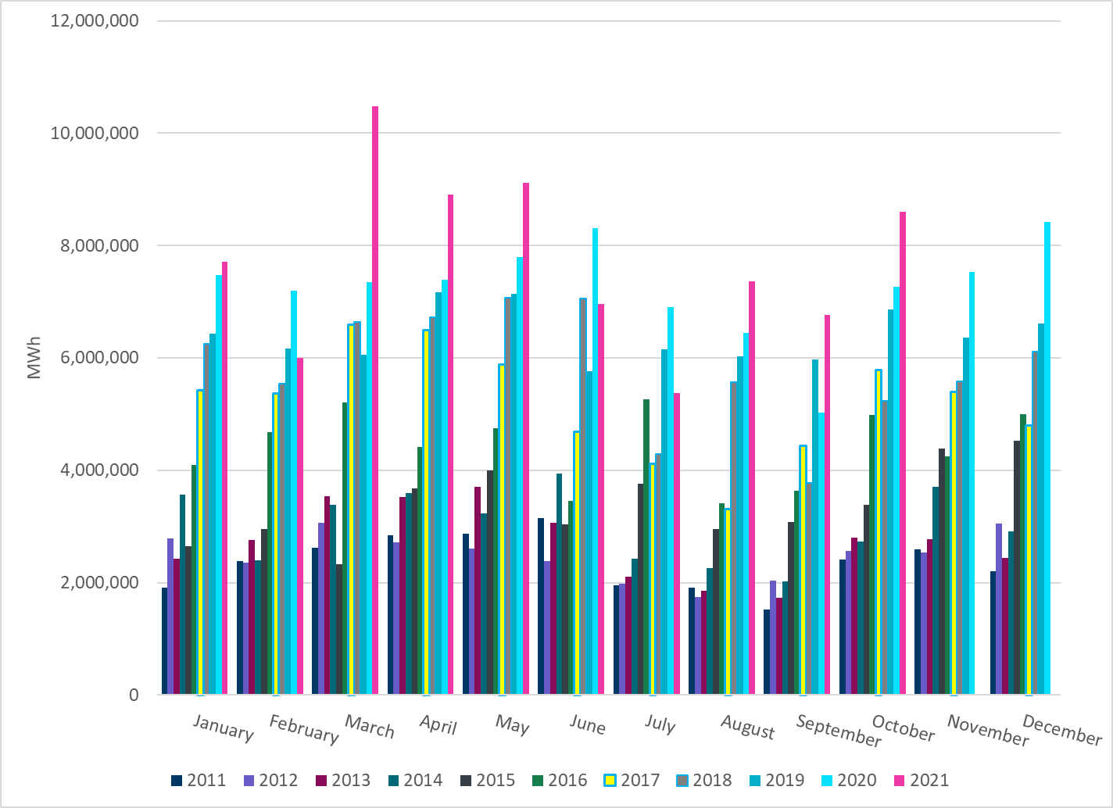
ERCOT Total Energy from Wind Generation
Notes:
8,604,573 MWh

Slide 15
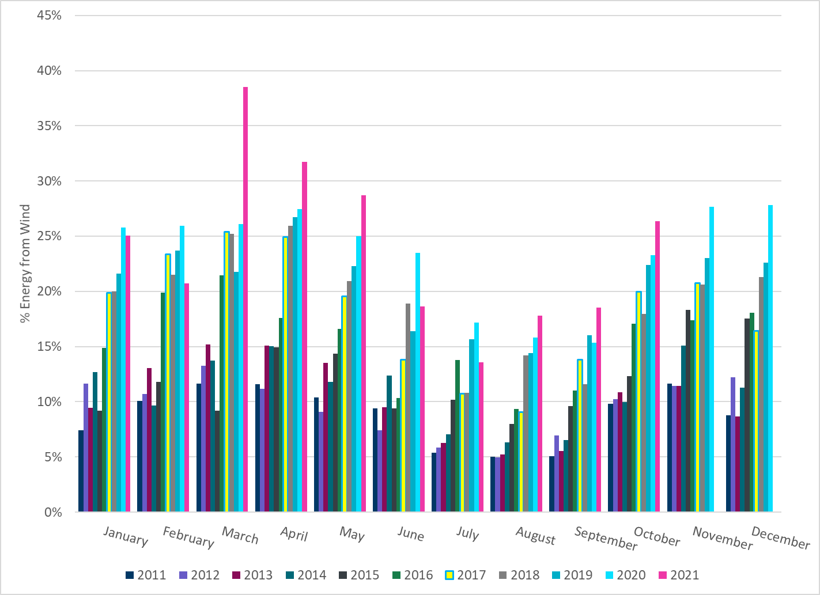
ERCOT % Energy from Wind Generation
Notes:
26.34%

Slide 16
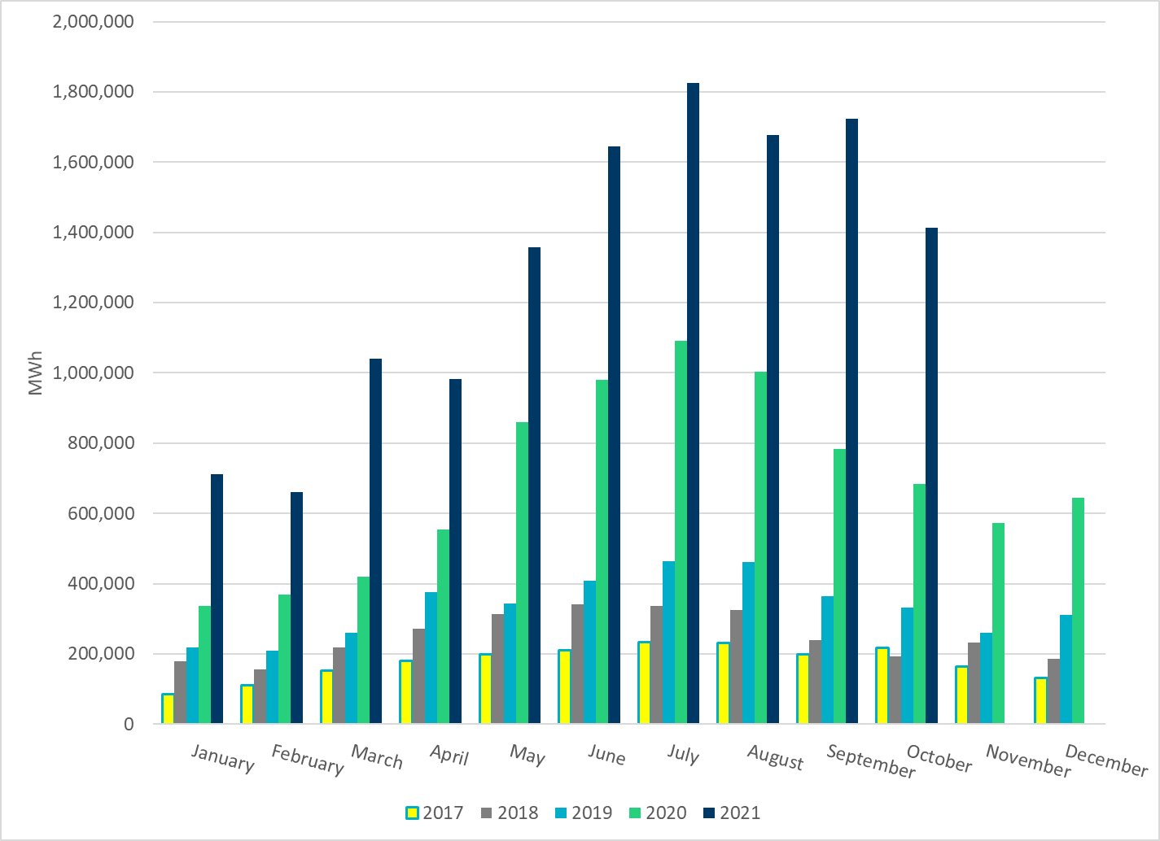
ERCOT Total Energy from Solar Generation
Notes:
1,414,241 MWh

Slide 17
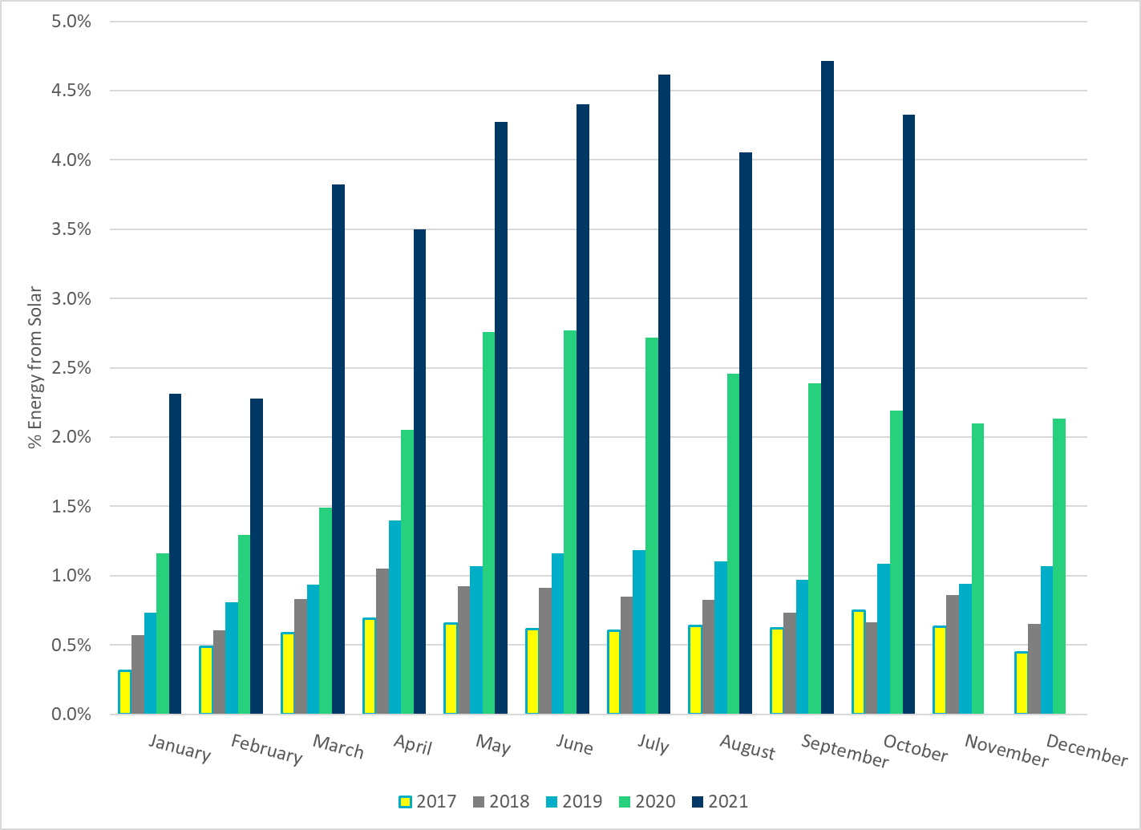
ERCOT % Energy from Solar Generation
Notes:
4.33%

