Slide 1
NPRR 649 Board Appeal
Koch Ag & Energy Solutions
February 9, 2016

Slide 2
Discussion Outline
Provide context regarding NPRR 649
What are HDL Overrides and how they impact Resources
Explain NPRR 649 and describe how it solves the issue of HDL Override
Illustrate how NPRR 649 is consistent with other similar situations addressed in the Protocols
Discuss some of the objections to NPRR 649
Conclusion

Slide 3
NPRR 649 Background
In November 2012, through the use of HDL overrides, ERCOT limited generation from the Odessa plant during a period of very high prices which caused significant financial losses for the plant.
Odessa initially filed a dispute and an ADR which were both denied by ERCOT. Odessa then filed an appeal with the PUCT which was ultimately settled.
ERCOT made a resettlement payment related to the opportunity cost to follow the instructions and agreed to submit NPRR 649 in order to prevent future ambiguity.

Slide 4
NPRR 649 Voting History
September 12, 2014 – Mandy Bauld and Chad Seely of ERCOT filed NPRR 649
Stakeholder working groups worked on this NPRR to achieve consensus and minimize cost
October 7, 2015 - Wholesale Market Subcommittee (WMS) unanimously voted to endorse NPRR 649 with all segments present
November 12, 2015 - Protocol Review Subcommittee (PRS) voted to endorse with only one opposing vote from the Consumer segment and one abstention from the IREP segment
November 19, 2015 TAC - NPRR 649 having received 56% of the votes in favor of the NPRR, failed to achieve the 67% support necessary for approval
December 7, 2015 - Koch filed this appeal to the ERCOT Board

Slide 5
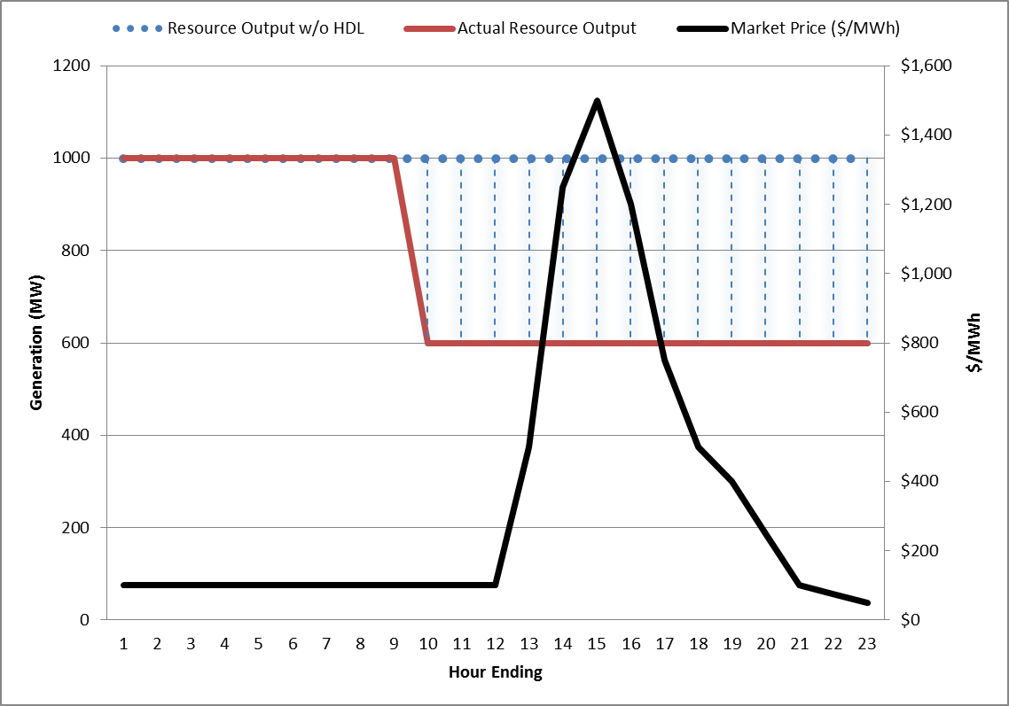
What are HDL Overrides
EXAMPLE
The main objective of an override is to achieve reliability
The Nodal Protocols were drafted under the assumption that there was no need for this type of instruction, but in practice, the ERCOT operators still need this type of tool to ensure grid reliability

Slide 6
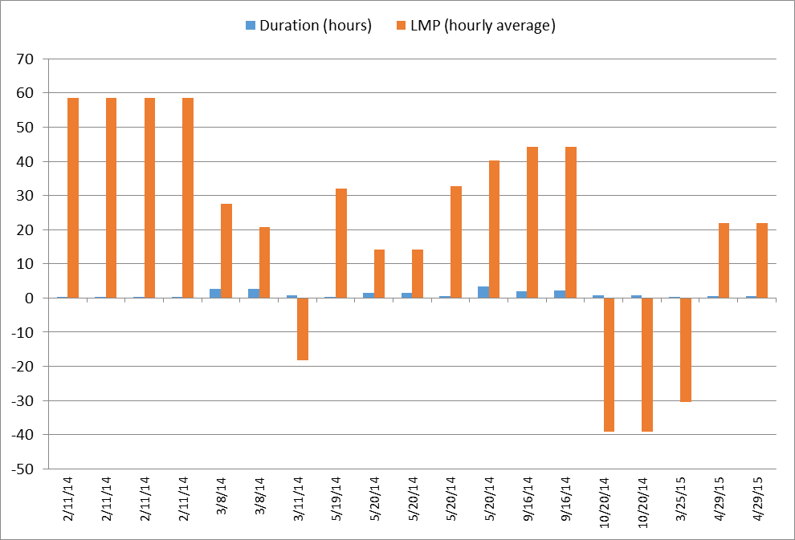
HDL overrides since January 2014
The impact of granting occasional HDL overrides would be insubstantial to the ERCOT system as a whole, but could be very meaningful to an individual Resource

Slide 7
NPRR 649 compensates resources when output is restricted
NPRR 649 ensures Resources that respond to reliability instructions are then compensated for any lost generation that would have been produced had the Resource’s output not been restricted.
To prevent overcompensation, the affected Resource’s offer curve is used to determine the output level that the Resource would have produced had it not received the HDL override.
Affected Resources will be required to file a dispute to receive compensation.
To keep costs under control, ERCOT will be required to post costs of overrides and mitigation suggestions to reduce the necessity for them.

Slide 8
Precedents within the Protocols for NPRR 649
Make-whole for out-of-merit reliability instructions is entirely consistent with existing Protocols
NPRR 649 is substantially the same as the existing Protocol Section 6.6.9 (4), which pays a Resource when instructed to generate ABOVE its economic level while NPRR 649 pays a Resource when instructed to generate BELOW its economic level
Examples within the Protocols where Resources instructed to operate at levels other than their economic level and receive compensation for providing these services include
6.6.3.7 Real-Time Make-Whole Payment for Exceptional Fuel Cost
6.6.6 Reliability Must-Run Settlement
6.6.7 Voltage Support Settlement
6.6.9 (1) Emergency Operations Settlement – Emergency Conditions or Watches
6.6.9 (2) Emergency Operations Settlement - Testing
6.6.9 (3) Emergency Operations Settlement - QSGR
6.6.9 (4) Emergency Operations Settlement – Base Points that are inconsistent with Real-Time Settlement Point Prices (RTSPP)
6.6.9 (5) Emergency Operations Settlement – SCED failure
Each example above uses the same methodology to charge for these services

Slide 9
Arguments against NPRR 649
Argument 1: A Resource could mitigate or eliminate any exposure if they do not offer into the DAM
Rebuttal: DAM Energy awards are not the only way a Resource incurs a future obligation. Bilateral energy trades in addition to obligations to perform under call options or tolling agreements, create responsibilities for Resources. Resources also use the CRR Market as a tool to hedge or mitigate congestion exposure. The length of the bilateral contracts varies greatly—one day to beyond ten years. Therefore, the ability to “turn off” this exposure is not as simple as withholding an offer in the DAM. Good market design should encourage participation in both centralized markets and forward bilateral markets, not discourage it.
Argument 2: A Resource should be paid for the first day of harm, but not subsequent days
Rebuttal: First, this argument assumes that ERCOT’s operational plans are public and that the Resource can determine how long the overrides will continue. Second, contracts, involving CRRs, bilateral trades, call options, and tolling agreements, often obligate Resources to perform for days or even years; in many cases these cannot be “bought back”. Failure to generate at desired levels can leave Resources exposed. Resources cannot “adjust operations” without financial impacts, often exceeding the actual harm the override causes.
Argument 3: A Resource should only be paid “actual harm”, not “opportunity cost”
Rebuttal: For good reasons, opportunity costs have been consistently viewed as actual costs in the Protocols. Opportunity costs are also known as “resources lost”, and if ignored in a make-whole, the override would merely be a taking. The Resource owner should be allowed to participate in any available market to sell their power without fear of any financial loss due to potential HDL overrides.
Argument 4: Cost Allocation
Rebuttal: Cost allocation is consistent with other charge types in the Protocols where direct assignment is not possible.

Slide 10
Conclusion
As long as ERCOT continues to need out-of-merit reliability tools, NPRR 649 must be implemented to prevent financial losses when complying with ERCOT’s instructions.
If NPRR 649 is not implemented, ERCOT must stop using HDL overrides. Failure of the ERCOT Board to approve NPRR 649 represents a risk to a single-market segment that cannot be hedged, managed, or mitigated.
This risk has serious and negative consequences for the entire market as resources will shy away from forward transactions that drive financing and investment in new resources.
Koch supports ERCOT’s claim that it needs HDL overrides for reliability reasons, and therefore requests the ERCOT Board to approve NPRR 649.

