Slide 1
Texas Retail Market
Testing
Flight 0219
Market Participant
Retail Testing Orientation

Slide 2
Agenda
Business Requirements for Entering Test Flight
Flight Overview
Retail Testing Website Overview
Texas SET
Scripts Overview
TDSP Issues Experienced
Retail Testing Requirements and Expectations
Timeline Review and Next Steps

Slide 3

Business Requirements for Entering Test Flight

Slide 4
Entering Test Flight
How do I sign up to participate in Flight 0219?
  New LSE
  Current MPs
  Additional DUNS for Certified REP
What are the business requirements I must fulfill before entering the test flight?

Slide 5
Signing up for Flight 0219: New LSEs
New LSEs that wish to sign up for Flight 0219 must complete ALL of the following by Flight Deadline:
Wednesday, January 16, 2019 - 5:00 p.m. CPT
Submit LSE Application
    Application can be found online:
    http://www.ercot.com/services/rq/lse
    QSE Designation must be made prior to production
      Note – QSE must be Qualified/Certified by ERCOT
    Application requires a DUNS number (www.dnb.com)
    Please note that proper registration of your company must be on file at the Texas Secretary of State office in order for your ERCOT LSE application to be accepted (http://www.sos.state.tx.us/).

Slide 6
Signing up for Flight 0219: New LSEs
Submit $500 LSE Application Fee
File for REP Certification with PUCT (not required for MOU/EC)
    Send the PUCT docket number to: RetailMarketTesting@ercot.com
Complete and submit a Testing Worksheet (TW)
    TW located on the Texas Retail Testing Website
      (https://etod.ercot.com)
Notify ERCOT of intent to test via email
    Notification must include company legal name and DUNS
    E-mail must be sent directly from the Authorized Representative as designated on the LSE application
    Send notification e-mail to: RetailMarketTesting@ercot.com

Slide 7
Signing up for Flight 0219: New LSEs
Additional DUNS for Certified REP please note:
If a decision is made to add a DUNS for a Certified REP (DUNS or DUNS plus 4), this new entity is considered a new LSE from a business perspective
  The new LSE must follow the “New LSE” steps for signing up for Flight 0219
From a testing perspective, there are ad-hoc truncated testing tracks available under certain circumstances.

Slide 8

Signing up for Flight 0219: Current LSEs
Current LSEs will be required to test if they are entering new service territories, testing additional business functionality, changing banking information, changing their service provider, or adding another entity to their business umbrella.

Slide 9
Signing up for Flight 0219: Current LSEs
To sign up for Flight 0219, a current LSE must complete the following by Flight Deadline:
Wednesday, January 16, 2019 - 5:00 p.m. CPT
Adhoc Deadline (subject to Flight Administrator and TDSP approval) Friday, February 22, 2019
Submit UPDATED Testing Worksheet (TW)
    TW located on the Texas Retail Testing Website
      (https://etod.ercot.com)
Notify ERCOT of intent to test via email
    Notification must include company legal name, DUNS, and what the entity plans to test for
    E-mail must be sent directly from the Authorized Representative ERCOT currently has on file
    Send notification e-mail to: RetailMarketTesting@ercot.com

Slide 10

Registration Requirements
ERCOT Registration Requirements are defined in Protocol Section 16: Registration and Qualification of MPs
  http://www.ercot.com/mktrules/nprotocols/current
ERCOT Registration Requirements must be fulfilled prior to a Market Participant receiving their Retail Qualification letter and migrating to production.

Slide 11

LSE Registration Requirements
New Load Serving Entity (LSE) Registration Requirements:
LSE Application Completed
    Executed Standard Form Agreement
    QSE Designation
      Note – QSE must be qualified/certified by ERCOT
LSE Application Fee Received
PUCT Certification Issued (not required for MOU/EC)

Slide 12
Flight Overview

Slide 13
Flight 0219 Test Participants
Existing CRs currently in the Market
  Some may be testing in new TDSP territories or for new functionality
Existing TDSPs
  Some may be testing new CR relationships
ERCOT
  Testing any new CR/TDSP relationships or new CR functionality
CRs new to the Market
  Testing full Flight using ‘NEW’ Track

Slide 14
How Do We Move Forward?
Days – MPs and ERCOT are required to complete their daily activities as outlined in the testing scripts.
Critical Dates – Scripts are marked with several critical dates that must be met for specific Business Rules to be tested successfully.

Slide 15
How Do We Move Forward?
Check Points – Check Points will exist throughout the market test. These check points exist to allow:
  The Flight Administrator to gauge where the market test is in relation to the flight timeline.
  Take necessary action to get the flight back on schedule.
Weekends – The Flight Administrator may elect to use weekends for testing in the event testing has fallen behind schedule.

Slide 16
Testing Tracks
and
Testing Relationships

Slide 17
Testing Tracks for V4.0 End-to-End Scripts
Track Names
  TX SET 4.0
  Connectivity Testing Scripts
  All New IOU CRs
  All New MOU/EC CRs
  All New IOU CSA CRs
  All New MOU/EC CSA CRs
  PUCT REP Certification Option 2 LSEs
  Existing CR – Changing Service Provider
  Existing CR – Changing Bank

Slide 18
Testing Tracks for V4.0 End-to-End Scripts
New IOU CR
  All New LSEs will execute all scripts in this track with at least one TDSP territory that the LSE is entering
New MOU/EC CR
  Any LSE who signed up to test with a MOU/EC TDSP will execute all scripts in this track with the MOU/EC TDSP
New IOU CSA CR
  New IOU CSA LSEs and existing LSEs wanting to add CSA functionality will test this track with ERCOT who will simulate the TDSP
New MOU/EC CSA CR
  New MOU/EC CSA LSEs and existing MOU/EC LSEs wanting to add CSA functionality in MOU/EC territories will test this track with the MOU/EC TDSP territory the LSE is entering

Slide 19
Testing Tracks for V4.0 End-to-End Scripts
PUCT REP Certification Option 2 LSEs
  LSEs who are PUCT REP Option 2 LSEs are only required to test this track within the Market
Changing Service Provider
  LSEs who are changing Service Providers will execute all scripts in the track with all TDSP territories in which the LSE is certified
Changing Bank
  LSEs who are changing Banks will execute all scripts in the track with all TDSP territories in which the LSE is certified

Slide 20
NAESB Connectivity Testing
All testing participants must test Connectivity using NAESB EDM v1.6
Everyone participating in Flight 0219 must test Connectivity with all trading partner relationships defined within your TW and ERCOT
When sending connectivity transactions, include the NAESB connectivity log in the notification email
After Connectivity is tested, any changes will require retesting before the start of the Flight

Slide 21
Testing Relationships
ERCOT has committed to providing the following information to the market:
  For all new LSEs and TDSPs in the market, ERCOT will provide the testing relationship list by Friday, January 18, 2019.
  These lists will be sent to the Primary Testing, Secondary Testing, and Primary Business contact for each LSE and each TDSP that is listed on the Testing Worksheet (TW)

Slide 22
Testing Relationships
If a Market Participant has issues with the testing relationships, issues must be communicated back to ERCOT by 5:00 p.m. on Monday, January 21, 2019.
ERCOT will contact each party who has issues and work towards resolving the issue.
Checklists will be created after the final testing relationships lists are delivered to the Market Participants.

Slide 23
What Happens If I Don’t Meet Flight Checkpoints/Tasks?
Weekly conference call with the Flight Administrator
Escalation procedures to executive management at the MP, ERCOT, and possibly the PUCT
MP may be requested to work overtime and/or weekends to catch up
MP may be asked to start the script over at a later time

Slide 24
Pre-Testing Preparation
Review ERCOT Protocols, Solution to Stacking documentation, Texas Market Test Plan, TDSP Tariffs, and the Terms and Conditions
Review the TX SET V4.0 Implementation Guides
  These often contain additional information on the business processes
Market Participants must establish banking relationships prior to the Connectivity Kick-Off call
Review Flight 0219 Pre-Testing Timeline

Slide 25
Pre-Testing Preparation
Review all test scripts within your test tracks
Contact ERCOT and/or Texas SET working group when you have questions
If you have a service provider, coordinate your testing activities in advance
When utilizing a service provider for Flight Testing, the testing process between the MP and the service provider must be representative of their production environments

Slide 26
The Testing Process
Preparation – Review test scripts for your testing track(s)
Kickoff and Weekly Conference Calls(as needed)
Connectivity Testing
“Penny Test”
Sending and Receiving Transactions
Script Days, and Business Days

Slide 27

Conference Calls
Teleconferences as needed
  Attendance is Required
  Roll Call
  Mute when not talking
  Avoid cell phones
  Calls begin promptly
Conference calls will be held as needed. The Flight Administrator or a person designated by the Flight Administrator will facilitate the call. In the event the Flight Administrator finds it necessary, a follow-up call will be scheduled for later that day or early the next day before 10:00 a.m. CPT.

Slide 28

Testing Contacts
Market Participants must provide the following Testing Contacts on the Testing Worksheet (TW)
    Primary & Secondary Testing Contact
    Primary & Secondary Business Contact – MUST be an employee of the Market Participant company
    Emergency Contact
    Executive Contact

Slide 29

Testing Contacts
Market Participants must provide the following Testing Contacts on the Testing Worksheet (TW): (Continued)
    Treasury Contact
    Primary & Secondary
    Connectivity Contacts
    Encryption Contact
    TW contacts should be updated as MP contact information changes

Slide 30

Retail Testing Website
Your One Stop Shop for Retail Market Testing!

Slide 31

This Site Contains…
Texas Market Test Plan (TMTP)
Pre-testing activities schedule for V4.0 Flight testing
Testing Scripts – End to End
Testing Contacts
Conference Call Agendas/ Meeting Notes
Testing Worksheet (TW)
Flight Test Checklists
File Cabinet – various documents and archived files

Slide 32

Login Information
        Retail Testing Website
        https://etod.ercot.com
Internet Explorer Must be used to be able to access all parts of the Testing Website. Compatibility Mode Must be used.
Many of the sections are password protected
To obtain your own logon, send an email to: RetailMarketTesting@ercot.com
You will receive your username and password to access everything you will need on the website

Slide 33

Testing Worksheet
The Testing Worksheet (TW) provides valuable information to testing participants such as:
  Company Information
  Contact Information
  Testing Information
  Connectivity Information
  EDI Specifications Information

Slide 34
New or Existing TW?
To create a New TW means that your entity has never created a TW in the past
To update an Existing TW indicates that you have previously created a TW
  Update means only what you are requesting to test in this Flight
  This is not an all-inclusive list for your entity. The updates are only those for which you are testing in this Flight

Slide 35
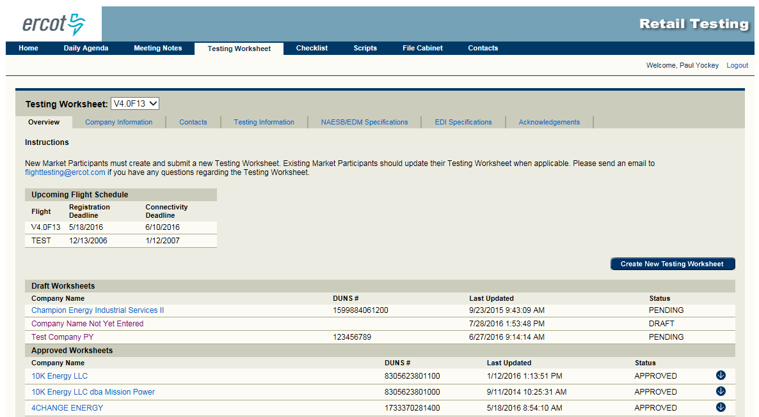
New MPs create a new TW
Current MPs update existing TW

Slide 36
Delete Button - TW
The Delete button, which appears on any of the tabs contained within the Testing Worksheet, is a functional delete option.
That means if you select the Delete button, the information will disappear from your view; however, ERCOT still stores the data which was contained within your saved TW at the time of the delete.
If you delete your TW by accident, you may contact ERCOT and we can recover your TW for you.
Please note – the Delete function deletes your entire TW, not just the information appearing within that tab.

Slide 37
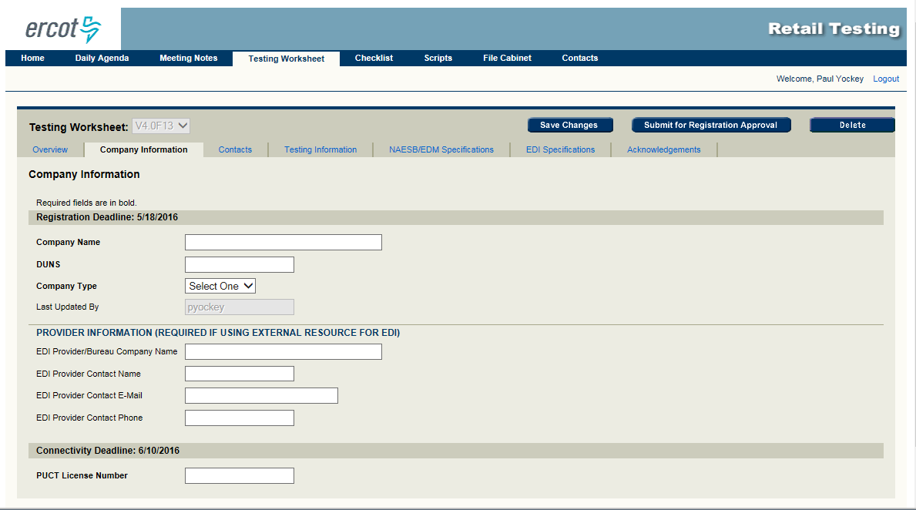
Delete Button

Slide 38
Options
What is the difference between Service Order/Outage Options and PUCT REP Certification Options on the TW?

Slide 39
IOU Service Order & Outage Options
More Information on the Service Order and Outage Options can be found in the Standard Terms & Conditions:
www.puc.state.tx.us
Select Industry
Select Rates and Tariffs (under “Electric”)
Select Transmission and Distribution Rates
for Investor Owned Utilities (IOU)

Slide 40
IOU Service Order & Outage Options
Option 1 – LSE may direct Retail Customers to call the LSE for such reporting or requests and electronically forward outage information to the TDSP
Option 2 – LSE may direct Retail Customers to call the LSE for such reporting or requests and then forward the call to the TDSP
Option 3 – LSE may direct Retail Customers to directly call TDSP to make such reports or requests

Slide 41
MOU/EC Service Order & Outage Options
Option 1 –
Unless otherwise agreed to by LSE and MOU/EC TDSP, the LSE will direct Retail Customers to call or contact the MOU/EC TDSP directly to report outages, interruptions, irregularities, and/or to make service requests.
The LSE will provide Retail Customers with a toll-free number supplied by the MOU/EC TDSP for purposes of such reporting.

Slide 42
MOU/EC Service Order & Outage Options
Alternatively, and only with the mutual consent of LSE and MOU/EC TDSP, one of the following options can be selected:
Option 2 – Retail Customers will be directed to call the LSE to report outages, interruptions, irregularities, and/or service requests. The LSE will then electronically forward such information to MOU/EC TDSP
Option 3 – Retail Customers will be directed to call the LSE to report outages, interruptions, irregularities, and/or service requests. The LSE will then forward such calls to MOU/EC TDSP

Slide 43
PUCT REP Certification Options
Option 1 – REPs defining their service area by geography
Option 2 – REPs defining their service area by customers
  Option 2 LSEs that serve only their own load such as power plants may qualify as an Option 2 REP when they file for their PUCT REP certification
  Option 2 LSEs would test with the TDSPs that provide wires service to their affected loads
  Please do not confuse this with Service Order Option 1, 2, or 3 and/or Outage Option 1, 2, or 3.

Slide 44
Options
Again……
What is the difference between Service Order/ Outage Options and PUCT REP Certification Options on the Testing Worksheet?
Service Order/ Outage Options refer to how the REP communicates with its customers and the TDSP with regard to service orders and outages
PUCT REP Certification Options refer to how the REP defines their service area: geographically or by customers they will serve

Slide 45
PUCT REP Certification Option 2 REPs Only
Scripts that must be executed
  I-BANK01 (Payment/Bank Script)
  ENR01 (MVI on Standard Meter ESI ID, usage, cycle bill)
  These Scripts are subject to change.

Slide 46
New TW Information
You may view your new Testing Worksheet, but it must first be activated before others at your company may view it, and before it may be used for testing
To have your new TW activated, select the Submit for Registration Approval button from any tab within the Testing Worksheet
Changes to existing TWs may be viewed immediately

Slide 47
Texas SET Working Group
Evaluates market processes defined by ERCOT Protocols, other RMS Working Groups, and PUCT Rulemakings to establish testing requirements and materials necessary to validate those processes among Market Participants
Develops and maintains testing processes and related testing standards for the MPs directly involved in the testing process.

Slide 48
Texas Market Test Plan (TMTP)
The processes and procedures for testing are defined in the Texas Market Test Plan as follows:
https://etod.ercot.com
Select Texas Market Test Plan (TMTP)
or
www.ercot.com
Select Committees and Groups
Under Retail Market Subcommittee (RMS),
Select Texas SET WG
Under Key Documents, Select TMTP Document

Slide 49
Texas SET Participation
Participation in meetings allows your entity a chance to offer suggestions for improvement of the testing process
Continued participation is a valuable opportunity for your company to keep up to date on Market changes and upgrades

Slide 50
How Do I Sign Up For Mailing Lists?
Go to http://lists.ercot.com
If you have a ListServ password
  Select Log In
  Enter your email address and password
  Select Log In
If you do not have a ListServ password
  Select Log In
  Select the link, get a new LISTSERV password
  Enter your email address, password, verify your password
  Select Register Password
  A confirmation email will be sent to you
  Open the email and select the link within the email

Slide 51
How Do I Sign Up For Mailing Lists?
To Subscribe to a Mailing List
  Select Subscriber’s Corner tab
  Search Options, select Show All Lists from the drop down, click the search button
  A list of the mailing lists will appear
  Select the box next to the mailing list that you would like to subscribe to
  Select Subscribe from the drop down box. This box is located at the bottom of the screen
  Select Submit
Upon completion of these steps, you will receive emails from
LISTSSERV@LISTS.ERCOT.COM:

Slide 52
How Do I Sign Up For Mailing Lists?
To Unsubscribe to a Mailing List
  Select Subscriber’s Corner tab
  All mailing lists that you currently subscribe to will appear
  Select the box next to the mailing list that you would like to unsubscribe to
  Select Unsubscribe from the drop down box. This box is located at the bottom of the screen
  Select Submit
Upon completion of these steps, you will receive emails from
LISTSSERV@LISTS.ERCOT.COM:

Slide 53
ERCOT Meeting Calendar
A link to Market meetings and meeting material may be found as follows:
www.ercot.com
Select View Calendar
Select the Month of the Meeting
Select the link for the Market meeting

Slide 54
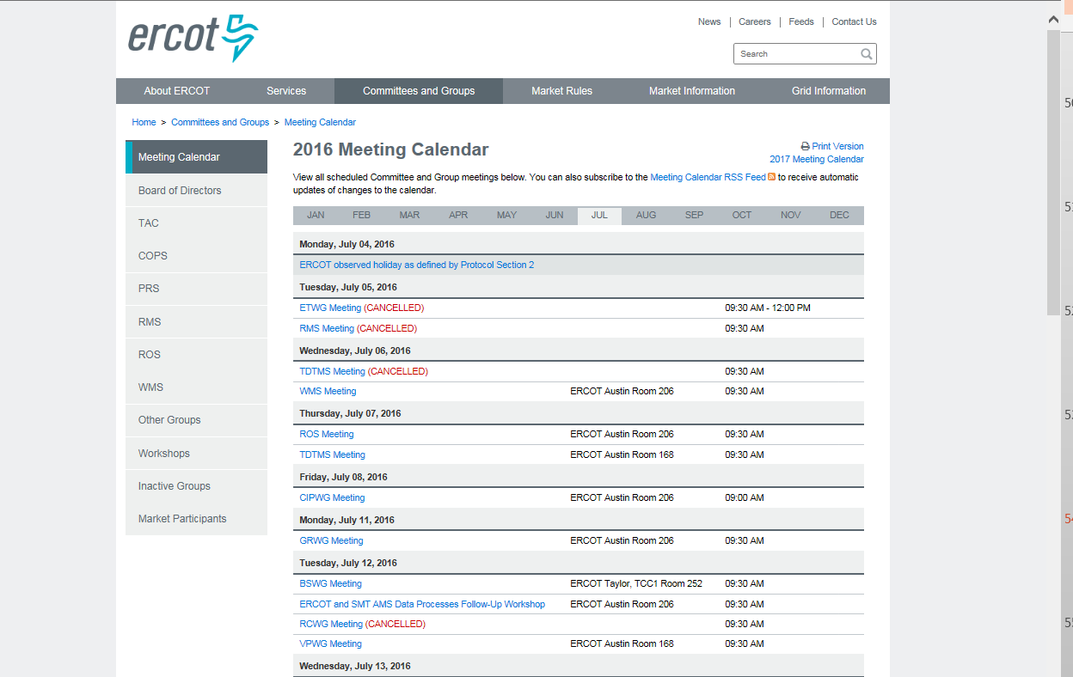
Meeting Agendas and Notes/Minutes
Prior to attending a meeting, individuals may review the meeting agenda and supporting documents from the ERCOT Calendar.

Slide 55

A Final Note…
Texas SET is the forum for testing standards and testing issue resolution by Market Participants
      REMEMBER!
Input from every Market Participant is vital; not only to the success of the individual company, but also to the success of the Market as a whole.

Slide 56
Scripts Overview

Slide 57
Scripts Approach
Script tasks are delineated by Day and are designed to mimic production business processes
Business Processes or Transaction Lifecycles can be tracked by color or by Lifecycle number
Transactions that close a business process scenario will be the color of the lifecycle they are closing
Initiating transactions must be sent on the Day required by the script
Market Participants should not hold response transactions unless the script specifies that the transactions be held

Slide 58
TX SET V4.0
All documents related to the TX SET V4.0 can be found at:
www.ercot.com
Select Market Rules
Select Market Guides
Select Texas SET Guides
Select Current Texas SET Implementation Guides

Slide 59

Texas Retail Testing Requirements and Expectations

Slide 60
Methodology
Highlights of script methodology
Some scripts use simulated LSEs with testing LSEs to execute required functionality
Not all scripts carry through to billing
When possible, contingencies are built into the scripts in the event a MP falls behind and is required to retest
  NOTE: This does not apply to all scripts
Failure to consistently meet checkpoints will result in escalation to Executive Contacts

Slide 61
Retail Qualification letters
Upon notification to Retail Client Services from the Flight Administrator, New Market Participants will receive their ERCOT Retail Qualification letter when they have successfully completed testing and met all Registration requirements
Existing Market Participants testing new TDSP territories, new business functionality, and/or adding an additional DUNS will receive their ERCOT Retail Qualification letter upon completion of the Flight.
Market Participants testing for Change of Service Provider or Change of Bank will not receive an ERCOT Retail Qualification letter upon completion of the Flight.

Slide 62

Testing to Production Checklist
Please refer to the Testing to Production Checklist for Production requirements.
The Testing to Production Checklist will advise your entity of the next steps that must be taken to enter into Production with ERCOT and your Trading Partners (TDSPs)
www.ercot.com
Select Services
Select Registration and Qualification
Select Load Serving Entities
Select the Texas Retail Market Testing and latest test flight link
Under Key Documents

Slide 63

Testing to Production Transition
REMINDER:
A Qualified Scheduling Entity (QSE) must be
designated as part of the completion for your LSE
Application.

Slide 64

Training Opportunities
Information regarding Training Opportunities offered by ERCOT may be found as follows:
www.ercot.com
Select Services
Select Training
Select Course Catalog
Select the link of the Training Opportunities
you are interested in

Slide 65
Training Opportunities
The link allows you to:
  View currently offered training classes
  Register for training classes
  Withdraw from training classes
A user name and password are required to register for the classes
You may create an account if you do not already have a Login
The Login allows only that individual to sign up for the class

Slide 66

Training Documentation
You may obtain copies of training presentations through the ERCOT website as follows:
www.ercot.com
Select Services
Select Training
Select Course Catalog
Select the course name
Select the Materials tab

