Slide 1
Regulation Bias Analysis Post SCR-773
Oct 2021
ERCOT
Operations Planning
PDCWG | Nov 12th, 2021

Slide 2
Discussion Points
Current GTBD Parameters & References
Metric to measure Regulation bias and performance
Regulation Deployed comparison for last three months.
Total Regulation (net) Deployed Comparison
Regulation Deployed 15-minute interval comparison by each hour for 2018, 2019, and 2020 months
Regulation Exhaustion Rate
Regulation bias for consecutive 5-min SCED intervals
Time Error & Contributing Factors
Summary

Slide 3
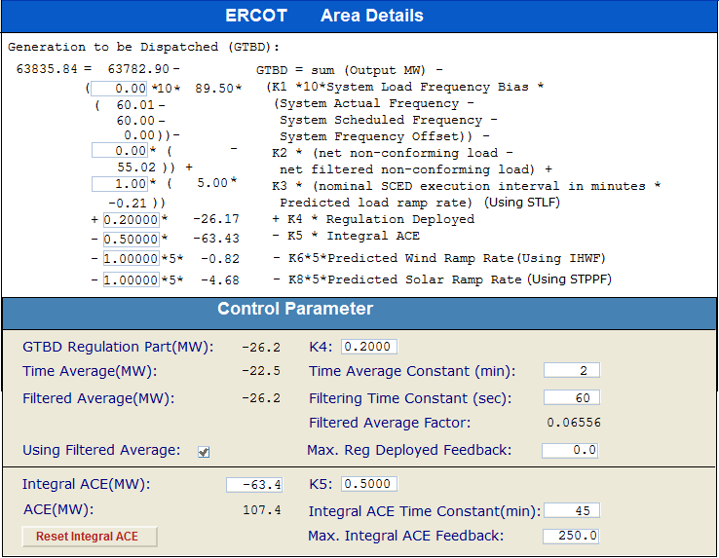
Current GTBD Parameters
Notes:
3/12/18 – Integral ACE Time Constant Changed from 60 min to 45 min
5/17/18 – K4 Changed from 0.3 to 0.2 and K5 Changed from 0.4 to 0.5
12/4/18 – 10:05 AM – K6 Changed from 0 to 0.5
2/12/19 – 2:15 PM – K6 changed from 0.5 to 1.0
3/12/19 – 2:10 PM – PWRR Threshold from 10 to 15 MW/min
3/19/19 – 2:15 PM – PWRR Threshold from 15 to 20 MW/min
4/01/19 – 10:00 AM – K5 changed from 0.5 to 0.4 and Max. Integral ACE Feedback changed from 250 to 150
4/24/19 – 1:15 PM – Max. Integral ACE Feedback changed from 150 to 160. PWRR Threshold changed from 20 to 25.
5/22/19 – 1:10 PM – K5 changed from 0.4 to 0.5, Max Integral ACE feedback changed from 160 to 200, PWRR Threshold changed from 25 to 30
6/17/20 – 10 AM - PWRR Calculation method changed from Direct to Interpolated
9/1/20 – 11 AM - Max Integral ACE Feedback changed from 200 to 250
9/3/20 – 3 PM - Max Integral ACE Feedback changed from 250 to 300
9/4/20 – 3 PM - Max Integral ACE Feedback changed from 300 to 250
6/1/21 – 10:00 AM – K8 Changed from 0 to 0.5, PSRR Threshold changed to 10
6/2/21 – 10:00 AM – PSRR Threshold changed from 10 to 20
6/3/21 – 10:00 AM – K8 Changed from 0.5 to 0.75
6/4/21 – 10:00 AM – K8 Changed from 0.75 to 1
9/2/21 – 10:00 AM – PSRR Threshold changed to 30

Slide 4
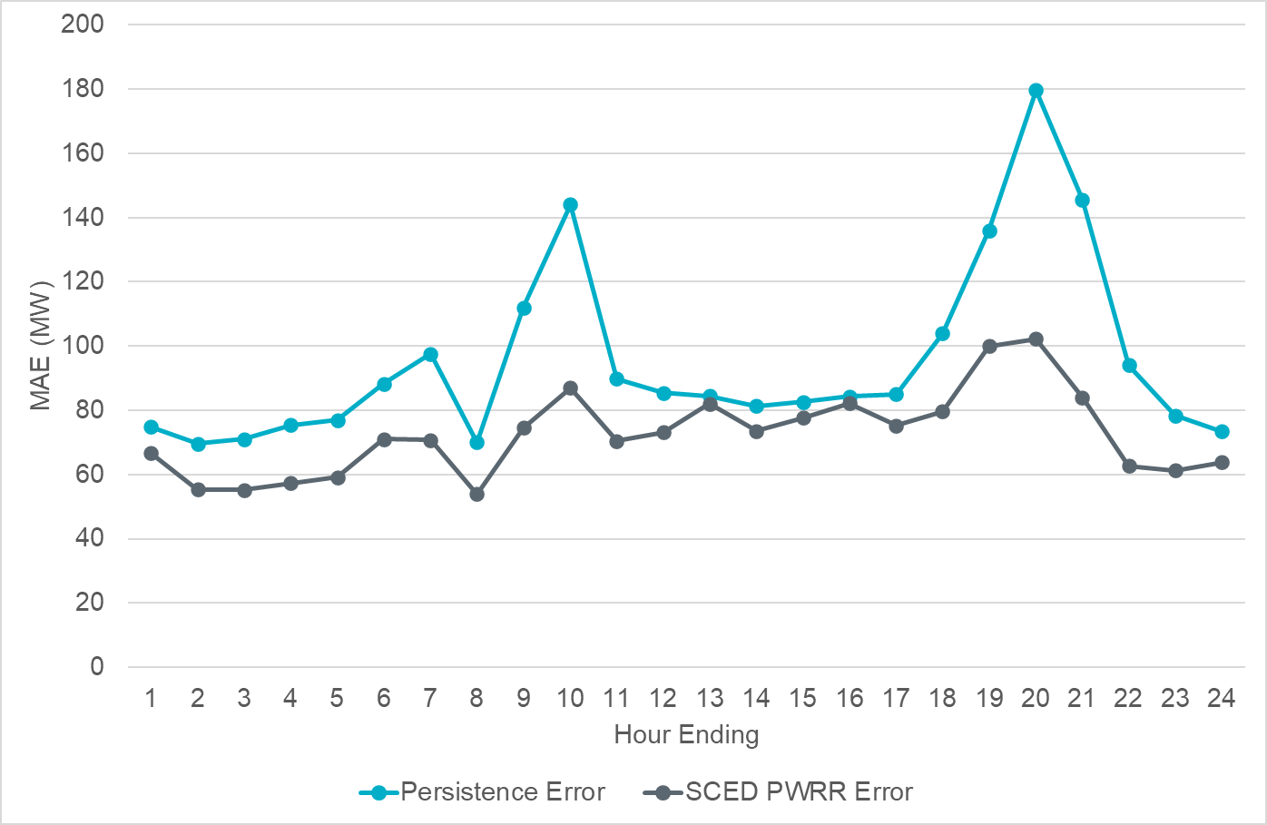
Projected Wind Ramp Rate MAE

Slide 5
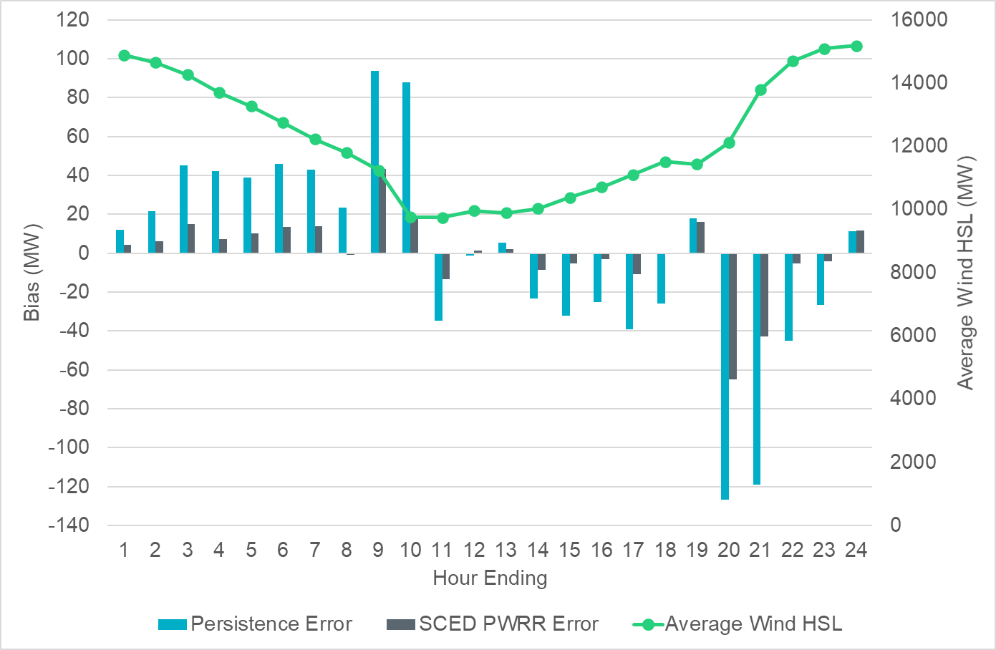
Projected Wind Ramp Rate Error

Slide 6
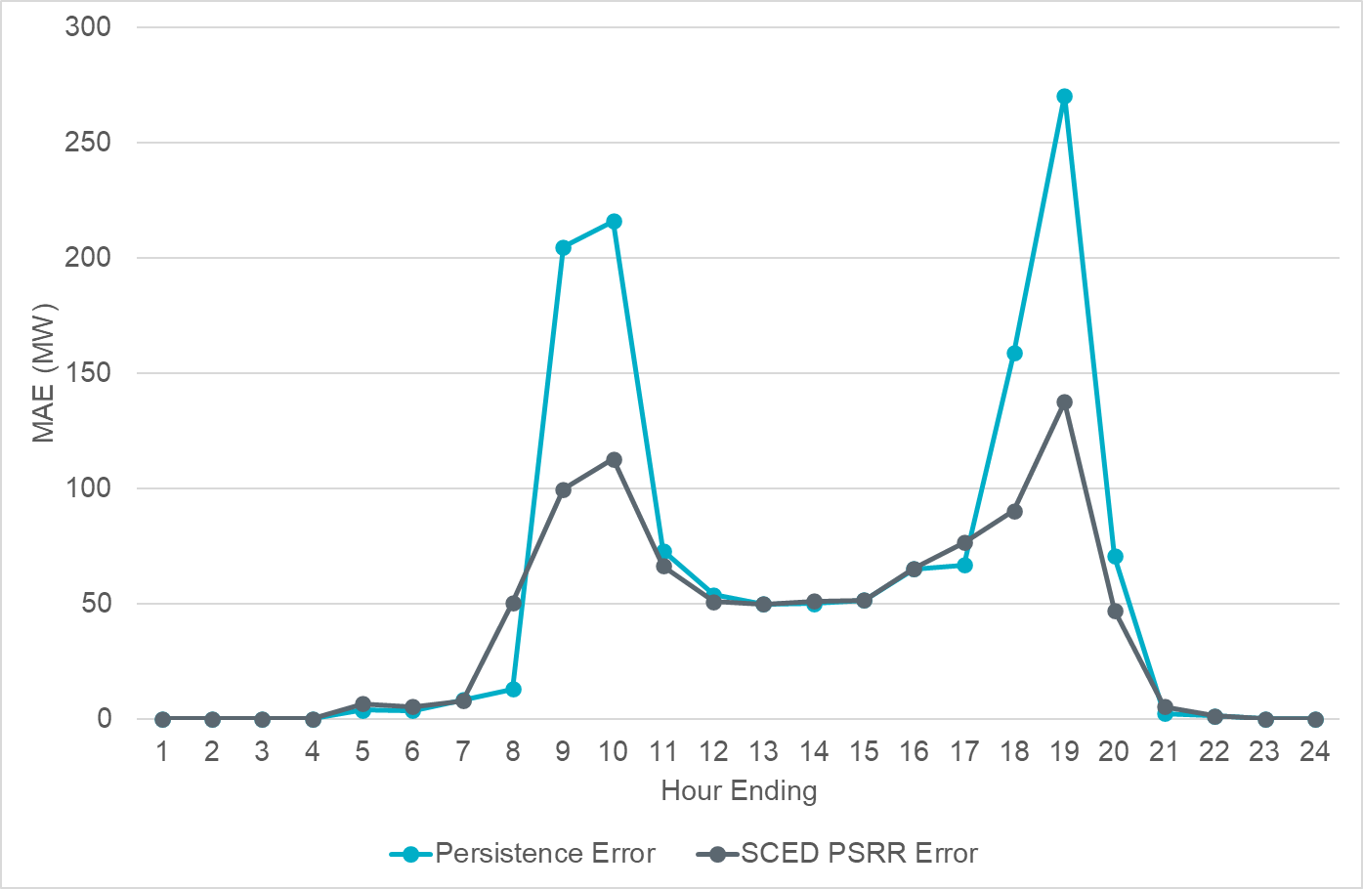
Projected Solar Ramp Rate MAE

Slide 7
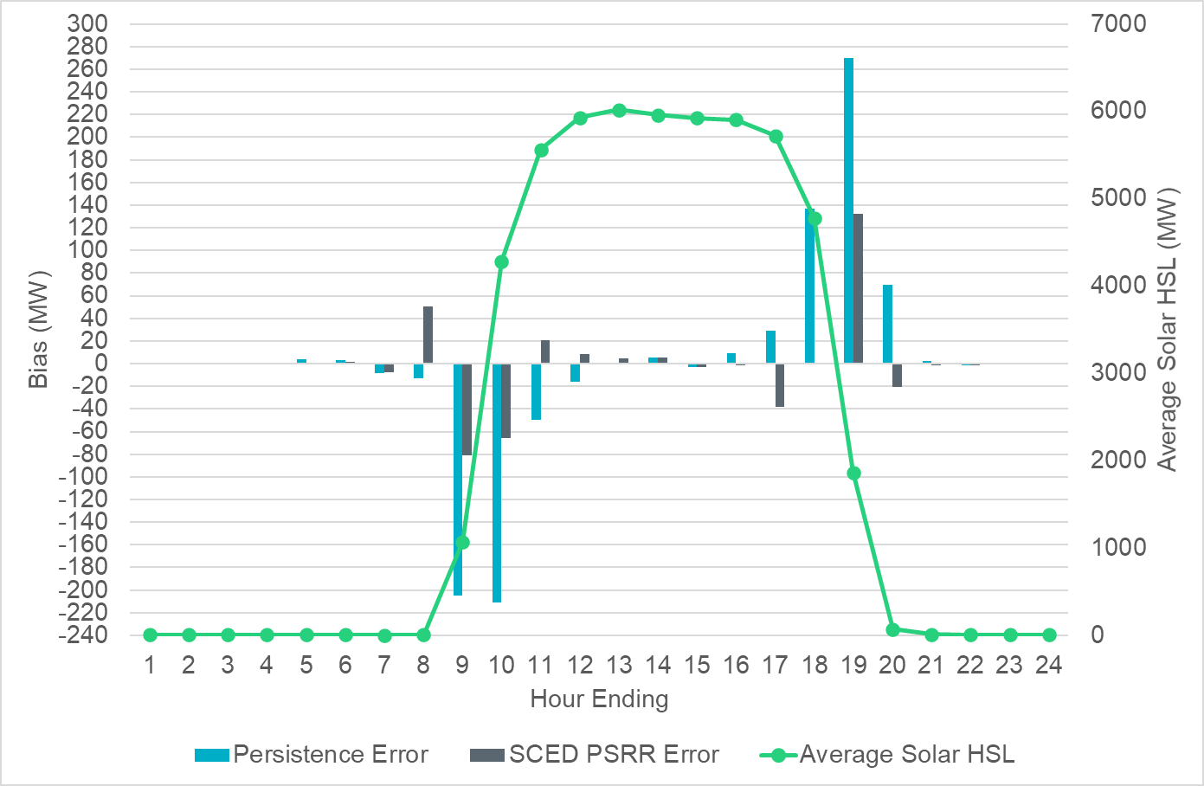
Projected Solar Ramp Rate Error

Slide 8
References

Slide 9
Metrics to Measure SCR-773 Performance
Trend and monitor the regulation deployed by hour.
Set target of 50 MW for total regulation deployed by hour for peak hours.
Set target of 85% for the number of intervals where regulation deployment was both up and down for peak hours.
Track the Regulation exhaustion rate for all hours (not to exceed 5%).
Using a 50MW filter, target 15 occurrences or less per month for regulation bias of six or more consecutive 5 minute intervals for peak hours.

Slide 10
Total Regulation Deployed Comparison
Total regulation deployed for the last three months.

Slide 11
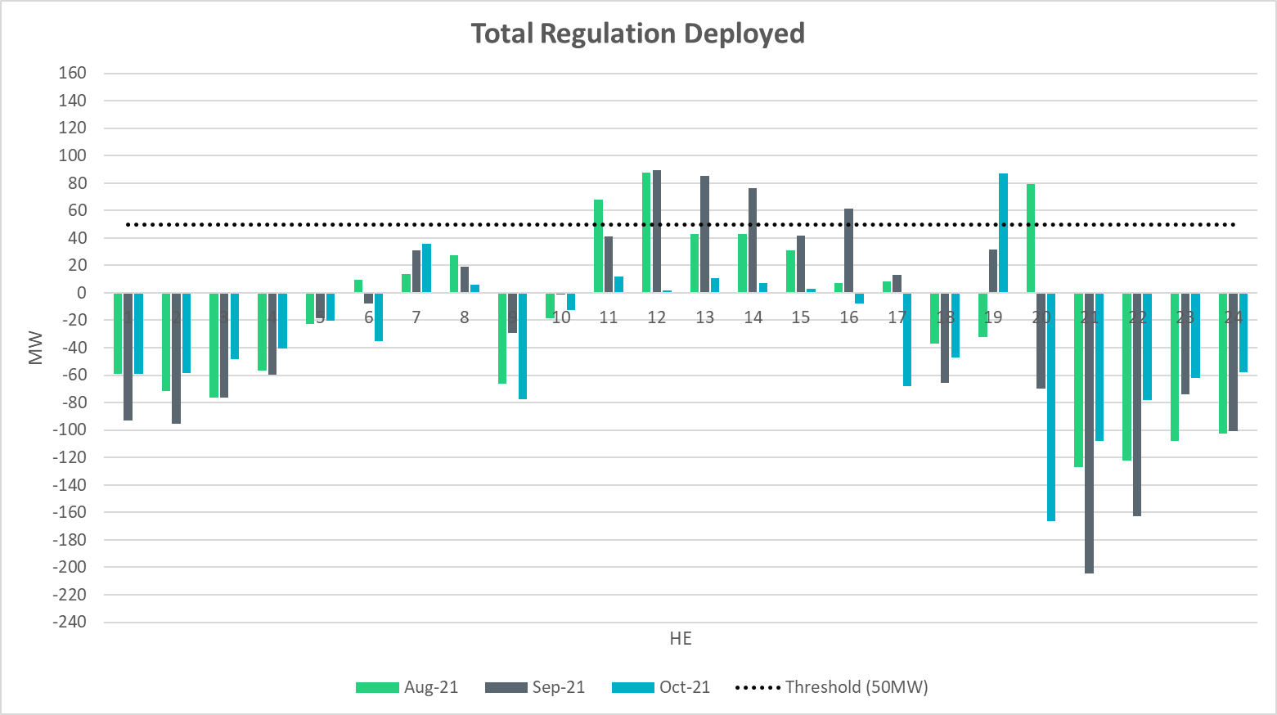
Total Regulation Deployed Comparison - Monthly

Slide 12
Metric 1: Regulation Deployed Comparisons
Trend and monitor the regulation deployed by hour.

Slide 13
Regulation Deployed Comparison

Slide 14
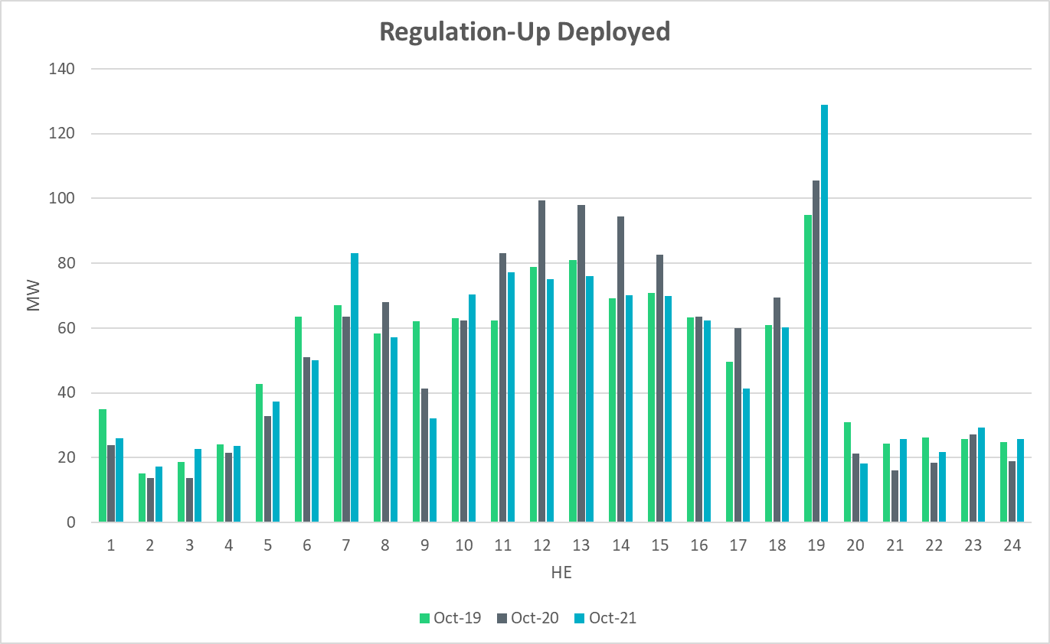
Regulation Deployed Comparison

Slide 15
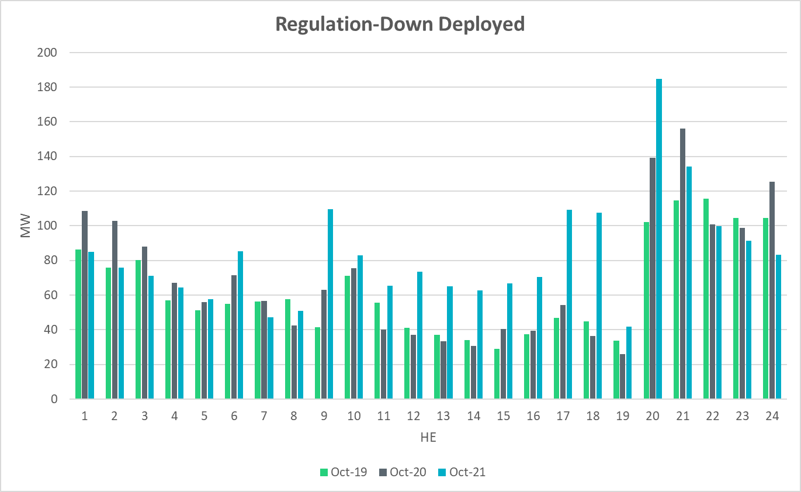
Regulation Deployed Comparison

Slide 16
Metric 2: Total Regulation Deployed Comparisons
Set target of 50MW for total regulation deployed by hour for peak hours.

Slide 17
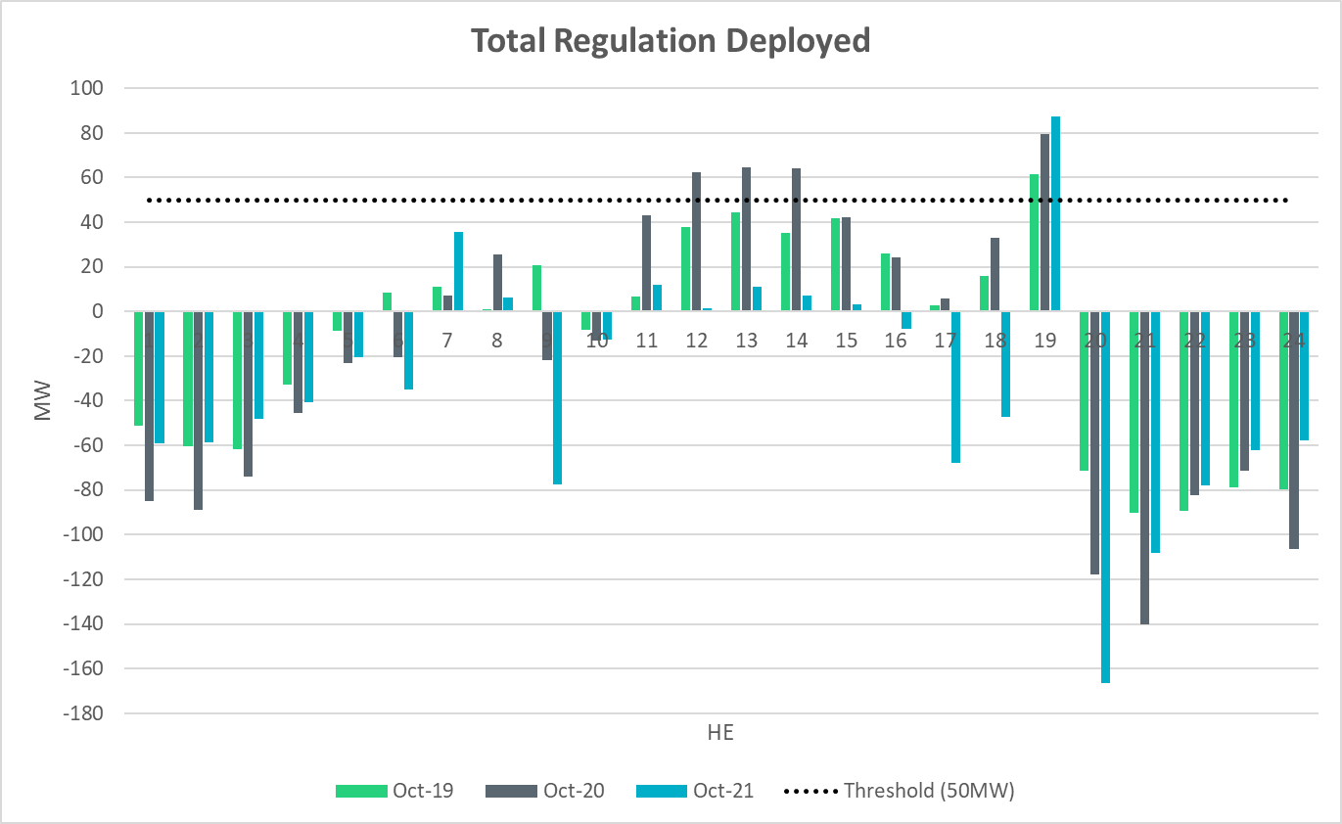
Total Regulation Deployed Comparison

Slide 18
Metric 3: 15-min Intervals Where Both REGUP/REGDN Were Deployed
Set target of 85% for the number of intervals where regulation deployment was both up and down.

Slide 19
“Zero” Crossing Regulation

Slide 20
“Zero” Crossing Regulation

Slide 21
Metric 4: Regulation Exhaustion Rate
Track the regulation exhaustion rate for all hours (not to exceed 5%.)

Slide 22
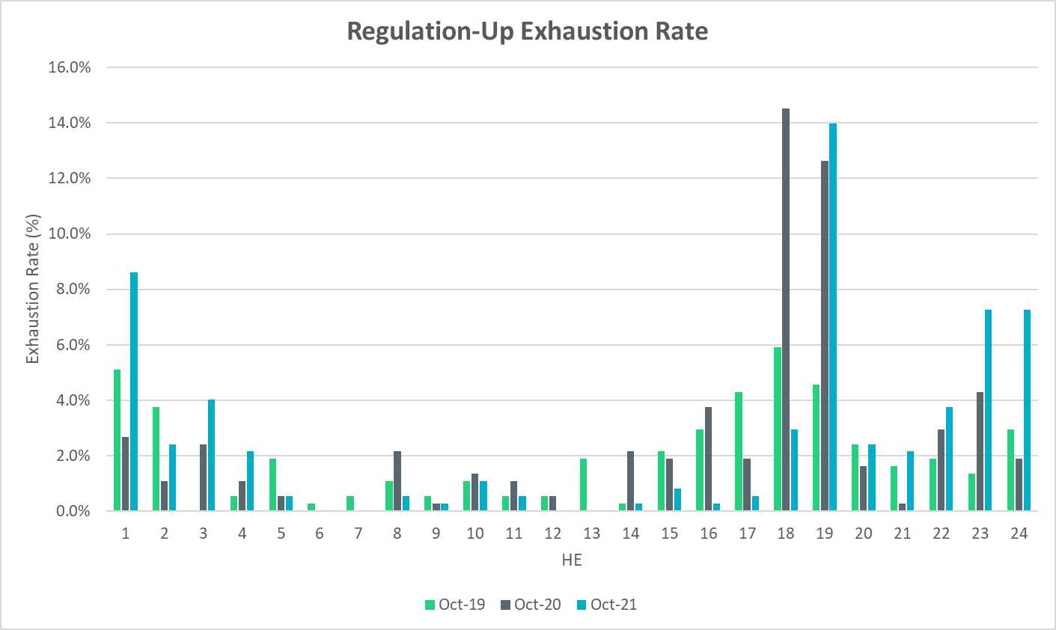
Regulation Exhaustion Rate

Slide 23
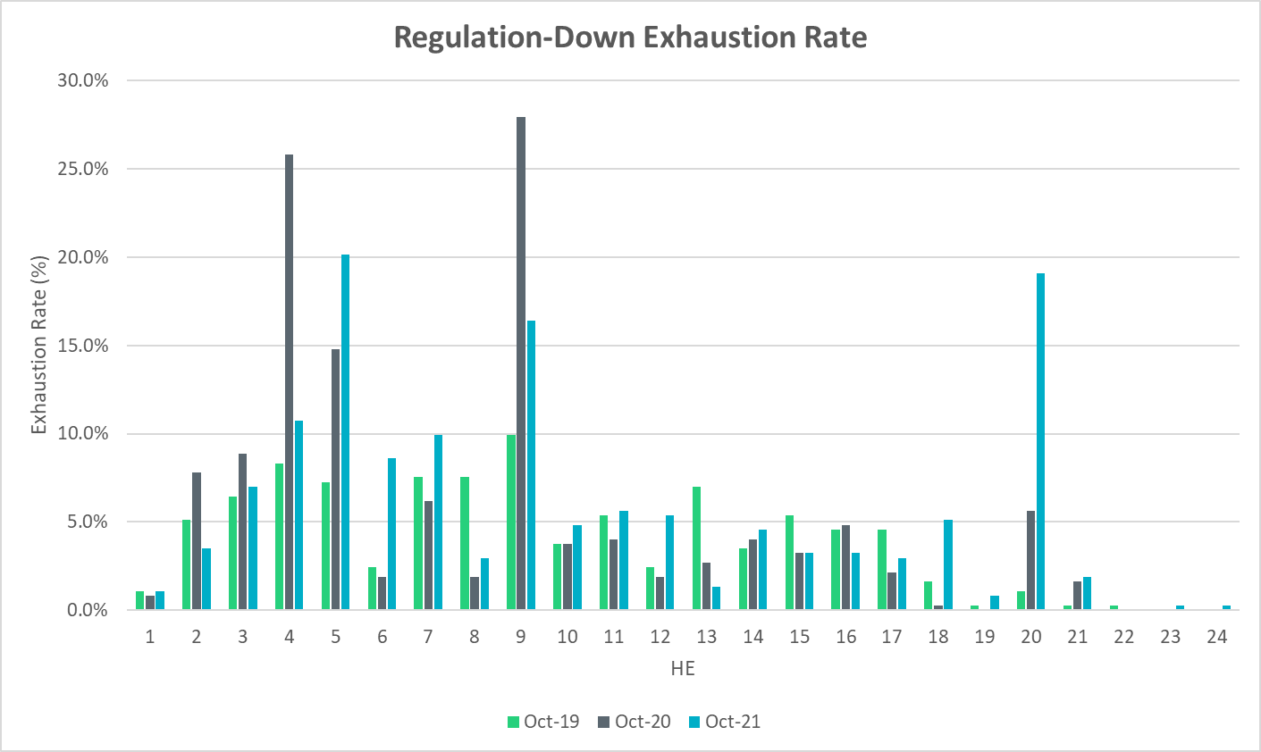
Regulation Exhaustion Rate

Slide 24
Metric 5: Stats on REGUP Bias for Consecutive 5-min Intervals
Using a 50MW filter, target 15 occurrences or less per month for regulation bias of six or more consecutive 5-minute intervals for peak hours.

Slide 25
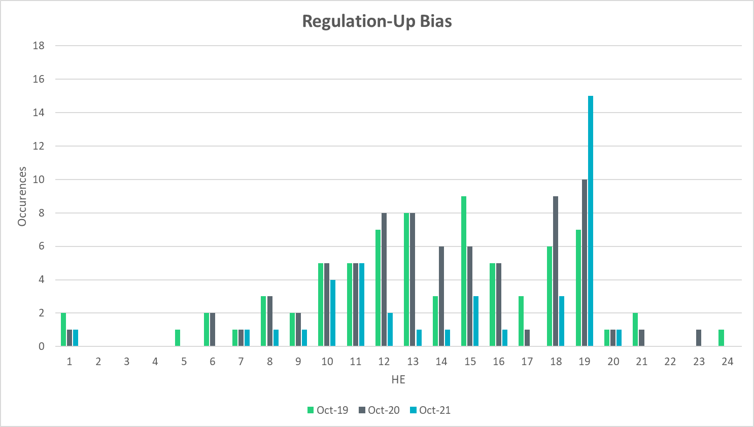
Regulation Bias for Consecutive SCED Intervals

Slide 26
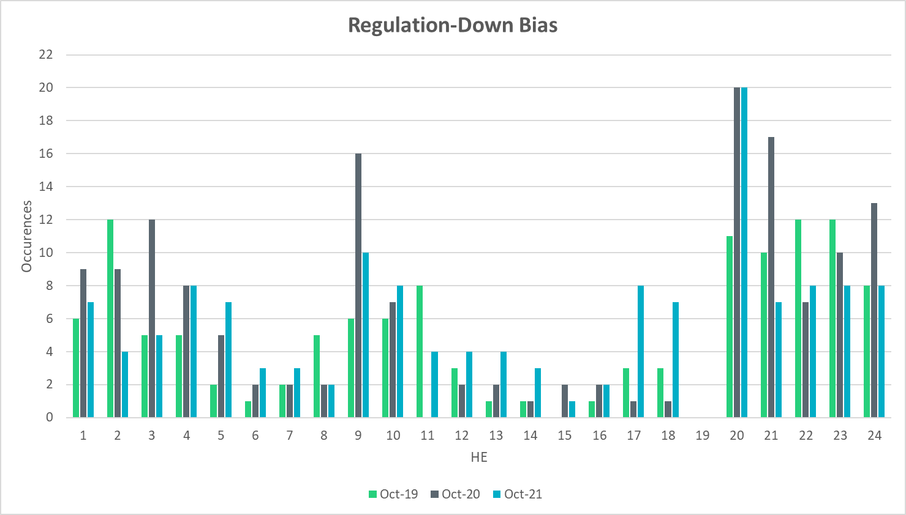
Regulation Bias for Consecutive SCED Intervals

Slide 27
Time Error and Contributing Factors
Accumulated Time Error, Load and Wind Ramp, PWRR Error, Start-Up/Shut-Down Hours, STLF Error, and Expected Generation Deviation.

Slide 28
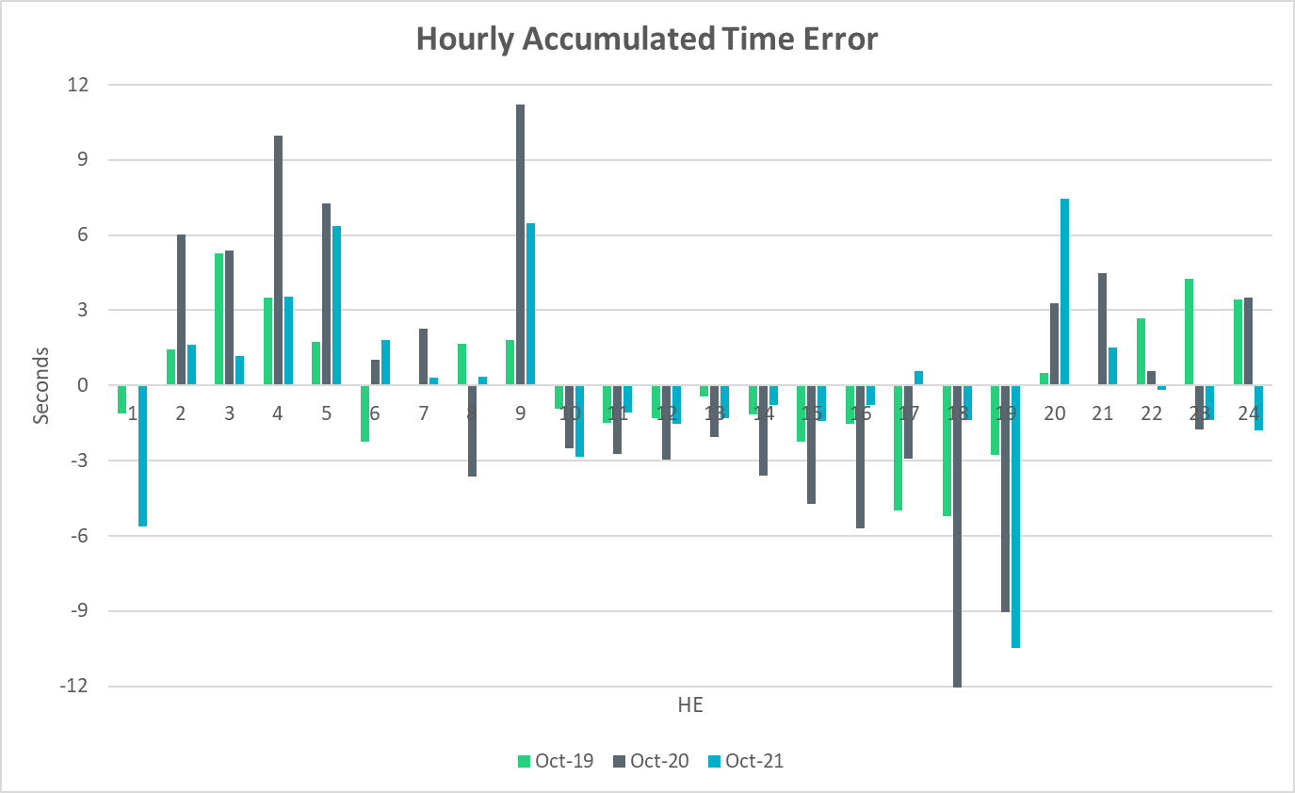
Time Error Accumulation

Slide 29
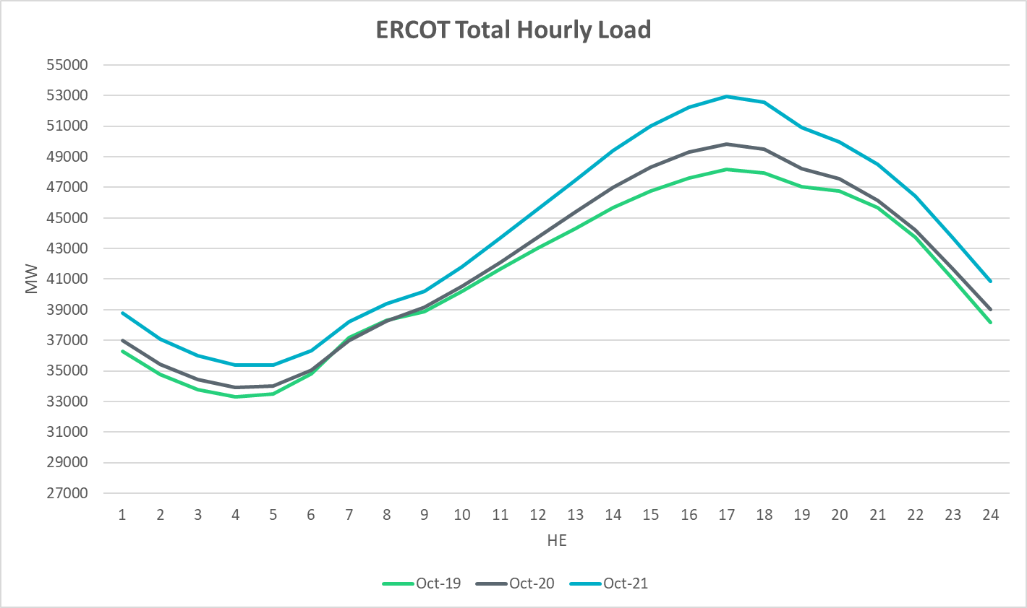
Load Profile

Slide 30
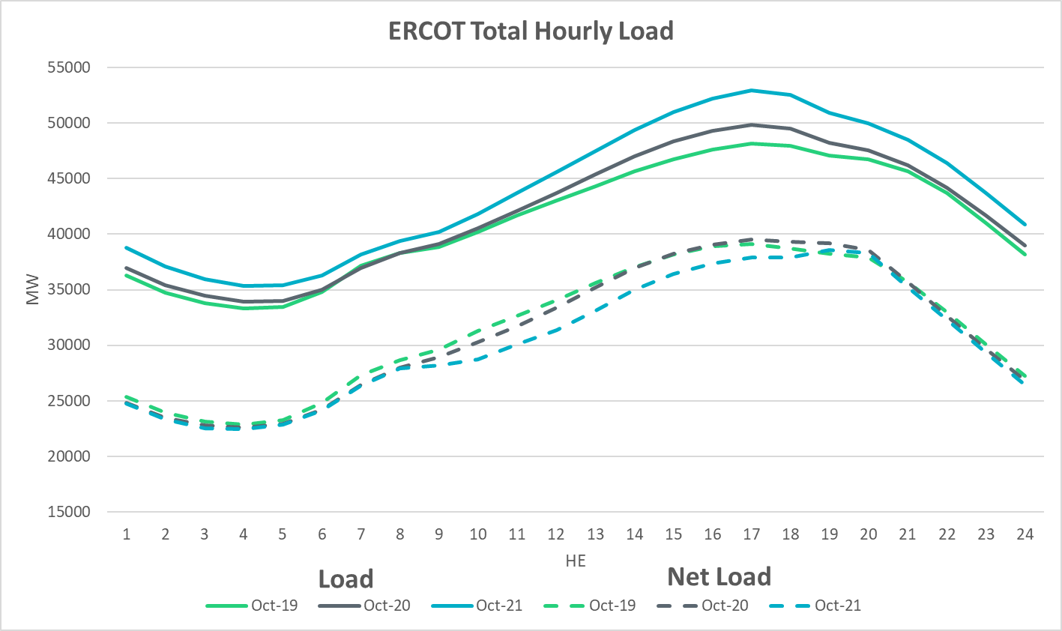
Net Load Profile

Slide 31
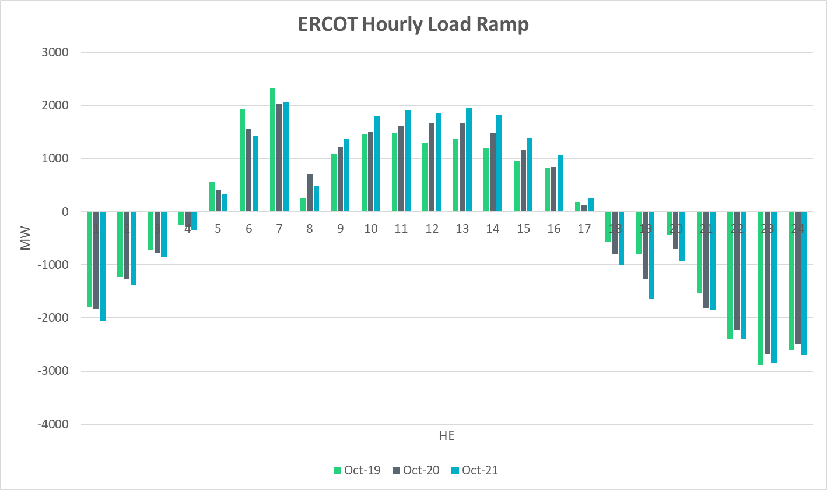
Load Ramp

Slide 32
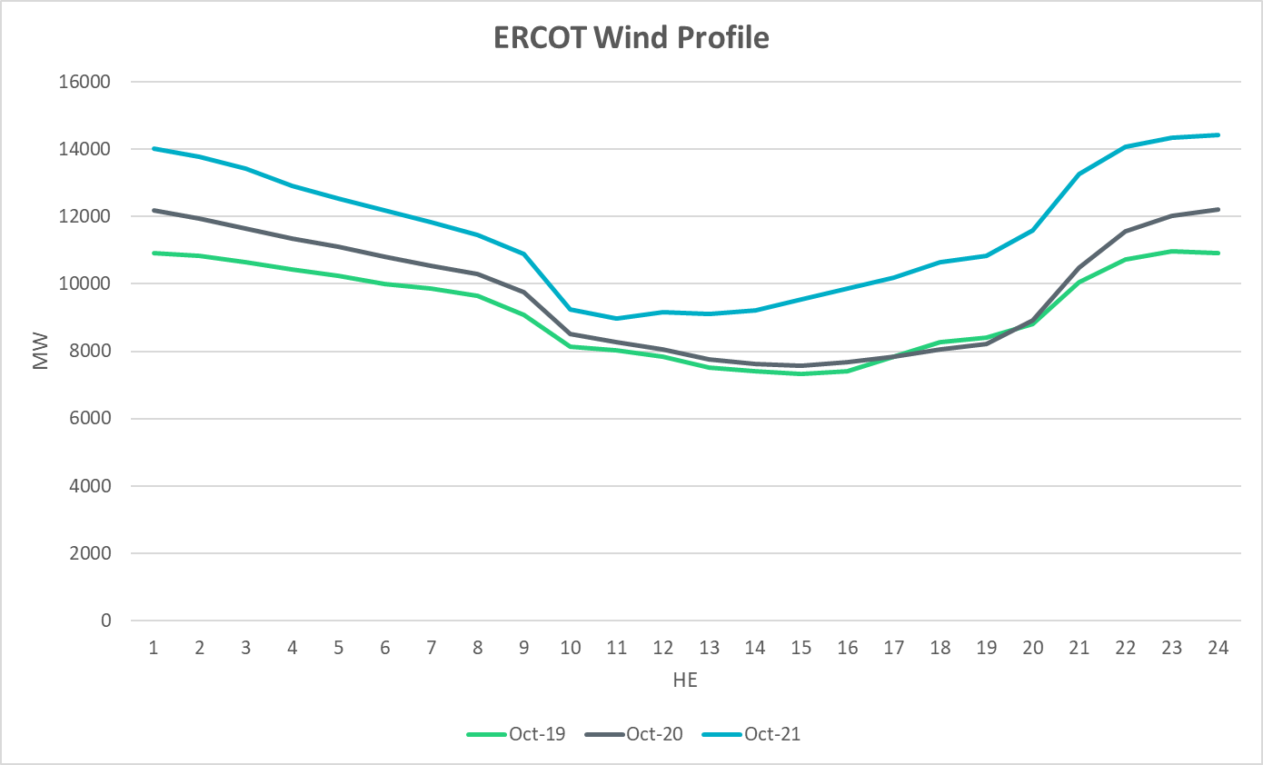
Wind Profile

Slide 33
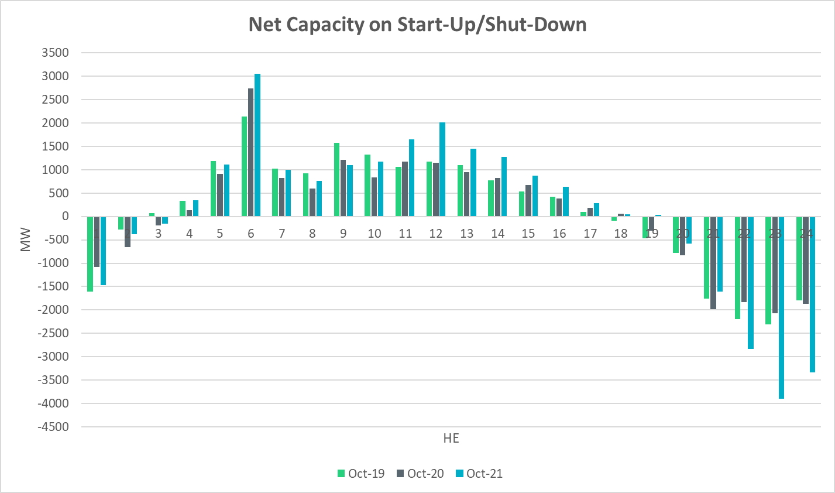
Start-Up & Shut-Down Hours

Slide 34
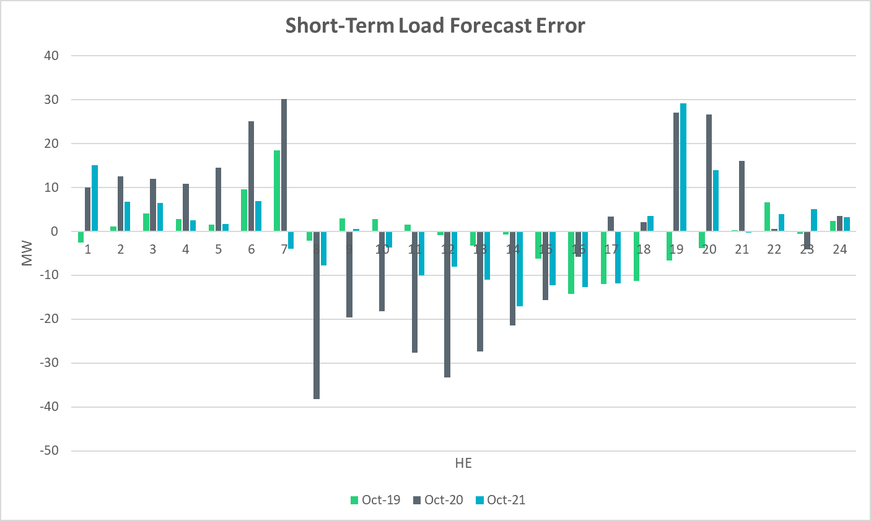
Short-Term Load Forecast Error
Notes:
Forecast – Actual
+ve Error => Over forecasted load
-ve Error +> Under forecasted load

Slide 35
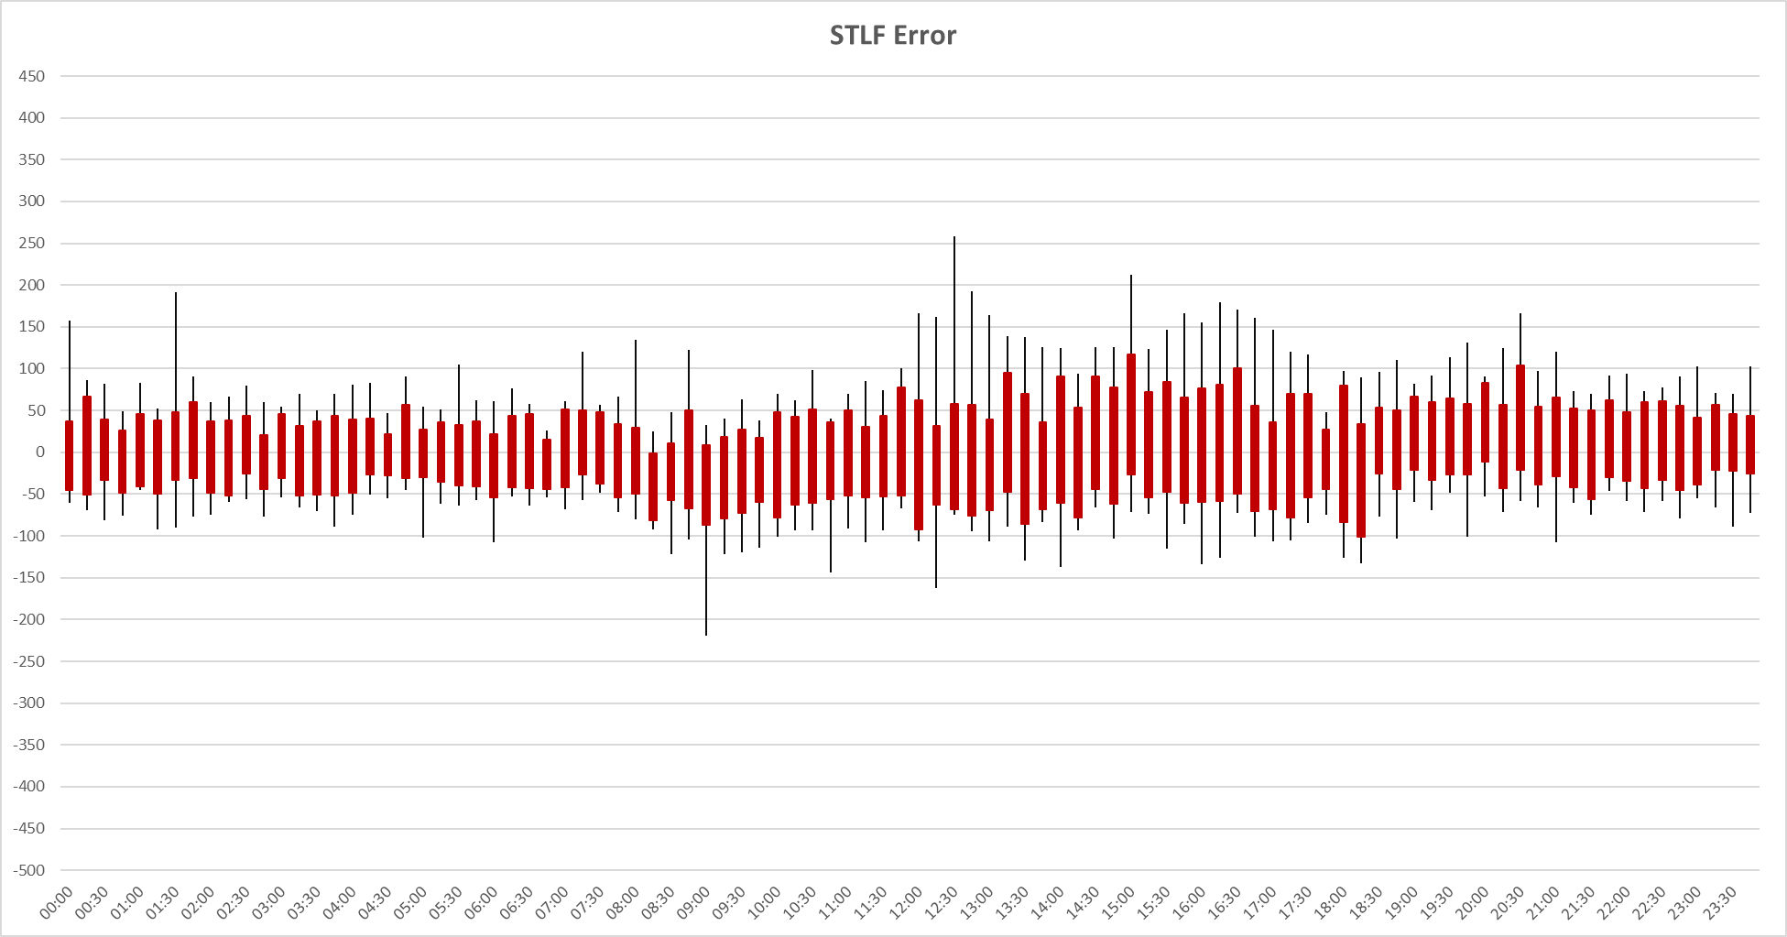
STLF Error Chart
Notes:
Error = Forecast – Actual
Min,Max, 10th, 90th percentile
15 minute intervals
Max Positive Forecast Error:
10/14/2021 12:30 -> 258 MW
Max Negative Forecast Error:
10/22/2021 9:00-> -220 MW

Slide 36
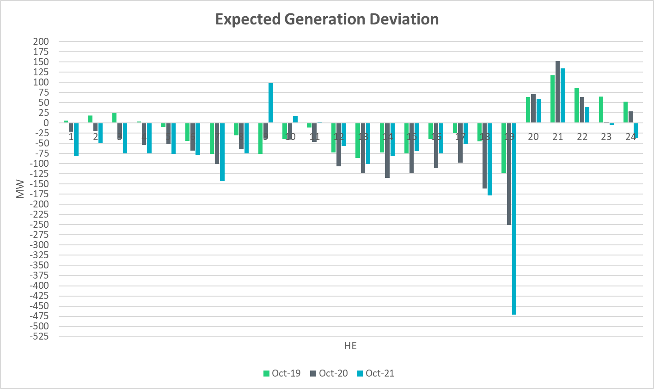
Expected Generation Deviation

Slide 37
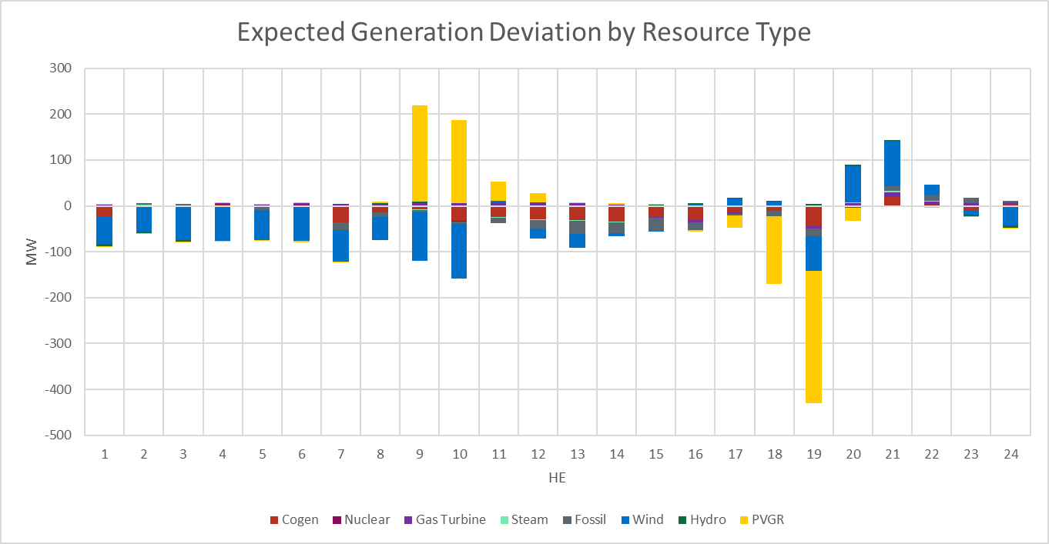
Expected Generation Deviation

Slide 38
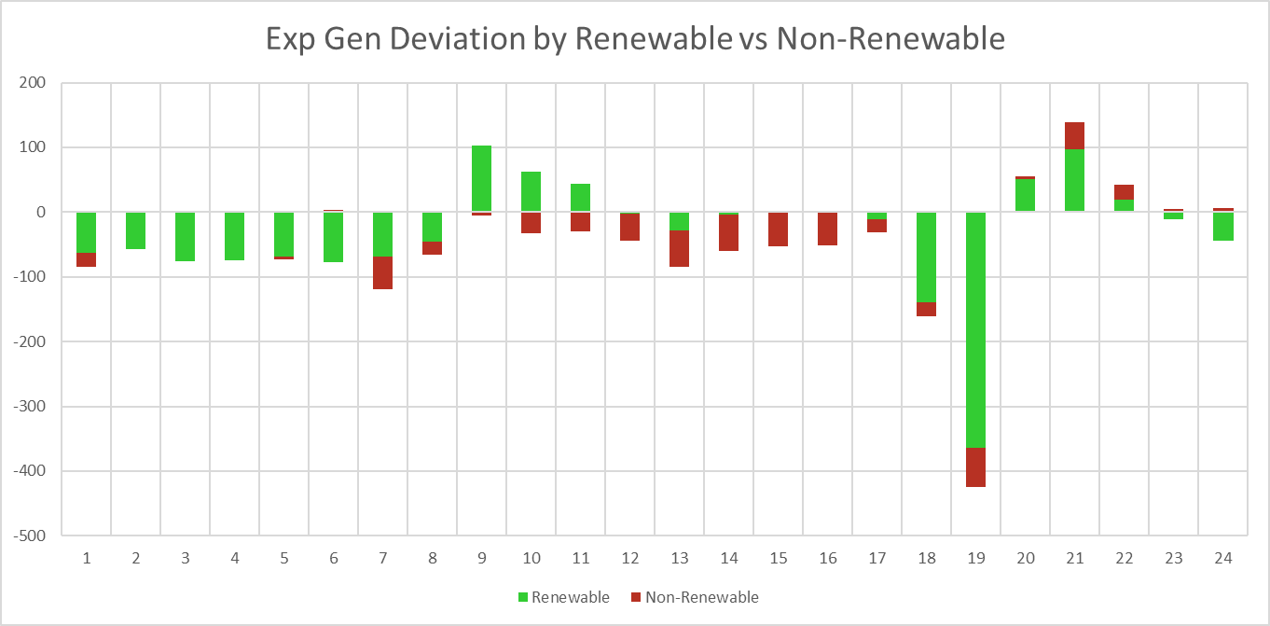
Expected Generation Deviation

Slide 39
Questions?
Thank you!

