Slide 1
ERCOT Frequency Control Report
October 2021
ERCOT
Operations Planning
PDCWG | November 12th, 2021

Slide 2
Summary of October 2021
CPS1: 170.98%
Current CPS1 12-Month Rolling Average: 169.37%
1 BAAL Exceedance(s)
5 hourly CPS1 score below 100%
BAAL-003 Events have updated through 2020
2020 BAAL-003 FRM Performance: -789.34
2021 RMS1 Statistics
  Mean: 16.44 mHz
  Min: 12.01 mHz
  Max: 60.6 mHz
Energy Statistics
  Total Energy: 32,664,264 MWh
  Wind Energy: 8,604,573 MWh
  Percent Energy from Wind: 26.34%
  Solar Energy: 1,414,241 MWh
  Percent Energy from Solar: 4.33%
Minimum System Inertia
  Mean: 181,905 MW*s
  Max: 245,061 MW*s on Oct 4th
  Min: 134,760 MW*s on Oct 29th
Notes:
2018 BAAL-003 FRM Performance: -843.17
Mean: 16.44 mHz
Min: 12.01 mHz
Max: 60.6 mHz
Mean: 181,905 MW*s
Max: 245,061 MW*s on Oct 4th
Min: 134,760 MW*s on Oct 29th

Slide 3
Frequency Control
CPS1, BAAL, & RMS1

Slide 4
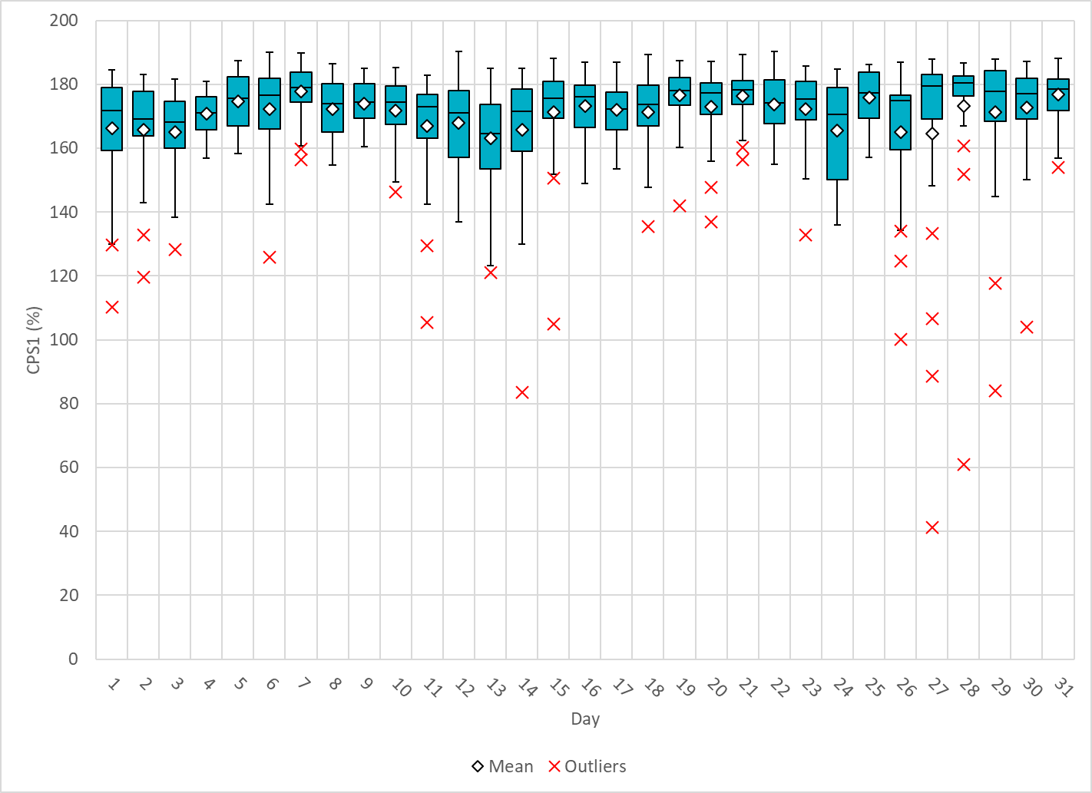
Hourly CPS1 by Day
Oct-21 CPS1 (%): 170.98
Notes:
1. 83.5% @ 10/14/2021 HE 19:00
Expected Generation Deviation
Expected gen dev remained negative for the entire hour. The largest expected gen dev was -2507 MW @ 18:15 with contribution from solar and wind.
IRR Ramps
Between 18:00 to 19:00 solar ramped down by 3900 MW and wind ramped down by 1000 MW.
Regulation: Regulation up was exhausted for the most part of this hour. A 300 MW SCED manual offset was applied.
2. 88.7% @ 10/27/2021 HE 2:00
Expected Generation Deviation
Expected gen dev remained negative for half of the hour. The largest expected gen dev was -2125 MW @ 1:17 with contribution from wind and combine cycles.
IRR Ramps
Between 1:03 to 1:18 wind ramped down by 450 MW.
DC Ties
Between 1:00 to 1:20 DC Tie ramped up by 215 MW.
Regulation: Regulation up was exhausted during the ramp intervals. A 200 MW SCED manual offset was applied.
3. 41.3% @ 10/27/2021 HE 19:00
Expected Generation Deviation
Expected gen dev remained negative for the entire hour. The largest expected gen dev was -3600MW @ 18:30 with contribution from solar and wind.
IRR Ramps
Between 18:32 to 19:00 solar ramped down by 700 MW and wind ramped down by 2800 MW. Steel mill load ramped up by 290 MW during the IRR ramps.
Regulation: Regulation up was exhausted during these IRR ramp intervals. A 200 MW SCED manual offset was applied.
4. 61.1% @ 10/28/2021 HE 19:00
Expected Generation Deviation
Expected gen dev remained negative for the entire hour.. The largest expected gen dev was -3685 MW @ 18:32 with contribution from solar and wind.
IRR Ramps
Between 18:00to 19:00 solar ramped down by 2200 MW and wind ramped down by 3200 MW.
Regulation: Regulation up was exhausted for the entire hour. A 300 MW SCED manual offset was applied.
5. 84.0% @ 10/29/2021 HE 19:00
Expected Generation Deviation
Expected gen dev remained negative for the entire hour. The largest expected gen dev was -2818 MW @ 18:08 with contribution from solar and wind.
IRR Ramps
Between 18:00to 19:00 solar ramped down by 3100 MW and wind ramped down by 4600 MW.
Regulation: Regulation up was exhausted for most part of the hour. A 250 MW and a 400 MW SCED manual offset were applied.

Slide 5
BAAL Exceedances & Violations
There is 1 BAAL exceedance(s) in October
Notes:
Occurred on 10/1/2021

Slide 6
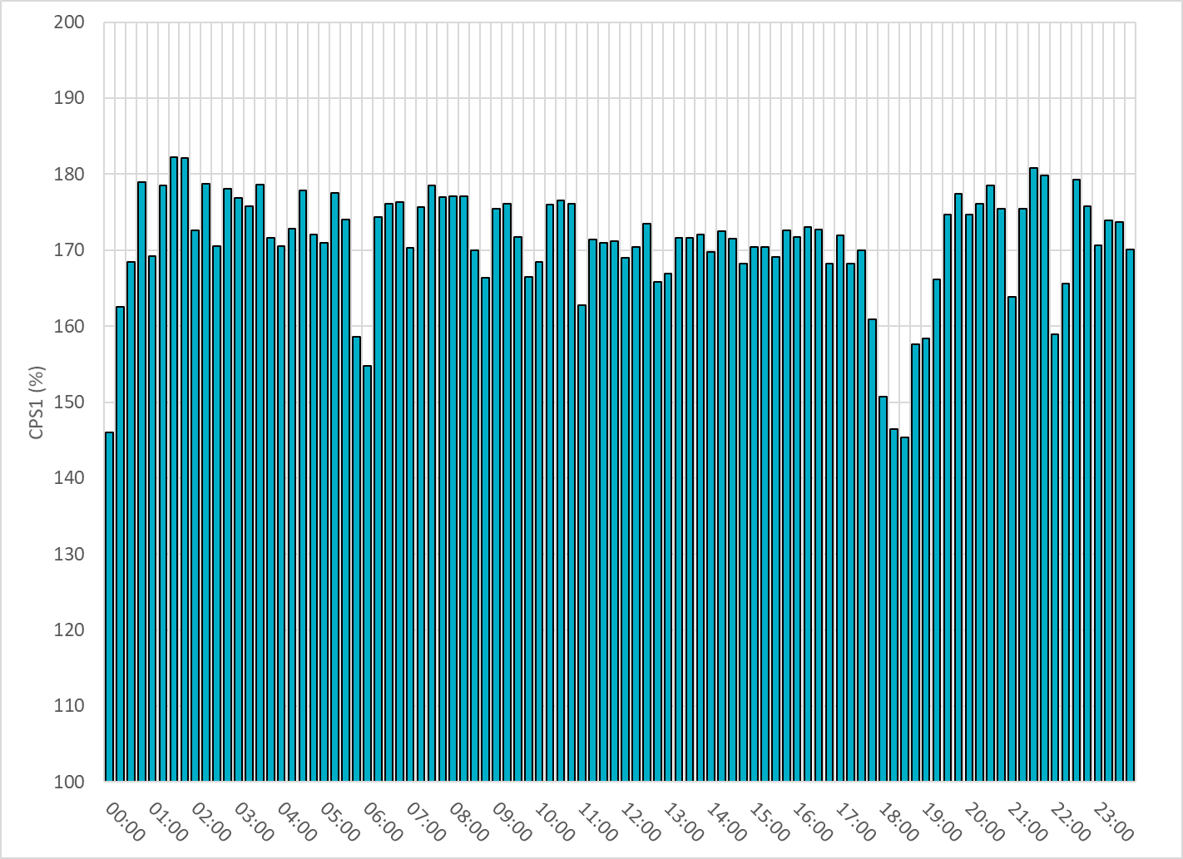
15-Minute Average CPS1%
Oct-21 CPS1 (%): 170.98

Slide 7
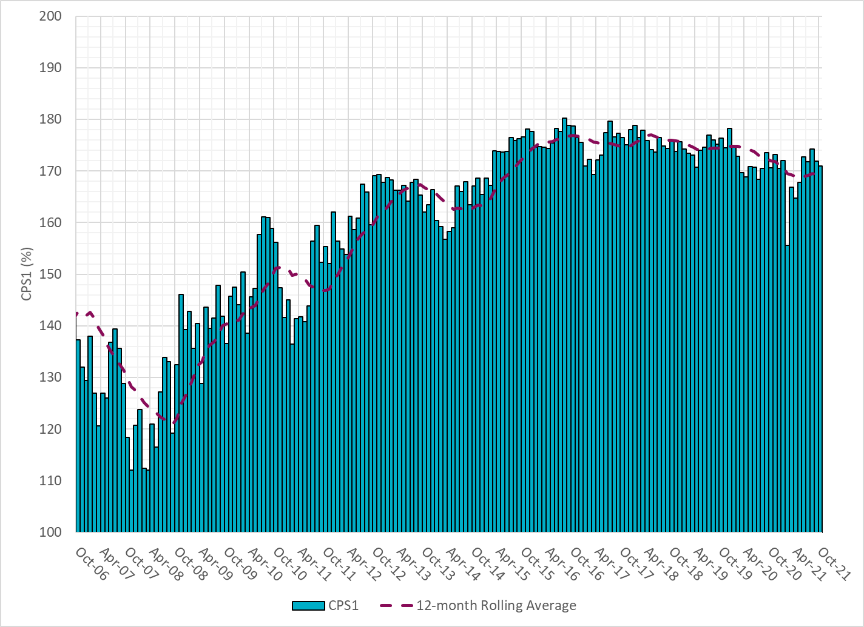
12-Month Rolling Average CPS1
Current 12-Month Rolling Average: 169.37%

Slide 8
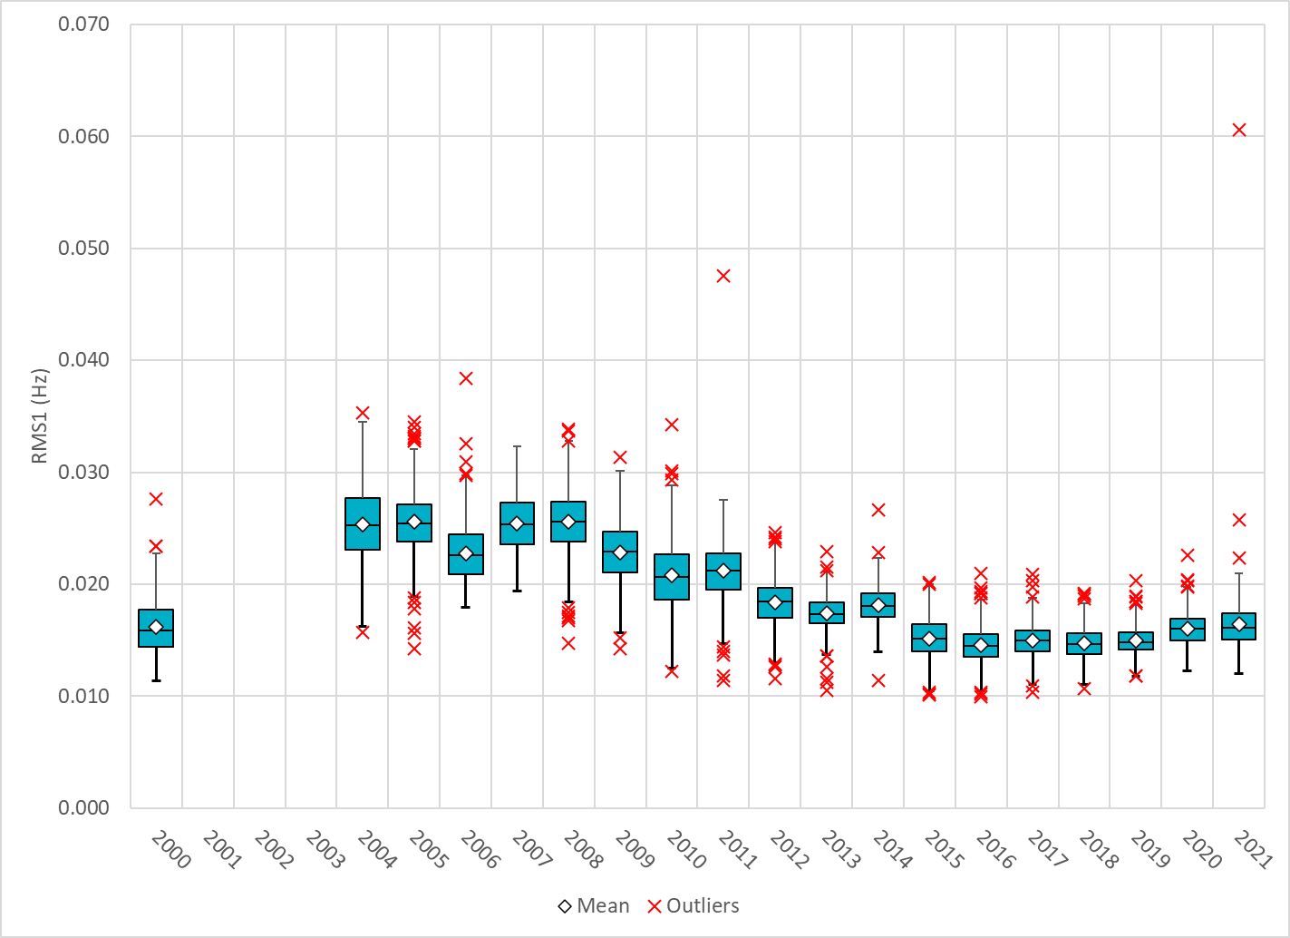
Daily RMS1 of ERCOT Frequency by Year
Notes:
Mean: 16.44 mHz
Min: 12.01 mHz
Max: 60.6 mHz

Slide 9
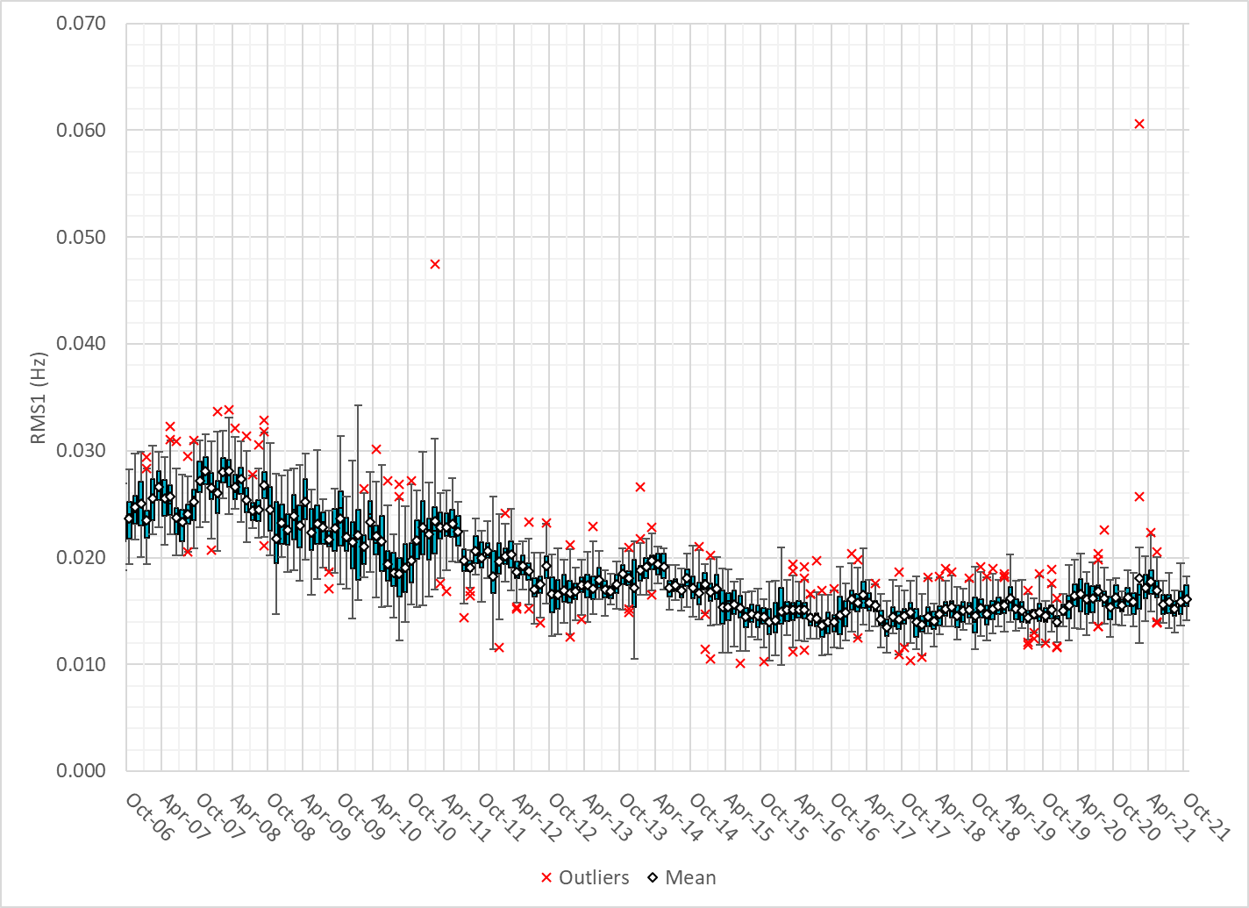
Daily RMS1 of ERCOT Frequency by Month

Slide 10
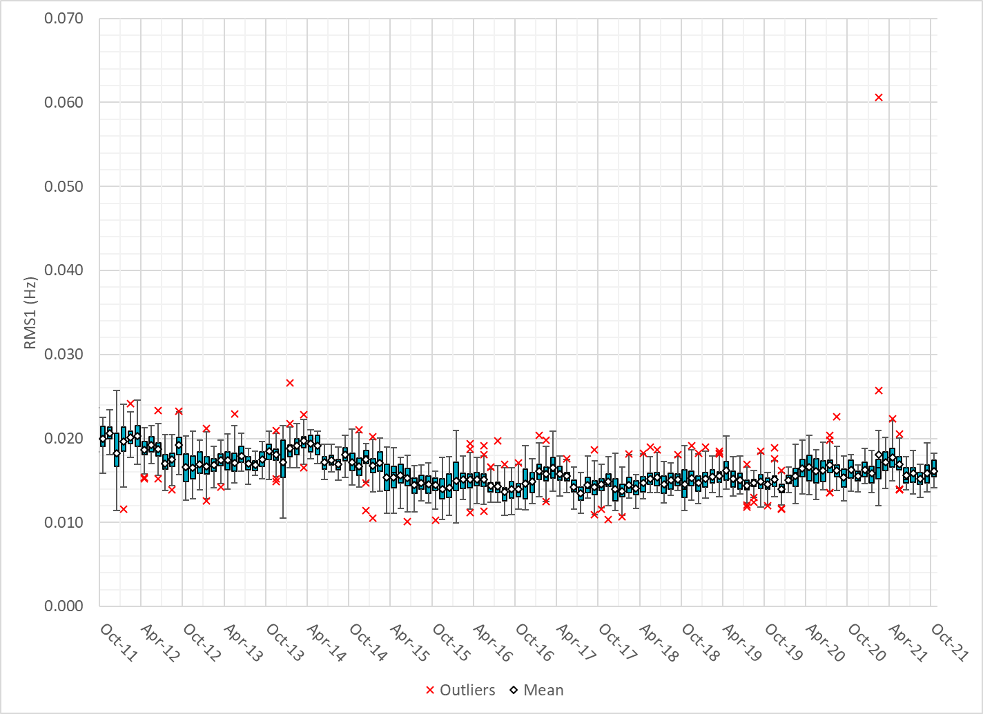
Daily RMS1 of ERCOT Frequency by Month
Notes:
16Mhz on avg

Slide 11
Frequency Profile Comparison

Slide 12
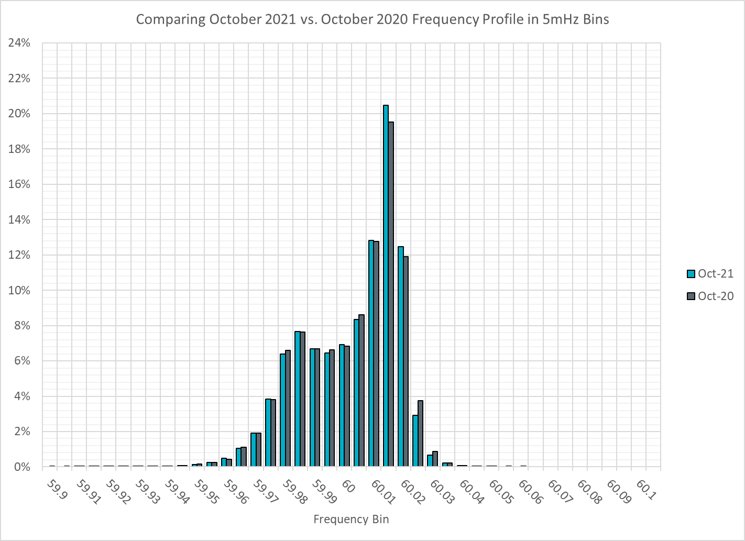
Frequency Profile Comparison

Slide 13

Frequency Profile Comparison

Slide 14
Time Error Correction

Slide 15
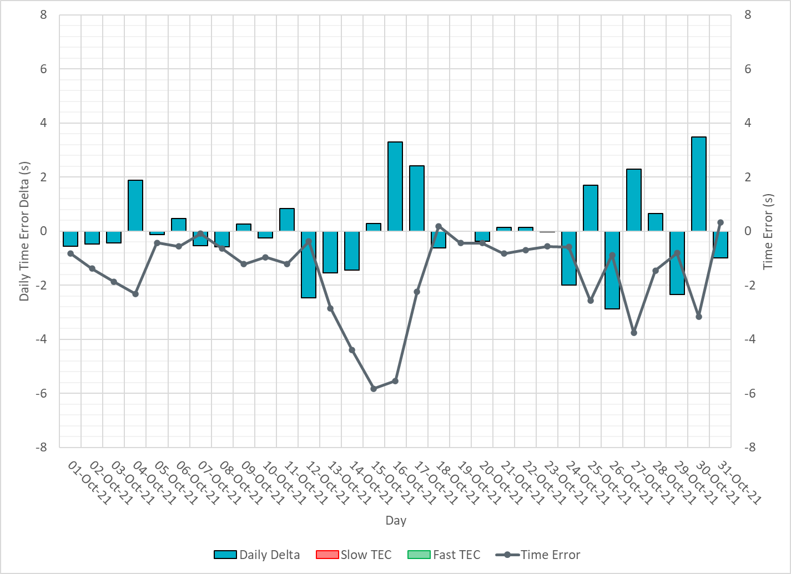
ERCOT Daily Time Error

Slide 16
Time Error Corrections Log Summary
There have been no time error corrections since December 2016

Slide 17
BAL-003 Performance

Slide 18
Op. Year 2020 BAL-003 Selected Events – Update
Notes:
BAL-003

Slide 19
Op. Year 2020 BAL-003 FRM Performance - Update
Notes:
OP2018: FRO = -381.0, FRM_median = -843.17, FRM_average = -959.7
OP2019: FRO = -381.0, FRM_median = -811.14, FRM_average = -892.5
OP2020: FRO = -425.0, FRM median = -789.34, FRM average = -879.0
OP2021: FRO =

Slide 20
ERCOT Energy Statistics

Slide 21
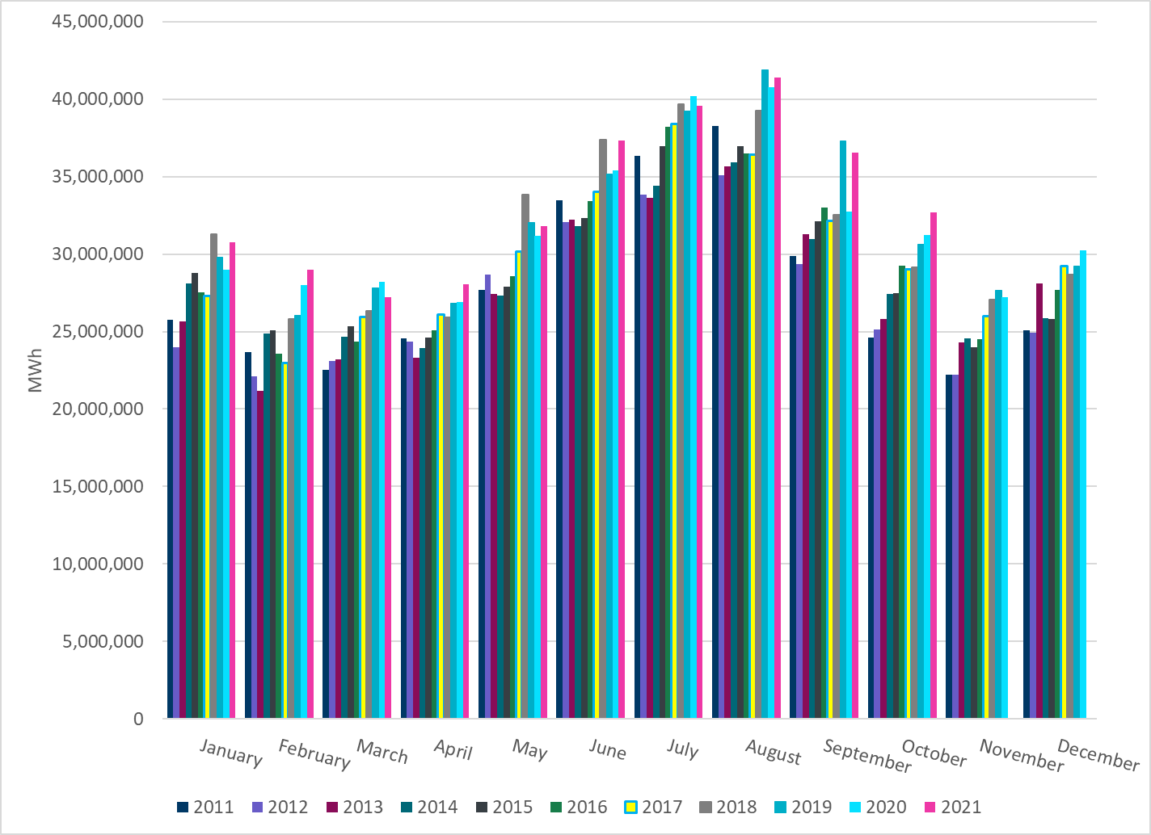
Total Energy
Notes:
32,664,264MWh

Slide 22
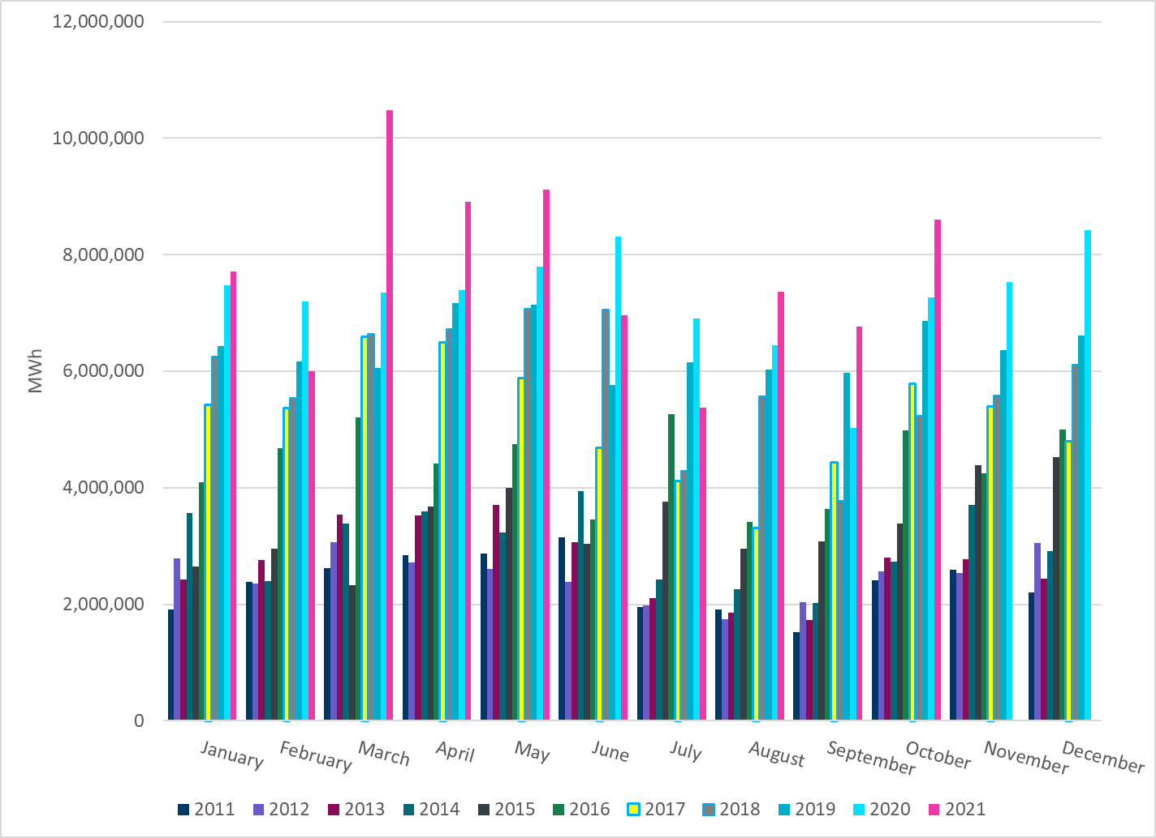
Total Energy from Wind Generation
Notes:
8,604,573 MWh

Slide 23
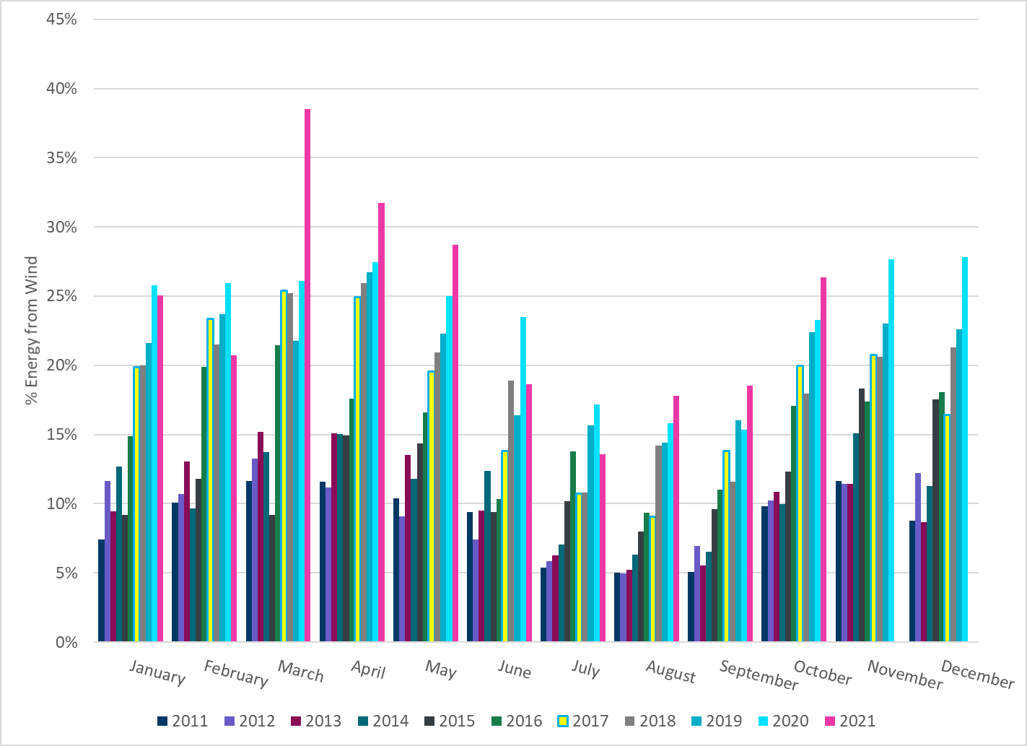
% Energy from Wind Generation
Notes:
26.34%

Slide 24
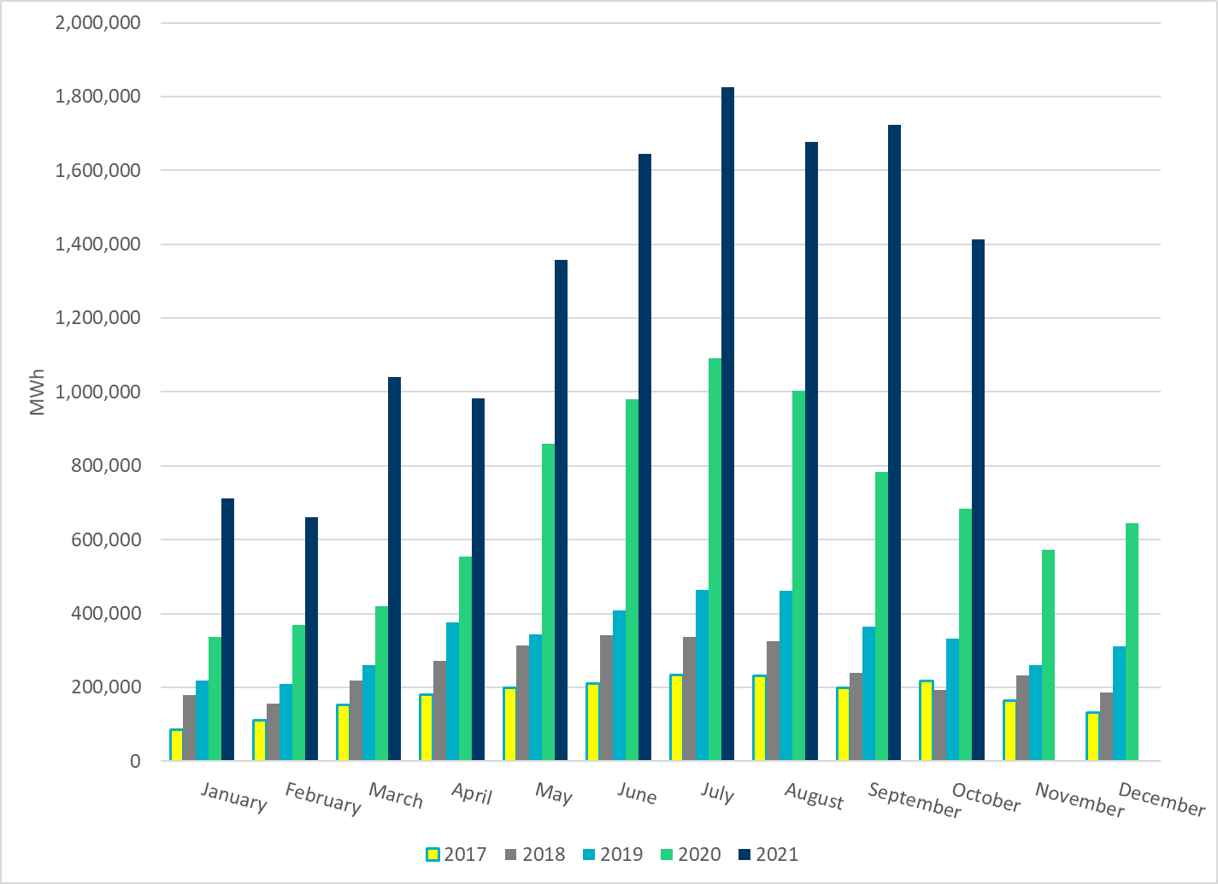
Total Energy From Solar Generation
Notes:
1,414,241 MWh

Slide 25
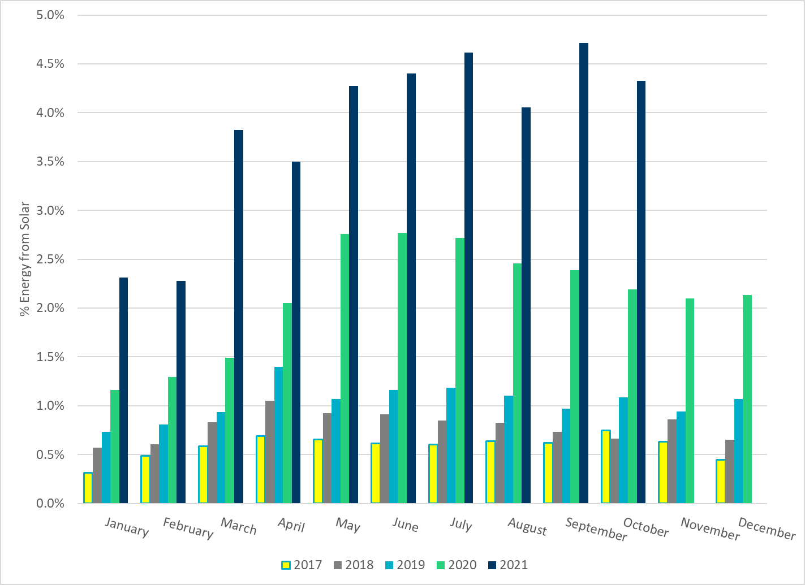
% Energy from Solar Generation
Notes:
4.33%

Slide 26
ERCOT System Inertia

Slide 27
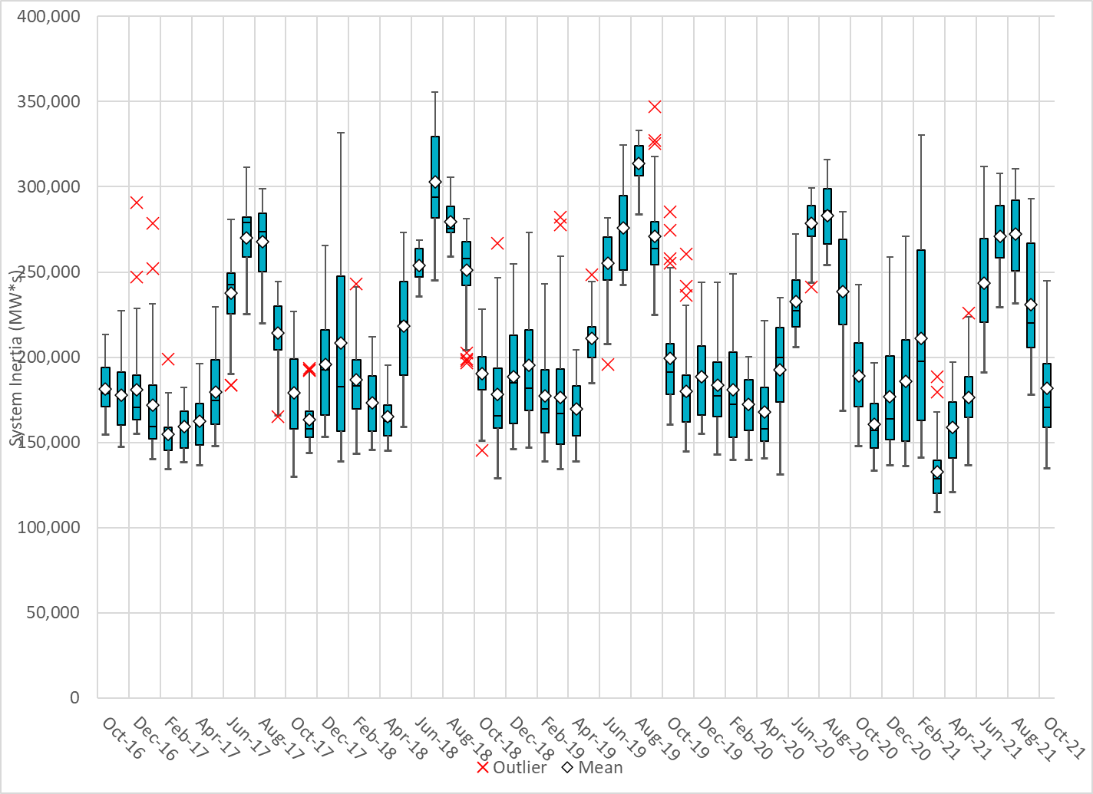
Daily Minimum System Inertia
Notes:
Minimum Inertia = 134,760 MW*s on 10/29/2021
Previous Minimum was 109,029 MW*s on 3/22/2021
Data:
Mean: 181,905 MW*s
Max: 245,061 MW*s on Oct 4th
Min: 134,760 MW*s on Oct 29th

Slide 28
Questions?
Thank you!

