Slide 1
ERCOT Frequency Events
October 2021
ERCOT
Operations Planning
PDCWG | November 12th, 2021

Slide 2
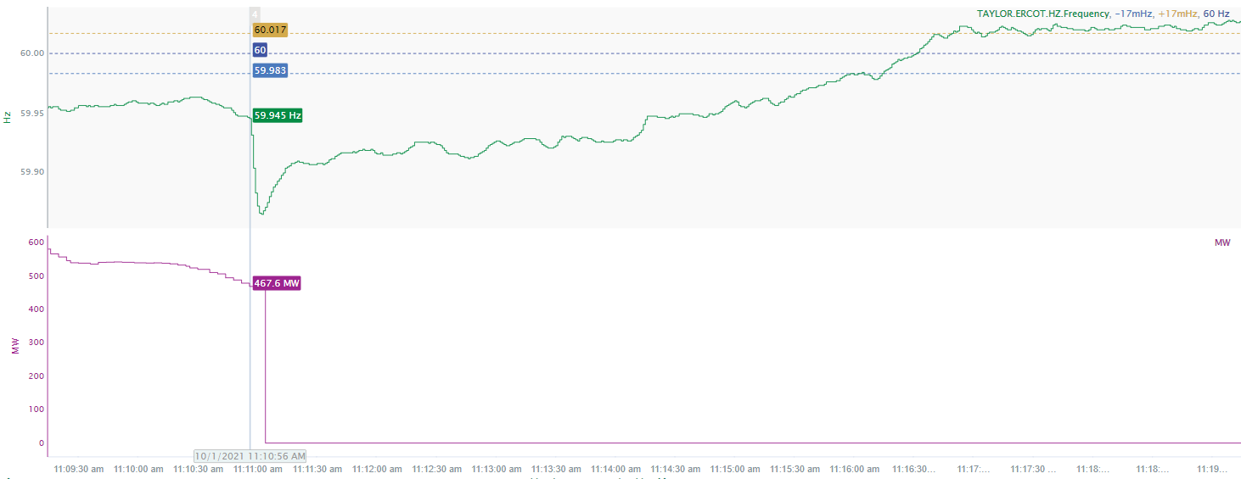
10/1/2021 11:10:56 (NON FME)
Notes:
Unit experienced runback and tripped offline while carrying 468 MW
Starting Frequency: 59.945 Hz
Minimum Frequency: 59.864 Hz
A-C Time: 6 seconds
Recovery Time (back to deadband): 5 minutes
RRS Deployed: 809.22 MW
Trip Reason: loss of boiler feed pump
Contextual Information: A total of 436MW of regulation up was deployed during the event.
No Selection Reason: The starting frequency is too low.

Slide 3
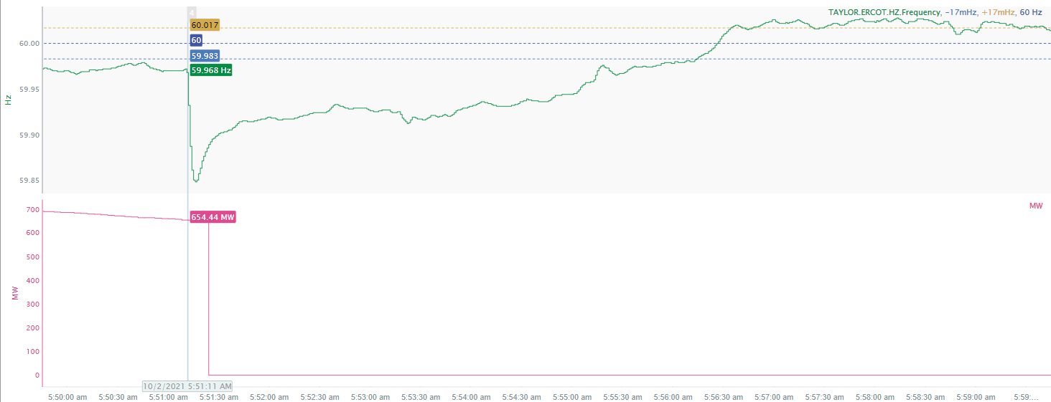
10/2/2021 05:51:11(NON-FME)
Notes:
Unit experienced runback and tripped offline while carrying 654 MW
Starting Frequency: 59.968 Hz
Minimum Frequency: 59.848 Hz
A-C Time : 5 seconds
Recovery Time(back to deadband): 5 minutes and 3 seconds
RRS Deployed: 908 MW
Trip Reason: loss of alpha air pre-heater
Contextual Information: A total of 356 MW of regulation up was deployed during the event.
No Selection Reason: The starting frequency outside the low deadband

Slide 4
Questions?
Thank you!

