Slide 1
Winter Weather Readiness Report and Attestation via DocuSign

Slide 2
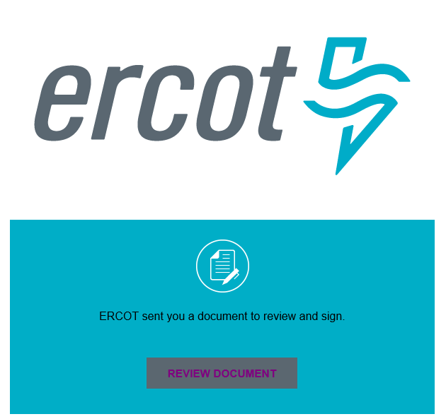

WWRR via DocuSign
ERCOT will use DocuSign to collect Winter Weather Readiness Report responses

Slide 3
DocuSign Workflow
TSP

Slide 4
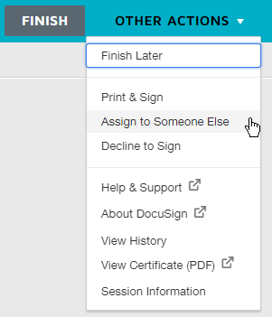
Authorized Representative (AR) Role
ERCOT will send all DocuSign envelopes the AR
The AR can forward the DocuSign envelope to the Submitter by:
  Forwarding the DocuSign email or
  “Assigning to Someone Else” via DocuSign
Update: It is recommended to forward the envelopes using the DocuSign functionality.
TSP

Slide 5
Submitter Role
Only one person, the Submitter, can modify and submit a DocuSign envelope
The Submitter will:
  Enter answers into the envelope,
  Attach files to the envelope,
  “Sign” the envelope,
  Attach a notarized sworn attestation, and
  Submit the completed envelope
TSP

Slide 6
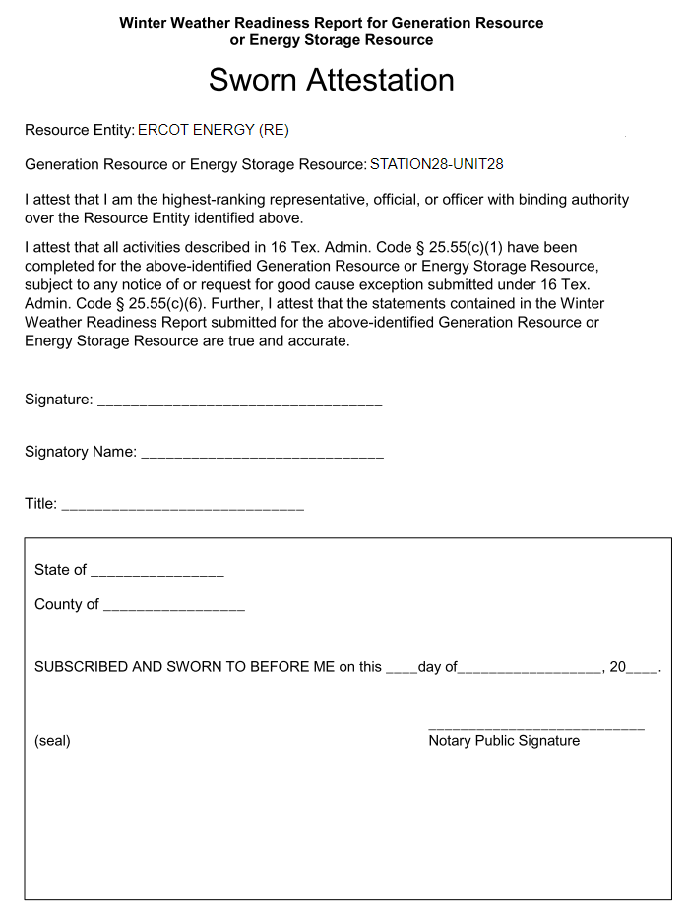


Sworn Attestation - Completing
The pre-populated Resource-specific Sworn Attestation must be printed, signed, notarized, and attached to the envelope prior to submission
Completed Attestation Image File
Print the pre-populated attestation
Sign, notarized, and scan the document

Slide 7
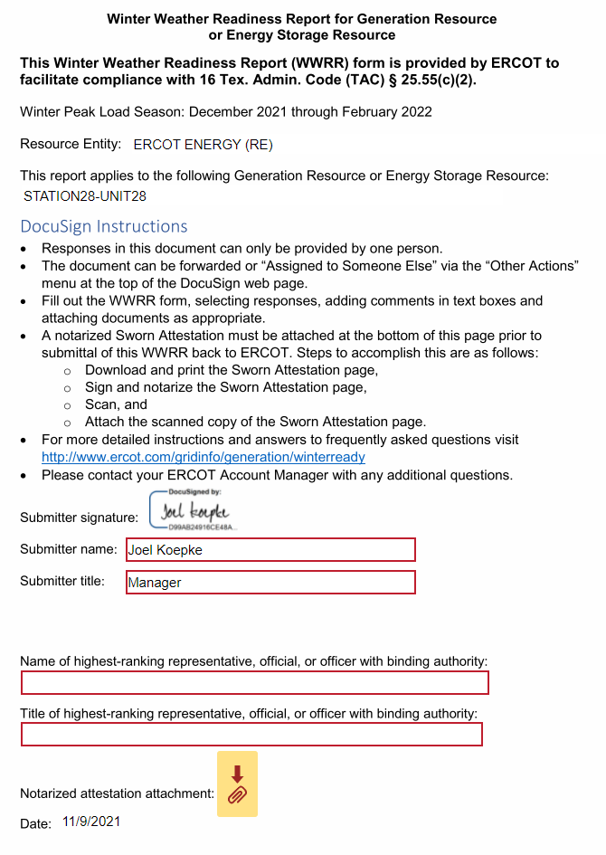
Sworn Attestation - Attaching
The completed attestation image file must be attached to the envelope prior to submission
Completed Attestation Image File

Slide 8
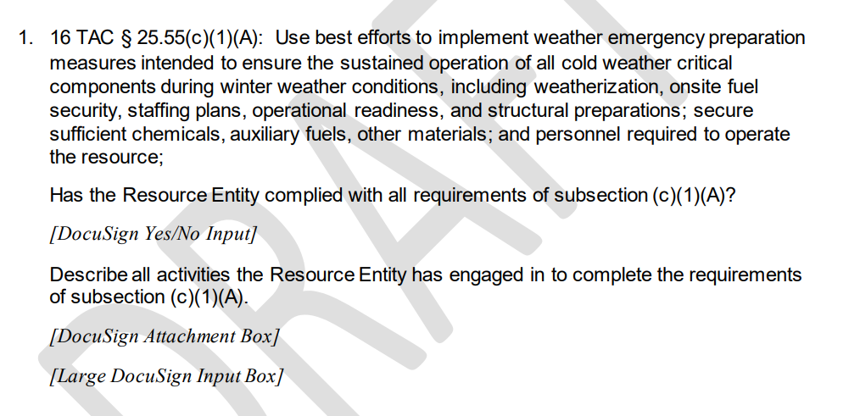
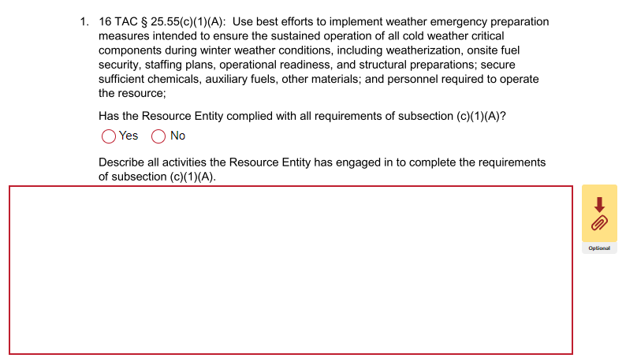
Posted WWRR PDF vs DocuSign
DocuSign Envelope
WWRR PDF Form
Draft WWRR PDFs are posted at: http://www.ercot.com/gridinfo/generation/winterready

Slide 9
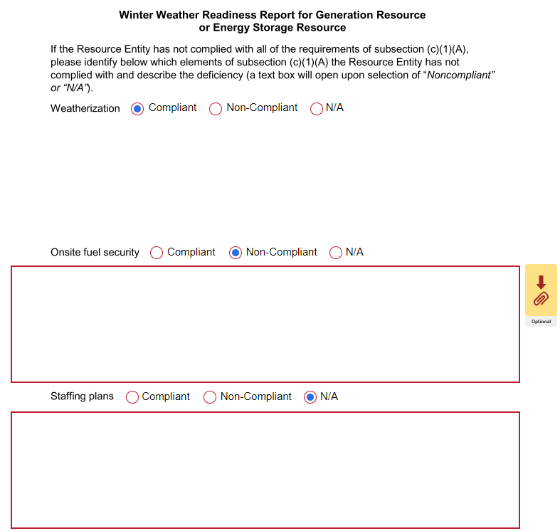
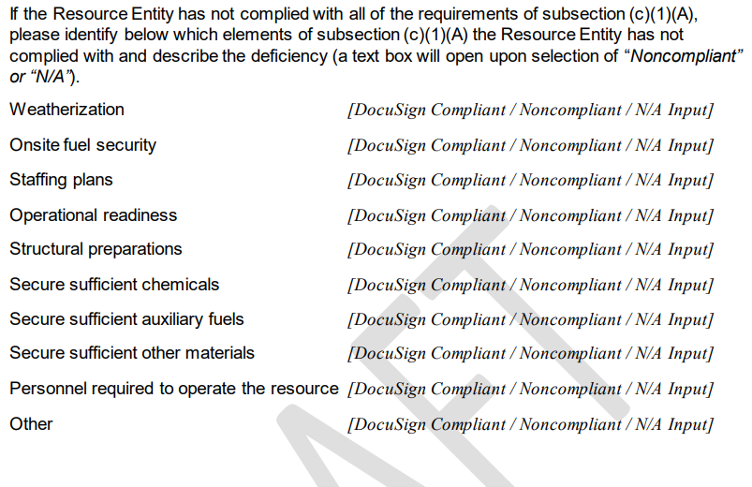
Posted WWRR PDF vs DocuSign
DocuSign Envelope
WWRR PDF Form
The DocuSign envelope is expanded vertically to allow text entry

Slide 10
Questions?

