Slide 1
NPRR 1096 Sustained Duration for ECRS and Non-Spin Ancillary Services
ERCOT Staff
November 12, 2021
PDCWG Meeting

Slide 2
Overview
NPRR1096 proposes that ECRS be provided with a capacity that is capable of being sustained for two consecutive hours and Non-Spin be provided with a capacity that is capable of being sustained for four consecutive hours.
Background:
ECRS and Non-Spin are both ancillary services that can be expected to be utilized to cover risks associated with net load forecast errors. ECRS and Non-Spin may be also be deployed to replenish Regulation and RRS. Going forward Non-Spin will also be used to cover risks associated with intra-day forced outages of thermal resources.
In the above situations, Non-Spin deployment would be needed to last until other units can be brought online.
Winter morning load ramp can last anywhere from 4 to 6 hours. Depending on the season, Solar ramp down events last between 2.5 to 3.5 hours. Wind down ramps do not have a consistent pattern tied to seasonality and/or time of day, these wind down ramps tend to last several hours and are far more vulnerable to forecast errors.
A duration limit on the capacity that is used to provide ECRS and Non-Spin is needed under today’s market constructs. Future design changes to DAM, RUC, and RTC clearing engines to consider state of charge for ESRs could lead to a reassessment of the proposed duration limits.
In order to assess the appropriate duration requirement for ECRS and Non-Spin, historical net load (load – wind – solar) and net load forecast errors were analyzed to extract trends in sustained up ramps and under forecast errors. Historical offline generation capacity availability was also assessed.
Notes:
ECRS: ERCOT Contingency Reserve Service
RRS: Responsive Reserve Service
Non-Spin: Non-Spinning Reserve Service
DAM: Day-Ahead Market
RUC: Reliability Unit Commitment
RTC: Real-Time Co-Optimization
ESRs: Energy Storage Resources

Slide 3
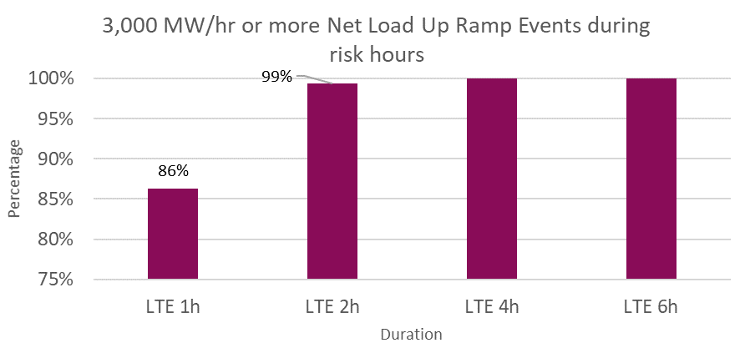
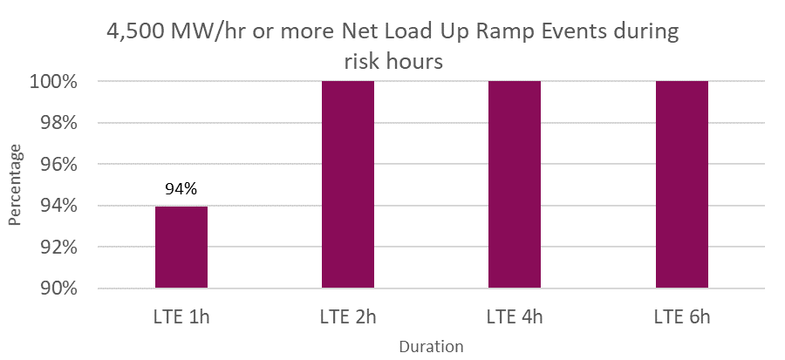
Sustained Net Load Up Ramp Analysis
In analyzing historical* sustained net load up ramps that were
3,000 MW/hr or more in magnitude,
~99% events occurred during high risk hours** and lasted 2 hours or less
All events that occurred during high risk hours and lasted 4 hours or less.
4,500 MW/hr or more in magnitude,
All events that occurred during high risk hours and lasted 2 hours or less.
*Between January 1, 2018 and July 31, 2021; excludes February 15 – 19, 2021.
**High risk hours are hours where the risk of net load up ramp is high. These are computed using a methodology that is consistent with the current Non-Spin methodology.
*Excludes Feb 15 – Feb 19, 2021

Slide 4
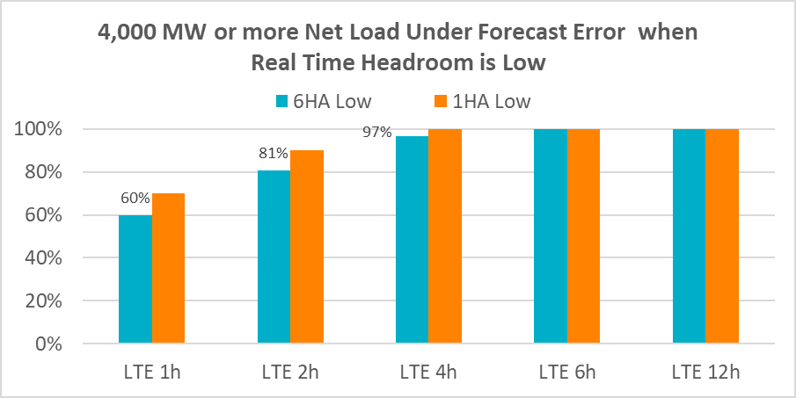
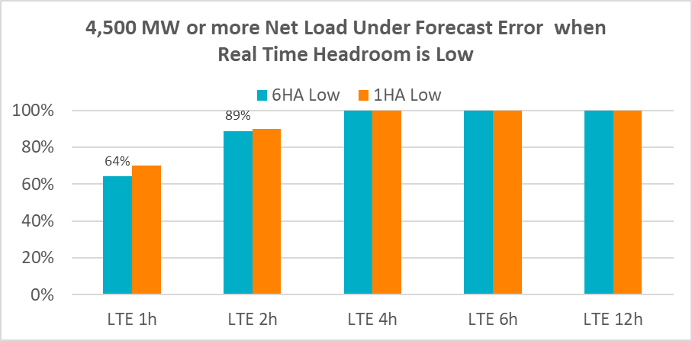
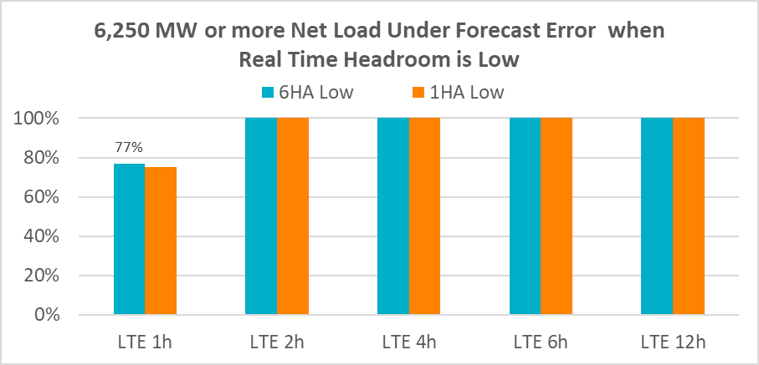
Sustained Net Load Under Forecast Error Analysis
In analyzing historical* sustained net load up under forecast errors that were
4,000 MW or more in magnitude
~81% events occurred during times when Real Time headroom** was low*** and lasted 2 hours or less
~97% events occurred during times when Real Time headroom was low and lasted 4 hours or less.
All events occurred that during times when Real Time headroom was low and lasted 6 hours or more.
4,500 MW or more in magnitude
~89% events occurred during times when Real Time headroom was low and lasted 2 hours or less.
All events that occurred during times when Real Time headroom was low and lasted 4 hours or less.
6,250 MW or more in magnitude
All events that occurred during times when Real Time headroom was low and lasted 2 hours or less.
*Between January 1, 2018 and December 31, 2020
**Real Time Headroom = Total Online HSL + Offline Non-Spin – Actual Load
***Real Time headroom less than 5,000 MW

Slide 5
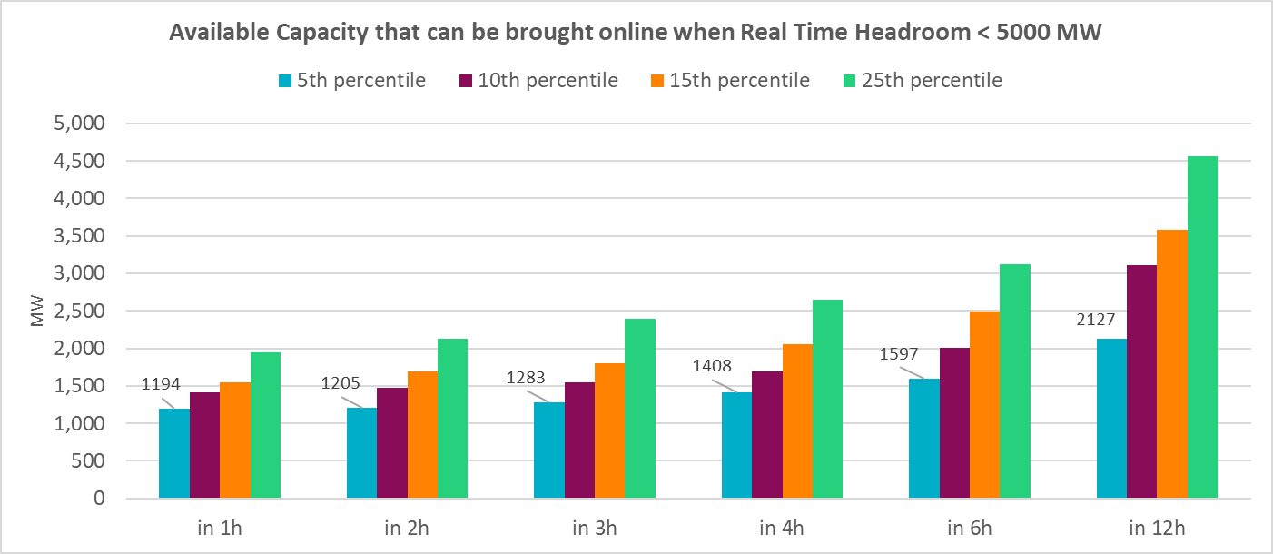
Available Offline Capacity Analysis
In analyzing historical* available offline capacity during conditions when Real Time headroom** was low,
~1,408 MW could be brought online in 4 hours about 95% of the time
~1,597 MW could be brought online in 6 hours about 95% of the time
*Between Jan 1, 2020 and October 27, 2021; Excludes Feb 15 – Feb 19, 2021
**Real Time Headroom = Total Online HSL + Offline Non-Spin – Actual Load
***Real Time headroom less than 5,000 MW

Slide 6
As a result, for ECRS….
Knowing that,
ECRS was designed to primarily meet the frequency recovery metrics under North American Electric Reliability Council (NERC’s) BAL-002, Disturbance Control Standard – Contingency Reserve for Recovery from a Balancing Contingency Event Standard. This standard also requires ERCOT’s Physical Responsive Capability (PRC) to be recovered within 90 minutes.
ECRS will also provide ERCOT a targeted mechanism for addressing future ramping and variability on the ERCOT grid as ERCOT’s PhotoVoltaic (PV) generation fleet grows.
And noting that,
~99% of historic sustained net load up ramps that were 3,000MW/hr or more in magnitude during high-risk hours have lasted 2 hours or less; AND
all of historic sustained 6 hours ahead net load forecast errors that were 6,250 MW or more in magnitude during times when Real Time headroom** was low*** have lasted 2 hours or less,
ERCOT is proposing a two-hour duration limit for ECRS. This limit will help meet the NERC Contingency Reserve restoration requirement and sufficiently provide ramping flexibility to cover short duration net load ramps.
**Real Time Headroom = Total Online HSL + Offline Non-Spin – Actual Load
***Real Time headroom less than 5,000 MW

Slide 7
And for Non-Spin….
Knowing that
Similar to ECRS, Non-Spin can be utilized to cover risks associated with sustained net-load under-forecast forecast errors and may also be deployed to replenish Regulation Up Service (Reg-Up) and Responsive Reserve (RRS).
Non-Spin may also be used to cover risks associated with intra-day Forced Outages of thermal Resources.
Upon deployment in these situations, the Non-Spin deployment would be needed to last until other Resources can be brought On-Line.
And noting that,
all historic sustained net load up ramps that were 3,000 MW/hr or more in magnitude during high-risk hours have lasted 4 hours or less; AND
all of historic sustained 6 hours ahead net load forecast errors that were 4,500 MW or more in magnitude during times when Real Time headroom** was low*** have lasted 4 hours or less; AND
95% of the time in the past ~1,408 MW of offline capacity could be brought online in 4 or more hours during times when Real Time headroom was low***,
ERCOT is proposing a four-hour duration for Non-Spin. This limit will cover risks during most of the periods with sustained net load up ramps and sustained net load forecast errors.
**Real Time Headroom = Total Online HSL + Offline Non-Spin – Actual Load
***Real Time headroom less than 5,000 MW

