Slide 1
Project Update
November 10, 2021
Troy Anderson
ERCOT Portfolio Management

Slide 2
Project Update Agenda
Recent / Upcoming Project Highlights
2021 Release Targets
2022 Release Targets
In-Flight Strategic Projects
Fast-Frequency Response (FFR) Advancement
FFR Advancement Update
DGR/DESR Implementation
BES Combo Model Implementation
Securitization Update
Priority/Rank Options for Revision Requests with Impacts
NPRR1077 – Extension of Self-Limiting Facility Concept to SOGs…
NPRR1101 – Create Non-Spin Deployment Groups…
NPRR1103 – Securitization – PURA Subchapter M Default Charges
Appendix
DGR/DESR Moratorium Market Notice
Location of Revision Request Project Information: http://www.ercot.com/services/projects

Slide 3
Recent / Upcoming Project Highlights
2021 December Release – 12/7/2021-12/9/2021 In Flight
NPRR863 – FFR portion (FFR Advancement)
NPRR1015 – Clarification of DAM implementation of NPRR863 Phase 2
NPRR1079 – Day-Ahead Market RRS / ECRS 48-Hour Report Clarification
NOGRR187 – Related to NPRR863
2022 February Release – 2/1/2022-2/3/2022 In Flight
NPRR917 – Nodal Pricing for SODGs and SOTGs
NPRR1016 – Clarify Requirements for DGRs and Distribution Energy Storage Resources
NPRR1052 – Load Zone Pricing for Settlement Only Storage Prior to NPRR995
NPRR1065 – Implementation Adjustment for NPRR917
PGRR082 – Revise Section 5 and Establish Small Generation Interconnection Process
NOGRR212 – Related to NPRR1016
RRGRR026 – Related to NPRR1016
LPGRR068 – Add BUSLRG and BUSLRGDG Profile Types
2022 March Release – 3/29/2022-3/31/2022 In Flight
SCR800 – Addition of DC Tie Ramp to GTBD Calculation
SCR809 – Changes to External Telemetry Validations in Resource Limit Calculator
Note: Projected Go-Live dates are subject to change. Please watch for market notices as the effective dates approach.

Slide 4
2021 Release Targets – Board Approved NPRRs / SCRs / xGRRs
R1
R3
R5
February 2/2 – 2/4 | April 3/30 – 4/1 | May 5/25 – 5/27 | July 7/27 – 7/29 | October 10/5 – 10/7 | December 12/7 – 12/9
NPRR902(a) NOGRR195 NPRR1055 OBDRR023(a) NPRR1020 SCR804 | NPRR971 NPRR986 NPRR998 NPRR1024 NPRR1043 NOGRR213 VCMRR027 PGRR070 NPRR1060 | NPRR974 NPRR978(c) NPRR1048 NPRR1051 SCR811 ECMS ECMS NPRR1080 OBDRR030 NPRR1081(a) | NPRR902(b) NPRR905 SCR789 NPRR1062 RMGRR164 NPRR1031 NPRR867 NPRR1081(b) | None NPRR984 OBDRR023(b) SCR781 | FFR Advancement (NPRR863 FFR) NPRR1015 NPRR1079 NOGRR187
R2
R4
R6
ü
ü
ü
ü
ü
ü
ü
ü
ü
ü
ü
ü
ü
ü
ü
ü
ü
ü
ü
ü
ü
ü
ü
E
E
E
E
ü
1/1
7/14
10/1
ü
ü
ü
7/23
2/1
Replace NoticeBuilder
ü
6/25
5/1
8/1
ECMS
11/17 – 11/20
New navigation
3/15
ü
ü
New public version of ERCOT.com homepage
ü
7/1
9/10
4/22
6/1
ü
RIOO – Q4 2021
RARF Add Functionality Go-Live
ü
ü
9/16
E
ü
TBD Items | NPRRs: 484, 825(b), 826, 829, 841, 857, 879, 885, 904, 918, 930, 935(b), 936, 941, 945, 962, 965, 1004, 1006, 1019, 1023, 1030, 1032, 1034, 1040, 1057 SCRs: 799, 805, 809, 812 Market Guides: PGRR066, PGRR076 Other Binding Docs: OBDRR009
Go-live dates can differ from Protocol effective dates – Please refer to market notices for more details
APPENDIX
Red Text: New additions and target release changes
Strike-Through Text: Previous target release
(a), (b), etc.: Multiple phase release
Project Status Codes
NS = Not Started
I = Initiation
P = Planning
E = Execution
H = On Hold
NPRR902(a) – ECEII Market Participant MPIM role
NPRR902(b) – MIS links updated for ECEII reports
NPRR978(c) – Forecast Zone scope
NPRR1081(a) – Manual implementation
NPRR1081(b) – Automated solution
OBDRR023(a) – ERS Expenditure Limit
OBDRR023(b) – 4 Standard Contract Terms/Year
Release targets are subject to change

Slide 5
2022 Release Targets – Board Approved NPRRs / SCRs / xGRRs
R1
R3
R5
February 2/1 – 2/3 | March 3/29 – 3/31 | May 5/24 – 5/26 | July 7/26 – 7/28 | October 10/4 – 10/6 | December 12/6 – 12/8
LPGRR068 DGR/DESR NPRR917 NPRR1016 NPRR1052 NPRR1065 NOGRR212 PGRR082 RRGRR026 | SCR800 SCR809 | NPRR939 NPRR1093 | TBD | TBD | TBD
R2
R4
R6
E
E
E
E
E
E
E
E
I
I
I
P
Go-live dates can differ from Protocol effective dates – Please refer to market notices for more details
APPENDIX
Red Text: New additions and target release changes
Strike-Through Text: Previous target release
(a), (b), etc.: Multiple phase release
Project Status Codes
NS = Not Started
I = Initiation
P = Planning
E = Execution
H = On Hold
Release targets are subject to change

Slide 6
In-Flight Strategic Projects
ESR: Energy Storage Resource
DGR: Distributed Generation Resource
BES: Battery Energy Storage
PR325-01 Fast-Frequency Response (FFR) Advancement (Gated to Execution on 6/22/2021)
Planned go-live for 2021-R6 (December 2021)
NPRR863, NPRR1015, NPRR1079, NOGRR187
PR354-01 DGR/DESR Implementation (Gated to Execution phase on 7/30/2021)
Target go-live 2022-R1 (February 2022)
NPRR917 – Nodal Pricing for SODGs and SOTGs
NPRR1016 – Clarify Requirements for DGRs and Distribution Energy Storage Resources
NPRR1052 – Load Zone Pricing for Settlement Only Storage Prior to NPRR995
NPRR1065 – Implementation Adjustment for NPRR917
PGRR082 – Revise Section 5 and Establish Small Generation Interconnection Process
Related RRs – NOGRR212, RRGRR026
PR353-01 BES Combo Model Implementation – potential for multiple go-lives
Target go-live TBD (core project On Hold until resources are available after FFR and DGR/DESR)
NPRR963 – Base Point Deviation Settlement & Deployment Performance Metrics for ESRs (Combo Model)
NPRR987 – BESTF-3 ESR Contribution to Physical Responsive Capability and RT On-Line Reserve Capacity Calcs
NPRR989 – BESTF-1 ESR Technical Requirements
NPRR1002 – BESTF-5 ESR Single Model Registration and Charging Restrictions in Emergency Conditions
NPRR1026 – BESTF-7 Self-Limiting Facilities and Self-Limiting Resources
NPRR1038 – BESTF-8 Limited Exemption from Reactive Power Requirements for Certain ESRs
NPRR1069 – Align Ancillary Service Responsibility for ESRs with NPRR987
Related RRs – NOGRR204, NOGRR208, OBDRR017, PGRR081, RRGRR023
See September 2021 PRS Project Update for additional FFR Advancement implementation details
Blue text: ERCOT considering removing from project for earlier delivery

Slide 7
FFR Advancement Update – Nov 10, 2022
WMS highlighted risk of not being ready for FFR Advancement in 2021-R6 (December 2021)
ERCOT asked to look at delivery options for FFR Advancement and report back to PRS (today)
ERCOT’s project analysis confirmed feasibility for moving to 2022-R1 (February 2022):
From a project and portfolio perspective, it is technically feasible to move delivery of FFR Advancement into 2022-R1 with the DGR/DESR release.
ERCOT also performed informal outreach ahead of this meeting to determine if December 2021 and/or February 2022 was feasible for QSEs and vendors
Very few companies could achieve December 2021
While some companies could make February 2022, many QSEs unable to implement before April 2022 due to vendor constraints.
Based on this initial feedback, ERCOT is planning for:
Removal of FFR Advancement from the December 2021 release
Will send a Market Notice to that effect in the coming days
De-coupling DGR/DESR from FFR Advancement so it can go-live without FFR Advancement in February 2022 due to QSE/vendor readiness risk
Re-assess timing for FFR Advancement after DGR/DESR (February 2022) and Securitization (March 2022), TBD
Other changes affecting Ancillary Service submissions are also scheduled to be worked on in ’22, specifically NPRR1093 and the ECRS component of NPRR863.
ERCOT considering how to expedite release of interface changes to meet QSE/vendor lead times
Notes:
Acronyms
AS - Ancillary Service
COP - Current Operating Plan
DAM - Day Ahead Market
ESR - Energy Storage Resource
ESR-Gen – ESR Generation Resource
ESR-CLR – ESR Controllable Load Resource
FFR - Fast Frequency Response
NCLR - Non-Controllable Load Resource
RRS – Responsive Reserve Service
UFR - Under-frequency Relay
Some affected reports
Total AS Offers,
QSE AS Capacity Monitor,
2 Day AS disclosure,
60 Day disclosure reports (SASM Generation/Load Offers/Awards, COP, DAM Generation Resource Data, DAM Generation/Load Resource AS Offers, AS Obligation and Responsibility, SCED disclosure – QSE self arranged AS) and
Aggregated Ancillary Service Offer Curve.
Planned Market Notice schedule for the workshop
60 Days before: 8/30
30 Days before: 9/27
10 Days before: 10/15
1 Day before: 10/26

Slide 8
Securitization Update
See presentation posted with PRS materials – to be discussed with NPRR1103

Slide 9
Priority / Rank Options for Revision Requests with Impacts
Options for…
Revision Request | Description | Priority | Rank | Comments
NPRR1077 | Extension of Self-Limiting Facility Concept to Settlement Only Generators (SOGs) and Telemetry Requirements for SOGs | 2022 | 3550 | $100k-$160, 7-10 months Impacted Systems: RIOO, EMS, Grid Modeling Systems
NPRR1095 SCR817 | Texas SET V5.0 Changes | TBD | TBD | IA in progress
NPRR1098 | Direct Current Tie (DC Tie) Reactive Power Capability Requirements | TBD | TBD | $10k-$20, 3-5 months (Southern Cross funding) Impacted Systems: Grid Decision Support Systems Request to table expected
NPRR1101 | Create Non-Spin Deployment Groups made up of Generation Resources Providing Off-Line Non-Spinning Reserve and Load Resources that are Not Controllable Load Resources Providing Non-Spinning Reserve | 2022 | 3195 | $30k-$50k, 3-5 months Impacted Systems: MMS, Reporting Possible bundle with NPRR1093 for efficiency
NPRR1103 | Securitization – PURA Subchapter M Default Charges | 2021 | 320 | $1.5M-$2.0M, 18-26 months REGULATORY Impacted Systems: CMM, S&B, Reporting
SCR816 | CRR Auction Bid Credit Enhancement | TBD | TBD | IA in progress
PPL Rank Information
Next available 2022 Rank in Business Strategy = 3550
Next available Rank in Regulatory = 320

Slide 10
Appendix

Slide 11
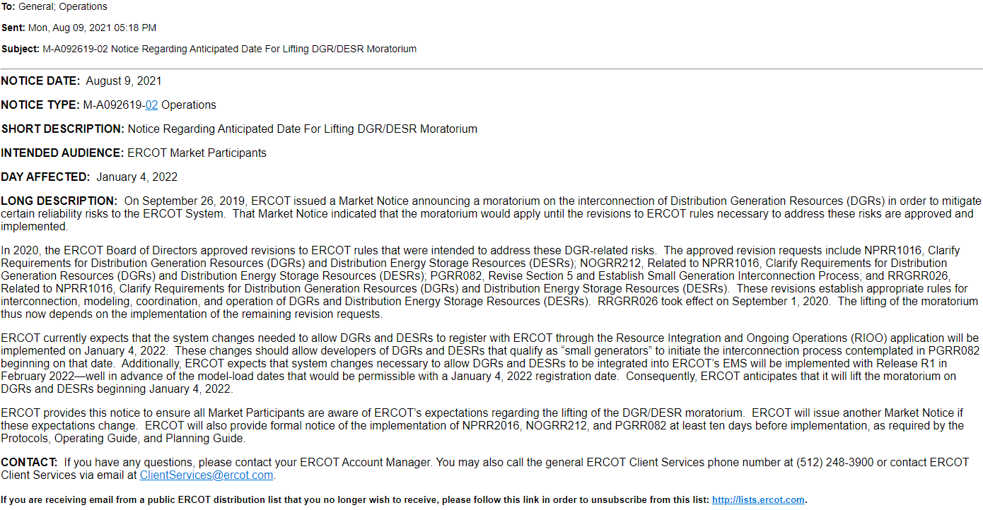
DGR/DESR Moratorium Market Notice – 8/9/2021

