Slide 1
Impact of SVC Power Oscillation Damper at AEP’s 345kV substation

Slide 2
Out Lines
Review of existing problem
POD (Power Oscillation Damper) with 2021 HWLL configuration with both Lubbock system (LPL) in and out
POD with 2023 HWLL configuration
Conclusion

Slide 3
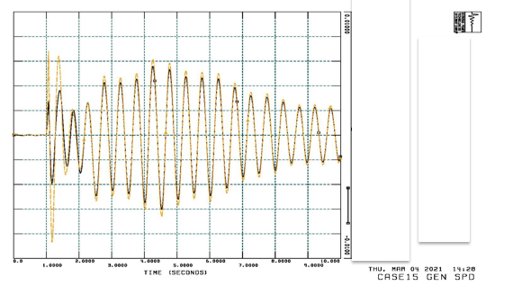
Review of Existing Problem
Undamped power system oscillations may occur following some severe contingencies under certain system conditions in the region near Tesla 345 kV station (ERCOT TNC region).
Undamped Oscillations with N-1 Contingency

Slide 4
Review of Existing Problem
ETT (Electric Transmission Texas, LLC) has approached ABB to investigate whether the POD equipped within the potential Static VAR Compensators (SVCs) installed at the Tesla 345 kV and Hamilton Road 138 kV substations can help to improve damping of power system oscillations
AEP identified 12 undamped /poorly damped contingency cases in the Tesla region using 2021 HWLL case .The cases were then sent to ABB to design POD for the available SVC at Tesla and Hamilton.
Study showed SVC at Tesla 345 kV station alone can damp the oscillation. SVC at Hamilton Road 138 kV station is not necessary

Slide 5
Two Solutions involving six actions are provided for each contingency in order to solve the undamped power system oscillations. Solution 1 involves Action 1, 2, 3, 4 and 6. Solution 2 involves Action 5 and 6.
Action 1 :Switch in the existing shunt capacitor banks. There are two shunt capacitor banks (2x130.9 MVAR) at Tesla 345 kV substation. In the original power flow models, no bank or only one bank is switched in-service under steady-state conditions.
Action 2 :Install and switch in new shunt capacitor bank(s) (assuming the same size of 130.9 MVAR as existing banks) at the Tesla 345 kV substation under steady-state conditions.
Action 3 :Reduce SVC’s regulating voltage at Tesla 345 kV bus from 1.03 pu to 1.0 pu.

Slide 6
Solution 1 involves Action 1, 2, 3, 4 and 6. Solution 2 involves Action 5 and 6.
Action 4 : Increase the nominal rating of SVC (mainly the capacitive limit) to increase the dynamic reactive power supporting capability during system disturbances.
Action 5 : Enable SVC’s supplementary control (also known as the slow susceptance control).
Action 6 : Enable SVC’s POD

Slide 7
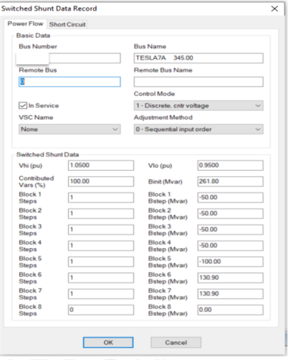
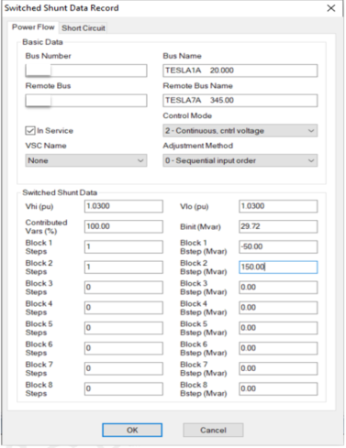
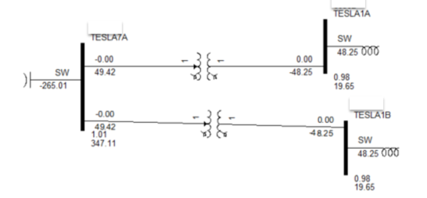
Tesla SVC and Shunt Capacitor
Tesla Shunt Device Data
Tesla SVC data

Slide 8
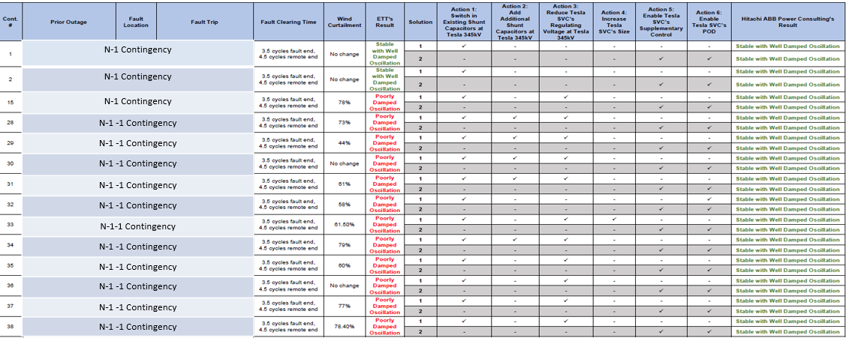
Summary of proposed solution

Slide 9
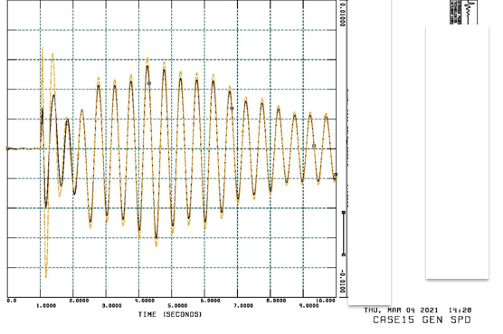
POD with 2021 HWLL Configuration
Without LPL: Case 15
Undamped Oscillations with N-1 Contingency

Slide 10
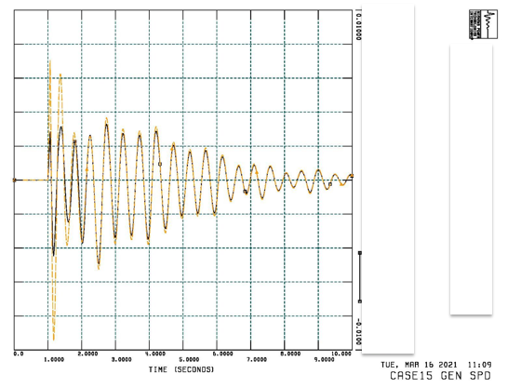
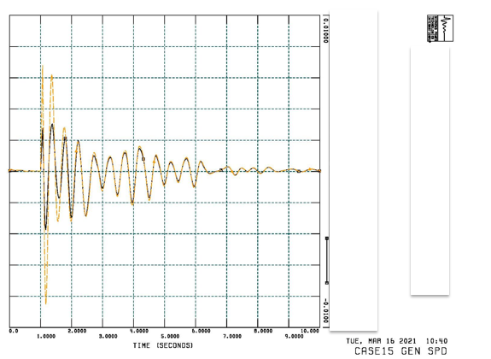
POD can effectively damp out oscillations
POD Solution 1
POD Solution 2

Slide 11
However, the entire study done by ABB was based on ERCOT DWG 2021HWLL configuration which is out of date. This is because:
The integration of LPL in 2020 has greatly improved stability margin of Panhandle area.
Many new generators interconnected in this area in recent years.
As a result, AEP has tested contingency scenarios with Lubbock system added to 2021HWLL base case. There was no oscillation when LPL was added to 2021HWLL.

Slide 12
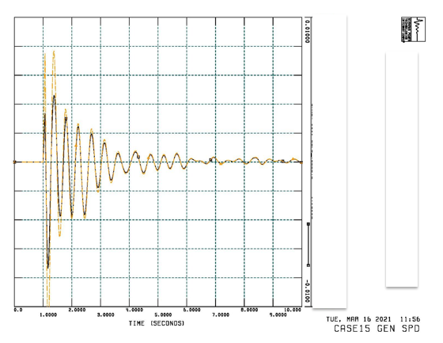
With LPL: Case15,N-1 contingency, Damped oscillations.

Slide 13
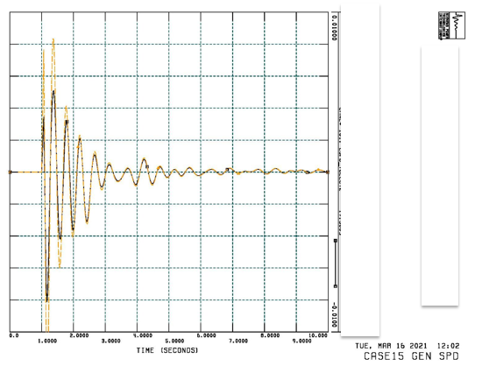
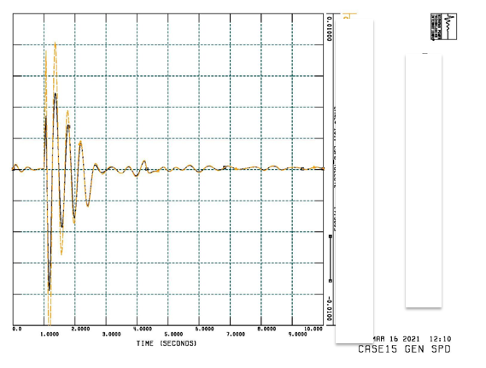
POD function will not negatively impact the system stability performance.
POD Solution 1
POD Solution 2

Slide 14
POD with 2023 HWLL Configuration
Since in recent years more renewable generations were added to the area, we did not try to increase the generation dispatch in 2021HWLL to find oscillation threshold. Instead, 2023HWLL configuration (with newly added generations) was used for study.
We have tested four contingencies against 2023HWLL configuration. No undamped oscillation was observed. At 100% dispatch, there is no flat start although system is still stable. Good flat start can be achieved at 80% dispatch.

Slide 15
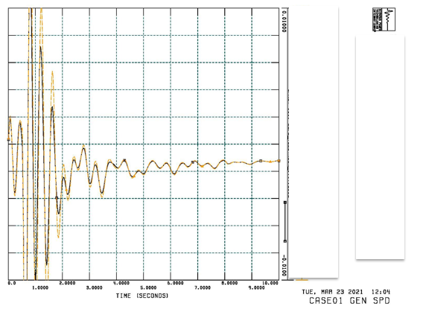
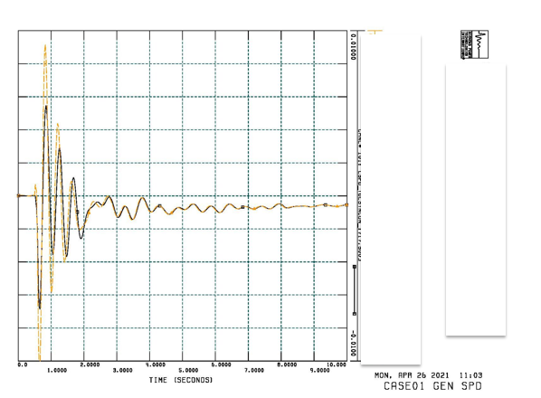
Case 15. N-1 contingency, System is stable with damped oscillations.
100% dispatch, bad flat start
80% dispatch, good flat start

Slide 16
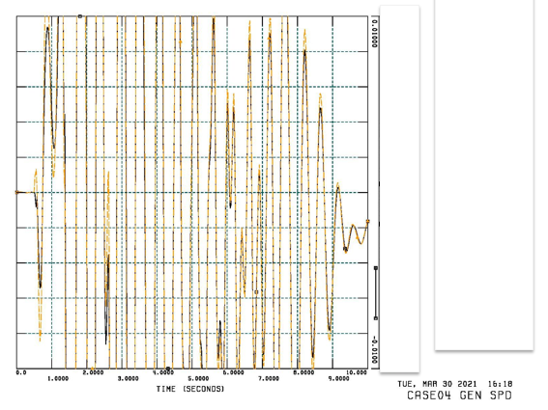
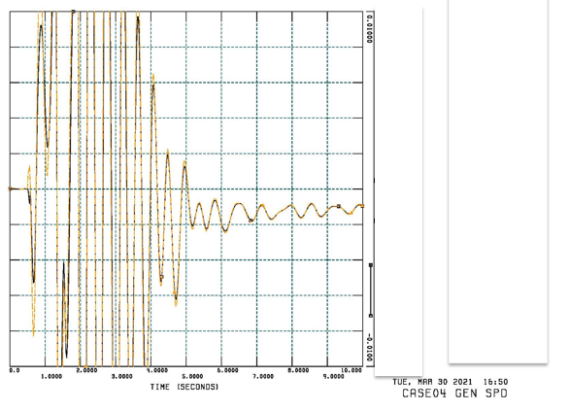
Case 32. N-1-1 Contingency, The system is either stable or unstable. No undamped oscillation.
74% dispatch without POD
73.6% dispatch without POD

Slide 17
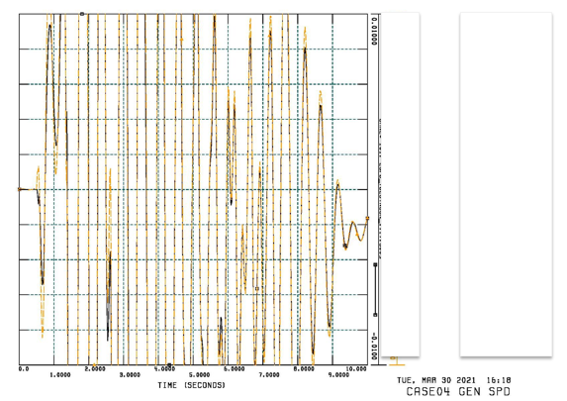
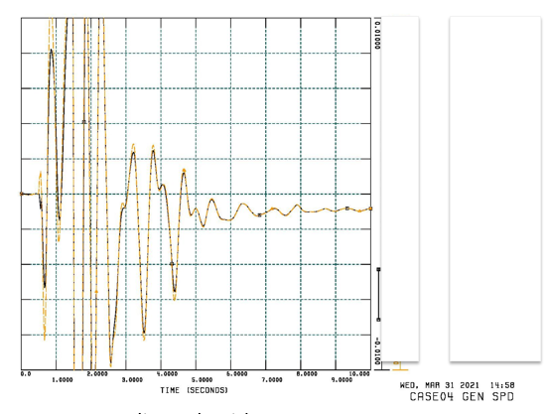
Case 32. N-1-1 Contingency, 3p fault. POD function could slightly increase stability margin (<1%)
74% dispatch without POD
74% dispatch with POD

Slide 18
Conclusion
Only 2021HWLL configuration without LPL exhibits undamped oscillations.
LPL has positively increased system stability margin and potentially mitigated oscillation problems.
With more renewable generation resources connect to this area, it is expected to continue assess the system stability and identify if POD support is need to mitigate the issues.

Slide 19
Conclusion
Questions ?

