Slide 1
PDCWG Report to ROS
Chair: Chad Mulholland, NRG
Vice Chair: Jimmy Jackson, CPS
ROS
November 04, 2021

Slide 2
Report Overview & Notes
Report Overview
Meeting Minutes
BAL-001-TRE-2 FMEs and IMFR
2 FMEs in the month of September
Frequency Control Report

Slide 3
Meeting Minutes
PDCWG Meeting 10/13/2021
Review of emergency conditions list from ROS
ERCOT Ancillary Service Methodology Discussion
Overview of updates related to ESR operations in QSE Operations during Operating Hour Business Practice Manual
ERCOT reports

Slide 4
PDCWG Items from TAC Emergency Conditions List (p1)
6 Resource Telemetry: Ensure accurate exchange of Resource telemetry information related to PRC to enhance situational awareness during EEA events.
Consideration should be given to creating a new Resource Status for ONHOLD – this could be developed for situations of uncertainty, or trouble-shooting, on the generator side, and would provide ERCOT and PRC with better insight when a generator is experiencing issues.
NPRR1085 is tied to this topic.
PDCWG recommendation is to close the action item and allow NPRR1085 to work through the stake holder process.
30 Frequency Relay Points: Analyze load shed responsibilities related to frequencies for generation and load and ensure alignment.
PDCWG believes our role for this action item is secondary to other groups, and that the topic closely ties to action item 45. On action item 45, PDCWG feels that our role is leading.
PDCWG believes some collaborative discussions should be held to consider any options to modify load shed procedures. In particular, could some amount of automated load shed occur at frequency thresholds above 59.30 Hz (in relation to NOGRR 226)?
It is possible for damage to occur to generator turbines when frequency is between 59.6 Hz and 59.3 Hz if the condition persists, or if it reaches resonance with turbines.
PDCWG recommendation is to close the action item and allow NOGRR226 to work through the stakeholder process.

Slide 5
PDCWG Items from TAC Emergency Conditions List (p2)
44 Ancillary Service Products: Review existing ancillary service products and determine if existing suite of products and amounts is adequate based on lessons learned from the February 2021 winter weather event.
PDCWG views this as a very broad issue – it warrants continuous reevaluation and revision consideration, but changes have complicated impacts to both reliability and economics
Ancillary Services already have planned future modifications tied to Real-Time Co-optimization and NPRR 863 (ERCOT Contingency Reserves)
There are aspects of Energy Storage Resources, in particular, that might deserve some product/service re-design – TAC Emergency Contingency List Item 91 is directed at this topic
PDCWG recommends closing the action item and creating a new, temporary, task force or work group to dive deeper into ERCOT’s Ancillary Service Methodology, and analyzing historical Ancillary Service allocations
91 Could FFR play a bigger role?
Any additional ESR capacity (not necessarily specific to FFR) that could have been brought on line on Feb 15 could have been beneficial – as is true for any additional MW availability, from any resource
Had some ESR devices carrying FFR been awarded and served during the Feb 15 cold weather event, that service could have been particularly valuable in that it would have delivered those MW only once the frequency dropped below 59.85 Hz
Additional frequency trigger points for FFR could enhance the benefits of the service
PDCWG recommendation is to close the action item and allow NOGRR226 and the temporary task force/work group to review the Ancillary Service Methodology to work through the stakeholder process (per Action Item 30 and 44)

Slide 6
PDCWG Items from TAC Emergency Conditions List (p3)
45 Frequency: Analyze system frequency leading up to EEA conditions and determine impact of low frequency on generation and load tripping
Telemetry errors from generators due to rapidly developing weather conditions and grid dynamics contributed to errant PRC calculation at ERCOT; this created a negative feedback loop where errors from generators caused errors at ERCOT, which then worsened problems for the generators
The slow frequency degradation, exhausted Ancillary Services / Contingency Reserves, and incremental load sheds resulted in a frequency value between 59.30 and 59.40 Hz for about 4 minutes and 20 seconds on the morning of Feb 15
Any frequency value below 59.60 Hz presents some risk of damage to the generator fleet – the impacts are highly dependent upon other system conditions (voltage), the depth of the frequency excursion, and on trend-line stability (oscillations are particularly problematic)
24,000 MW of ERCOT generation has relay settings that trip if frequency is below 59.4 Hz for 9 min (PRC-024) – 17,000 MW of such generation was on line on Feb 15; had frequency remained low for a few minutes longer, our circumstance could have become much worse
NOGRR 226 proposes that the first 5% of TO Load Shed relay set point be moved from 59.30 Hz to 59.40 Hz, and PDCWG members have expressed some wide ranging flexibility as to how something like NOGRR 226 might be implemented
PDCWG recommendation is to close the action item and allow NOGRR226 and the temporary task force/work group to review the Ancillary Service Methodology to work through the stakeholder process (per Action Item 30 and 44)

Slide 7
Frequency Measurable Events Performance

Slide 8
Frequency Measurable Events
There were 2 FMEs in September
9/12/2021 23:17:44
Loss of 847 MW generation
Interconnection Frequency Response: 931 MW/0.1 Hz
45 Resources were evaluated. These includes,
43 Generation Resources
2 Controllable Load Resources
0 Energy Storage Resources
9 of 43 Evaluated Generation Resources had less than 75% of their expected Initial Primary Frequency Response.
9 of 43 Evaluated Generation Resources had less than 75% of their expected Sustained Primary Frequency Response.

Slide 9
Frequency Measurable Events
9/25/2021 15:39:15
Loss of 499 MW generation
Interconnection Frequency Response: 1134 MW/0.1 Hz
27 Resources were evaluated. These includes
25 Generation Resources
2 Controllable Load Resources
0 Energy Storage Resources
1 of 25 Evaluated Generation Resources had less than 75% of their expected Initial Primary Frequency Response.
0 of 25 Evaluated Generation Resources had less than 75% of their expected Sustained Primary Frequency Response.

Slide 10
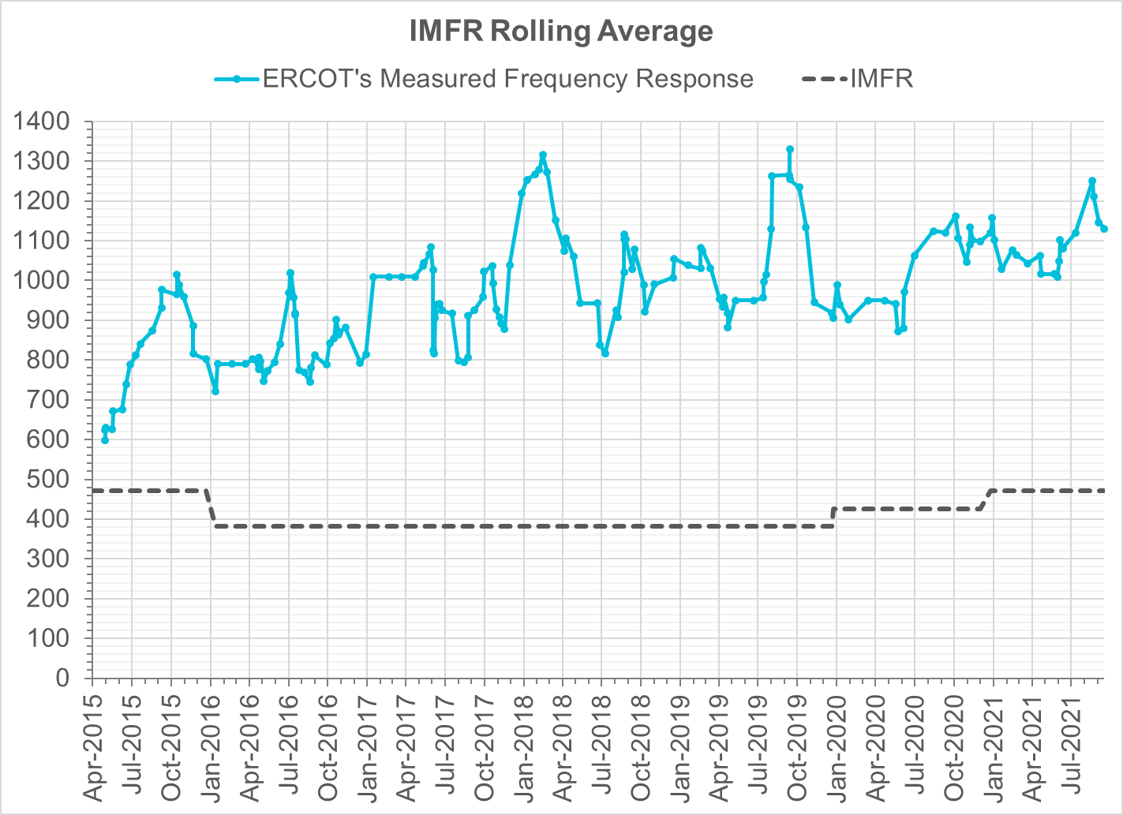
Interconnection Minimum Frequency Response (IMFR) Performance
IMFR Performance currently
1130.5 MW/0.1HZ
Frequency Response Obligation (FRO): 471 MW/0.1 Hz

Slide 11
Questions?

Slide 12
Frequency Control Report
September 2021

Slide 13
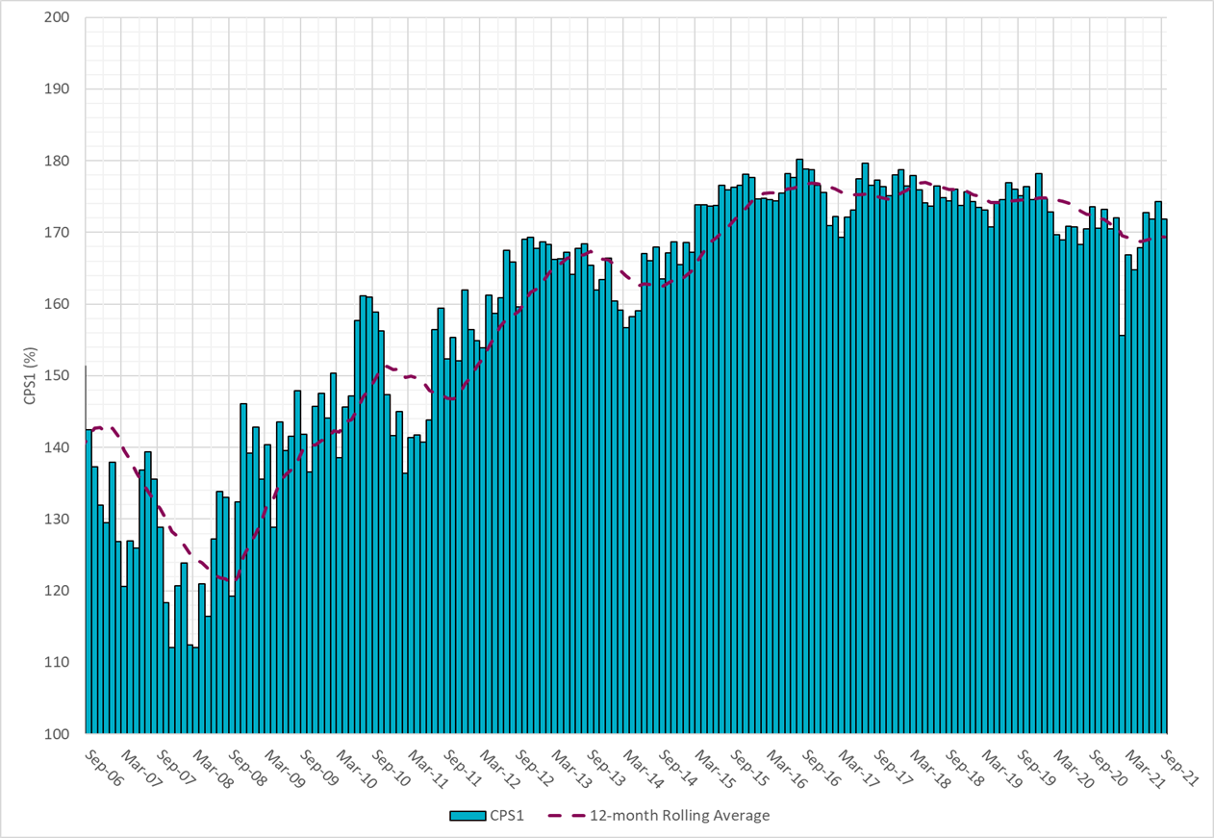
CPS1 Performance
Current 12-Month Rolling Average: 169.33%

Slide 14
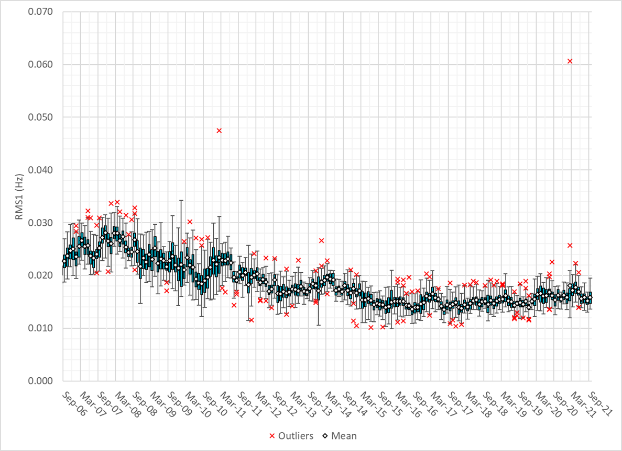
RMS1 Performance of ERCOT Frequency

Slide 15
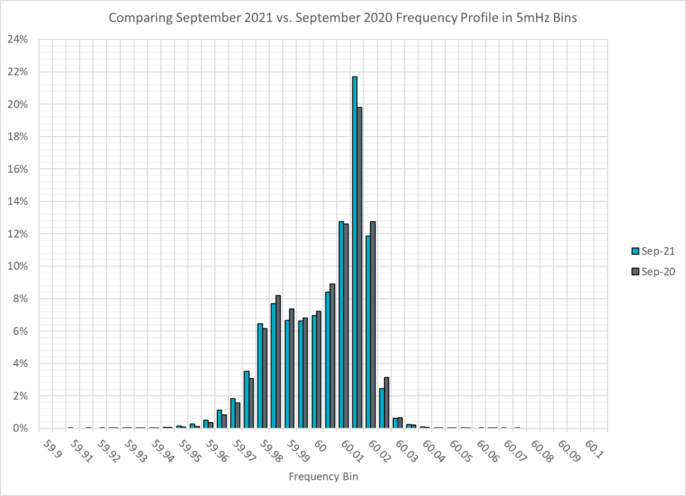
Frequency Profile Analysis

Slide 16
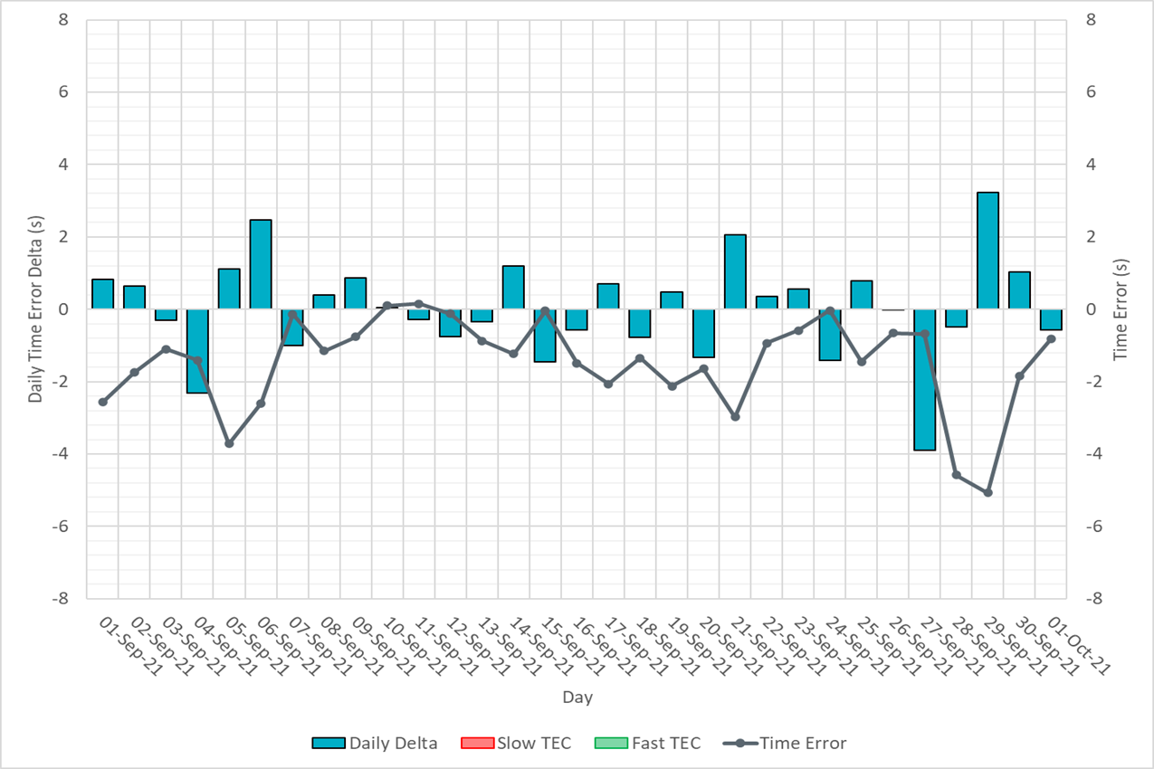
Time Error Corrections

Slide 17
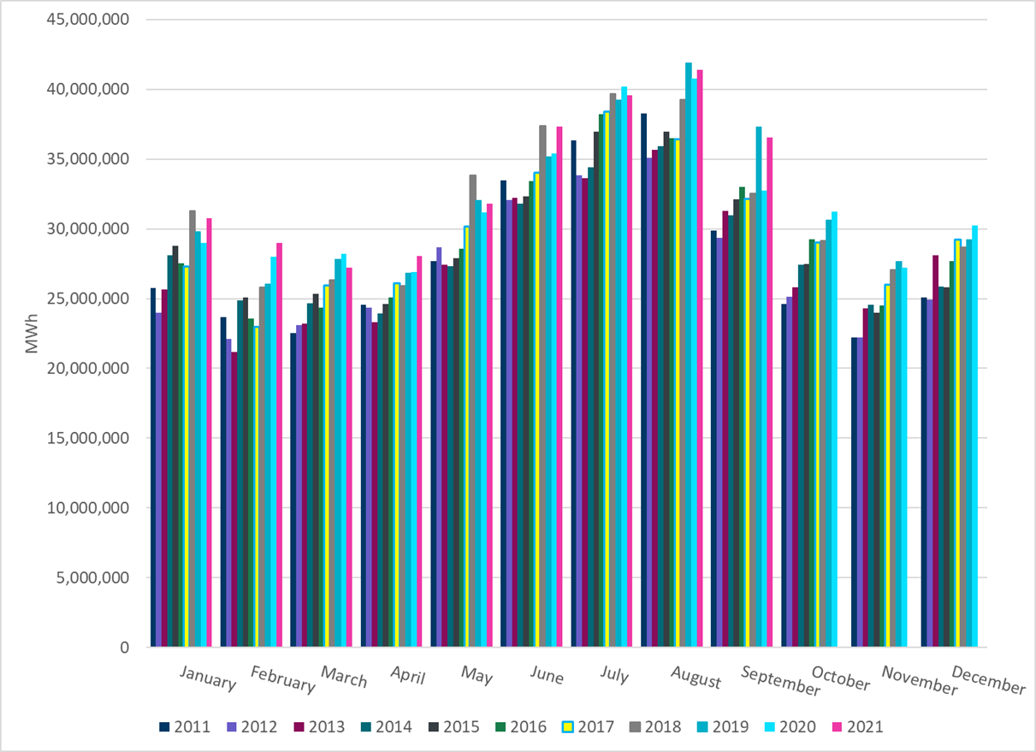
ERCOT Total Energy
Notes:
36,556,459 MWh

Slide 18
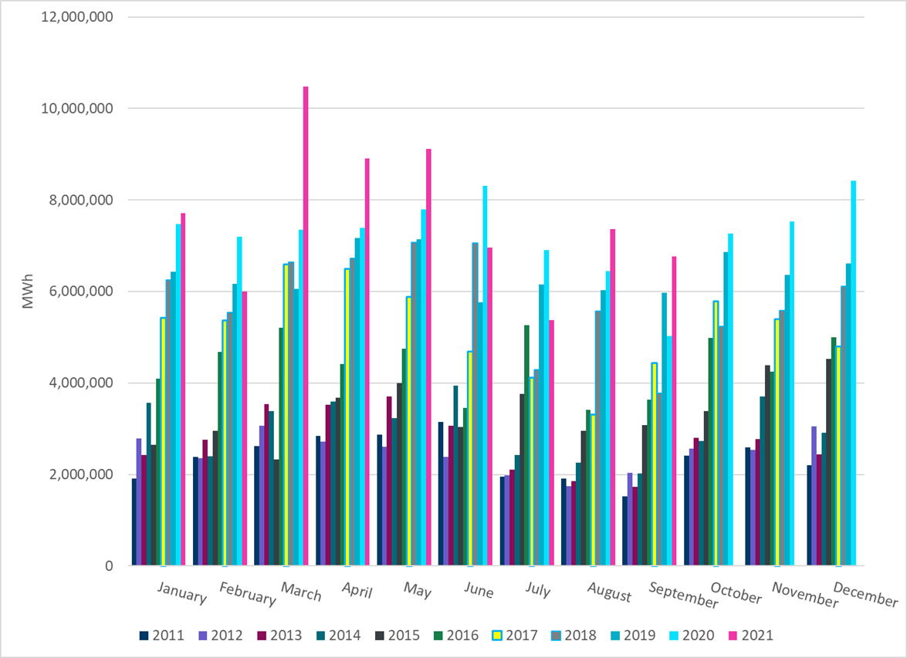
ERCOT Total Energy from Wind Generation
Notes:
6,767,688 MWh

Slide 19
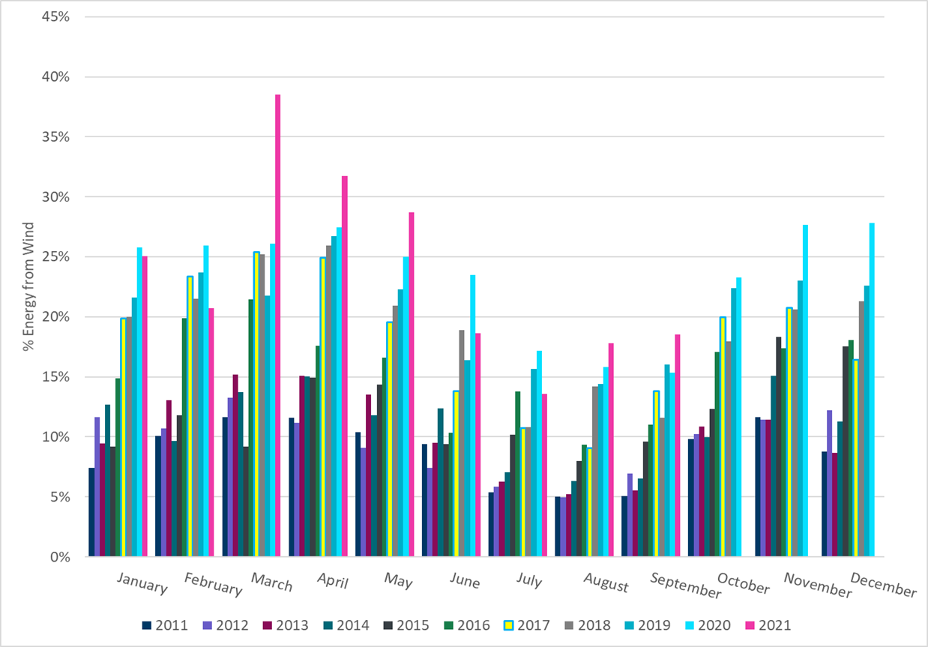
ERCOT % Energy from Wind Generation
Notes:
18.51%

Slide 20
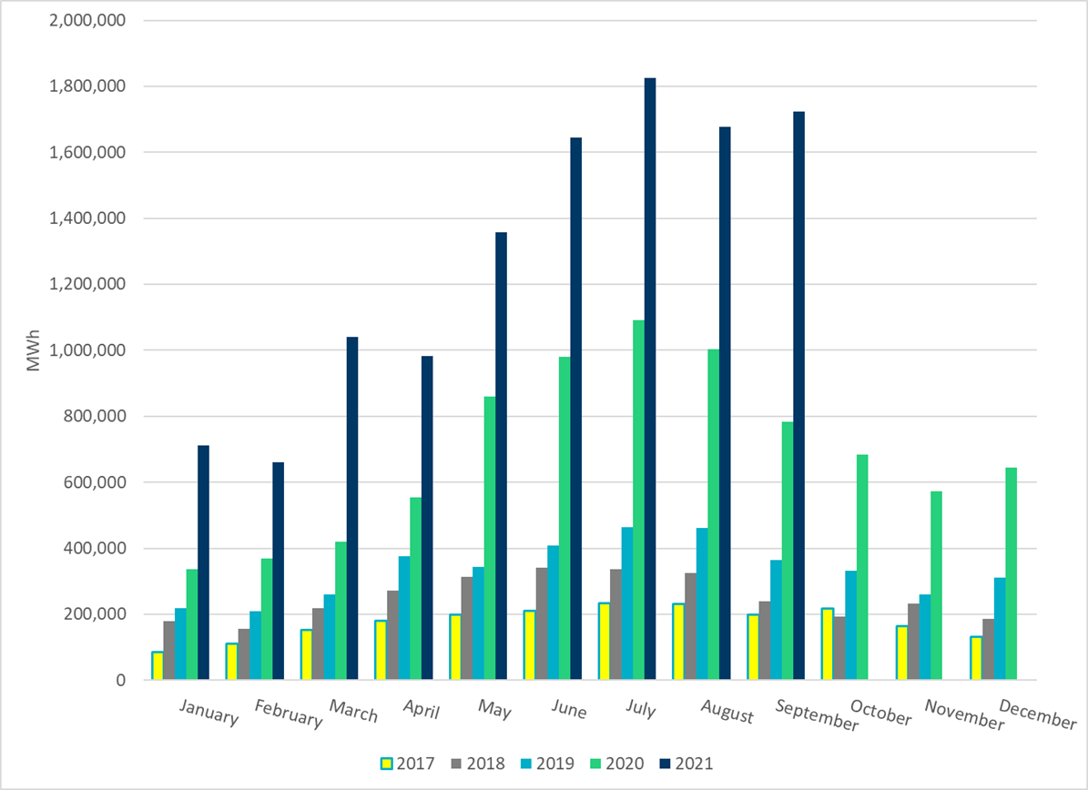
ERCOT Total Energy from Solar Generation
Notes:
1,723,725 MWh

Slide 21
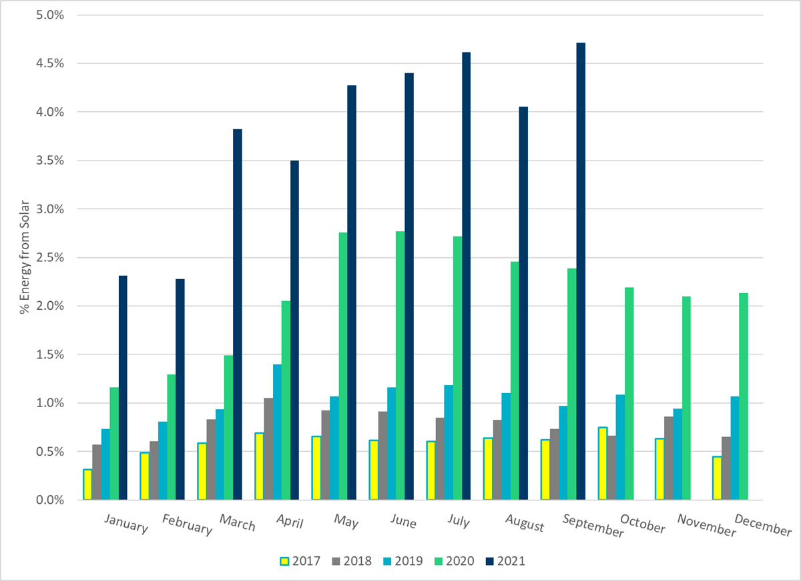
ERCOT % Energy from Solar Generation
Notes:
4.72%

