Slide 1
2021 RMS Winter Weather Preparedness Workshop
Jim Lee, AEP Texas
Sheri Wiegand, Vistra

Slide 2
Agenda:
Purpose & Scope
ERCOT EEA Operations
TDU Evaluation and Approval of Critical Care/Chronic Condition &
Critical Load applications
Review of Widespread Prolonged Outage Procedures
& TDSP EOP Procedures
Overview of Mass Transition Processes, Timeline & Communication
Q&A

Slide 3
Scope & Purpose
Overview of the processes and procedures established for the ERCOT Retail market and its Market Participants, and suggestions for preparation in the events of a major weather event which may necessitate emergency operation deployment/activation in order to preserve the integrity and reliability of the ERCOT grid.
Highlighting applicable PUCT substantive rules, ERCOT Nodal Protocols, Retail operational practices, and Market Participant communications utilized before, during, and after emergency situations including, but not limited to: ERCOT Energy Emergency Alert (EEA) operations, critical care/critical load processes, TDSP outage management and communications, handling of AMS data during prolonged widespread outages, and overview of the Mass Transition process.
These workshops will be held twice a year and Market Participants are encouraged to fully review referenced PUCT Rules and ERCOT Protocols and Market Guides for a full understanding of applicable rules and protocols.

Slide 4
ERCOT Energy Emergency Alert (EEA) Operations

Slide 5
ERCOT Role
& Responsibilities

Slide 6
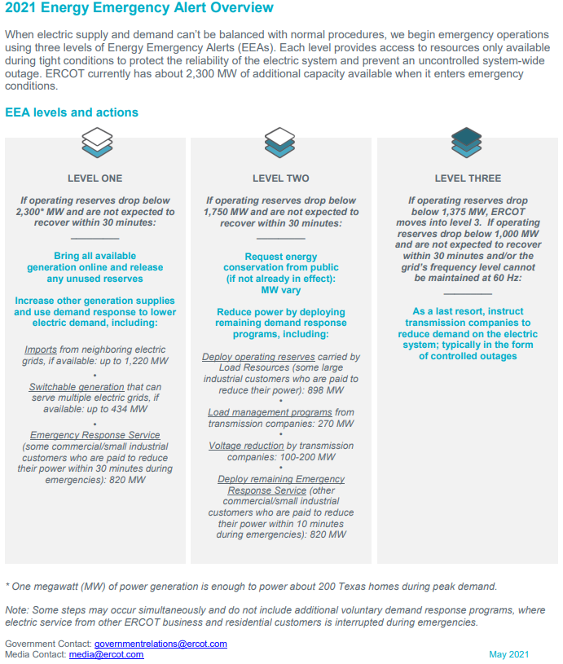

Slide 7
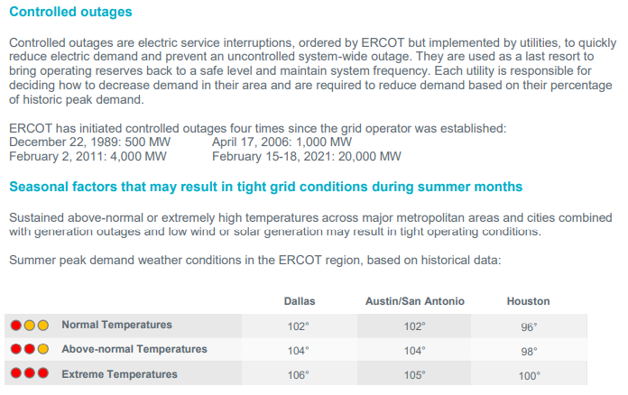

http://www.ercot.com/news/summer2021

Slide 8
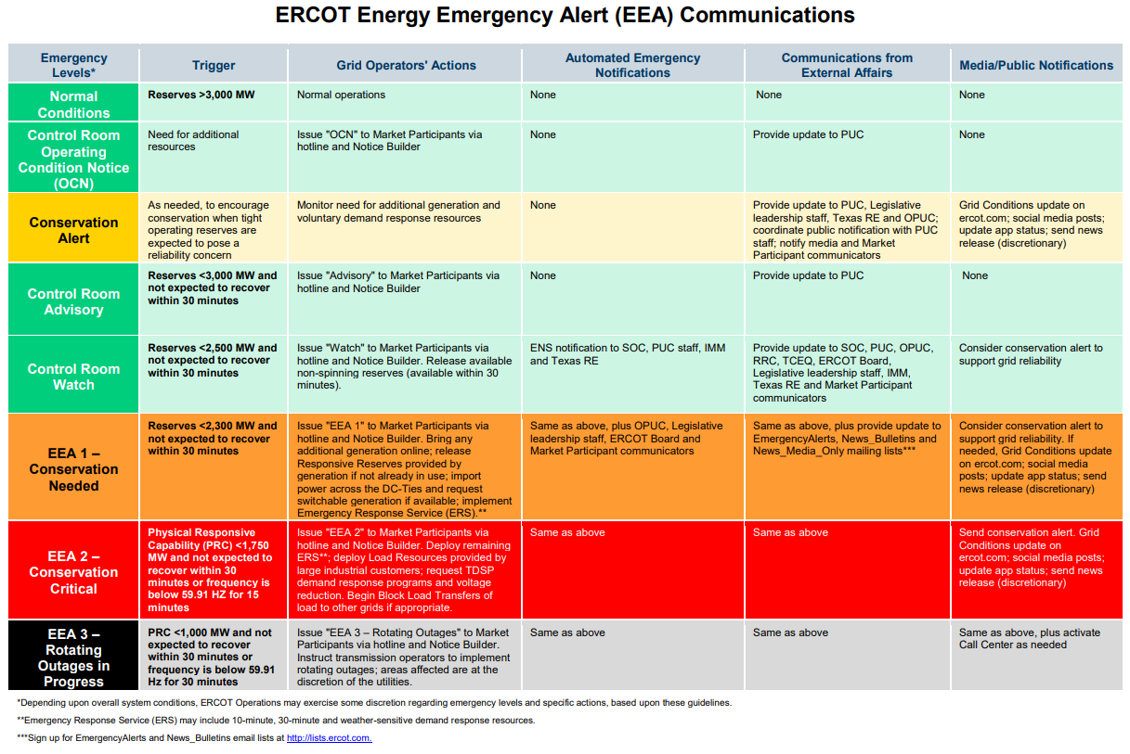

Slide 9
Nodal Protocol 6.5.9, Emergency Operations
NP 6.5.9.3(2) – Communication under Emergency Conditions
The type of communication ERCOT issues is determined primarily on the basis of the time available for the market to respond before an Emergency Condition occurs. The timing of these communications could range from days in advance to immediate. If there is insufficient time to allow the market to react, ERCOT may bypass one or more of the communication steps.
  Operating Condition Notice (OCN) [NP 6.5.9.3.1]
  Advance Action Notice (AAN) [NP 6.5.9.3.1.1]
  Advisory [NP 6.5.9.3.2]
  Watch [NP 6.5.9.3.3]
  Emergency Notice [NP 6.5.9.3.4]

Slide 10
Nodal Protocol 6.5.9.3.4, Emergency Notice
(2) ERCOT shall issue an Emergency Notice for one or both of the following reasons:
  ERCOT cannot maintain minimum reliability standards (for reasons including fuel shortages) during the Operating Period using every Resource practicably obtainable from the market; or
  Immediate action cannot be taken to avoid or relieve a Transmission Element operating above its Emergency Rating.
(3) The actions ERCOT takes during an Emergency Condition depend on the nature and severity of the situation.
(5) If the Emergency Condition is the result of a transmission problem, ERCOT shall act immediately to return the ERCOT System to a reliable condition, including instructing Resources to change output, curtailing any remaining DC Tie Load, and instructing TSPs or DSPs to drop Load.

Slide 11
TSP/DSP
Role & Responsibilities

Slide 12
ERCOT will declare EEA levels according to available Physical Responsive Capability (PRC) MW reserves, and will take the steps outlined in NOG 4.5.3.3, EEA Levels, to maintain steady state system frequency near 60 Hz and restore PRC appropriate for each EEA level.
When the TSP/DSP receives Energy Emergency Alert (EEA) Load Shedding instructions from ERCOT, the TSP/DSP’s responsibility is to perform all necessary actions as prescribed in the ERCOT Nodal Operating Guides (NOG) Section 4, Emergency Operations within the timelines as specified throughout this section.
Section 4: Emergency Operation

Slide 13
Example: Timing of ERCOT Instructions to TSP/DSP
Initial Instructions:
ERCOT will instruct TSP/DSPs to shed X MWs on the Distribution System within 30 minutes.
Follow-up Instructions:
After completing the initial 30 minute instruction, ERCOT operator may continue with further instructions if the PRC has not been restored.
Follow up instructions can range from ten (10) to thirty (30) minute durations with specific instructions for TSP/DSPs to continue load shedding procedures until ERCOT declares the EEA event has been terminated.
Note: TDSPs rotate outages on the Distribution system only. The Transmission system is not subject to rotating outages.

Slide 14
Nodal Operating Guide 4.5.3.4, Load Shed Obligation

Slide 15
EEA Termination

Slide 16
Nodal Operating Guide 4.5.3.5, EEA Termination
  (1) ERCOT shall:
    (a) Continue EEA until sufficient Resources are available to ERCOT to eliminate the shortfall and restore adequate reserves;
    (b) Restore full reserve requirements (normally 2300 MW);
    (c) Terminate the levels in reverse order, where practical;
    (d) Notify each QSE and TO of EEA level termination; and
    (e) Maintain a stable ERCOT System frequency when restoring Load.
  (2) QSEs and TOs shall:
    (a) Implement actions to terminate previous actions as EEA levels are released in accordance with these Operating Guides;
    (b) Notify represented Market Participants of EEA levels changes;
    (c) Report back to the ERCOT System Operator when each level is accomplished; and
    (d) Loads will be restored when specifically authorized by the ERCOT.

Slide 17
Additional ERCOT Communications Information
  Tips for Conservation: http://www.ercot.com/content/wcm/lists/219692/Energy_Conservation_FINAL_8.4.2021.pdf
  ERCOT EEA Communications Matrix: http://www.ercot.com/content/wcm/lists/197394/ERCOT_Energy_Emergency_Alert_Communications_Matrix_October_2020.pdf
  ERCOT EEA Overview: http://www.ercot.com/content/wcm/lists/219692/2021_EEA_Overview_Final.pdf
  ERCOT Emergency Operations & Communications Web-Based Training
  http://www.ercot.com/services/training/course/159883

Slide 18
ERCOT Energy Emergency Alerts (EEA) Matrix

Slide 19

  Questions?

Slide 20
TDU evaluation and approval of
Critical Care,
Chronic Condition & Critical Load applications

Slide 21
For your Reference
PUCT Subst. Rule §25.497
    Critical Load Industrial Customers, Critical Load Public Safety Customers,
    Critical Care Residential Customers, and Chronic Condition Residential Customers

Slide 22
Critical Load, Critical Care, Chronic Condition
A complete step-by-step procedure for obtaining Critical Care Residential Customer or Chronic Condition Residential Customer designation is provided in 25.497(e).
The TDU is responsible for evaluation and approval of Critical Care, Chronic Condition and Critical Load status through the submittal of the PUCT-approved form, which is posted on the PUCT website and on each TDU’s website.
Following TDU evaluation and approval, the TDU will update ESI ID attributes to reflect the Critical Care, Chronic Condition or Critical Load status via 814_20 ESIID Maintenance transaction through ERCOT, which is passed to the CR of Record.

Slide 23
Critical Load, Critical Care, Chronic Condition
(c) Benefits for Critical Load Public Safety Customers, Critical Load Industrial Customers, Critical Care Residential Customers, and Chronic Condition Residential Customers.
  (1) A Critical Load Public Safety Customer or a Critical Load Industrial Customer qualifies for notifications of interruptions or suspensions of service as provided in Sections 4.2.5, 5.2.5, and 5.3.7.1 of the TDU’s tariff for retail delivery service.
  (2) A Critical Care Residential Customer or Chronic Condition Residential Customer qualifies for notification of interruptions or suspensions of service, as provided in Sections 4.2.5, 5.2.5, and 5.3.7.1, and for Critical Care Residential Customers protections against suspension or disconnection, as provided in Section 5.3.7.4(1)(D) and (E), of the TDU’s tariff for retail delivery service.
  (3) A Critical Care Residential Customer or Chronic Condition Residential Customer is also eligible for certain protections as described in §25.483 (relating to Disconnection of Service).
  (4) Designation as a Critical Load Customer, Critical Care Residential Customer, or Chronic Condition Residential Customer does not guarantee the uninterrupted supply of electricity.

Slide 24
  Questions?

Slide 25
TDSP AMS Data Practices
&
TDSP EOP Procedures

Slide 26
  Questions?

Slide 27
Overview of Mass Transition process, Timeline, and communications
Note: Mass Transition events are not always tied to an ERCOT EEA event or a TDSP EOP event.

Slide 28
Timeline for Initiation of a Mass Transition

Slide 29
Mass Transition Timeline
“Notification Date”
Day 0
Day 1
“Mass Transition Date”
Day 2
Day 3 / Day 4 / Day 5
ERCOT provides notice of Mass Transition event to impacted CRs, TDSPs, and PUCT
Notice before 3pm CT:
Proj. Coord. call held by 5pm.
Notice after 3pm CT:
Proj. Coord. call held next morning.
Project Coordination
Call 1
Project Coordination
Call 2
Project Coordination
Call 3
Where applicable, TDSPs will send 867_04 and/or 867_03F for SWI/MVI/Drop to POLR transactions completed
ERCOT begins Customer outreach to inform of POLR event
(postcard/email/phone/text)
ERCOT forwards any ‘competitive’ 814_03
SWI or MVI to TDSP
ERCOT sends 814_03 “TS” Drop to POLR transactions to TDSPs with an effective date of two calendar days out
(“Mass Transition Date”)
TDSP executes
‘competitive’ 814_03
SWI or MVI
if rec’d by 7pm CPT
ERCOT forwards any ‘competitive’ 814_03
SWI or MVI to TDSP
TDSP schedules Drop to POLR as requested by ERCOT
Once a default is confirmed, ERCOT provides impacted TDSPs with the Defaulting CR DUNS to prepare systems for a Mass Transition event
TDSP executes SWI or MVI in lieu of scheduled Drop to POLR; ERCOT sends Cancel for Drop to POLR
Beginning 7:01pm CPT, TDSPs execute the remaining population of Drop to POLR transactions
(if SWI/MVI hasn’t been already executed by TDSP or Cancelled by ERCOT)
Default CR provides CBCI file to ERCOT
IMPORTANT NOTE:
Per PUCT Subst. R 25.43, if a Mass Transition Drop to POLR’s Effective Date falls on a Sunday or Holiday, non-AMS Operational Day rules and non-Business day rules shall apply. Meaning, no competitive 814_01 Switch or 814_16 Move-In will be scheduled for the same Effective Date, thereby only the Drop to POLR will effectuate.

Slide 30
Market Communications of Mass Transition event

Slide 31
ERCOT Market Communications
PUCT Subst. Rule §25.43(u) – Market Notice of Transition to POLR Service
ERCOT shall notify all affected Market Participants and the Retail Market Subcommittee (RMS) email listserv of a mass transition event within the same day of an initial mass-transition call after the call has taken place. The notification shall include the exiting REP’s name, total number of ESI IDs, and estimated load.
Market Participant suggested steps for Mass Transition event readiness:
Ensure Authorized Representative (AR) and Back-up AR contacts are up-to-date via ERCOT Notice of Change of Information (NCI) form for timely ERCOT communications regarding:
  Notification of Mass Transition event
  Receipt of ESI ID file
“ERCOT Initiated” MarkeTrak issues may be received by any impacted REPs with in-flight transactions involving exiting CR(s)
Customer Billing and Contact Information (CBCI) file will be received via NAESB
Mass Transition Web-Based Training for familiarity of Mass Transition process

Slide 32
Customer Communications (pre-transition)
PUCT Subst. Rule §25.43(t) - Notice of transition to POLR service to customers
When a customer is moved to POLR service, the customer shall be provided notice of the transition by ERCOT, the REP transitioning the customer, and the POLR provider.
The ERCOT notice shall be provided within two days of the time ERCOT and the transitioning REP know that the customer shall be transitioned and customer contact information is available. If ERCOT cannot provide notice to customers within two days, it shall provide notice as soon as practicable.
    (1) ERCOT notice methods shall include a post-card, containing the official commission seal with language and format approved by the commission. ERCOT shall notify transitioned customers with an automated phone-call and email to the extent the information to contact the customer is available pursuant to subsection (p)(6) of this section. ERCOT shall study the effectiveness of the notice methods used and report the results to the commission.

Slide 33
  Questions?

