Slide 1
Unregistered Distributed Generation Report:
2021 Q3 Update
Resource Adequacy
Fred Khodabakhsh,
11/3/2021

Slide 2
2021 Q3 Unregistered Distributed Generation Report
Load Zone | 2021 Q3 Distributed Generation Installed Capacity in MW (AC)
 | SOLAR |  | WIND |  | OTHER RENEWABLE |  | OTHER NON-RENEWABLE |  | TOTAL
 | < 50 kW | ≥ 50 kW | < 50 kW | ≥ 50 kW | < 50 kW | ≥ 50 kW | < 50 kW | ≥ 50 kW | < 50 kW | ≥ 50 kW | Combined
LZ_AEN | 70 | 28 | - | - | - | - | - | - | 70 | 28 | 98
LZ_CPS | 189 | 40 | - | - | 2 | - | - | 20 | 191 | 60 | 252
LZ_HOUSTON | 129 | 3 | - | - | - | - | - | 5 | 130 | 8 | 137
LZ_LCRA | 69 | 18 | - | - | - | 1 | 1 | - | 70 | 19 | 89
LZ_NORTH | 350 | 31 | 2 | 1 | - | - | 3 | 5 | 356 | 37 | 392
LZ_RAYBN | 24 | 3 | - | - | - | - | - | - | 24 | 3 | 27
LZ_SOUTH | 142 | 23 | 1 | - | - | - | 1 | - | 144 | 24 | 168
LZ_WEST | 57 | 7 | 1 | - | - | - | - | 1 | 57 | 7 | 65
TOTAL | 1,031 | 153 | 4 | 2 | 2 | 1 | 5 | 30 | 1,042 | 185 | 1,228
Totals may not match the sum of their columns/rows due to rounding
Notes:
Competitive vs. NOIE breakdown:
Competitive: 654 MW
NOIE: 574 MW
NOIE data is submitted through surveys. Competitive TDSP data is submitted through load profile codes.

Slide 3
2021 Q2 → Q3 Change
Load Zone | 2021 Q2 → Q3 Change in Distributed Generation Installed Capacity in MW (AC)
 | SOLAR |  | WIND |  | OTHER RENEWABLE |  | OTHER NON-RENEWABLE |  | TOTAL
 | < 50 kW | ≥ 50 kW | < 50 kW | ≥ 50 kW | < 50 kW | ≥ 50 kW | < 50 kW | ≥ 50 kW | < 50 kW | ≥ 50 kW | Combined
LZ_AEN | +2.97 | +0.96 | - | - | - | - | - | - | +2.97 | +0.96 | +3.93
LZ_CPS | +9.86 | +0.40 | - | - | +0.38 | - | - | - | +10.23 | +0.40 | +10.63
LZ_HOUSTON | +19.57 | +0.18 | - | - | +0.02 | - | +0.05 | - | +19.64 | +0.18 | +19.82
LZ_LCRA | +5.02 | +0.12 | - | - | - | - | +0.10 | - | +5.12 | +0.12 | +5.25
LZ_NORTH | +36.79 | +0.75 | +0.01 | - | +0.04 | +0.24 | +1.53 | - | +38.36 | +0.99 | +39.35
LZ_RAYBN | +3.29 | - | +0.01 | -0.05 | - | - | - | - | +3.30 | -0.05 | +3.25
LZ_SOUTH | +13.65 | +0.29 | - | - | - | - | +0.45 | - | +16.38 | +0.29 | +16.68
LZ_WEST | +8.41 | +0.38 | - | - | - | - | +0.02 | - | +8.42 | +0.38 | +8.80
TOTAL | +101.84 | +3.09 | +0.02 | -0.05 | +0.44 | +0.24 | +2.14 | - | +104.44 | +3.28 | +107.72
Totals may not match the sum of their columns/rows due to rounding
Notes:
- Negative number reflect a windmill retirement

Slide 4
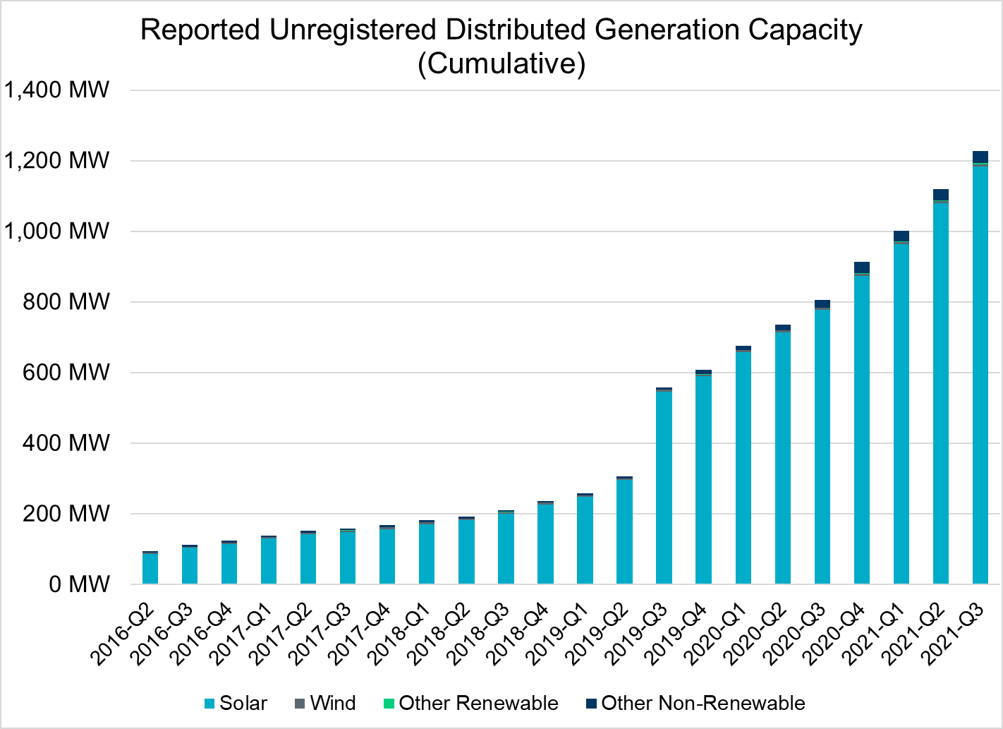
Unregistered DG Growth: 2016-Q2* to 2021-Q3
Large increase due to reporting requirement change**
* 2016-Q2 was the first report published after implementation of report changes per NPRR794/COPMGR044
** 2019-Q3 was the first report published after implementation of report changes per NPRR891

