Slide 1
Comparison of Unplanned Outages for the 2011, 2014, and 2018 Severe Winter Weather Events
Supply Analysis Working Group
Fred Khodabakhsh
Resource Adequacy Dept.
October 29, 2021
Notes:
Welcome to

Slide 2
Introduction
Evaluated the 2011, 2014 and 2018 severe winter weather events
Outages declined for severe weather events after the 2011 event; determine if the 2014 and/or 2018 events are comparable to the 2011 event — and each other — in terms of severity (lowest daily temps, low temp duration, wind speed)
Use the post-2011 reductions in instrumentation-freeze-related outages and maximum/average outages to inform what we may expect in terms of outage improvements from ongoing weatherization and other electric/gas supply reliability improvement efforts

Slide 3
Analysis Approach
Revisit weather and instrumentation outage data presented at the 2020 weatherization workshop
Determine maximum outage decreases for 2014 and 2018 events relative to the 2011 event baseline
All the resources with start dates after the 2011 winter weather event were excluded from this analysis to ensure resource comparability
2011 and 2018 events didn’t have any nuclear outages, so for this analysis the nuclear resources were excluded

Slide 4
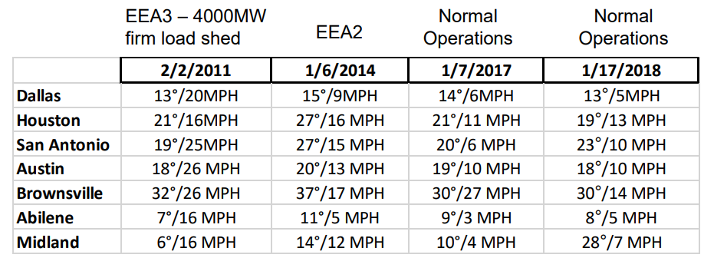
Event Comparison: Low Temps and Wind Speeds During Four Coldest Days
Source: Chris Coleman, Generator Winter Weatherization Workshop, September 3, 2020.
Compared to the 2011 event:
2014 event had less severe low temps and wind chills
2018 event comparable in low temp severity, but with less severe wind chills; exception is West Texas, which faired much better than 2011 and 2014 events with respect to low temps

Slide 5
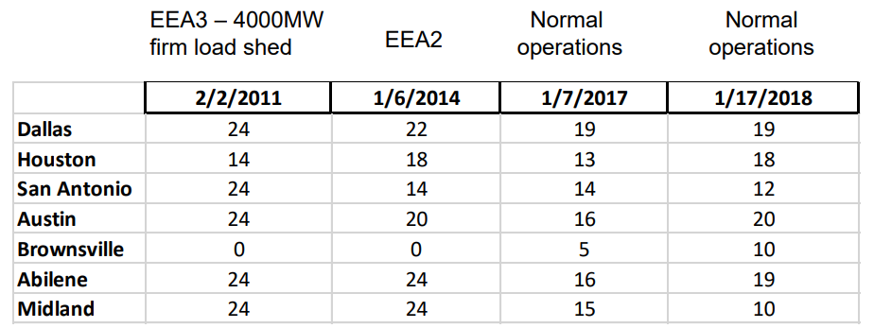
Event Comparison: Number of Hours at and below Freezing During Four Coldest Days
Source: Chris Coleman, Generator Winter Weatherization Workshop, September 3, 2020.
Compared to the 2011 event:
2014 event had a comparable low temp duration for north/west Texas, and shorter duration for central/south Texas
2018 event had shorter duration for north/west/central Texas, and longer duration for south/coastal Texas
2018 event distinguished from the others by extended freezing temps in south Texas

Slide 6
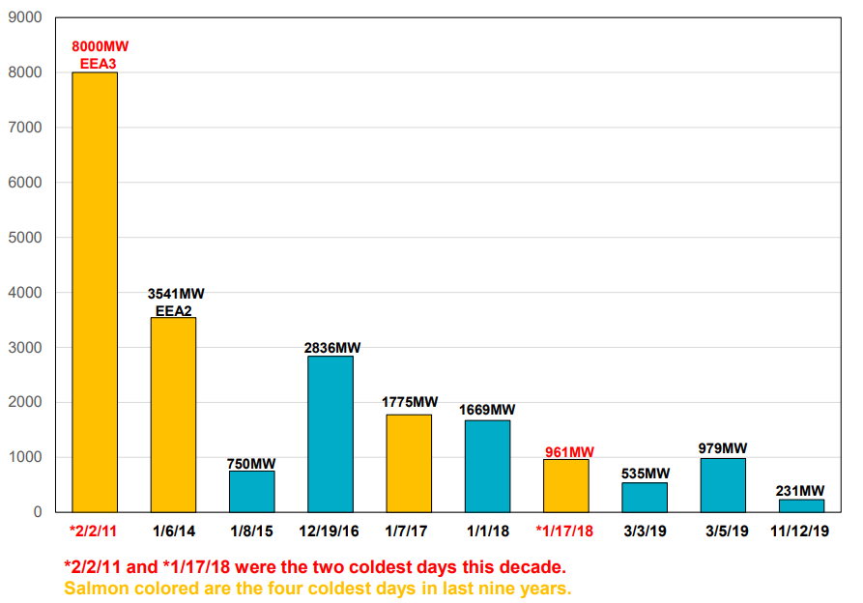
Generation Tripped or De-rated Due to Frozen Instrumentation
Source: Generator Winter Weatherization Workshop, September 3, 2020.
Relative to the 2011 event, frozen instrumentation-related outages decreased by an average of 74% for the three other coldest days

Slide 7
Unplanned Outages for Winter Events
The main conclusion from this analysis is that generation owners made significant progress in reducing unplanned outages due to severe weather events since winter 2011; this progress happened incrementally over several outlier weather events as owners conducted weatherization to pre-emptively respond to future events with characteristics similar to recent historical events

