Slide 1
Phase-1 Weatherization Standard Outage Impact Assumptions for Winter SARA Scenarios
Supply Analysis Working Group
Evan Neel
Resource Adequacy Dept.
October 29, 2021

Slide 2
Scenario Assumption Development Approach
Overall approach is to first identify x MW of thermal outages experienced during the Feb. storm that is associated with so called “acute issues” (per the phase-1 weatherization standards) that must be addressed by generation owners for the upcoming winter season
Then, determine how much of that outage capacity we reasonably expect to be avoided if we have a storm event like Uri this upcoming winter
Requires selecting and applying criteria with which to categorize outage capacity as “acute”, and then applying a reduction factor to the outage amount to obtain a realistically achievable amount

Slide 3
Scenario Assumption Development Steps
Determine ERCOT-wide forced outage MWs for gas plants prior to the start of the storm event
Determine ERCOT-wide forced outage MWs for gas plants at the time of the peak outage amount, and define a subset associated with “acute issues”
Focus on weather-related equipment failures that can be addressed by weatherization (for example, exclude fuel limitation outages)
Calculate the outage MW difference between steps 1 and 2
Apply an achievable success factor to account for:
Imperfect effectiveness of weatherization measures
Future outages that may be unforeseen during the weatherization planning and implementation processes
Assertions of good cause for weatherization noncompliance (§25.55(c)(6) Weather Emergency Preparedness Reliability Standards for a Generation Entity)

Slide 4
“Acute” Outage Definition
In order to define an “acute” outage three different variables were analyzed:
Outage Duration: minimum amount of time a unit was offline/derated
Unit Capacity: minimum size of the generating unit
Derate Percentage: minimum percentage of power output impact
Use of the unit capacity variable assumes that generation owners will prioritize their larger units for winterization efforts

Slide 5
Analysis Dataset
The dataset used for the analysis was taken from ERCOT’s Operations Analysis report on Winter Storm Uri
Based on information taken from the Outage Scheduler
Supplemented with RFI responses to better categorize outage causes
Same dataset was sent to FERC for review
The dataset was filtered to…
Exclude PUNs
Exclude fuel limitation outages
Include only weather-related equipment failures at gas plants

Slide 6
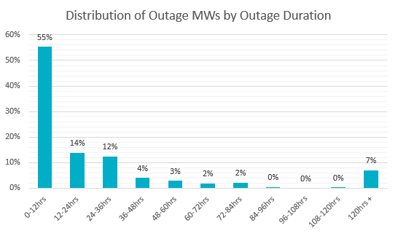
Sensitivity Analysis – Outage Duration
69% of all the outages had a duration of less than 1 day.
Most of those outages have a duration of less than 12 hours.
55% of the entire dataset

Slide 7
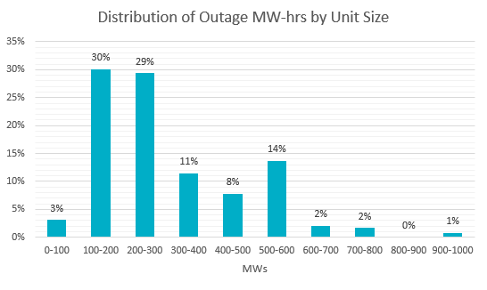
Sensitivity Analysis – Unit Capacity
Measurement unit changed from MW to MW-hrs to better account for magnitude of the outage
Majority of units fall into the lower-mid size range of 100 to 300 MWs (59%)

Slide 8
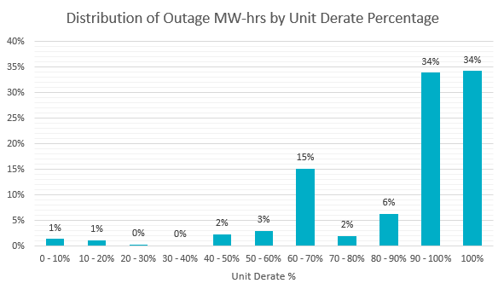
Sensitivity Analysis – Derate Percentage
73% of all the outages were derated more than 75%
68% of all outages were derated 90% or higher
34% of all outages had units completely offline

Slide 9
Scenarios
Scenario 1 – Basecase scenario with all variables set to 0.
Scenario 2 – Isolate the “Outage Min Time” variable and set it to 24 hrs
Scenario 3 – Isolate the “Min Unit Size” variable and set it to 100 MW
Scenario 4 – Isolate the “Percentage Derate” variable and set it to 90%

Slide 10
Scenarios

Slide 11
Scenarios
Scenario 3 has little effect on the Outage MW amount compared to the basecase (Scenario 1)
Altering the “Outage Duration” and “Derate Percentage” variables have a larger impact on “acute” outage MW totals
Changing the variables also alters the peak outage time
Combining all 3 variables:

Slide 12
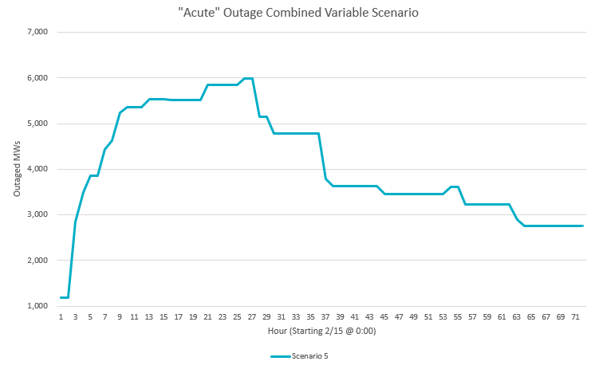
Combined Scenario
*Gas Outages Only

Slide 13
Moving Forward
The Winter Storm Uri “acute” outage analysis will be used to calculate conservative and optimistic outage reduction assumptions (by altering variable sensitivities and the achievable success factor), which will be listed as a new line-item adjustment for the SARA risk scenarios
Would like SAWG input on what achievable success factor values should be used for the SARA risk scenarios; we propose a value of 50% for the conservative assumption and 80% for the optimistic assumption
Will accept comments through November 2nd; send to Evan.Neel@ercot.com
Final values for the variables determining what qualifies as an “acute” outage will be fine tuned

