Slide 1
ERS & Fossil Fuel Distributed Generation Reporting for CDR/SARA Reports
Supply Analysis Working Group
Dan Mantena
Resource Adequacy
October 29, 2021

Slide 2
Recent Developments: NPRR for DG Reporting in CDR and SARA reports
May and Aug. 2021 SAWG: Proposed NPRR language for DG reporting in CDR http://www.ercot.com/content/wcm/key_documents_lists/235401/Proposed_NPRR_Language_CDR_DistributedGeneration.docx
Feb. 2020 SAWG: Proposed treated of DG resources that can be detailed in DG NPRR http://www.ercot.com/calendar/2020/2/20/199688-SAWG
Sep 2019 SAWG: presented Distributed Generation gap analysis for CDR reports http://www.ercot.com/content/wcm/key_documents_lists/172731/4_DG_table.docx

Slide 3
Capacity Contribution for Fossil Fuel SODGs
Background:
  Fossil fuel Settlement-Only Distributed Generators (SODGs) production is a purely economic decision made on a unit-specific basis
    SODG Units are not ERCOT dispatchable
    Nodal pricing will encourage response, but high prices do not correlate well historically with Peak Load periods.
  Unit is typically either on or off (100% or 0% output)
    Fundamentally do not lend themselves to our capacity contribution calculation methodology (example – solar output at peak summer hours)
Capacity contribution must avoid double counting with ERS
Proposal is to identify the total capacity that is potentially available to meet peak demand

Slide 4
Fossil Fuel DG Reporting Proposal
Rely on the latest ERS procurement to determine the amount of MWs awarded to fossil fuel settlement-only distributed generators (SODGs).
Use this value to
  breakout ERS forecast into Load and Distributed Generation portions
  exclude from fossil fuel SODG capacity estimates for Planning Reserve Margin calculations
ERS Load and Distributed Generation breakdown are example values for the DG in the CDR mockup Excel file.

Slide 5
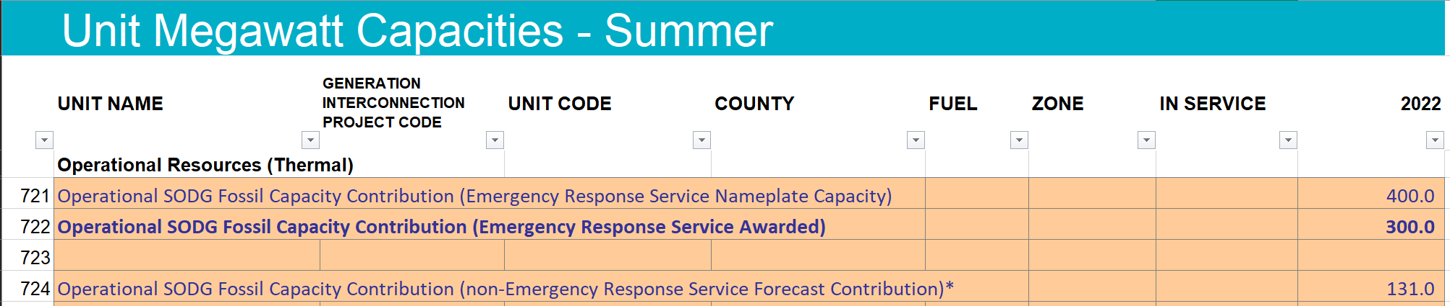
SODG fossil fuel groups in Capacities tab
*Operational SODG Fossil that is not part of Emergency Response Service is listed as available capacity for Planning Reserve Margin calculations in this CDR mockup file.

Slide 6
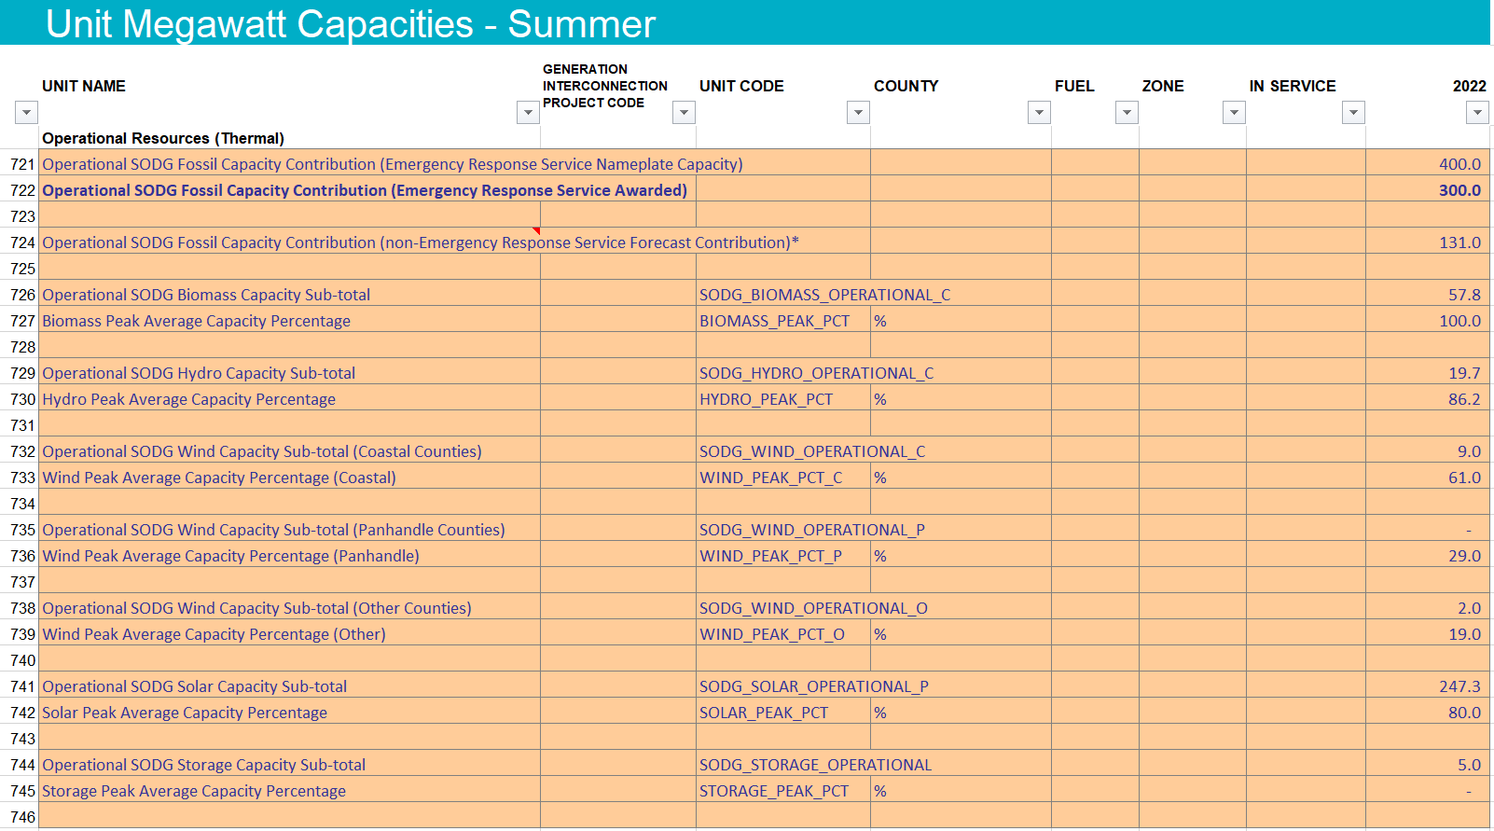
Other reporting changes: provided SODG information on a fuel-aggregate basis

Slide 7
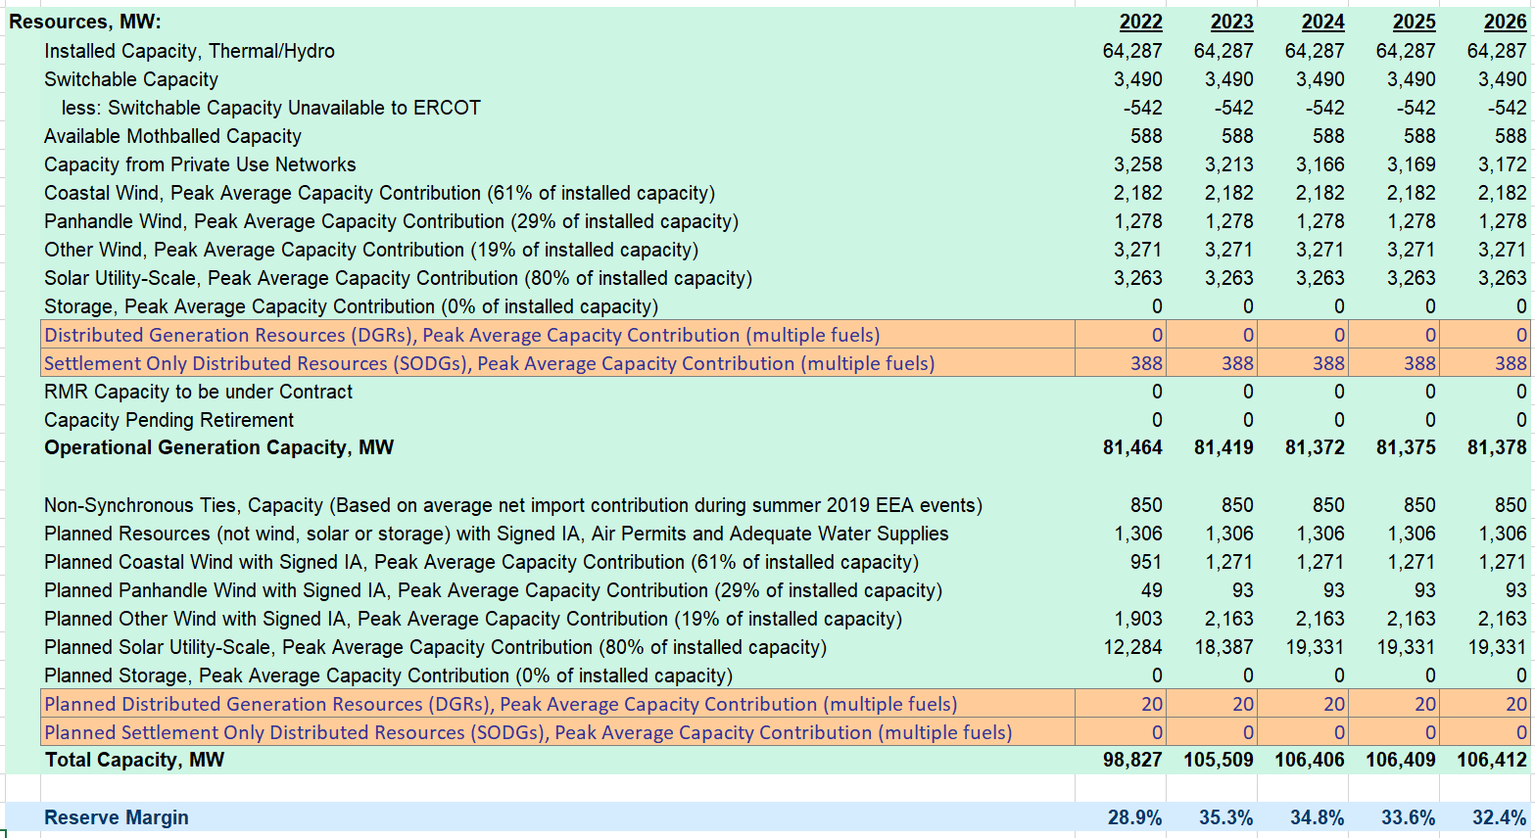
Other reporting changes: move DG resources to separate sub-sections on Summary tab

Slide 8
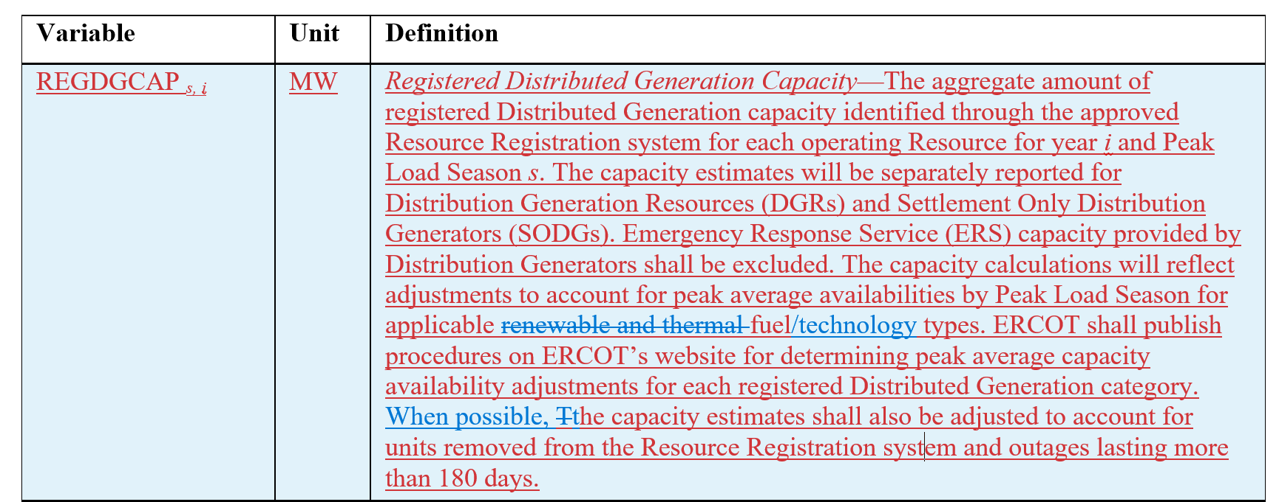
Supporting Notes
CDR mockup file can be found on SAWG meeting page: http://www.ercot.com/calendar/2021/10/29/215963-SAWG
Notes:
Proposed NPRR Language CDR Distributed Generation file from August 2021 SAWG
http://www.ercot.com/content/wcm/key_documents_lists/235401/Proposed_NPRR_Language_CDR_DistributedGeneration.docx

