Slide 1
Preliminary Winter 2021-22 Probabilistic Resource Adequacy Risk Assessment
Supply Analysis Working Group
Pete Warnken
Resource Adequacy Dept.
October 29, 2021

Slide 2
Probabilistic Model Overview
For each hour of a winter peak demand day, the model calculates the probability that “Capacity Available for Operating Reserves” (CAFOR) is at or below various risk thresholds for Energy Emergency Alert (EEA) declarations, including controlled load shed. CAFOR serves as a forecasting proxy for real-time operating reserves.
CAFOR is the same reserve risk measure used for the conventional SARA reports. CAFOR Formula:
= Maximum Expected Resource Generation Capability – Firm Demand* – Thermal Generator Outages* – Other Resource Adjustments Reflecting Reduced Availability During Extreme Grid Conditions* + EEA Resources
The model simulates CAFOR for the hourly range 7 AM through 9 PM (hour-ending) to capture ERCOT’s typical morning and evening demand peaks and associated wind and solar ramps.
* Firm demand excludes demand that can be interrupted on a voluntary basis. Thermal generator outages reflect full and partial outages of fossil-fueled and nuclear generating units. Resource adjustments include the reduced availability of wind and solar resources during extreme grid conditions.

Slide 3
Probabilistic Model Overview
The model conducts a Monte Carlo simulation; it runs 10,000 simulations (trials) with each trial based on various combinations of load/resource values randomly selected from probability distributions. A probability distribution describes all the possible values within a given range and their likelihoods.
The model includes probability distributions for the following average hourly variables:
Demand
Thermal unit unplanned outages
Wind production
Solar production
Thermal unit unplanned, wind and solar outages during an exceptional winter storm event
Injection into the ERCOT grid by Private Use Network (PUN) generators
Remaining non-synchronous DC tie capacity after EEA declaration
Requested switchable generation resource capacity from units serving other grids
.

Slide 4
Probabilistic Model Overview
Based on a given probability of occurrence of an exceptional winter storm event (at least as severe as February’s Winter Storm Uri), the impacts to demand, thermal unplanned outages, and wind/solar production are simulated with probability distributions.
Price Responsive Demand—the ability of consumers to control their energy expenditures by changing their electricity use in response to electricity price signals—is modeled as incremental increases in CAFOR as CAFOR approaches the EEA risk threshold levels.
In addition to PUN generator injection being represented with a probability distribution, incremental changes to CAFOR from PUN generators ramping up and down injection in response to reserve capacity shortages, are also modeled.

Slide 5
Risk Assessment Based on a 1.0% Probability of an Exceptional Winter Weather Event (Comparable to Winter Storm Uri)

Slide 6
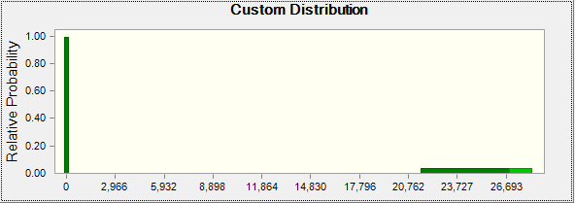
Thermal Unplanned Outage Probability Distribution: 1% Exceptional Winter Weather Event
Megawatts (MW)

Slide 7
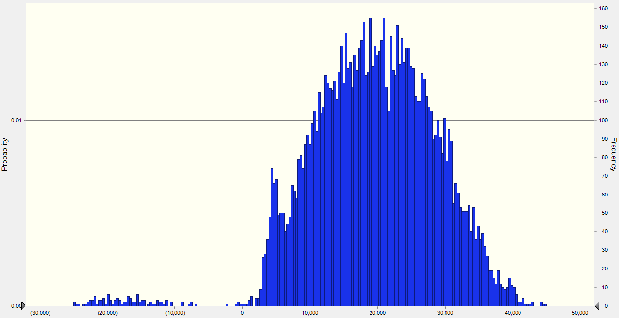
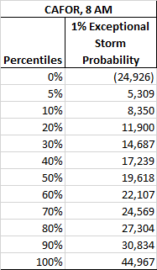
Range of CAFOR Outcomes for Hour-ending 8 AM
The chart below shows the range of CAFOR outcomes; each bar reflects the frequency and associated probability of CAFOR amounts falling within a small range (or bin) of values.
The vast majority of CAFOR outcomes are well above EEA risk thresholds, indicating a high probability of sufficient operating reserves for the winter.
Many of the CAFOR values cluster around 20,000 MW as shown in the chart and percentile table: the 50th and 5th Percentiles are 19,618 MW and 5,309 MW, respectively.
The outlier amounts to the far left reflect the impact of winter storm events, with the worst CAFOR at -24,926 MW.

Slide 8
Hourly EEA Risk Profile
The table below shows the hourly probabilities that CAFOR will be equal to or less than various Energy Emergency Alert thresholds specified in the ERCOT Nodal Protocols.
The peak EEA risk hour is 8 AM due to this hour having the highest demand and trivial solar production ranging from 0 MW to a maximum of 165 MW across the 10,000 simulation trials.
Hourly probabilities are slightly above 1% for all hours and dip during the mid-morning and afternoon hours; the probabilities increase in the evening hours due to the ramp-up in demand and loss of solar energy production.

Slide 9
Hourly Large Reserve Deficit Risk Profile
The table below shows the hourly probabilities that CAFOR will be equal to or less than various deficit reserve levels starting at -5,000 MW and decreasing by 5,000 MW increments.
The probability of CAFOR being equal to or less than -20,000 MW ranges from 0% to 0.16% across the 15 hours.
The highest probabilities for large reserve deficits occur in the early evening. This is explained by the impact to wind production from the exceptional winter storm events. Normally wind is ramping up in the early evening and helping to offset the decrease in solar production and increase in demand; with the storm events, the support from wind production is lowered significantly.
For the trials with CAFOR less than -20,000 MW, demand was 76,800 MW (fixed at this amount for all hours when there is an exceptional storm), wind production averaged 3,294 MW, and thermal outages averaged 25,916 MW.

Slide 10
CAFOR Variance Contributions from Key Risk Variables
The chart below shows the percentage contributions to the variability in CAFOR for 8 AM for the key risk variables: wind, demand, and thermal unplanned outages. (The contributions for other risk variables are not shown as they are less then 1%.)
Wind contributes the largest variance at 70.9% (in a positive direction), while demand and thermal unplanned outages contribute much less to the variance (in a negative direction).
While the capacity share of solar is increasing, solar production variability is significantly less than for wind, so it is currently a minor contributor for explaining the variability in CAFOR results.

Slide 11
Risk Assessment Based on a 0.5% Probability of an Exceptional Winter Weather Event (Comparable to Winter Storm Uri)

Slide 12
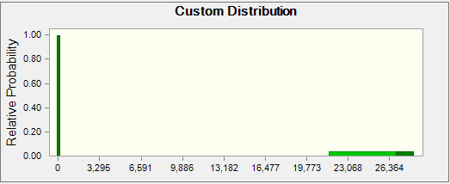
Thermal Unplanned Outage Probability Distribution: 0.5% Exceptional Winter Weather Event
Megawatts (MW)

Slide 13
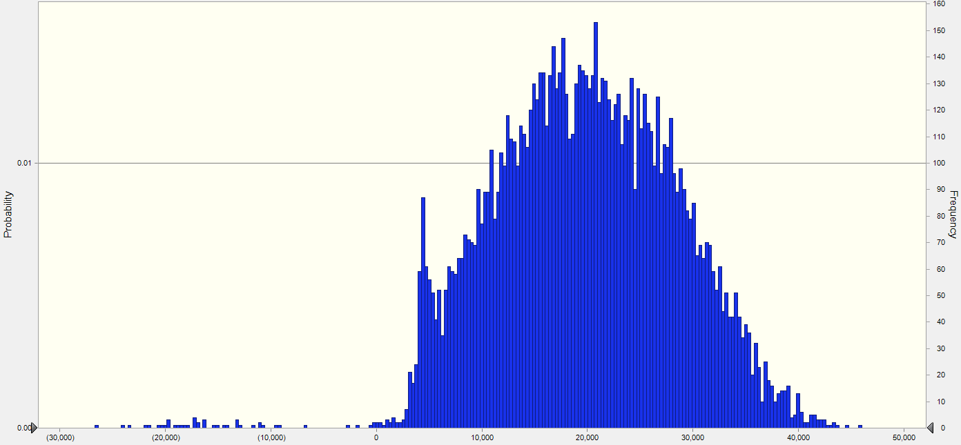
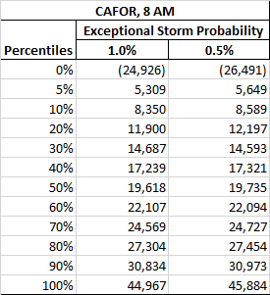
Range of CAFOR Outcomes for Hour-ending 8 AM
The chart below shows the range of CAFOR outcomes; each bar reflects the frequency and associated probability of CAFOR amounts falling within a small range (or bin) of values.
The chart compares CAFOR percentile values for the 1.0% and 0.5% exceptional storm probability simulations. CAFOR increases by an average of 64 MW across the percentile values; excluding the 0% percentile (or maximum) trial value raises the average increase to 212 MW.

Slide 14
Hourly EEA Risk Profile
The table below shows the hourly probabilities that CAFOR will be equal to or less than various Energy Emergency Alert thresholds.
Hourly probabilities range from 0.42% to 0.63%
The peak EEA risk hour continues to be 8 AM due to this hour having the highest demand and low solar production (0 to 164 MW for the 10,000-trial simulation).
EEA risk decreases during the afternoon hours and then increases slightly for the evening hours, reflecting the late-day demand increase as well as the drop-off in solar production.

Slide 15
Hourly Large Reserve Deficit Risk Profile
The table below shows the hourly probabilities that CAFOR will be equal to or less than various deficit reserve levels starting at -5,000 MW and decreasing by 5,000 MW increments.
The probability of CAFOR being equal to or less than -20,000 MW ranges from 0% to 0.08% across the 15 hours. For the 1% exceptional storm probability simulation, the maximum probability was 0.16%.

