Slide 1
Impact of Growth in Wind and Solar on Net Load
ERCOT Staff
October 25, 2021
WMWG

Slide 2
Things to be noted
This study uses 2020 weather year and associated load, wind and solar profiles to build potential net load profiles with increased wind and solar penetration. Following are the assumptions used in this assessment that are worth noting,
  Only net load up ramps have been analyzed.
  No growth in demand/load.
  Impact of year-to-year weather pattern changes not considered.
  Impact of wind and solar curtailment due to transmission constraint is not considered.
  Impact on system inertia due to decreases in net load and the impact of maintaining a minimum amount of reserves and critical inertia on net load is not considered.
  Generation resource mix changes such as new resources other than wind as solar (such Energy Storage Resource, Combined Cycle Plants etc.) or retirement of thermal resource is not considered.
Considering the notes above, the results presented in this slide deck should be viewed as indicative of operational trends but should not be considered a prediction of any specific future operating conditions.

Slide 3
Agenda
Historical trends in net load
Trends in net load as Wind and Solar capacities increase
Grid and Market operations considerations

Slide 4
Introduction
Solar installed capacity in ERCOT is expected to increase significantly over next 2-3 years. This growth in solar installed capacity may,
  exaggerate the magnitude of the net load ramps that the grid may experience,
  introduce more uncertainties in intra-hour and hourly net load forecasts, and
  increase the potential for lower inertia during lighter load periods (typically in shoulder months).
To assess the impact of growth in wind and solar on net load this study interpolated the 2020 wind and solar profiles to build expected net load profiles under the following 3 scenarios.
  Upward net load changes in 5-min, 10-min, 30-min, 60-min and 180-min were analyzed.
This slide deck will share observations and results from this assessment.
Scenario | Load | Wind Installed Capacity | Solar Installed Capacity
2020 (BASE) | 2020 ERCOT Load | 27 - 30 GW | 2.5 - 5 GW
10 GW Solar | 2020 ERCOT Load | 35 GW | 10 GW
20 GW Solar | 2020 ERCOT Load | 35 GW | 20 GW
30 GW Solar | 2020 ERCOT Load | 35 GW | 30 GW

Slide 5
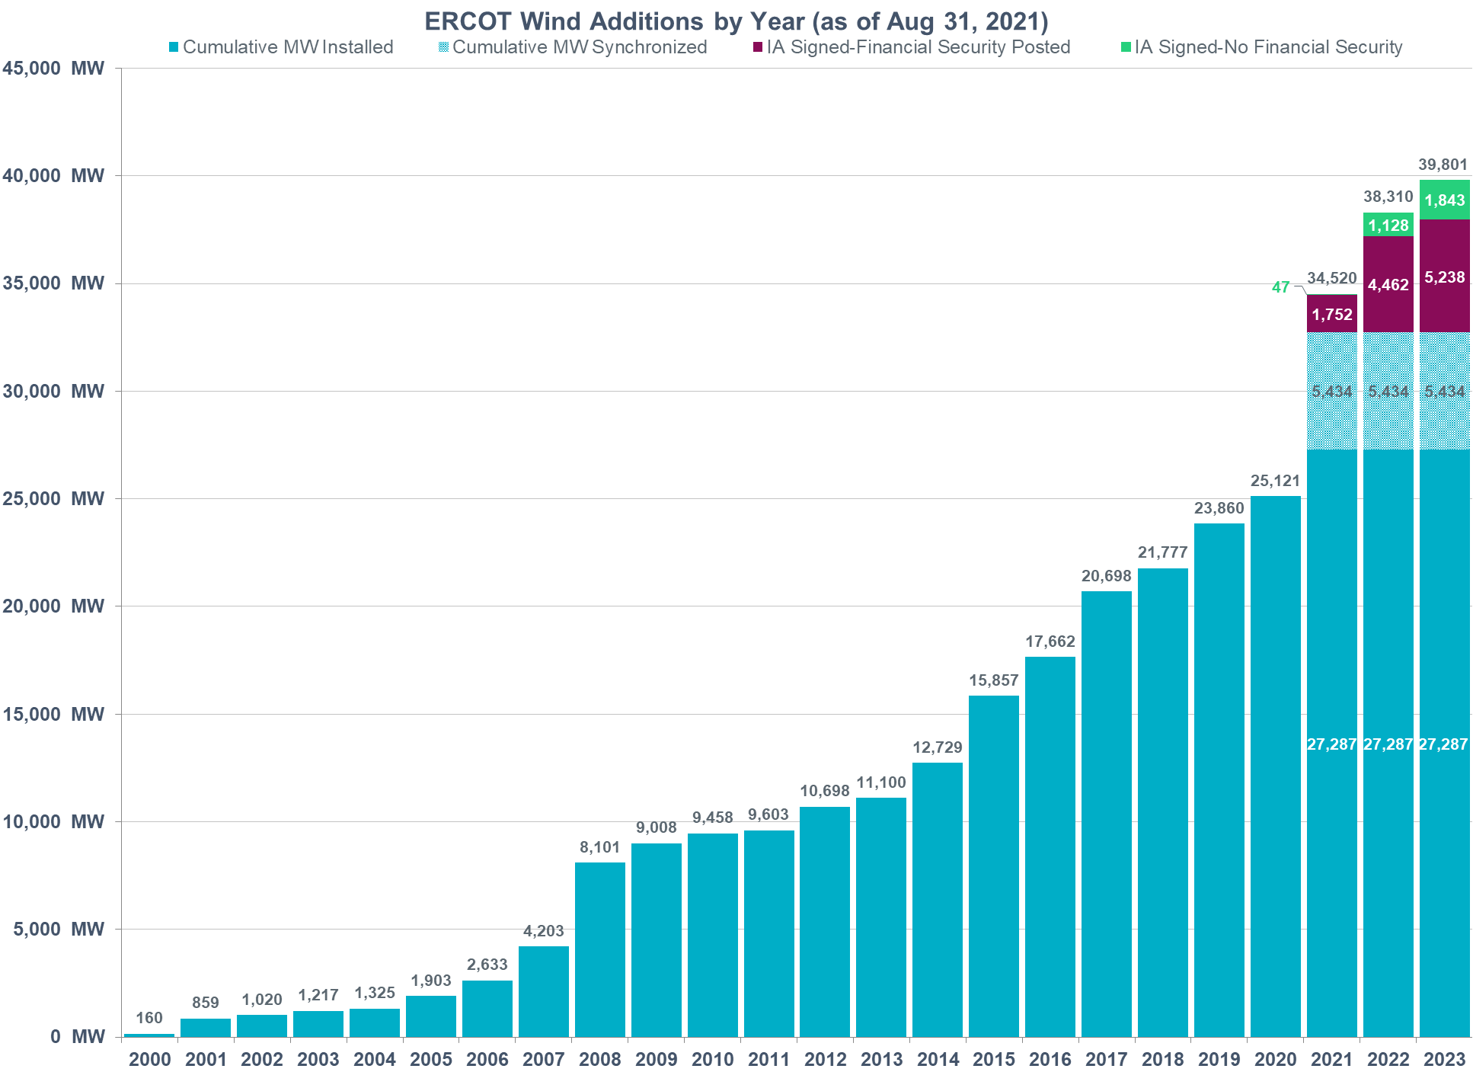
Growth in Wind Installed Capacity

Slide 6
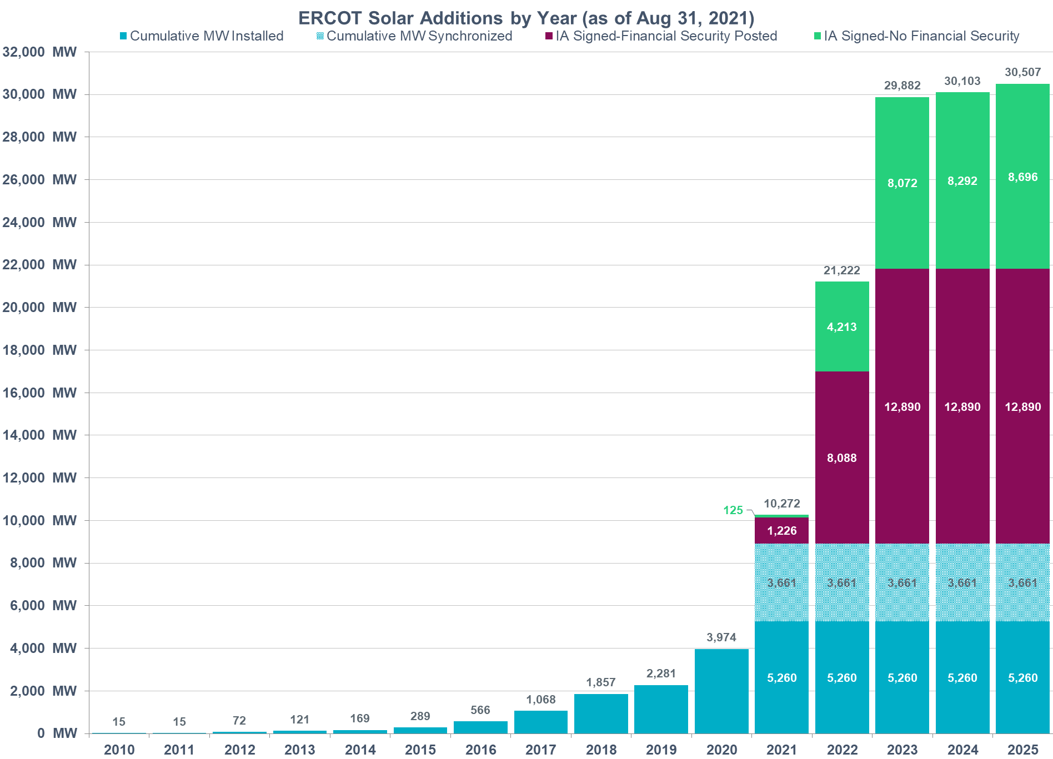
Growth in Solar Installed Capacity

Slide 7
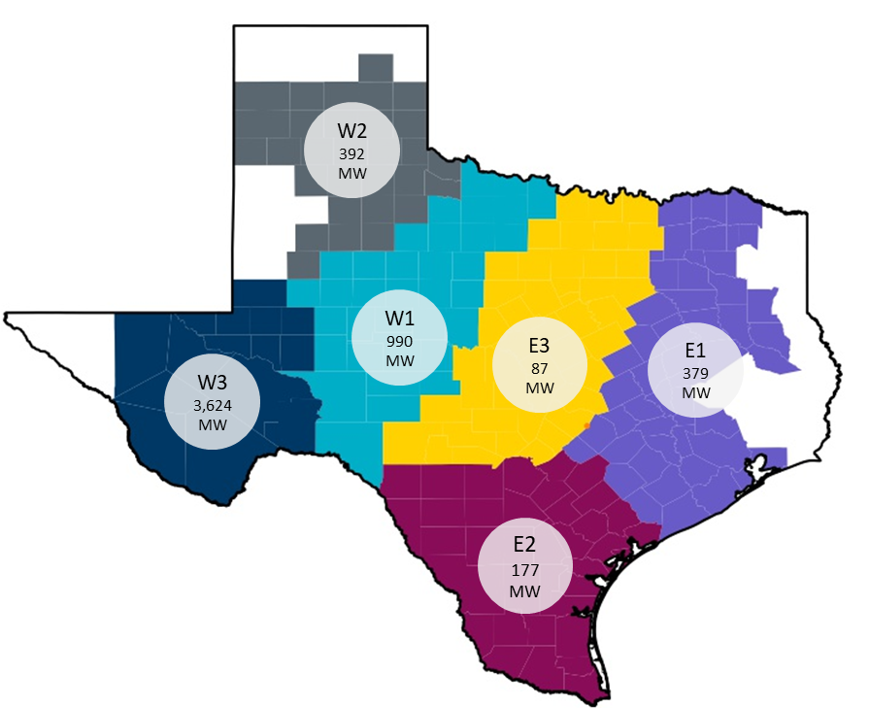
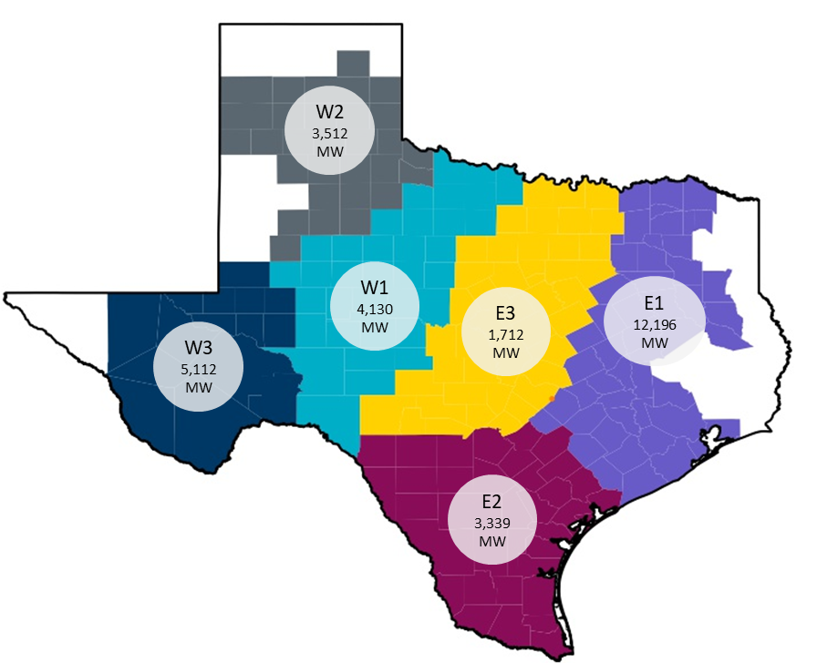
Solar Installed Capacity by Region
2020
Total Capacity = 5,649 MW
West Capacity = 5,006 MW
East Capacity = 643 MW
2023
Total Capacity = 30,001 MW
West Capacity = 12,754 MW
East Capacity = 17,247 MW
A large concentration of exiting solar is in West Texas.
  Installed capacity in the West regions is projected to triple by end of 2023.
East regions have the greatest potential for solar growth.
  Installed capacity in the East regions is projected to increase by ~15.9 GW by the end of 2023.
Note that in 2020, the magnitude of solar resources in each of the 3 east solar regions wasn’t sufficient to build representative solar generation profiles for every east solar region. Hence for the purposes of this analysis all three east regions were combined.

Slide 8
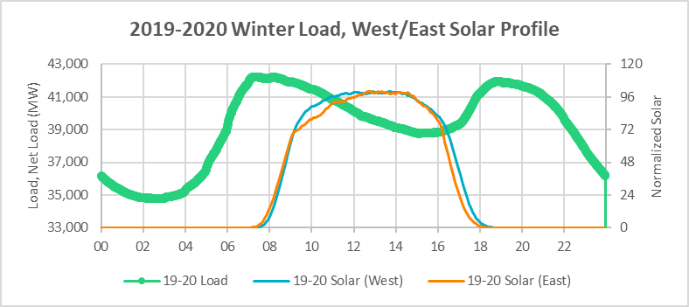
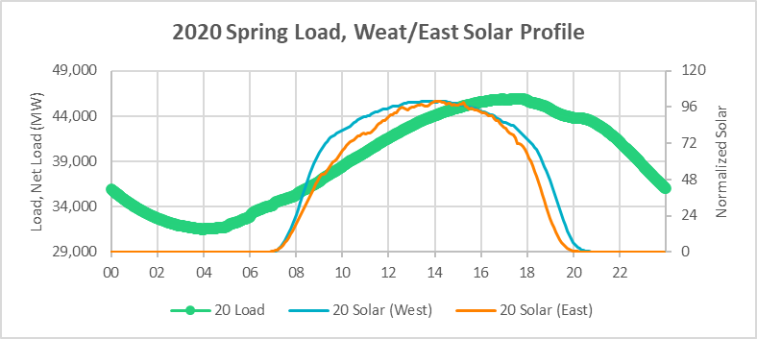
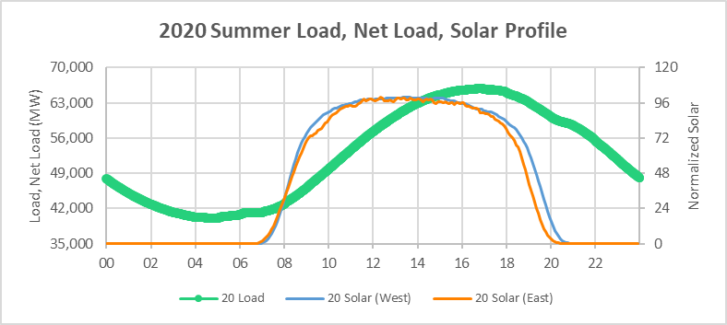
West and East Solar Profiles
In Winter, solar generation in both regions ramps down to 0 MW before the evening load peak.
In Spring and Summer, solar generation in both regions is better aligned with peak-load hours. Solar generation in West region ramps down later during sunset hours than in East region.

Slide 9
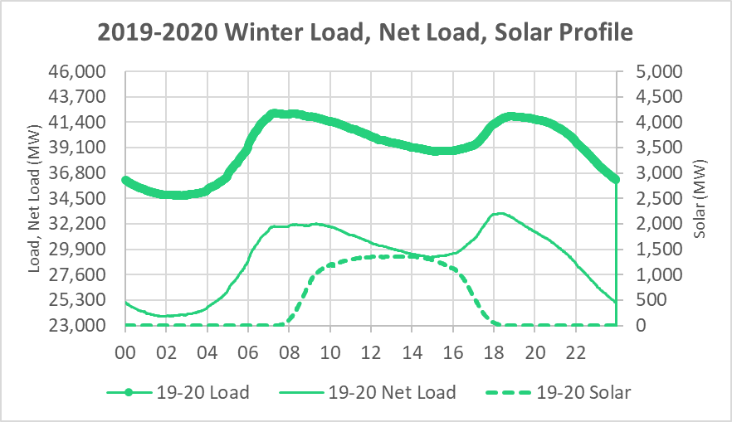
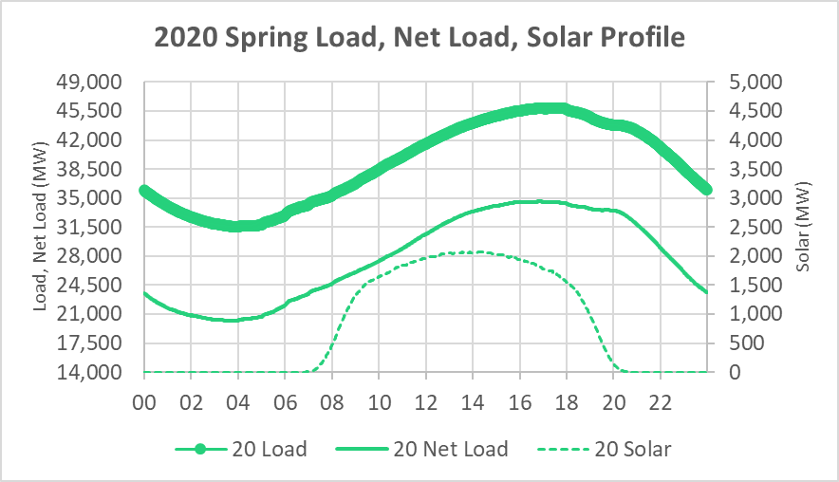
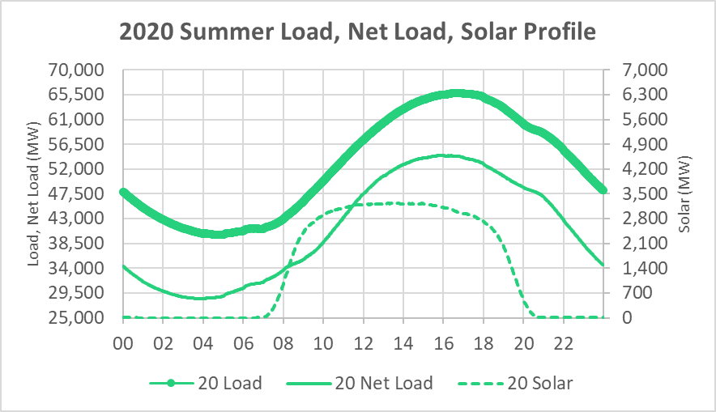
2020 Net Load Profile
In 2020, that largest net load was primarily between HE12 and HE21 in the months of June through September.
Peak net load hour was generally corelated with the peak load hour.
During winters, typically the evening load peaks around HE19/20. Sunset starts reducing solar output between HE15 and HE19. Reduction in solar output exacerbated/magnified the net load up ramp during these hours.
Around 2500 MW increase in 2 hours
Around 3500 MW increase in 2 hours

Slide 10
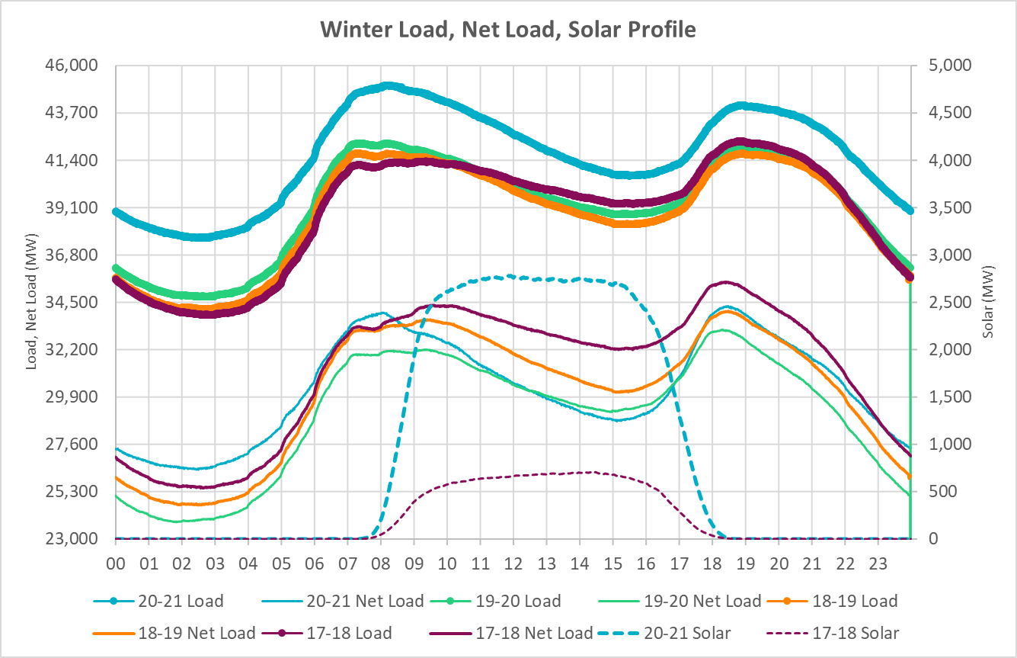
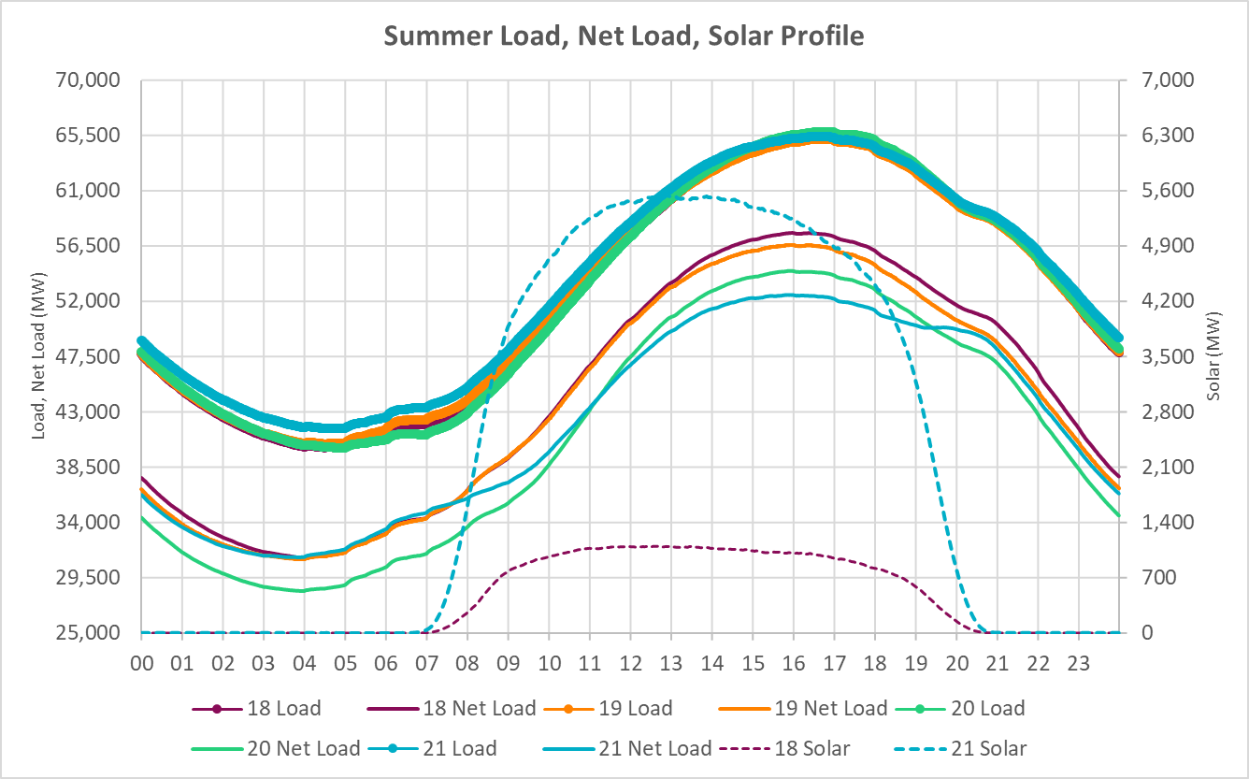
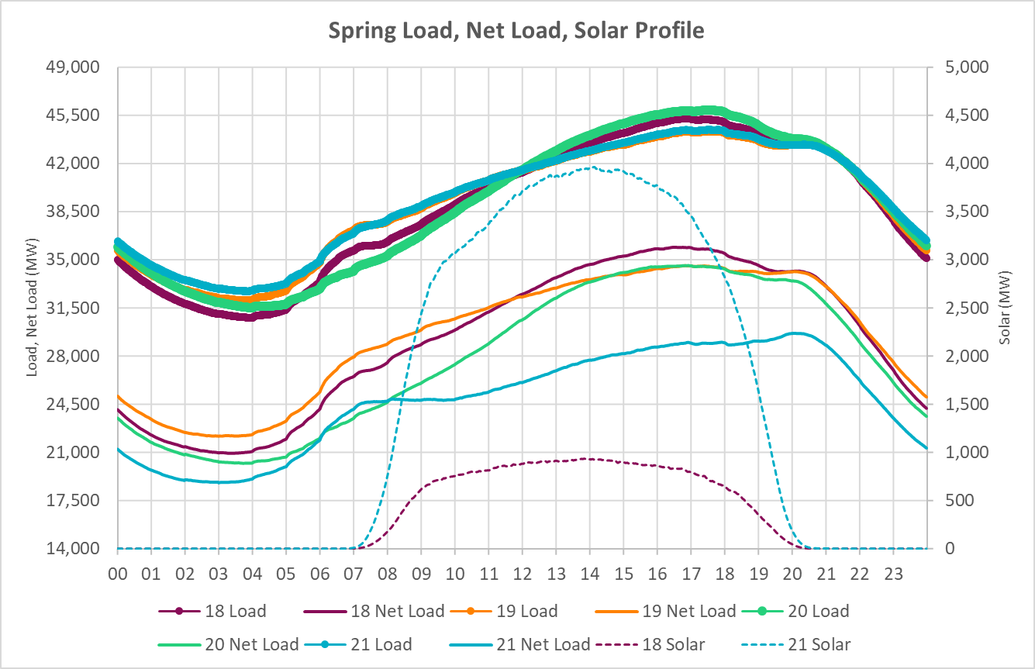
2018 - 2021 Seasonal Net Load Profile Comparison
During the evening hours in 2020-2021 winter season, on average the net load ramped up at a much faster rate than the load ramp.
Peak net load hour in spring has a visible shift to be in HE21.
Around 3200 MW increase in 2.5 hours
Around 5000 MW increased in 2.5 hours
Shift in peak net load hour

Slide 11
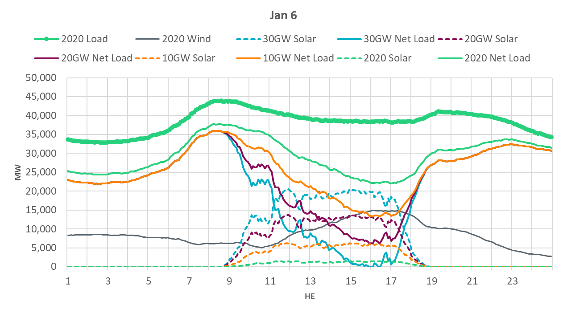
A Mockup of Net Load Profile with only growth in Wind & Solar – January 6*
Around 20,000 MW increase in 2 hours
*Note: Slide 2 outlines the assumptions that were used in this assessment. This analysis is based on extrapolating the wind and solar generation profiles from 2020. The locations of future solar farms (geographic effect), wind/solar curtailment and dispatch of other resources will change the actual net load ramps the grid experiences.

Slide 12
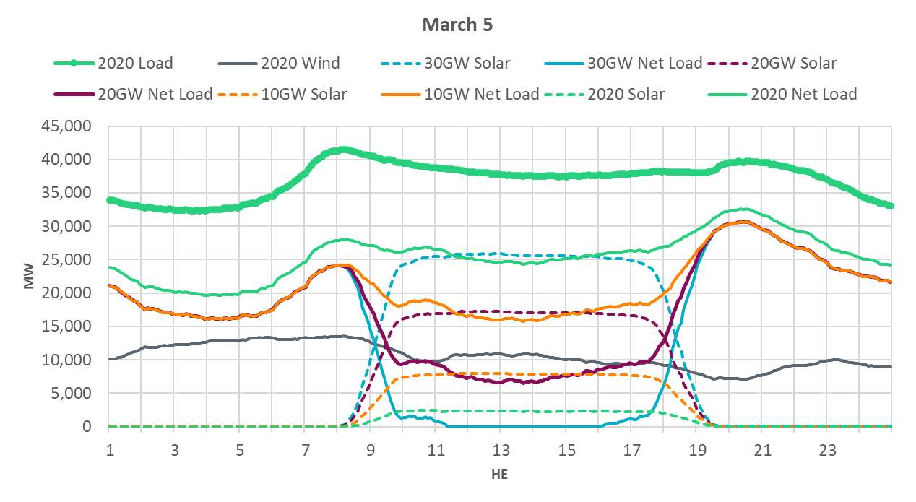
A Mockup of Net Load Profile with only growth in Wind & Solar – March 5*
Around 20,000 MW increase in 3 hours
*Note: Slide 2 outlines the assumptions that were used in this assessment. This analysis is based on extrapolating the wind and solar generation profiles from 2020. The locations of future solar farms (geographic effect), wind/solar curtailment and dispatch of other resources will change the actual net load ramps the grid experiences.

Slide 13
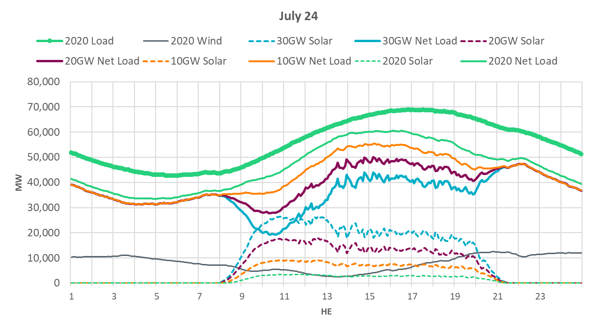
A Mockup of Net Load Profile with only growth in Wind & Solar – July 24*
Around 10,000 MW increase in 1.5 hours
*Note: Slide 2 outlines the assumptions that were used in this assessment. This analysis is based on extrapolating the wind and solar generation profiles from 2020. The locations of future solar farms (geographic effect), wind/solar curtailment and dispatch of other resources will change the actual net load ramps the grid experiences.

Slide 14
Net Load with growth in Wind and Solar*
As the amount of solar installed capacity increases
  The magnitude of peak net load will reduce (visible reduction in red shades in the heat maps).
  The hour at which peak net load occurs shifts to being more correlated with the sunset hours.
  Periods with lower net load specifically during the shoulder months will increase (visible increase in blue shades in the heat maps).
*Note: Slide 2 outlines the assumptions that were used in this assessment. This analysis is based on extrapolating the wind and solar generation profiles from 2020. The locations of future solar farms (geographic effect), wind/solar curtailment and dispatch of other resources will change the actual net load ramps the grid experiences.

Slide 15
5-min Net Load Change
In comparison to 2020, on an average
  there is a marginal increase in the 5-min net load ramps in the 10 GW scenario.
  the 5-min net load ramps increase by ~150% in the 20 GW scenario.
  the 5-min net load ramps increase by ~300% in the 30 GW scenario
  Winter, Spring and Summer months have the most prominent changes in extreme 5-min net load ramp magnitudes.
There is a vast difference between the maximum value and the 98th percentile. This signifies that the most extreme 5-min net load ramps occur very few times.
 | 5-min Net Load Up Change
Scenario | Max | 98th | 95th | 90th
2020 | 1,094 | 729 | 634 | 533
10 GW | 1,436 | 899 | 783 | 678
20 GW | 3,664 | 2,245 | 1,627 | 1,359
30 GW | 5,466 | 3,254 | 2,386 | 1,946

Slide 16
5-min Net Load Change - 95th percentile
From previous slide….
In comparison to 2020, on an average
  there is a marginal increase in the 5-min net load ramps in the 10 GW scenario.
  the 5-min net load ramps increase by ~150% in the 20 GW scenario.
  the 5-min net load ramps increase by ~300% in the 30 GW scenario
  Winter, Spring and Summer months have the most prominent changes in extreme 5-min net load ramp magnitudes.
  In Winter and Spring the extreme 5-min net load ramps are correlated with sunset hours.

Slide 17
10-min Net Load Change
In comparison to 2020, on an average
  there is a marginal increase in the 10-min net load ramps in the 10 GW scenario.
  the 10-min net load ramps increase by ~150% in the 20 GW scenario.
  the 10-min net load ramps increase by ~250% in the 30 GW scenario
  Winter, Spring and Summer months have the most prominent changes in extreme 10-min net load ramp magnitudes.
There is a vast difference between the maximum value and the 98th percentile. This signifies that the most extreme 10-min net load ramps occur very few times.
 | 10-min Net Load Up Change (MW)
Scenario | Max | 98th | 95th | 90th
2020 | 2,154 | 1,265 | 1,107 | 949
10 GW | 2,571 | 1,489 | 1,347 | 1,139
20 GW | 5,343 | 3,197 | 2,497 | 1,987
30 GW | 8,022 | 4,595 | 3,560 | 2,753

Slide 18
10-min Net Load Change - 95th percentile
From previous slide….
In comparison to 2020, on an average
  there is a marginal increase in the 10-min net load ramps in the 10 GW scenario.
  the 10-min net load ramps increase by ~150% in the 20 GW scenario.
  the 10-min net load ramps increase by ~250% in the 30 GW scenario
  Winter, Spring and Summer months have the most prominent changes in extreme 10-min net load ramp magnitudes.
  In Winter and Spring the extreme 10-min net load ramps are correlated with sunset hours.

Slide 19
30-min Net Load Change
In comparison to 2020, on an average
  there is a marginal increase in the 30-min net load ramps in the 10 GW scenario.
  the 30-min net load ramps increase by ~75% in the 20 GW scenario.
  the 30-min net load ramps increase by ~150% in the 30 GW scenario.
  Winter, Spring and late Summer months have the most prominent changes in extreme 30-min net load ramp magnitudes.
There is a vast difference between the maximum value and the 98th percentile. This signifies that the most extreme 30-min net load ramps occur very few times.
 | 30-min Net Load Up Change (MW)
Scenario | Max | 98th | 95th | 90th
2020 | 5,944 | 3,290 | 2,743 | 2,419
10 GW | 7,302 | 3,604 | 3,069 | 2,651
20 GW | 9,672 | 6,106 | 4,507 | 3,645
30 GW | 12,259 | 8,846 | 6,256 | 4,931

Slide 20
30-min Net Load Change - 95th percentile
From previous slide….
In comparison to 2020, on an average
  there is a marginal increase in the 30-min net load ramps in the 10 GW scenario.
  the 30-min net load ramps increase by ~75% in the 20 GW scenario.
  the 30-min net load ramps increase by ~150% in the 30 GW scenario.
  Winter, Spring and late Summer months have the most prominent changes in extreme 30-min net load ramp magnitudes.
  In Winter, Spring and late Summer the extreme 30-min net load ramps are correlated with sunset hours.

Slide 21
60-min Net Load Change
In comparison to 2020, on an average
  there is a marginal increase in the 60-min net load ramps in the 10 GW scenario.
  the 60-min net load ramps increase by ~65% in the 20 GW scenario.
  the 60-min net load ramps increase by ~125% in the 30 GW scenario.
  Winter, Spring and late Summer months have the most prominent changes in extreme 60-min net load ramp magnitudes.
There is a vast difference between the maximum value and the 98th percentile. This signifies that the most extreme 60-min net load ramps occur very few times.
 | 60-min Net Load Up Change (MW)
Scenario | Max | 98th | 95th | 90th
2020 | 10,595 | 6,442 | 5,354 | 4,640
10 GW | 12,981 | 6,884 | 5,717 | 4,704
20 GW | 17,601 | 10,233 | 7,931 | 5,904
30 GW | 22,417 | 15,141 | 10,574 | 7,597

Slide 22
60-min Net Load Change - 95th percentile
From previous slide….
In comparison to 2020, on an average
  there is a marginal increase in the 60-min net load ramps in the 10 GW scenario.
  the 60-min net load ramps increase by ~65% in the 20 GW scenario.
  the 60-min net load ramps increase by ~125% in the 30 GW scenario.
  Winter, Spring and late Summer months have the most prominent changes in extreme 60-min net load ramp magnitudes.
  In Winter, Spring and late Summer the extreme 60-min net load ramps are correlated with sunset hours.

Slide 23
180-min Net Load Change
In comparison to 2020, on an average
  there is a marginal increase in the 180-min net load ramps in the 10 GW scenario.
  the 180-min net load ramps increase by ~50% in the 20 GW scenario.
  the 180-min net load ramps increase by ~85% in the 30 GW scenario.
  Winter, Spring and late Summer months have the most prominent changes in extreme 180-min net load ramp magnitudes.
There is a vast difference between the maximum value and the 98th percentile. This signifies that the most extreme 180-min net load ramps occur very few times.
 | 180-min Net Load Up Change (MW)
Scenario | Max | 98th | 95th | 90th
2020 | 19,191 | 16,763 | 14,457 | 12,728
10 GW | 22,722 | 17,381 | 14,533 | 12,340
20 GW | 31,998 | 18,285 | 15,765 | 12,549
30 GW | 40,684 | 25,424 | 21,909 | 14,754

Slide 24
180-min Net Load Change - 95th percentile
From previous slide….
In comparison to 2020, on an average
  there is a marginal increase in the 180-min net load ramps in the 10 GW scenario.
  the 180-min net load ramps increase by ~50% in the 20 GW scenario.
  the 180-min net load ramps increase by ~85% in the 30 GW scenario.
  Winter, Spring and late Summer months have the most prominent changes in extreme 180-min net load ramp magnitudes.
  In Winter, Spring and late Summer the extreme 180-min net load ramps are correlated with sunset hours.

Slide 25
Market and Operations
ERCOT ensures that there are enough resources and resource flexibility available on the system to meet net load, net load changes, and uncertainties by using Ancillary Services and Reliability Unit Commitment
Non-spinning Reserve
ERCOT Contingency Reserve Service
Uncertainties
Regulation Resource
5-min Load and Renewable Forecast
Reliability Unit Commitment
Variability
Short-term Load and Renewable Forecast
5-min
10-min
30-min
60-min
180-min
360-min

Slide 26
Net Load Profile - March 5 Some Thoughts
In focusing on the evening net load up ramp, from grid operations perspective, market’s self commitment of resources can be expected to help in responding to bulk of this ramp. However, ERCOT may need to procure incrementally more quantities of Ancillary Services during this period to cover for risks associated with “commitment errors” be it timing of unit commitment or forced outages.
SCED may need to curtail solar to allow for startup energy.
Unit Self Commitment
Reg, RRS, ECRS, and NSRS used to cover usual forecast errors, unit trips, reserve replacement and instantaneous variability. Additional quantities of ECRS and NSRS will be needed to cover unit commitment timing errors or startup failures which may be increased compared to historical quantities due to more MW starting to cover net ramp

Slide 27
Potential to support this growth in Solar Capacity
ERCOT may need to consider several changes as the installed capacity for wind and solar increases to these large volumes.
  Implement ECRS. Solar ramps are typically shorter in duration and ECRS provides a tool that can help respond to short duration system needs.
    The methodology for computing ECRS quantities to account for net load up ramp related concerns should also be revisited.
  Continue to improve intra-hour and hourly wind and solar forecast performance.
    Procure a second solar forecast provider.
    Add an extreme weather hourly solar forecast model.
  Implement tools in ERCOT’s EMS that will provide ability to monitor forecasted net load ramp and ramping capability of available resources.
  Reevaluate if the load, wind and solar forecasts inputs used for Reliability Unit Commitment (RUC) assessments should be adjusted such that the highest net load forecast expected within the Operating Hour is studied.
  Monitor market pricing outcomes to ensure these align with reliability needs.

Slide 28
Summary
With increase in installed solar capacities, there are substantial changes in net load that can be expected (specially in Winter, Spring and late Summer).
  Seasonal and temporal variations in net load ramp direction and magnitude can be expected.
  Larger net load up ramps are likely to be correlated with sunset hours.
    Based on 2020 load, wind and solar profile i.e. weather data, extremely large net load up ramps tend to occur a small portion time (less than 10%).
  ERCOT grid and market operations are expected to (and/or should) evolve to support these changes in net load.
    Timing of implementing some of the changes that have already been approved in the Stakeholder process may need to be revisited.
Max Net Load Up Change (MW)*
Scenario | 5-min | 10-min | 30-min | 60-min | 180-min
2020 | 1094 | 2154 | 5944 | 10595 | 19191
10 GW | 1436 | 2571 | 7302 | 12981 | 22722
20 GW | 3664 | 5343 | 9672 | 17601 | 31998
30 GW | 5466 | 8022 | 12259 | 22417 | 40684
98th Percentile Net Load Up Change (MW)*
Scenario | 5-min | 10-min | 30-min | 60-min | 180-min
2020 | 729 | 1265 | 3290 | 6442 | 16763
10 GW | 899 | 1489 | 3604 | 6884 | 17381
20 GW | 2245 | 3197 | 6106 | 10233 | 18285
30 GW | 3254 | 4595 | 8846 | 15141 | 25424
Max Net Load Up Ramp (MW/min)
Scenario | 5-min | 10-min | 30-min | 60-min | 180-min
2020 | 219 | 215 | 198 | 177 | 107
10 GW | 287 | 257 | 243 | 216 | 126
20 GW | 733 | 534 | 322 | 293 | 178
30 GW | 1093 | 802 | 409 | 374 | 226
*Note: Slide 2 outlines the assumptions that were used in this assessment. This analysis is based on extrapolating the wind and solar generation profiles from 2020. The locations of future solar farms (geographic effect), wind/solar curtailment and dispatch of other resources will change the actual net load ramps the grid experiences.

Slide 29
Discussion

