Slide 1
Credit Exposure Update
Spoorthy Papudesi
Credit Work Group
ERCOT Public
October 20, 2021

Slide 2
Monthly Highlights Aug 2021 – Sep 2021
Market-wide average TPE increased from $ 751.8 million in August to $ 802.6 million in September
  TPE increased mainly due to higher Real-Time and Day-Ahead Settlement Point prices in September than in August
Discretionary Collateral is defined as Secured Collateral in excess of TPE,CRR Locked ACL and DAM Exposure
  Average Discretionary Collateral decreased from $ 1,917.1 million to $1,721.0 million
  The decrease in Discretionary Collateral is largely due to decrease in Secured Collateral, increase in CRR Locked ACL and increase in TPE
No unusual collateral call activity

Slide 3
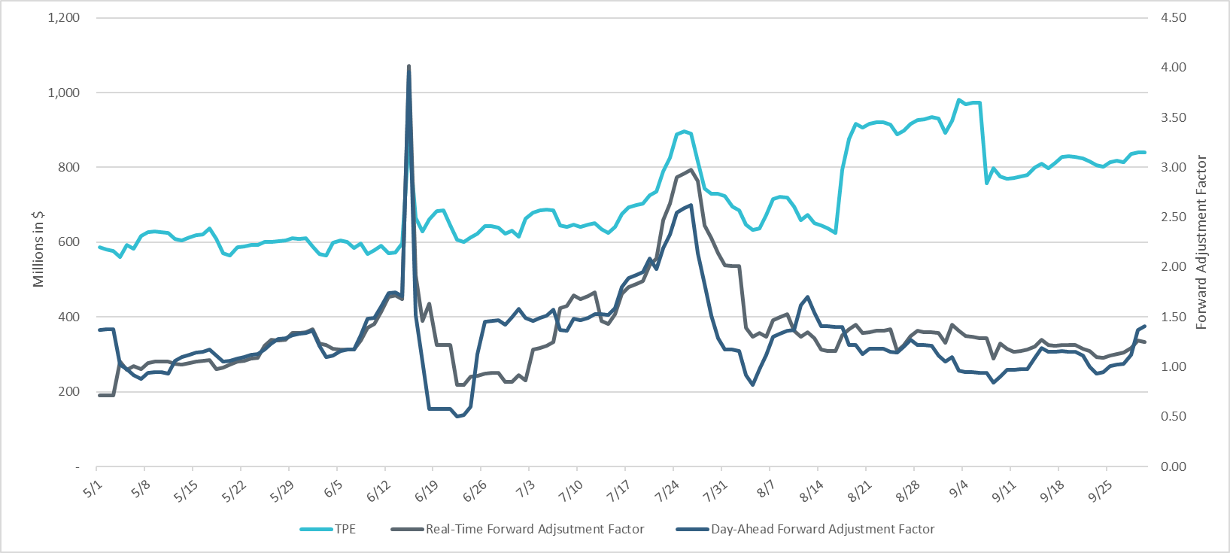
TPE and Forward Adjustment Factors May 2021- Sep 2021
*TPE adjusted to exclude short pay entities eliminating data skew

Slide 4
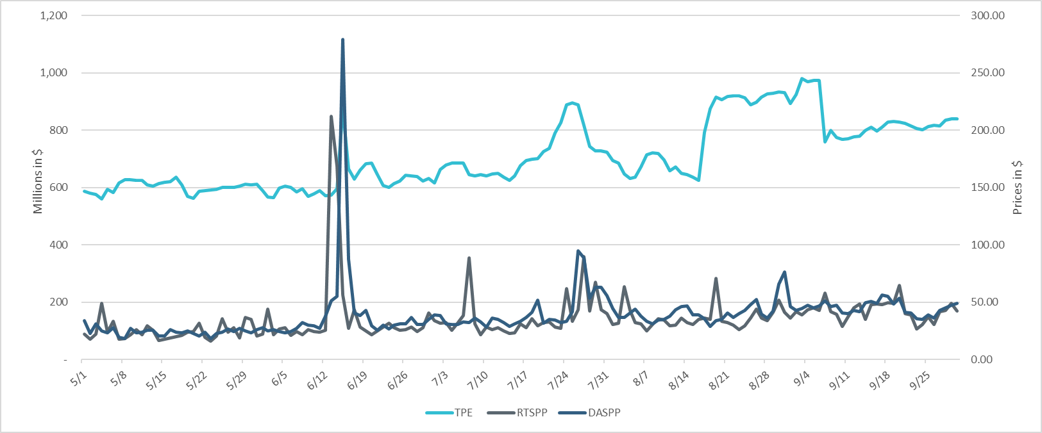
TPE/Real-Time & Day-Ahead Daily Average Settlement Point Prices for HB_NORTH May 2021- Sep 2021
* TPE adjusted to exclude short pay entities eliminating data skew

Slide 5
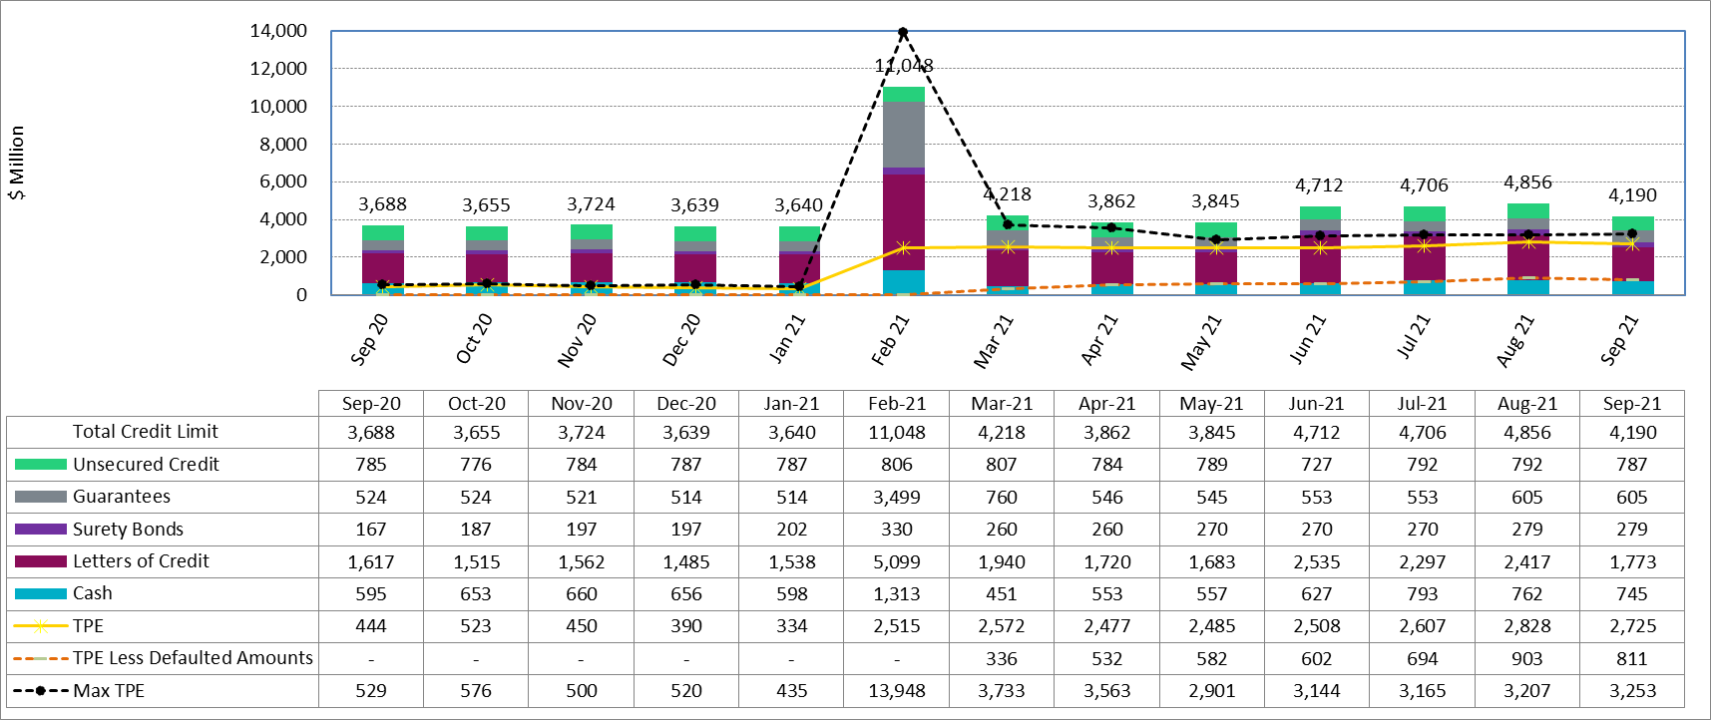
Available Credit by Type Compared to Total Potential Exposure (TPE) Sep 2020- Sep 2021
Numbers are as of month-end except for Max TPE
Max TPE is the highest TPE for the corresponding month
TPE less Defaulted Amounts: TPE – Short-Paid Invoices

Slide 6
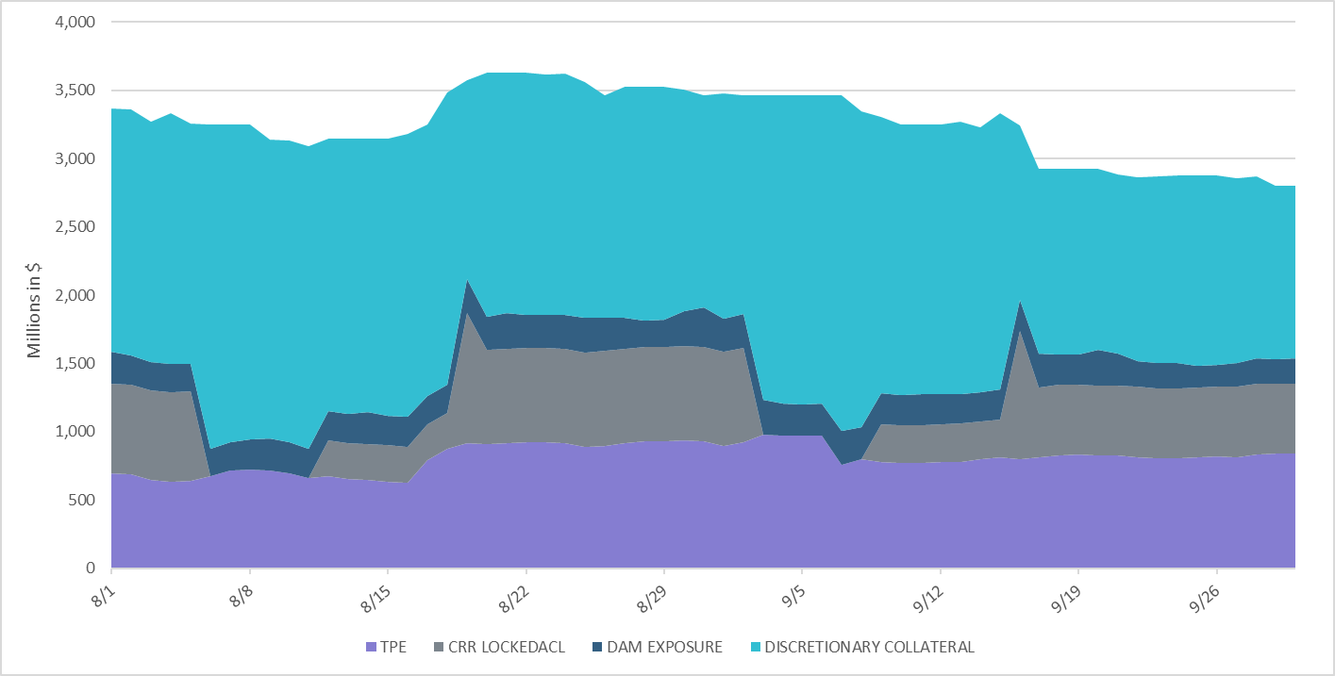
Discretionary Collateral Aug 2021 - Sep 2021
* Discretionary collateral doesn’t include Unsecured Credit Limit or parent guarantees
* TPE adjusted to exclude short pay entities eliminating data skew

Slide 7
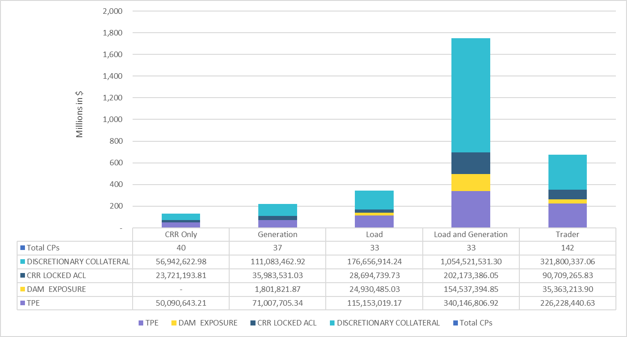
TPE and Discretionary Collateral by Market Segment- Sep 2021*
Load and Generation entities accounted for the largest portion of discretionary collateral
*Discretionary collateral doesn’t include Unsecured Credit Limit or parent guarantees
* TPE adjusted to exclude short pay amounts eliminating data skew

Slide 8
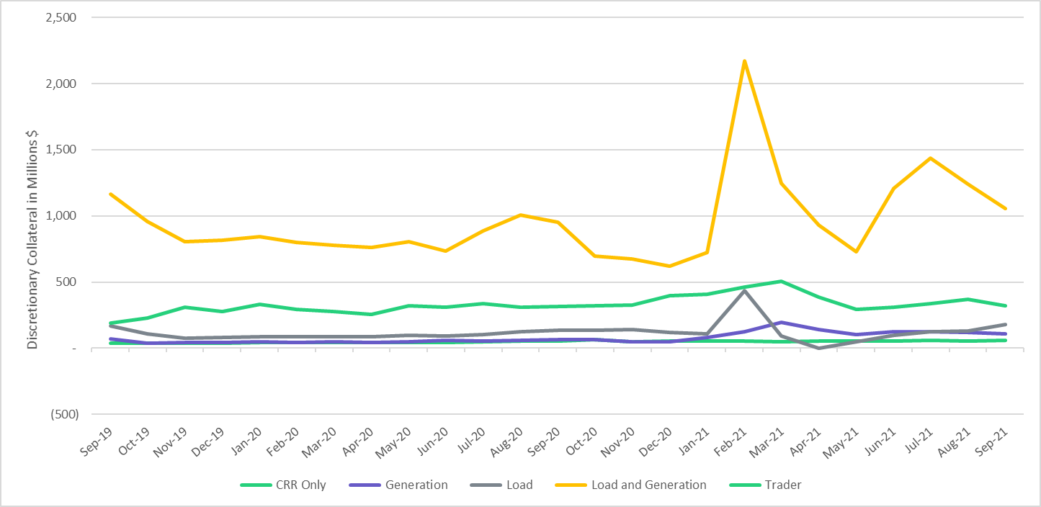
Discretionary Collateral by Market Segment Sep 2019- Sep 2021
* Discretionary Collateral adjusted to exclude short pay amounts eliminating data skew

Slide 9
TPEA Coverage of Settlements
  TPEA covers Settlement/Invoice exposure and estimated Real-Time and Day- Ahead completed but not settled activity (RTLCNS and UDAA)
  The analysis was performed for the period, August 2020 - August 2021
  Only Settlement invoices due to ERCOT are considered in the calculation
  Example
  For business date 2/1/2020, if a Counter-Party has M1 value of 20, then all the charge invoices till 2/21/2020 including RTLCNS and UDAA as of 2/1/2020 is summed up to arrive at “Invoice Exposure”

Slide 10
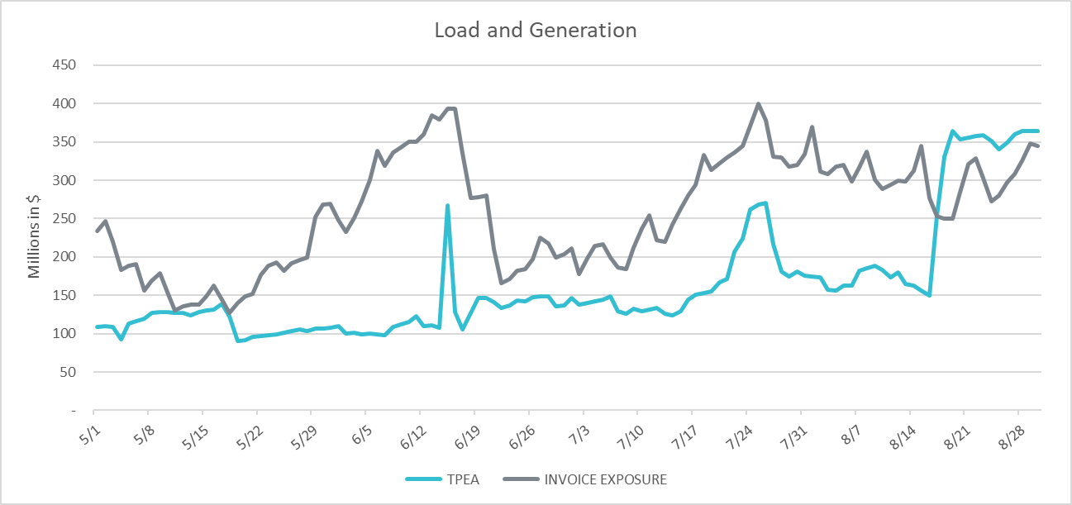
TPEA Coverage of Settlements May 2021– Aug 2021
Invoice exposure generally exceeds TPEA
TPEA adjusted to exclude short pay entities eliminating data skew

Slide 11
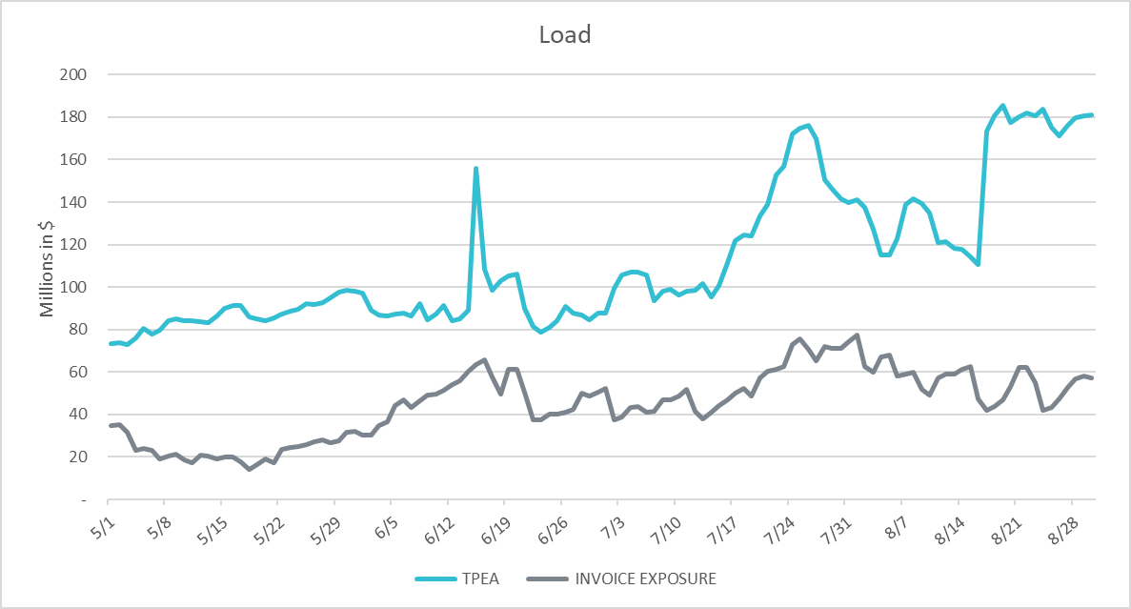
TPEA Coverage of Settlements May 2021– Aug 2021
*TPEA exceeds invoice exposure
*TPEA adjusted to exclude short pay entities eliminating data skew

Slide 12
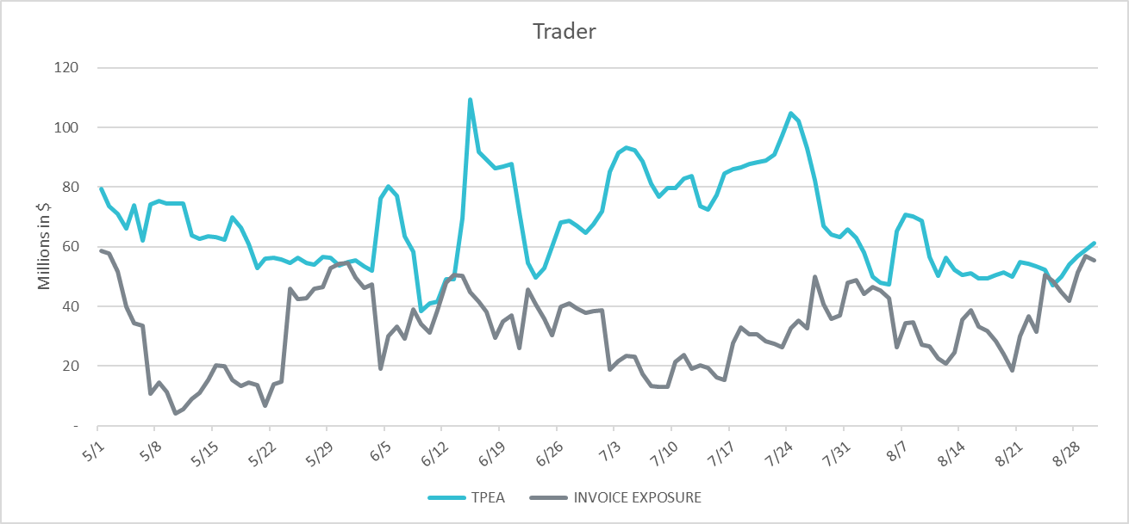
TPEA Coverage of Settlements May 2021– Aug 2021
*TPEA generally exceeds invoice exposure

Slide 13
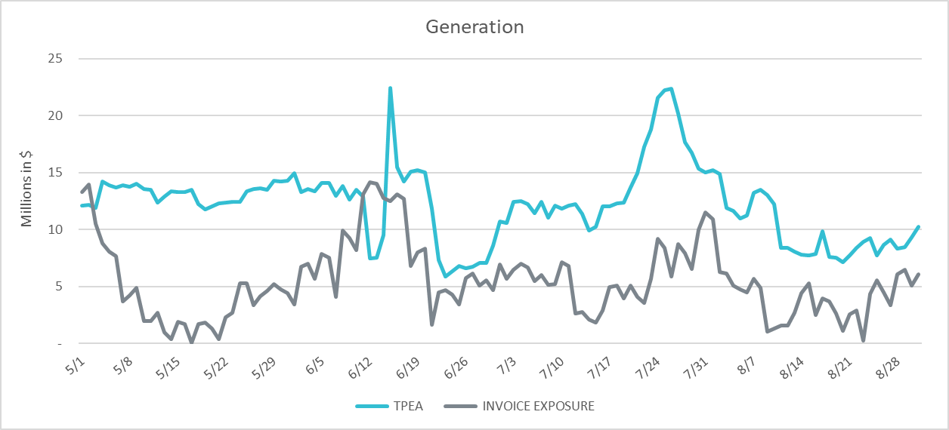
TPEA Coverage of Settlements May 2021– Aug 2021
*TPEA generally exceeds invoice exposure

Slide 14
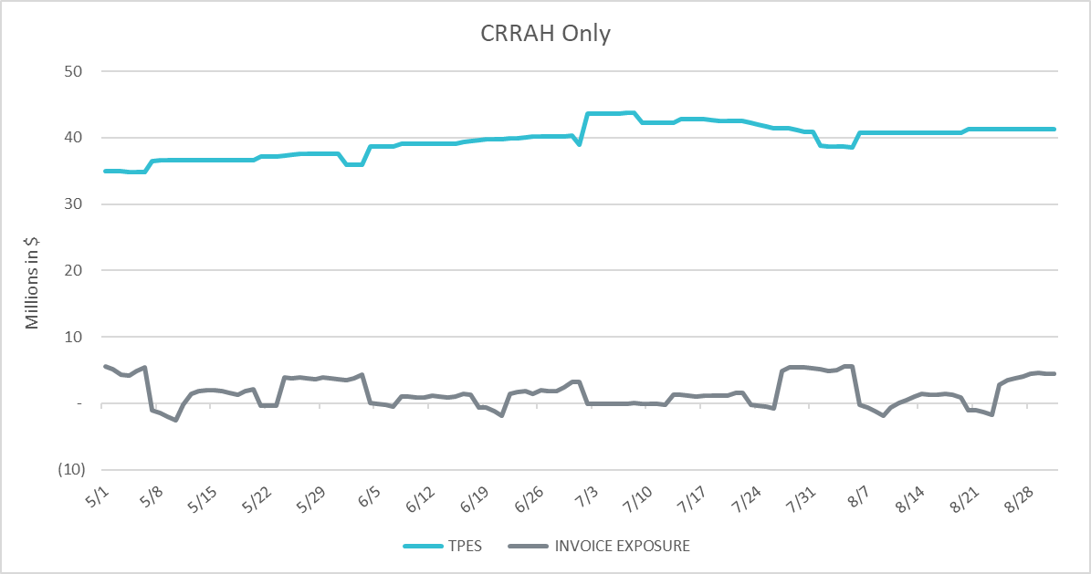
TPEA Coverage of Settlements May 2021– Aug 2021
*TPES exceeds actual/invoice exposure

Slide 15
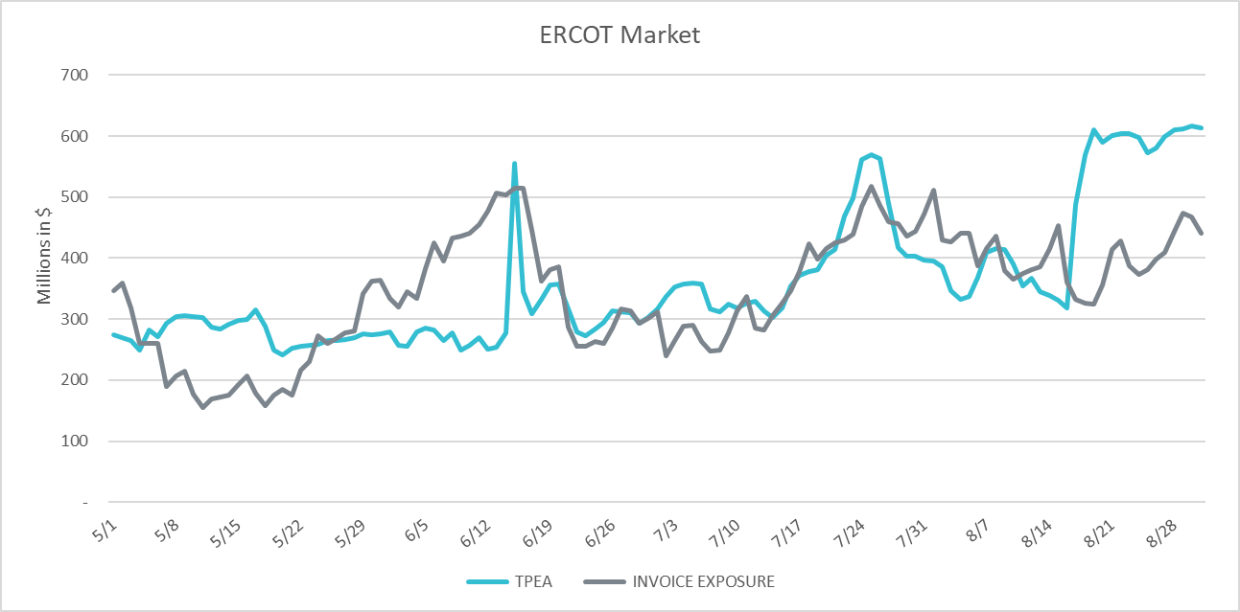
TPEA Coverage of Settlements May 2021– Aug 2021
*TPEA closely approximates actual/invoice exposure
*TPEA adjusted to exclude short pay entities eliminating data skew

Slide 16
Appendix

Slide 17
Summary of Distribution by Market Segment*
* Excess collateral doesn’t include Unsecured Credit Limit and is defined as Collateral in excess of TPE
* TPE adjusted to exclude short pay amounts eliminating data skew

Slide 18
Summary of Distribution by Rating Group*
* TPE adjusted to exclude short pay amounts eliminating data skew

Slide 19
Distribution of TPE by Rating and Category*
* TPE adjusted to exclude short pay amounts eliminating data skew

Slide 20
Distribution of Excess Collateral by Rating and Category*
*Excess collateral doesn’t include Unsecured Credit Limit
* TPE adjusted to exclude short pay amounts eliminating data skew

Slide 21
Questions

