Slide 1
DGR workshop XII
Implementation and Lifting the Moratorium
Bill Blevins
Director Grid Coordination
October 14, 2021

Slide 2
DGR Workshop Topics
Review Market Notice
Project Timelines
  RIOO (Create Phase)
  EMS and MMS
DGR Small Gen Process Overview
  Rules
  Small Gen Interconnection Group
  How to register in RIOO
  Necessary Items when submitting
  Expected Model ready dates
Commissioning

Slide 3
Market Notice – Lifting DGR Moratorium
NOTICE DATE: August 9, 2021
NOTICE TYPE: M-A092619-02 Operations
SHORT DESCRIPTION: Notice Regarding Anticipated Date For Lifting DGR/DESR Moratorium
LONG DESCRIPTION: On September 26, 2019, ERCOT issued a Market Notice announcing a moratorium on the interconnection of Distribution Generation Resources (DGRs) … That Market Notice indicated that the moratorium would apply until the revisions to ERCOT rules necessary to address these risks are approved and implemented.
ERCOT currently expects that the system changes needed to allow DGRs and DESRs to register with ERCOT through the Resource Integration and Ongoing Operations (RIOO) application will be implemented on January 4, 2022.
Additionally, ERCOT expects that system changes necessary to allow DGRs and DESRs to be integrated into ERCOT’s EMS will be implemented with Release R1 in February 2022—well in advance of the model-load dates that would be permissible with a January 4, 2022 registration date.
Consequently, ERCOT anticipates that it will lift the moratorium on DGRs and DESRs beginning January 4, 2022.
Full market notice can be found here: http://www.ercot.com/services/comm/mkt_notices/archives/5988

Slide 4
DGR timeline

Slide 5
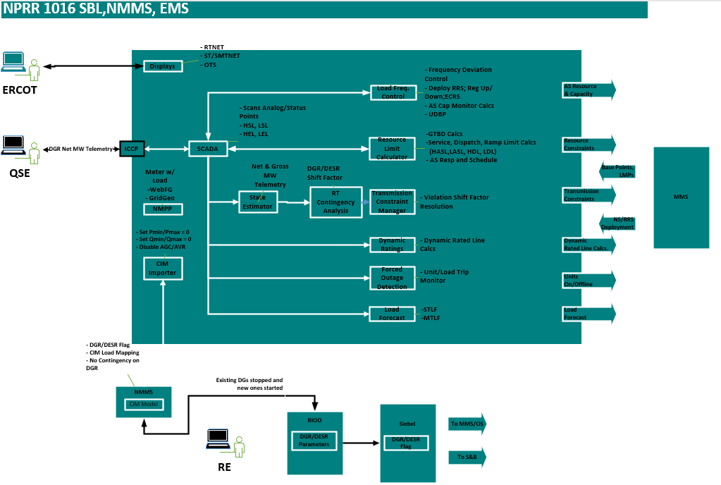
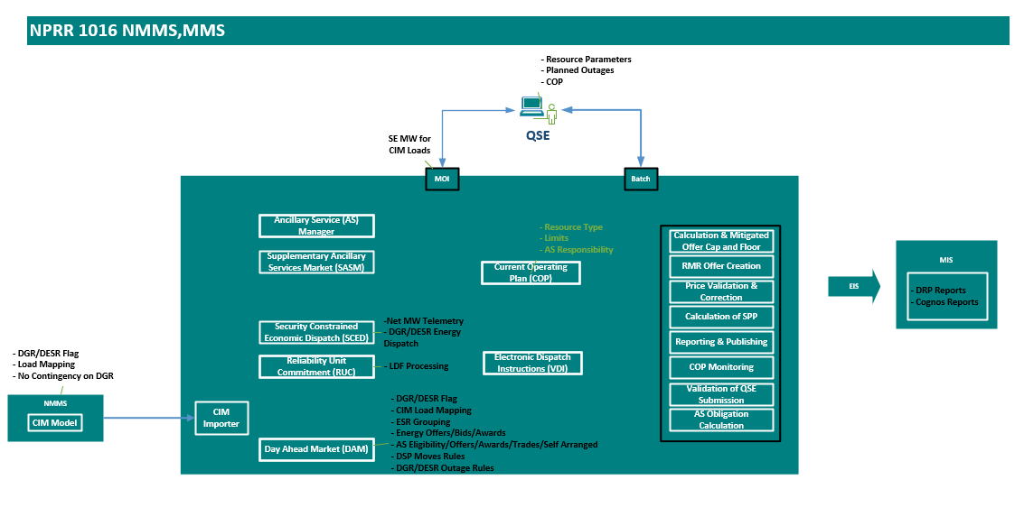
EMS and MMS system changes R-1

Slide 6
Summary of NPRR-1016 Changes
Revised Revision Description for interim process
Revised Section 2 definition of DGR/DESR for 1 MW minimum
Revised Section 3 language:
  Identifying Outage reporting requirements
  Clarifying VSS requirements
  Representing the DGR in the ERCOT Network model.
  Clarifying Load Shed and system change reporting
Update Section 16.5 language regarding registration
TBD: Potential language in Section 6.5.1.1 addressing limited scope of ERCOT’s authority over the distribution system and Distribution Service Providers
http://www.ercot.com/content/wcm/key_documents_lists/199883/DGR_workshop_4_NPRR_and_NOGRR_v1_nb2.pptx

Slide 7
Summary of NOGRR-212 Changes
Section 2 clarifying requirements for DGR/DESR
  Apply to Resources connected to the ERCOT System
  Must have “governor” in service
  Disconnection per DSP requirements
  Should not be connected to Load shed circuits
  Creating Frequency ride-through (FRT) requirements
    IEEE 1547-2018
    Grandfathering exemption
  Creating Voltage ride-through (VRT) requirements
    IEEE1547-2018
      Synchronous Cat 1
      Inverter-based Cat III
    Grandfathering exemption
Section 6 Clarifying exemption from Load shed
http://www.ercot.com/content/wcm/key_documents_lists/199883/DGR_workshop_4_NPRR_and_NOGRR_v1_nb2.pptx

Slide 8
Summary of RRGRR-026 Changes
RGRR026 simply provides a new data field so that ERCOT systems (Market Management System (MMS), Energy Management System (EMS), etc.) can distinguish distribution-connected Resources from transmission-connected Resources
This information is utilized during modeling so that the resource telemetry is appropriately used in the network model as defined in our “interim solution”
http://www.ercot.com/content/wcm/key_documents_lists/202920/PUBLIC_DGR_Interim_Solution_03242020.pptx

Slide 9
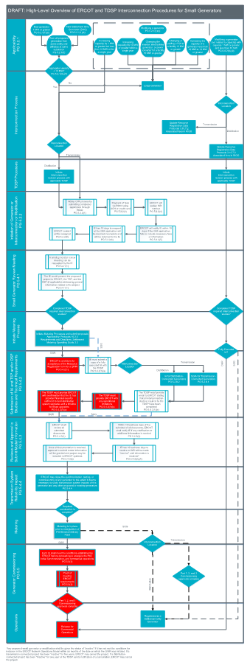
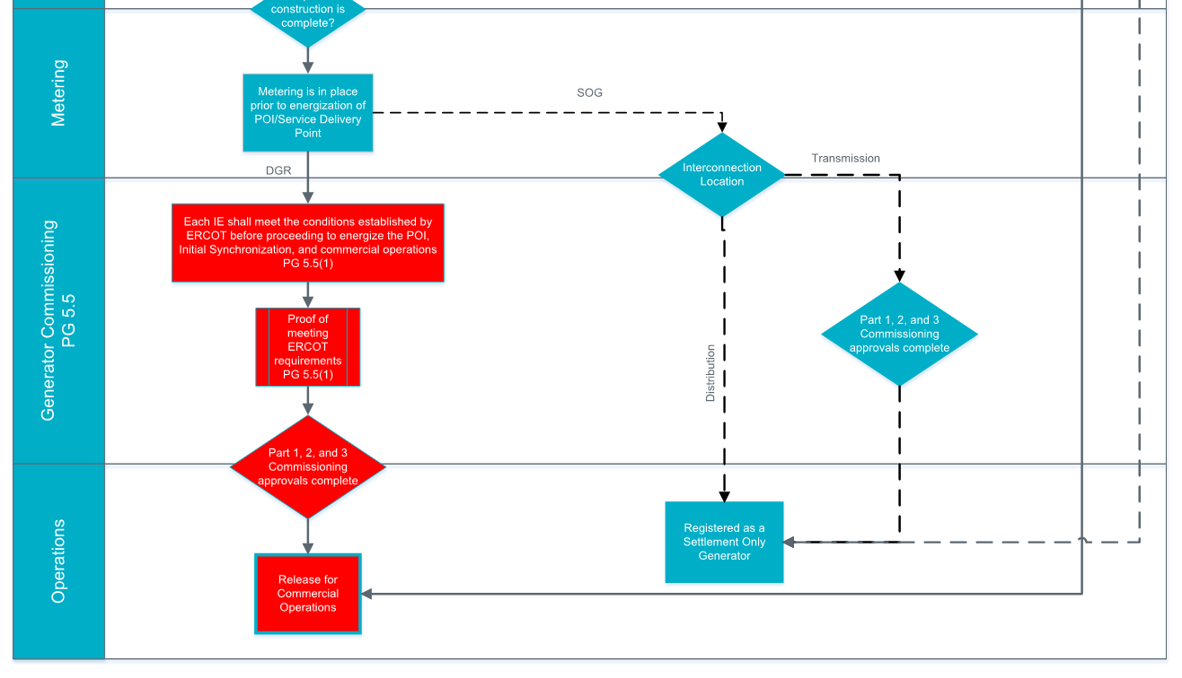
DGR and SOG Process Combined - PGRR082
Note: This Small Gen process also includes Transmission Connected SOGs.
The distinction between the DGRs and the SOGs is denoted by the dotted lines and red boxes with white text (See below):
(Magnified representation)

Slide 10
Examples for Applicability (Initial Interconnection)

Slide 11
Examples for Applicability (Modification Interconnection)

Slide 12
Examples for Applicability (Modification Interconnection)

Slide 13
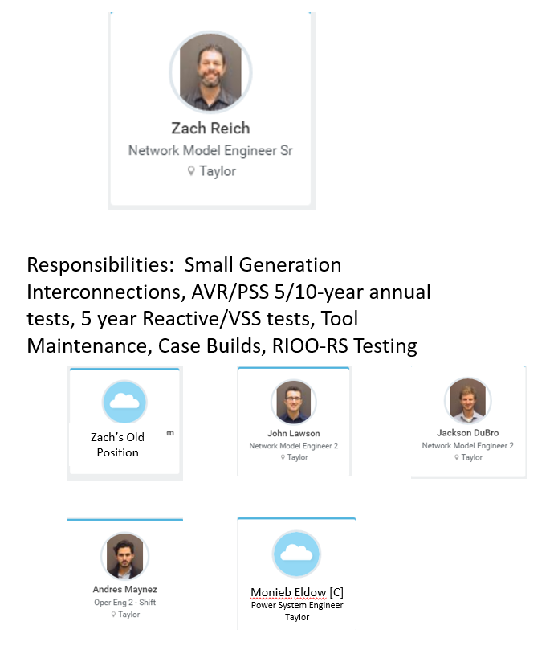
Small Generation Interconnection Team

Slide 14
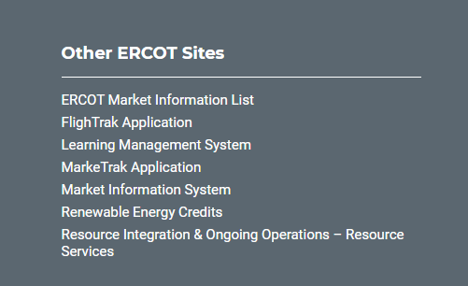
Registering in RIOO – Helpful Resources
Resource Services URL:
https://sa.ercot.com/rioo-rs/
Resource Services Sign Up Reference (RE):
http://www.ercot.com/content/wcm/lists/168284/RIOO_Resource_Services_Sign_Up_Reference.pdf
Interconnection Services Sign Up Reference (IE):
http://www.ercot.com/content/wcm/lists/168284/RIOO_IS_IE_Sign_Up_Reference.pdf
Interconnection Services Sign Up Reference (TSP):
http://www.ercot.com/content/wcm/lists/168284/RIOO_IS_TSP_Sign_Up_Reference.docx.pdf

Slide 15
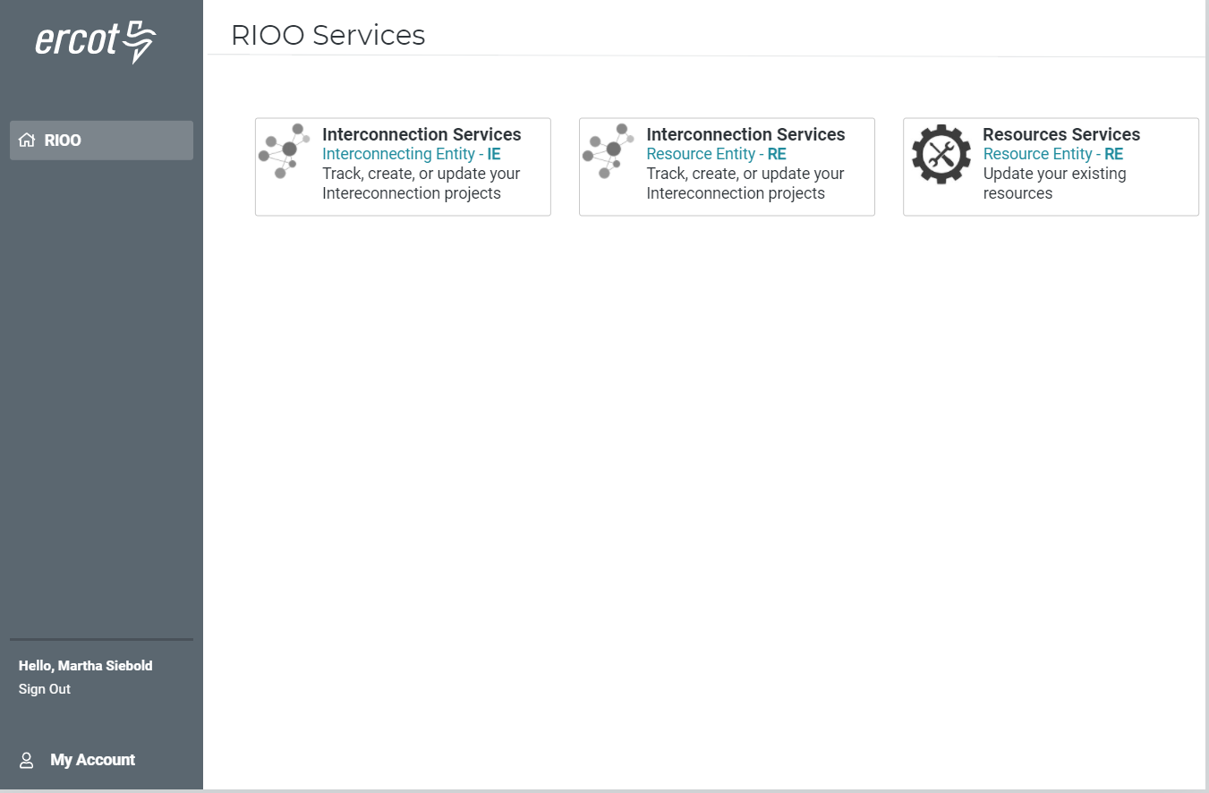
RIOO – After DGR Release (Q1 2022) Main
If you want to use an existing DUNS number and already an RE use this one.

Slide 16
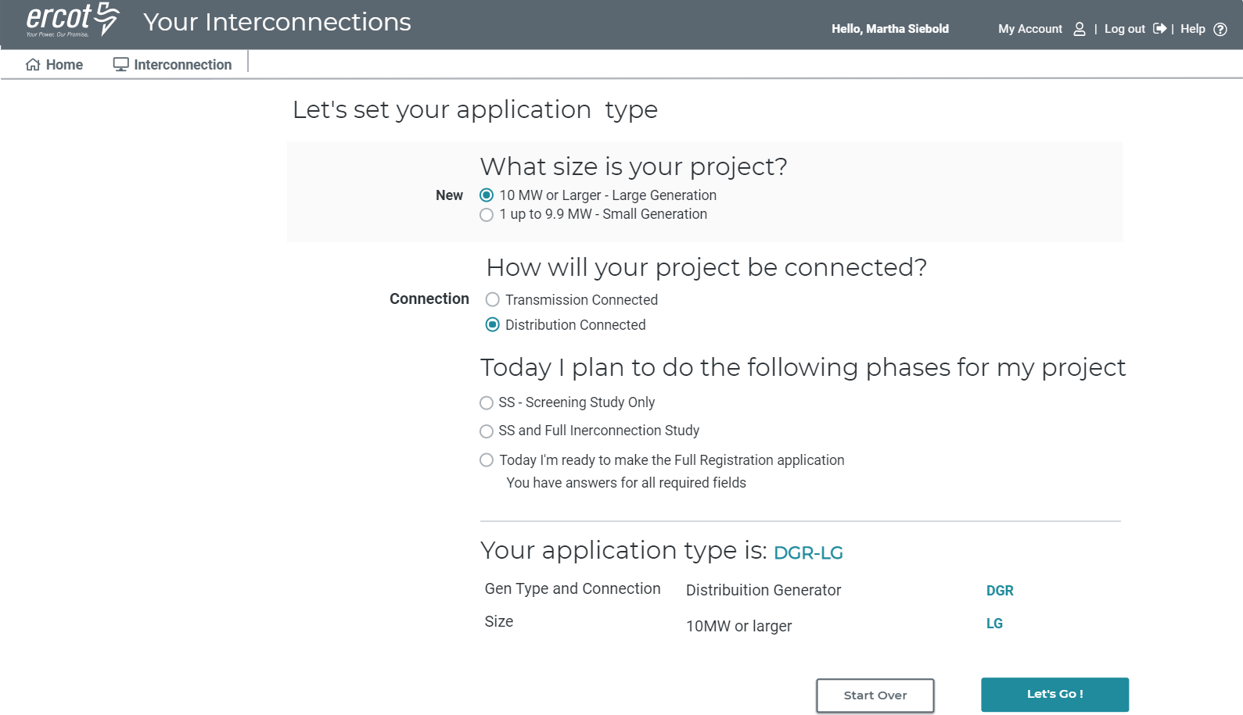
RIOO – After DGR Release (Q1 2022) IE

Slide 17
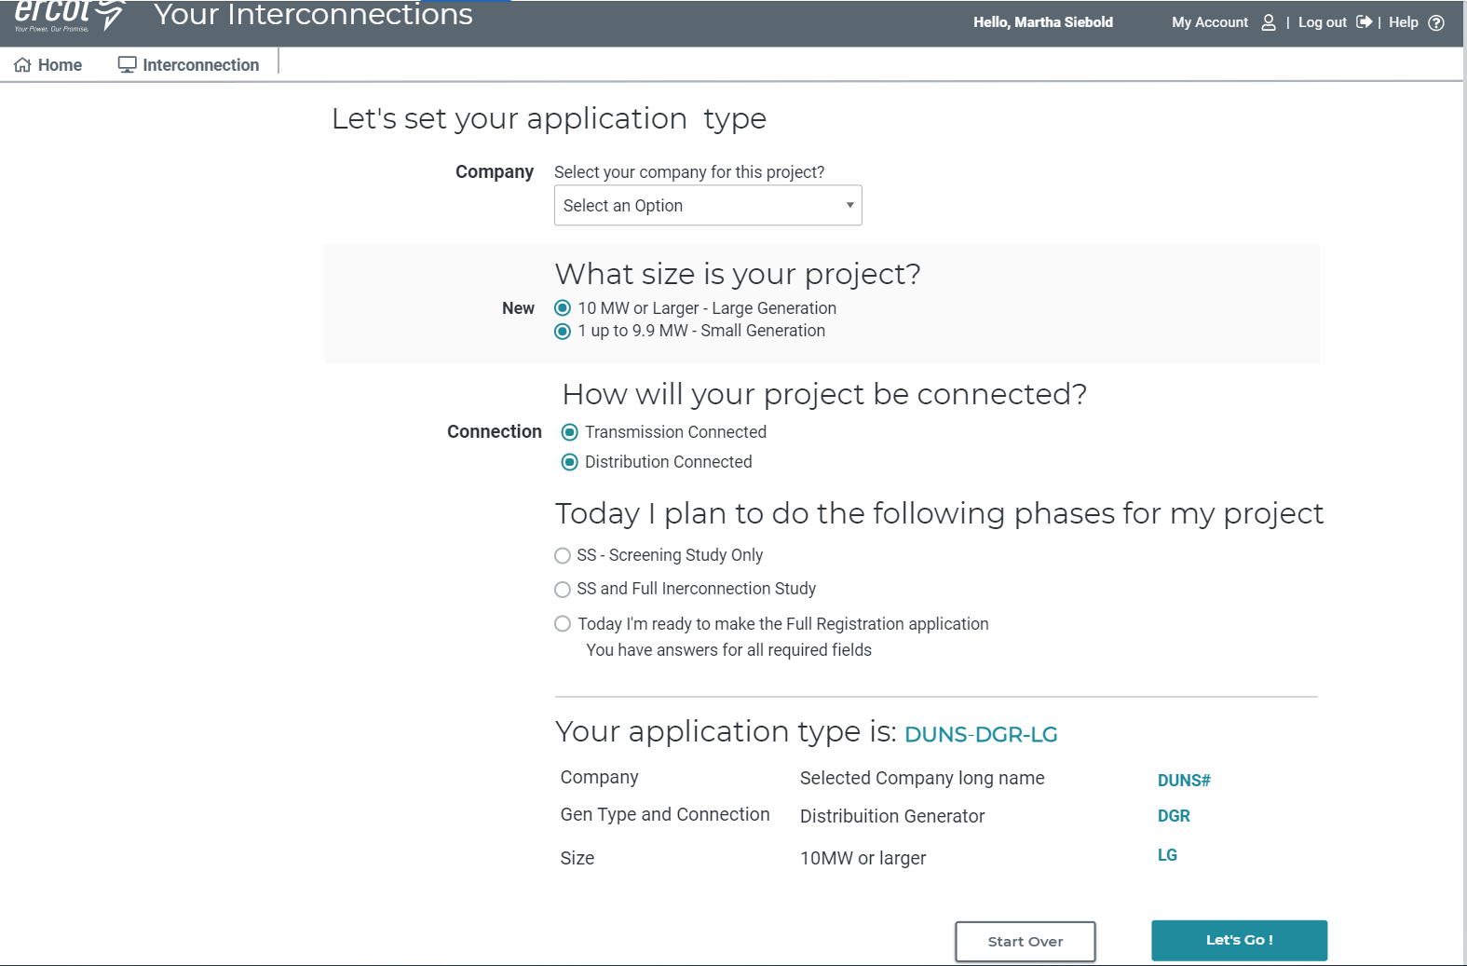
RIOO – After DGR Release (Q1 2022) RE

Slide 18
What Needs to be Ready for a Submission?
Small Gen Process per Planning Guide
Fee (TDB by Board)
EPS Metering design proposal
Resource Registration data
Affidavit for Conditions of Acceptance [5.4.2(1)] - (6 conditions)
  Confirmation of TDSP System Impact Studies
  Fully executed IA from TDSP
  Any operational limitations from TDSP
  VRT/FRT Performance
  TDSP confirmation that the IE has funded distribution system upgrades and a timeline for those upgrades

Slide 19
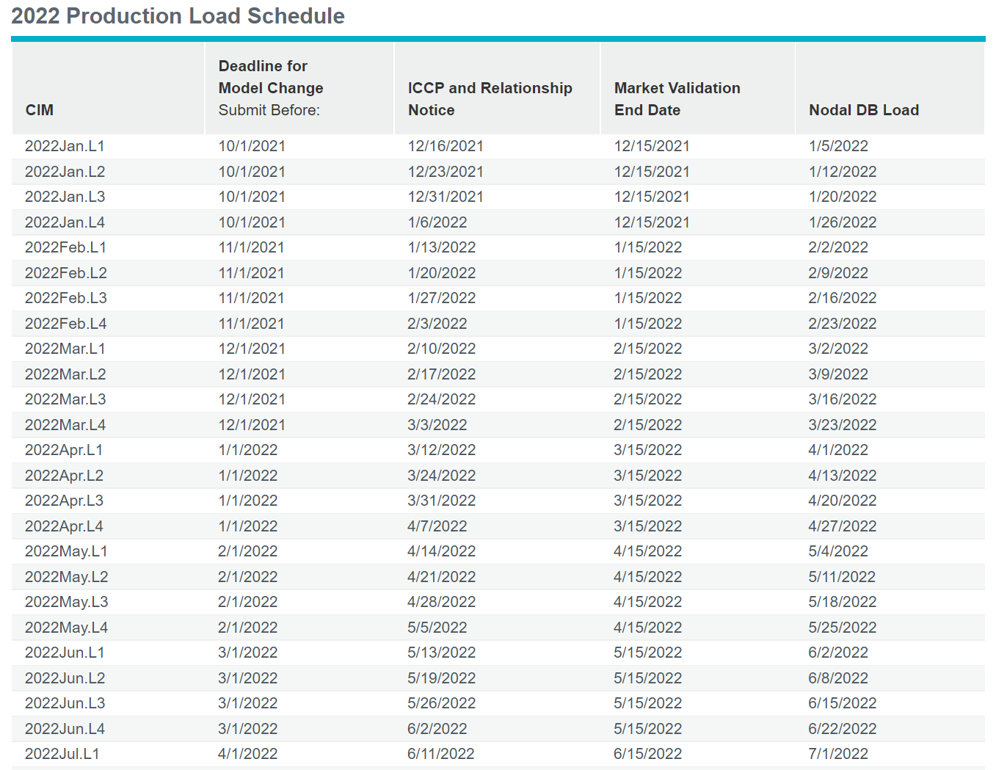
Model Ready Date (PLD) CIM Calendar
*
*Submitted prior to Jan 7 2022 due to ERCOT holiday

Slide 20
Commissioning
Commissioning Plan Template
  Submit 30 days prior to Part 1 checklist
Part 1: Request for Energization of Resource Entity Equipment
  Recommend submit 7 business days prior to desired energization (backfeed) date
  Plant and Interconnecting Facilities must be adequately modeled in ERCOT Network Operations Model
  Required telemetry must be set up and modeled for Plant and Interconnecting Facilities
  Telemetry data should be good quality and reasonable for at least 48 hours before approval

Slide 21
Commissioning
Part 2: Request for Initial Synchronization
  Submit after successful energization and recommend 7 business days before desired synchronization
  Part 3 Testing:
    AVR Test – Operating Guide section 2.2.5. Used to demonstrate unity power factor or local voltage control as specified by TDSP in the Interconnection Agreement. Test data is submitted to ERCOT via NDCRC.
    PFR Test – Nodal Operating Guide Section 8, Attachment C. Test data is submitted to ERCOT via NDCRC.
    Reactive Tests- Operating Guide section 3.3.2.2 – test reactive capability with RARF submittal
    Curtailment Test – IRR only – ability to follow SCED base point and respond appropriately with accurate telemetry

Slide 22
Commissioning
Part 3: Request to Commission a Resource
  Submitted after Part 3 testing is approved
  Part 3 testing to be completed no later than 90 days after initial synchronization
  Once Checklist Part 3 approval has been given, the Resource is given a Resource Commissioning Date by ERCOT and approved for participation in ERCOT market operations.
  AS qualification cannot begin until the resource is given a Resource Commissioning Date, but AS testing can begin after PFR test is approved
    If > 20 MVA must have Part 2 > 20 MVA approval

