Slide 1
Project Update
October 14, 2021
Troy Anderson
ERCOT Portfolio Management

Slide 2
Project Update Agenda
Recent / Upcoming Project Highlights
2021 Release Targets
2022 Release Targets
In-Flight Strategic Projects
Fast-Frequency Response (FFR) Advancement
DGR/DESR Implementation
BES Combo Model Implementation
Securitization Update
No update this month – see September 2021 PRS project update
Priority/Rank Options for Revision Requests with Impacts
None this month
Appendix
DGR/DESR Moratorium Market Notice
Location of Revision Request Project Information: http://www.ercot.com/services/projects

Slide 3
Recent / Upcoming Project Highlights
2021 October Release Off-Cycle – 10/1/2021 Complete
NPRR984 – Change ERS Standard Contract Terms
OBDRR023 – Related to NPRR984, Change ERS Standard Contract Terms
2021 October Release – 10/5/2021-10/7/2021 Complete
No Revision Requests
2021 December Release – 12/7/2021-12/9/2021 In Flight
NPRR863 – FFR portion (FFR Advancement)
NPRR1015 – Clarification of DAM implementation of NPRR863 Phase 2
NPRR1079 – Day-Ahead Market RRS / ECRS 48-Hour Report Clarification
NOGRR187 – Related to NPRR863
Note: Projected Go-Live dates are subject to change. Please watch for market notices as the effective dates approach.

Slide 4
2021 Release Targets – Board Approved NPRRs / SCRs / xGRRs
R1
R3
R5
February 2/2 – 2/4 | April 3/30 – 4/1 | May 5/25 – 5/27 | July 7/27 – 7/29 | October 10/5 – 10/7 | December 12/7 – 12/9
NPRR902(a) NOGRR195 NPRR1055 OBDRR023(a) NPRR1020 SCR804 | NPRR971 NPRR986 NPRR998 NPRR1024 NPRR1043 NOGRR213 VCMRR027 PGRR070 NPRR1060 | NPRR974 NPRR978(c) NPRR1048 NPRR1051 SCR811 ECMS ECMS NPRR1080 OBDRR030 NPRR1081(a) | NPRR902(b) NPRR905 SCR789 NPRR1062 RMGRR164 NPRR1031 NPRR867 NPRR1081(b) | None NPRR984 OBDRR023(b) SCR781 | FFR Advancement (NPRR863 FFR) NPRR1015 NPRR1079 NOGRR187 DGR/DESR (See next slide)
R2
R4
R6
ü
ü
ü
ü
ü
ü
ü
ü
ü
ü
ü
ü
ü
ü
ü
ü
ü
ü
ü
ü
ü
ü
ü
E
E
E
E
E
ü
1/1
7/14
10/1
ü
ü
ü
7/23
2/1
Replace NoticeBuilder
ü
ECMS – Nov.
Infrastructure replace
New navigation
2022 R1 (Feb.)
6/25
3/15
5/1
8/1
ü
ü
New public version of ERCOT.com homepage
ü
7/1
9/10
RIOO – Q4 2021
RARF Add Functionality Go-Live
4/22
6/1
ü
ü
ü
9/16
E
ü
TBD Items | NPRRs: 484, 825(b), 826, 829, 841, 857, 879, 885, 904, 918, 930, 935(b), 936, 939, 941, 945, 962, 965, 1004, 1006, 1019, 1023, 1030, 1032, 1034, 1040, 1057 SCRs: 799, 800, 805, 809, 812 Market Guides: PGRR066, PGRR076 Other Binding Docs: OBDRR009
Go-live dates can differ from Protocol effective dates – Please refer to market notices for more details
APPENDIX
Red Text: New additions and target release changes
Strike-Through Text: Previous target release
(a), (b), etc.: Multiple phase release
Project Status Codes
NS = Not Started
I = Initiation
P = Planning
E = Execution
H = On Hold
NPRR902(a) – ECEII Market Participant MPIM role
NPRR902(b) – MIS links updated for ECEII reports
NPRR978(c) – Forecast Zone scope
NPRR1081(a) – Manual implementation
NPRR1081(b) – Automated solution
OBDRR023(a) – ERS Expenditure Limit
OBDRR023(b) – 4 Standard Contract Terms/Year
Release targets are subject to change

Slide 5
2022 Release Targets – Board Approved NPRRs / SCRs / xGRRs
R1
R3
R5
February 2/1 – 2/3 | April 3/29 – 3/31 | May 5/24 – 5/26 | July 7/26 – 7/28 | October 10/4 – 10/6 | December 12/6 – 12/8
DGR/DESR NPRR917 NPRR1016 NPRR1052 NPRR1065 NOGRR212 PGRR082 RRGRR026 | SCR800 | NPRR939 | TBD | TBD | TBD
R2
R4
R6
Go-live dates can differ from Protocol effective dates – Please refer to market notices for more details
APPENDIX
Red Text: New additions and target release changes
Strike-Through Text: Previous target release
(a), (b), etc.: Multiple phase release
Project Status Codes
NS = Not Started
I = Initiation
P = Planning
E = Execution
H = On Hold
Release targets are subject to change

Slide 6
In-Flight Strategic Projects
ESR: Energy Storage Resource
DGR: Distributed Generation Resource
BES: Battery Energy Storage
PR325-01 Fast-Frequency Response (FFR) Advancement (Gated to Execution on 6/22/2021)
Planned go-live for 2021-R6 (December 2021)
NPRR863, NPRR1015, NPRR1079, NOGRR187
PR354-01 DGR/DESR Implementation (Gated to Execution phase on 7/30/2021)
Target go-live 2022-R1 (February 2022)
NPRR917 – Nodal Pricing for SODGs and SOTGs
NPRR1016 – Clarify Requirements for DGRs and Distribution Energy Storage Resources
NPRR1052 – Load Zone Pricing for Settlement Only Storage Prior to NPRR995
NPRR1065 – Implementation Adjustment for NPRR917
PGRR082 – Revise Section 5 and Establish Small Generation Interconnection Process
Related RRs – NOGRR212, RRGRR026
PR353-01 BES Combo Model Implementation – potential for multiple go-lives
Target go-live TBD (core project On Hold until resources are available after FFR and DGR/DESR)
NPRR963 – Base Point Deviation Settlement & Deployment Performance Metrics for ESRs (Combo Model)
NPRR987 – BESTF-3 ESR Contribution to Physical Responsive Capability and RT On-Line Reserve Capacity Calcs
NPRR989 – BESTF-1 ESR Technical Requirements
NPRR1002 – BESTF-5 ESR Single Model Registration and Charging Restrictions in Emergency Conditions
NPRR1026 – BESTF-7 Self-Limiting Facilities and Self-Limiting Resources
NPRR1038 – BESTF-8 Limited Exemption from Reactive Power Requirements for Certain ESRs
NPRR1069 – Align Ancillary Service Responsibility for ESRs with NPRR987
Related RRs – NOGRR204, NOGRR208, OBDRR017, PGRR081, RRGRR023
Blue text: ERCOT considering removing from project for earlier delivery

Slide 7
Priority / Rank Options for Revision Requests with Impacts
Options for…
Revision Request | Description | Priority | Rank | Comments
None
PPL Rank Information
Next available 2021 Rank in Business Strategy = 3360
Next available Rank in Regulatory = 320

Slide 8
Appendix

Slide 9
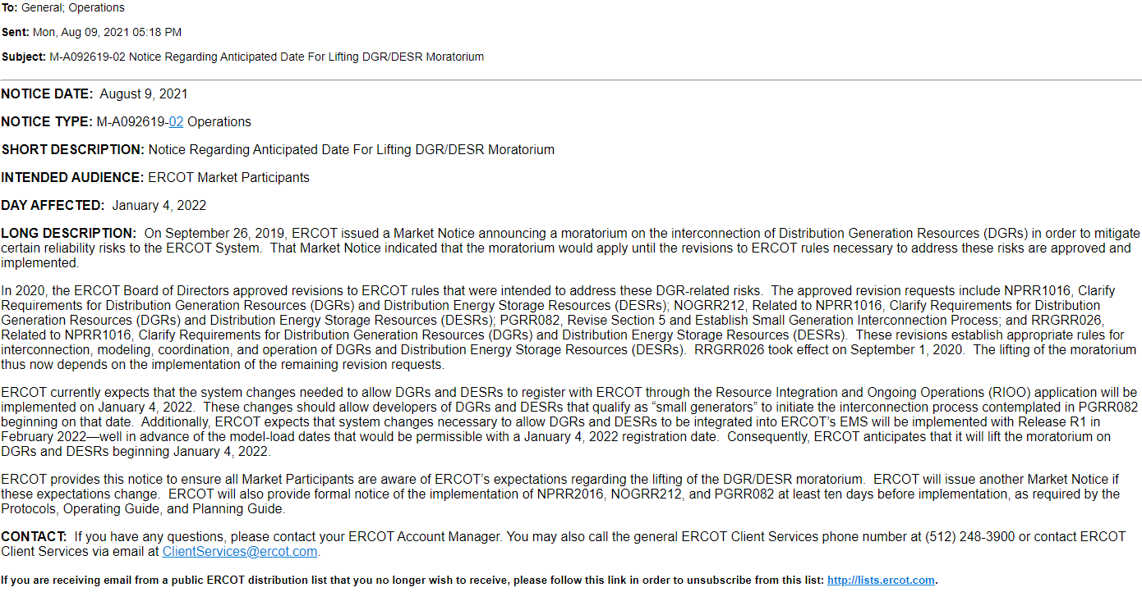
DGR/DESR Moratorium Market Notice – 8/9/2021

