Slide 1
ERCOT Frequency Events
September 2021
ERCOT
Operations Planning
PDCWG | October 13th, 2021

Slide 2
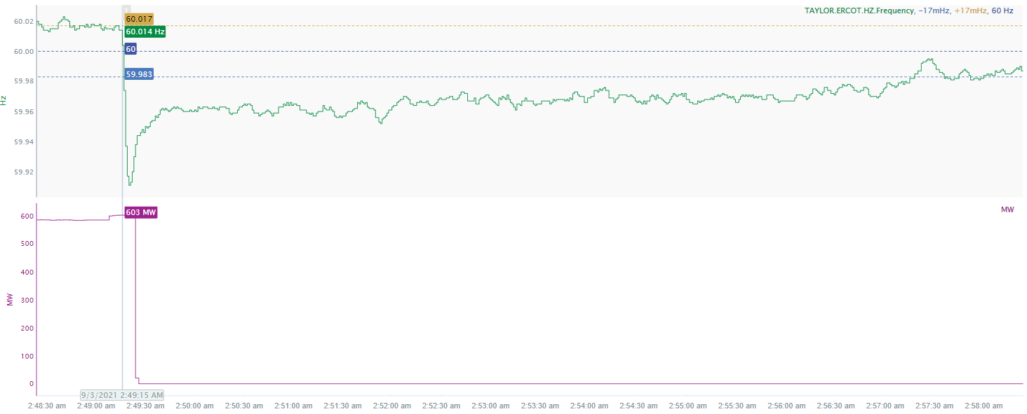
9/3/2021 2:49:15 (NON FME)
Notes:
Unit tripped offline while carrying 603 MW.
Starting Frequency: 60.014 Hz
Minimum Frequency: 59.911 Hz
A-C Time: 5 seconds
Recovery Time (back to deadband): 8 minutes and 30 seconds
RRS Deployed: 0 MW
Trip Reason: Unknown at this time.
Contextual Information: A total of 99.1 MW of regulation up was deployed and 150 MW of manual offset was applied during the event.
No Selection Reason: The frequency was oscillating at high deadband prior to the event.

Slide 3
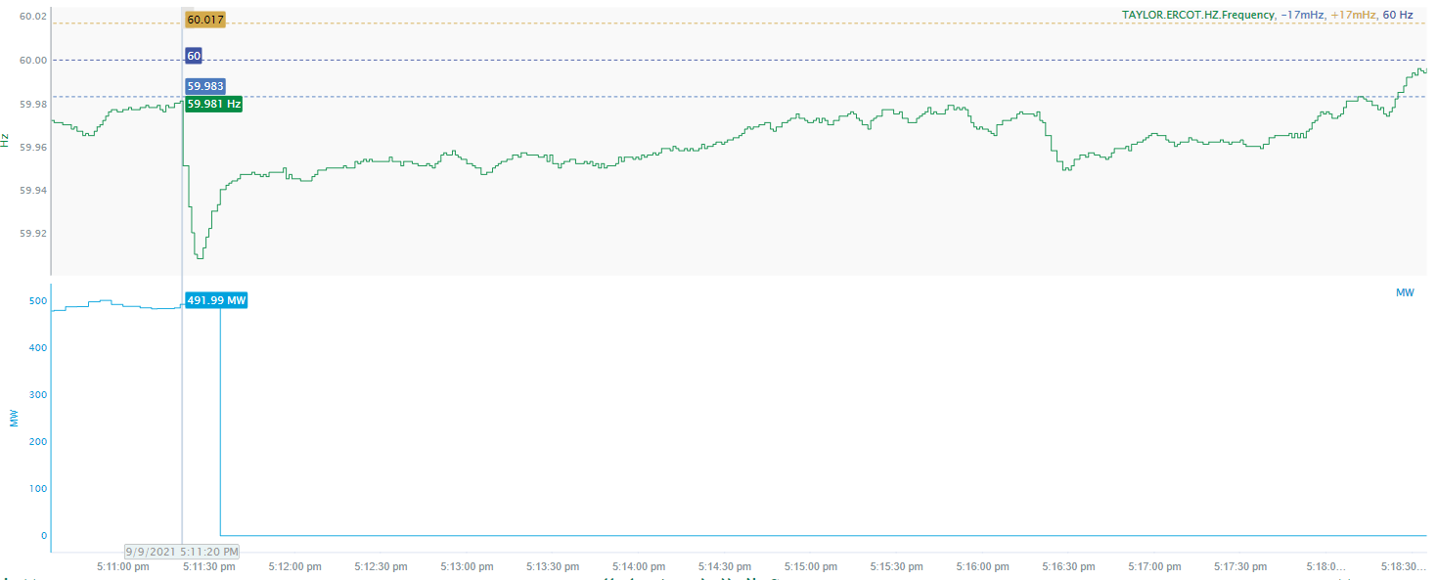
9/9/2021 17:11:20 (NON-FME)
Notes:
Unit tripped offline while carrying 493 MW
Starting Frequency: 59.981 Hz
Minimum Frequency: 59.908 Hz
A-C Time : 6 seconds
Recovery Time(back to deadband): 7 minutes and 0 seconds
RRS Deployed: 644.38 MW
Trip Reason: Due to control problems
Contextual Information: A total of 241.1 MW of regulation up was deployed and manual offset of 150 MW was applied during the event.
No Selection Reason: The starting frequency is too low

Slide 4
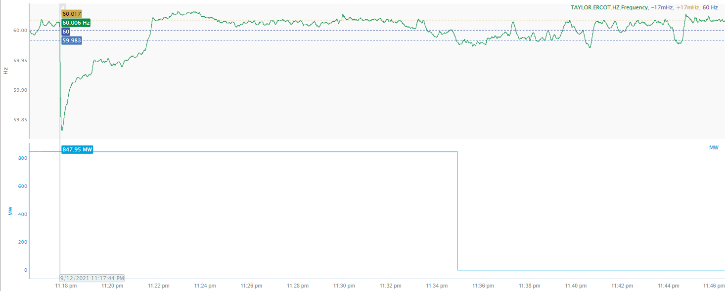
9/12/2021 23:17:44 (FME)
Notes:
Unit tripped while carrying 847 MW.
Starting Frequency: 60.006
Minimum Frequency: 59.833 Hz
A-C Time: 5 seconds
Recovery Time(back to deadband): 3 minutes and 43 seconds
RRS Deployed: 1186.6 MW
Trip Reason: The suspected cause was due to outside power load imbalance.
Contextual Information: A total of 102 MW of regulation up was deployed and 600 MW of manual offset was applied during the event.

Slide 5
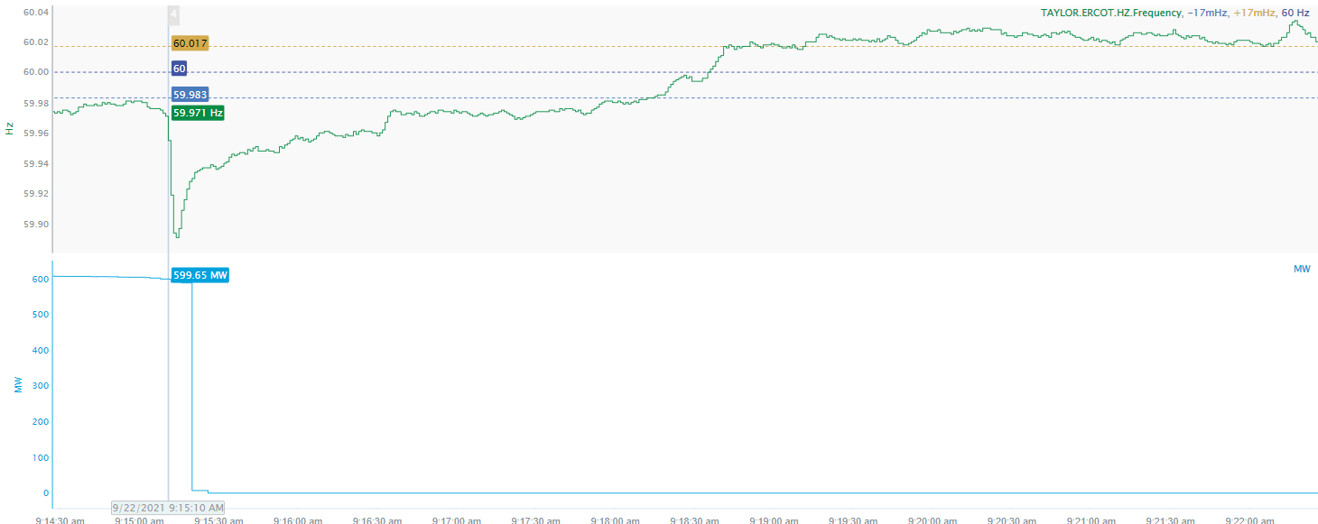
9/22/2021 9:15:10 (NON-FME)
Notes:
Unit tripped offline while carrying 589 MW.
Starting Frequency: 59.971 Hz
Minimum Frequency: 59.891 Hz
A-C Time: 4 seconds
Recovery Time(back to deadband): 3 minutes and 0 seconds
RRS Deployed: 359.46 MW
Trip Reason: Unit tripped when site personnel were changing PA fan filters
Contextual Information: A total of 426.62 MW of Regulation Up was deployed during the event.
No Selection Reason: The starting frequency is too low

Slide 6
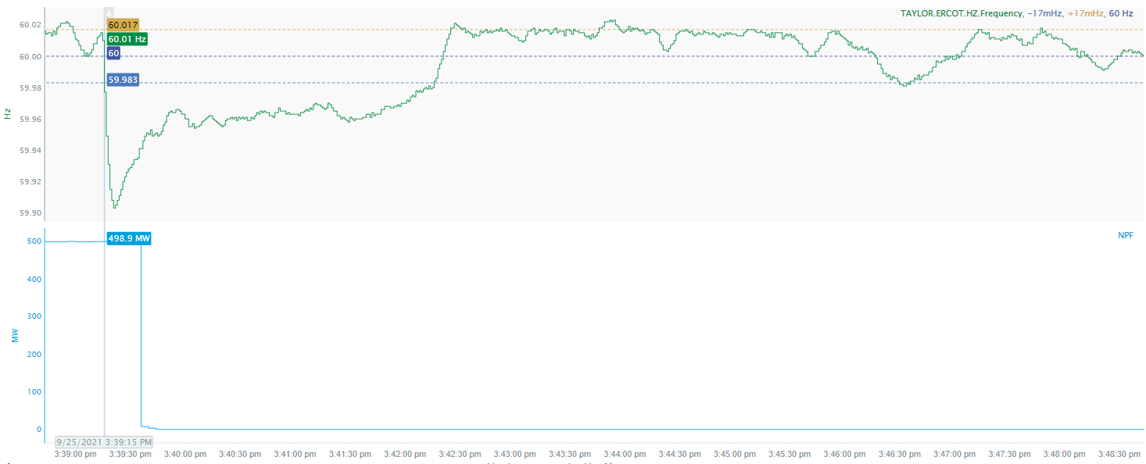
9/25/2021 15:39:15 (FME)
Notes:
Unit tripped offline while carrying 498 MW.
Starting Frequency: 60.01 Hz
Minimum Frequency: 59.903 Hz
A-C Time: 6 seconds
Recovery Time(back to deadband): 2 minutes and 54 seconds
RRS Deployed: 373.75 MW
Trip Reason: Unknown at this time.
Contextual Information: A total of 315 MW of regulation up was deployed during the event.

Slide 7
Questions?
Thank you!

