Slide 1
IDR/AMS
Workshop
October 13, 2021
Jim Lee – AEP Texas
Sam Pak – Oncor

Slide 2
Agenda
Antitrust Admonition
Introductions
Goals & Objectives
Background & Revision Requests
TDSP Metering Status
IDR to AMS Conversion Process
Data Impacts for Converted ESI IDs
  Data Availability & Formatting
  Historical Usage Data Accessibility – ROR & Non-ROR
Q&A
Adjourn

Slide 3
Antitrust Admonition
To avoid raising concerns about antitrust liability, participants in ERCOT activities should refrain from proposing any action or measure that would exceed ERCOT’s authority under federal or state law. For additional information, stakeholders should consult the Statement of Position on Antitrust Issues for Members of ERCOT Committees, Subcommittees, and Working Groups, which is posted on the ERCOT website.
Disclaimer: All presentations and materials submitted by Market Participants or any other Entity to ERCOT staff for this meeting are received and posted with the acknowledgement that the information will be considered public in accordance with the ERCOT Websites Content Management Operating Procedure.

Slide 4
Primary Goal:
Improve the accuracy of ERCOT’s initial settlements (actual vs estimated) by transitioning current IDR Metered premises, where possible, to AMS profiled premises (peak Demand > 700kW/700kVA applicable to 4CP billing) which allows for provision of post Operating Day interval data.
Objectives:
Identify a 4CP indicator for ERCOT and MPs when transitioning away from BUSIDRRQ
Identify the TDSP’s transition plan for converting BUSIDRRQ profiled ESIIDs to AMS profiled ESIIDs
Identify the data stream to retrieve interval data and billing determinants
Identify Historical Data accessibility methods for ESIIDs transitioned away from BUSIDRRQ profile
Goals & Objectives

Slide 5
Workshop I – June 1st 2020
IDR/AMS Meter Matrix
ERCOT Proposal – High Level
Workshop II – October 6th 2020
Goals and Requirements identified
4CP Indicator Reviewed
Refined Overall ERCOT Proposal
Workshop III – October 13th 2021
Transition Plans
Data Availability/Accessibility/Formatting
Background

Slide 6
IDR Load Profile to AMS Load Profile Process:
Add two new PROFILETYPECODEs to be used for > 700 kW/kVA premises where the TDSP can support a 4CP billing rate with an AMS profile. BUSLRG will be created for premises that do not have distributed generation and BUSLRGDG will be created for those premises that do have distributed generation. This would lead to the addition of sixteen PROFILECODES (one for each weather zone).
Existing BUSIDRRQ will remain an option for > 700 kW/kVA premises.
Profile Decision Tree will allow BUSLRG, BUSLRGDG, or BUSIDRRQ for > 700 kW/kVA premises.
  Profile Decision Tree, Segment Assignment, III. Business (BUS), A. – Assign LRG, LRGDG or IDDRQ Profile Segment to all BUS ESI IDs with a peak demand > 700 kW/kVA
ERCOT will set up the BUSLRGDG profile type to allow for loading of generation (export) data if submitted to ERCOT. Generation data will be treated as an LSE load reduction in the same manner as all other distributed generation AMS profile types.
NOTE: If the premise is registered with ERCOT as a Settlement Only Generator, the ESI ID should be set to BUSLRG and ERCOT will use the RID data in the generation aggregation process, not as a load reduction.
ERCOT will populate the BUSLRG and BUSLRGDG profile shapes with the same values applied to BUSIDRRQ load profiles.
BUSIDRRQ to AMS Profile

Slide 7
ERCOT Protocols will require 700 kW/kVA premises to have IDRs (instead of IDR Meters). NPRR1062
ERCOT will not produce an IDR Requirement report. NPRR1062
RMG Section 7.13 – Interval Data Recorder Meter Removal and Installation Process will be deleted in its entirety. RMGRR164
ERCOT will implement new AMS data threshold validations for BUSLRG and BUSLRGDG profiles.
When an AMS premise surpasses 700 kW/kVA, TDSP will transition to BUSLRG, BUSLRGDG, or BUSIDRRQ.
Transition of existing IDR Meters to AMS will be governed by new Protocol Section 18.7 (NPRR1062) which allows for the use of BUSLRG or BUSLRGDG (if >700 kW/kVA) or any other AMS profile types when <= 700 kW/kVA.
GEN OR LOAD | BUS_OR_RES | THRESHOLD | kW
BUSLRG -LOAD | BUS | 57,000 | 228,000
BUSLRG - GEN | BUS | 250 | 1000
LOAD | BUS | 500 | 2000
LOAD | RES | 100 | 400
GEN | BUS | 250 | 1000
GEN | RES | 250 | 1000
BUSIDRRQ to AMS Profile

Slide 8
Revision Requests approved through ERCOT Stakeholder process:
LPGRR068, Adds 16 New AMS Load Profiles Effective 02/01/2022 (06/2021)
  Alternative BUSLRG profiles represent 4CP customers with AMS meter & Load Profile
  BUSIDRRQ profiles remain in list of choices – represents 4CP customers with IDR Meter
  Provides optionality to use new profiles but not mandatory for MPs to utilize
RMGRR164, Related to NPRR1062, Modify IDR Meter Requirement and Eliminate IDR Meter Requirement Report (06/2021)
NPRR1062, Modify IDR Meter Requirement and Eliminate IDR Meter Requirement Report (06/2021)
Revision Requests
LPGRR068, which activates the BUSLRG & BUSLRGDG Load Profiles, will become effective February 2022 (ERCOT Release 1 2022).

Slide 9
TDSP Metering Status

Slide 10
 | Oncor | CNP | AEP | TNMP
Current # of BUSIDRRQ profiled ESI IDs | 7,058 (originally) ~50% have been transitioned to daily settlement | 5,233 Total (4,716 Active) | ~1,470 | 377
Eligible # of ESI IDs for transition to BUSLRG | 6900+ ESIs in process of transitioning to BUS profile via MTs | Internal investigations continue to identify LPGRR068 systems and resources impacts, includes impacts to kVA billing determinant requirements | ~1,360 | 306
Approx. # of ESI IDs to remain on BUSIDRRQ | ~100-200 IDR ESI IDs | Active Meter Counts Total 224: 178 Non-EPS/Transmission 40 Dedicated Phone 4 Subtractive 2 Netting | ~45 Transmission, ~10 Distribution, ~60 EPS | 53 Transmission, 3 Distribution; 15 EPS
Example situations where IDR Metering & BUSIDRRQ will remain for premises >700kW/kVA | EPS meters Note: Some meters may require additional time to transition | Transmission level; EPS Customer’s w/Direct Dedicated Telephone connections; Additive/Subtractive Meters | Some Transmission level; EPS meters; additive/subtractive meters | EPS; Customer Owned Transformer Sites, Billing on Secondary Side of Transformer Sites
Are pulse outputs available via AMS meters? | Yes | Yes | Yes | No – requires IDR Meter

Slide 11
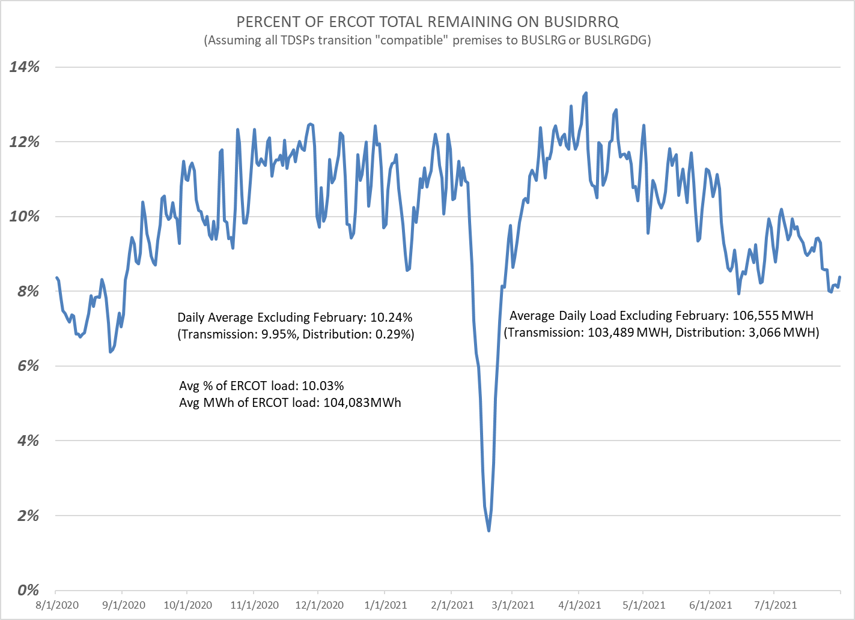
*RECTF ECL #19

Slide 12
IDR to AMS
Conversion Process

Slide 13
 | Oncor | CNP | AEP | TNMP
Before BUSLRG load profile availability (before 2/1/22) | Oncor plans to transition all applicable BUSIDRRQ profiled ESI IDs to BUSLRG or the default BUSLO Load Profile by Q3 2022. | Internal investigations continue to identify LPGRR068 systems and resources impacts, includes impacts to kVA billing determinant requirements | Upon Customer or REP request and confirming ESIID eligibility, AEP will transition ESI ID to the appropriate BUSHI/MED/LO load profile based on the Load Profiling Guide Profile Decision Tree, Appendix D. | TNMP does not plan to transition to BUSHI/MED/LO profiles before BUSLRG availability.
After BUSLRG load profile availability (after 2/1/22) | Once BUSLRG is available, all respective ESI IDs will transition to BUSLRG within 1-2 meter cycles, on cycle date. | Internal investigations continue to identify LPGRR068 systems and resources impacts, includes impacts to kVA billing determinant requirements | Once BUSLRG is available, eligible ESI IDs will transition to BUSLRG within 1-2 meter cycles, on cycle date. | Once BUSLRG is available, eligible ESI IDs will transition to BUSLRG within 1-2 meter cycles, on cycle date.
Transition Plans

Slide 14
ESI IDs converting to non-BUSIDRRQ Profile & Using daily LSE files to submit data
Customer and/or REP of Record (ROR) requests the TDSP convert an ESI ID from IDR load profile to AMS load profile – TDSP will evaluate and confirm eligibility of ESIID conversion.
TDSP will submit two (2) MarkeTrak issues with “Other” subtype using “BUSIDRRQ to AMS Conversion” in description – one to ERCOT and one to REP of Record.
ERCOT will enter ESIID into Threshold Bypass table and respond to the MarkeTrak issue indicating successful loading.
Upon receiving ERCOT acknowledgement, TDSP will submit the last IDR read via 867_03IDR to ERCOT and verify successful ERCOT data loading.
After verification of data loading, TDSP will submit 814_20 Load Profiling change, backdated to align with a loaded meter read.
After receiving confirmation via 814_21 response, TDSP will back-fill any missing daily interval data from the effective date of the AMS profile change to current date via daily LSE file to ERCOT and Smart Meter Texas, as needed.
After successful completion of steps 1-6, the ESIID is considered converted from BUSIDRRQ profile to AMS profile and interval data will be sent via daily LSE file to ERCOT for Settlement, and Smart Meter Texas for Customer & ROR access.
Note: Once new Load Profiles are effective (via Release 1 2022), TDSPs no longer need to submit a MT issue to put ESIID on ERCOT bypass. ERCOT’s solution will institute a new single interval threshold value for ESIIDs on the new Load Profiles and all will be subject to the threshold check.

Slide 15
Data Impacts for Converted ESI IDs

Slide 16
 | Oncor | CNP | AEP | TNMP
Which usage & billing transaction(s) should CRs expect to receive for a converted ESI ID? | Daily LSE files & monthly summary 867_03 | Current market approved processes will continue | Continue to receive monthly interval detailed 867_03IDR, plus the daily LSE files | Our plan is to submit the monthly interval 867_03, as well as the daily LSE file
Is 15 minute interval-level kVArh (Power Factor data) available? | Interval kVArh is unavailable for AMS profiled premises | Internal investigations continue to identify LPGRR068 systems and resources impacts, includes impacts to kVA billing determinant requirements | Interval level kVArh is available via monthly 867_03IDR. Power Factor is available in the Summary loop that occurred at peak kW | Interval level kVArh is available via monthly 867_03IDR. Power Factor is available in the Summary loop that occurred at peak kW
Data Availability

Slide 17
 | Oncor | CNP | AEP | TNMP
Interval Data Accessibility for REP of Record (ROR) | Via Smart Meter Texas | Current Market approved process will continue | Via Smart Meter Texas | Via Smart Meter Texas
Historical Usage accessibility for REP and/or ROR | Via Historical Usage Portal in CRIP | Current Market approved process will continue | Via AEP REP Desk | Via REP Portal
Is interval-level Historical Usage available for a converted ESI ID? | Via Historical Usage Portal in CRIP (Data begins aging after conversion) Note: Up-to-date historical interval data will be available via HU Portal in CRIP by mid-2022. | Current Market approved process will continue | Yes, via AEP REP Desk, if previously BUSIDRRQ | Yes, via REP Portal
Will interval-level Historical Usage output files for converted ESI IDs have the same format as “old” BUSIDRRQ interval data format? | Yes | Current Market Approved process will continue | Yes | Yes
Summary-level Historical Usage accessibility for 3rd Parties | Via Oncor ABC Portal w/ electronic LOA request process | Via email with completed LOA request to: Usage.Req@centerpointenergy.com | Via AEP Usage Hub w/ electronic LOA request process | Via TNMP REP portal w/ electronic LOA request process
Interval level Historical Usage for 3rd parties (non-ROR, Aggregators, Brokers) | Smart Meter Texas | Current Market Approved LOA process will continue | Smart Meter Texas | Smart Meter Texas
Data Accessibility

Slide 18

Q&A

