Slide 1
Supply Analysis Working Group
Update
Pete Warnken, Co-Vice Chair
October 6, 2021
Notes:
Welcome to

Slide 2
Summary of 9/17 SAWG Meeting
Meeting held jointly with PLWG to apprise each other of activities associated with severe weather event scenario analysis, and for PLWG to summarize ongoing discussions on severe winter weather transmission planning cases (TAC Emergency Conditions List Items 93-94)
Update on Winter SARA release plans and NERC’s request for an extreme winter weather event scenario for their 2021-22 Winter Reliability Assessment
Update on probabilistic winter SARA development project, with a presentation on probabilistic modeling of a severe winter weather event
Presentation on statistical relationship between temperature and forced outage rates for selected resource types and Weather Zones

Slide 3
Presentation/Discussion Highlights
National Grid provided an update on PLWG subgroup discussions on extreme cases/events, including examples of MISO’s gas/electric coordination efforts, ideas for changes to SARA and CDR reports (recap of proposals introduced at a prior SAWG meeting), and proposed transmission planning cases for extreme summer and winter weather and weather-related extreme events
ERCOT described the status and purpose of the weather study to support development of phase 2 of the PUCT’s weatherization standards
A stakeholder gave an update on electric-coordination issues; a key challenge is getting comprehensive data on fuel supply risks, and how to determine how much fuel supply would be available during severe weather events

Slide 4
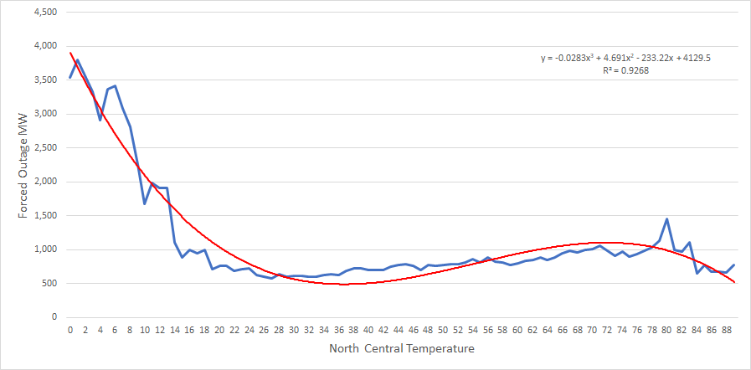
Presentation/Discussion Highlights
ERCOT provided charts showing the temperature vs. forced outage relationship for (1) gas-fired combined-cycle units in the North Central and South Central Zones, and (2) wind units in the West Zone; relationships can be used to develop temperature-threshold-based outage scenarios for the SARA
Combined-Cycle

Slide 5
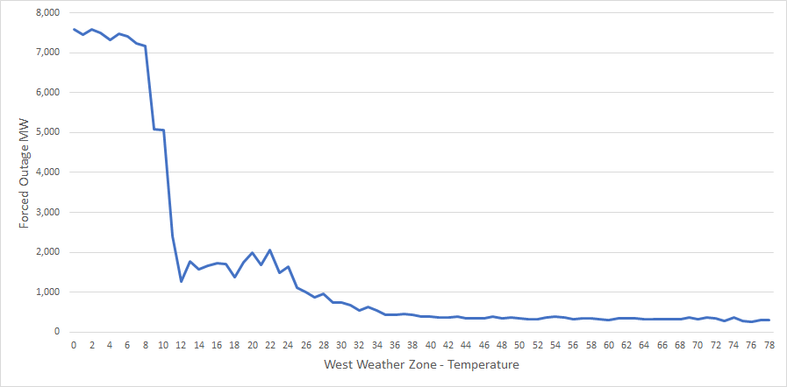
Presentation/Discussion Highlights
Wind

Slide 6
Presentation/Discussion Highlights
ERCOT’s plan is to release the Winter SARA report in mid-November
NERC requested a risk scenario based on past severe winter weather event of each Assessment Area’s choosing. This scenario would be included in NERC’s Weather Reliability Assessment report. ERCOT will brief the PUCT on the scenario as well as on associated messaging in the accompanying narrative description
ERCOT recommended that a scenario workshop be conducted at an appropriate time to take stock of progress in data gathering and research on scenario development, and to coordinate on efforts at scenario development that account for multiple working group needs and perspectives

Slide 7
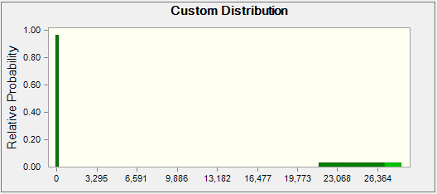
Presentation/Discussion Highlights
The winter probabilistic SARA model should be ready in October
A presentation was given on how the risk of outages and reduced renewables production during severe weather events (comparable to Winter Storm Uri), is being represented probabilistically in the model
Thermal Forced Outage Probability Distribution for Severe Winter Storm Event (3.5% overall probability)

