Slide 1


TDTMS Update
October 5th, 2021 RMS
Sheri Wiegand, Chair Sam Pak, VC

Slide 2
TDTMS
Update
Retail 2022 SLOs for Market Data Transparency & MarkeTrak Systems presented as DRAFT, likely will review at next month’s TDTMS, then up for RMS approval at November meeting
RMGRR166 – Create Switch Hold Extract Repository – Comments
RMGRR 167 – Switch Hold Removal Documentation Clarification –PUCT 10/7, Documentation effective 10/8, 11/1 enforcement date
SCR 815 – MarkeTrak Administrative Enhancements – Approved
SCR 817 – MarkeTrak Validation Revisions aligning with TXSET 5.0 – VOTE – TXSET V5.0 “package”

Slide 3
TDTMS
Update
GO LIVE is expected Q3 2022 (July – August)
ERCOT Communications – Listservs –
Refresh will require a longer outage – coordinating with planned SLOs and release weekends
Training and visibility goal May – June 2022
Contingency plans will be made
SLOs will be included for 2022 including emergency “break glass” back up process with Client Services
MARKETRAK UPGRADE no changes

Slide 4
TDTMS
New Occupant Statement – RMGRR 167
Encourage market participants to review Appendices J2 & J3 and be prepared to integrate into switch hold removal processes on 10/8. A market notice will be forthcoming upon PUCT approval of RMGRR 167. Old forms no longer accepted after 11/1/21.

Slide 5
TDTMS
Semi-Annual Review of MarkeTrak Subtypes – Mid Year 2021

Slide 6
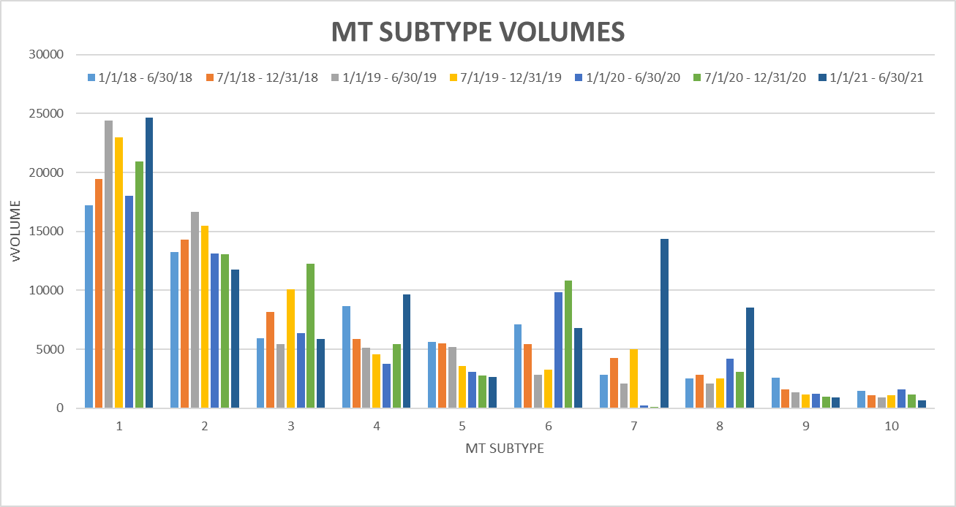
TDTMS
Semi-Annual Review of MarkeTrak Subtypes – Mid Year 2021
Inadvertent Losing MT volume continues to rise – will track against transaction volume
IAL vs IAG trajectory continues to widen
Usage & Billing Dispute and AMS LSE Dispute increases attributed to URI
Other increases likely due to Oncor efforts to transition BUSIDRRQ to BUSLO profiles
Switch Hold Removals seemed to move back to seasonal volumes
Increase in ERCOT Initiated MTs are due to special character transaction awareness and some for POLR Drops

Slide 7
TDTMS
Next Meeting – October 20th, Wednesday @ 9:30 WebEx
On the Agenda:
System instances and MarkeTrak Monthly Performance Review
Market Data Transparency 2022 SLOs
Status of proposed SCRs and RMGRRs
MarkeTrak Upgrade status
RMGRR 166 – Switch Hold Extract Repository – comments
Review Monthly IAG Report
SCR817 – MT Validation Revisions – common list of Unexecutable Reasons
Checkpoint on Goals for 2021

