Slide 1
PDCWG Report to ROS
Chair: Chad Mulholland, NRG
Vice Chair: Jimmy Jackson, CPS
ROS
October 07, 2021

Slide 2
Report Overview & Notes
Report Overview
Meeting Minutes
BAL-001-TRE-2 FMEs and IMFR
1 FME in the month of July
2 FMEs in the month of August
Frequency Control Report

Slide 3
Meeting Minutes
PDCWG Meeting 09/8/2021
Review of emergency conditions list from ROS
ERCOT Ancillary Service Methodology (Part2,discussion)
Loss of Generation Event Analysis – May 9,2021
ERCOT reports

Slide 4
Frequency Measurable Events Performance

Slide 5
Frequency Measurable Events
There was 1 FME in July
7/20/2021 8:46:05
Loss of 801 MW generation
Interconnection Frequency Response: 1313 MW/0.1 Hz
56 Resources were evaluated. These includes,
54 Generation Resources
2 Controllable Load Resources
0 Energy Storage Resources
4 of 54 Evaluated Generation Resources had less than 75% of their expected Initial Primary Frequency Response.
4 of 54 Evaluated Generation Resources had less than 75% of their expected Sustained Primary Frequency Response.

Slide 6
Frequency Measurable Events
There were 2 FMEs in August
8/28/2021 7:07:20
Loss of 781 MW generation
Interconnection Frequency Response: 1662 MW/0.1 Hz
53 Resources were evaluated. These includes,
51 Generation Resources
2 Controllable Load Resources
0 Energy Storage Resources
8 of 51 Evaluated Generation Resources had less than 75% of their expected Initial Primary Frequency Response.
7 of 51 Evaluated Generation Resources had less than 75% of their expected Sustained Primary Frequency Response.

Slide 7
Frequency Measurable Events
8/31/2021 17:40:36
Loss of 502 MW generation
Interconnection Frequency Response: 913 MW/0.1 Hz
82 Resources were evaluated. These includes
82 Generation Resources
0 Controllable Load Resources
0 Energy Storage Resources
20 of 82 Evaluated Generation Resources had less than 75% of their expected Initial Primary Frequency Response.
18 of 82 Evaluated Generation Resources had less than 75% of their expected Sustained Primary Frequency Response.

Slide 8
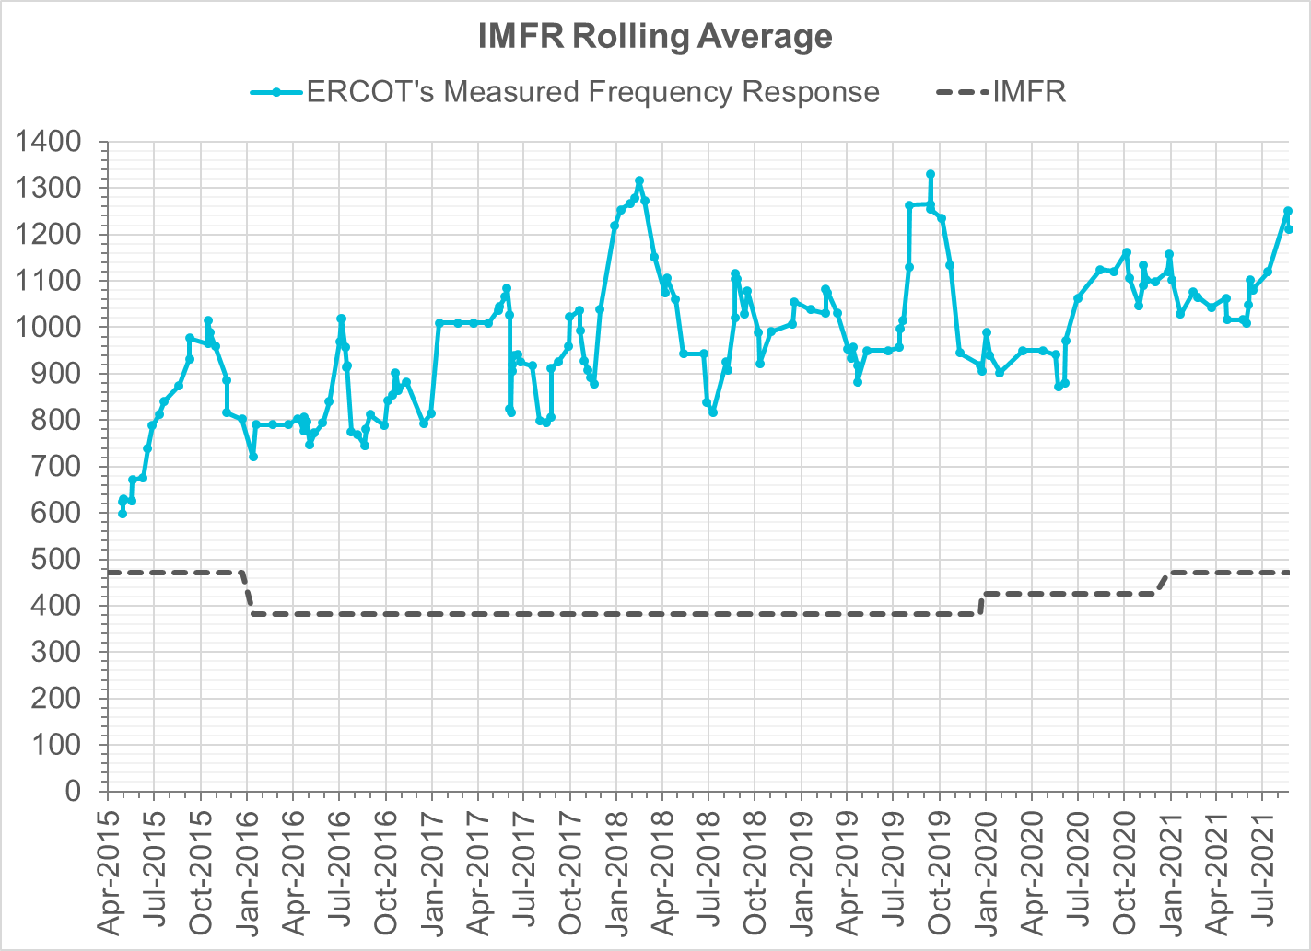
Interconnection Minimum Frequency Response (IMFR) Performance
IMFR Performance currently
1212.07 MW/0.1HZ
Frequency Response Obligation (FRO): 471 MW/0.1 Hz

Slide 9
Questions?

Slide 10
Frequency Control Report
August 2021

Slide 11
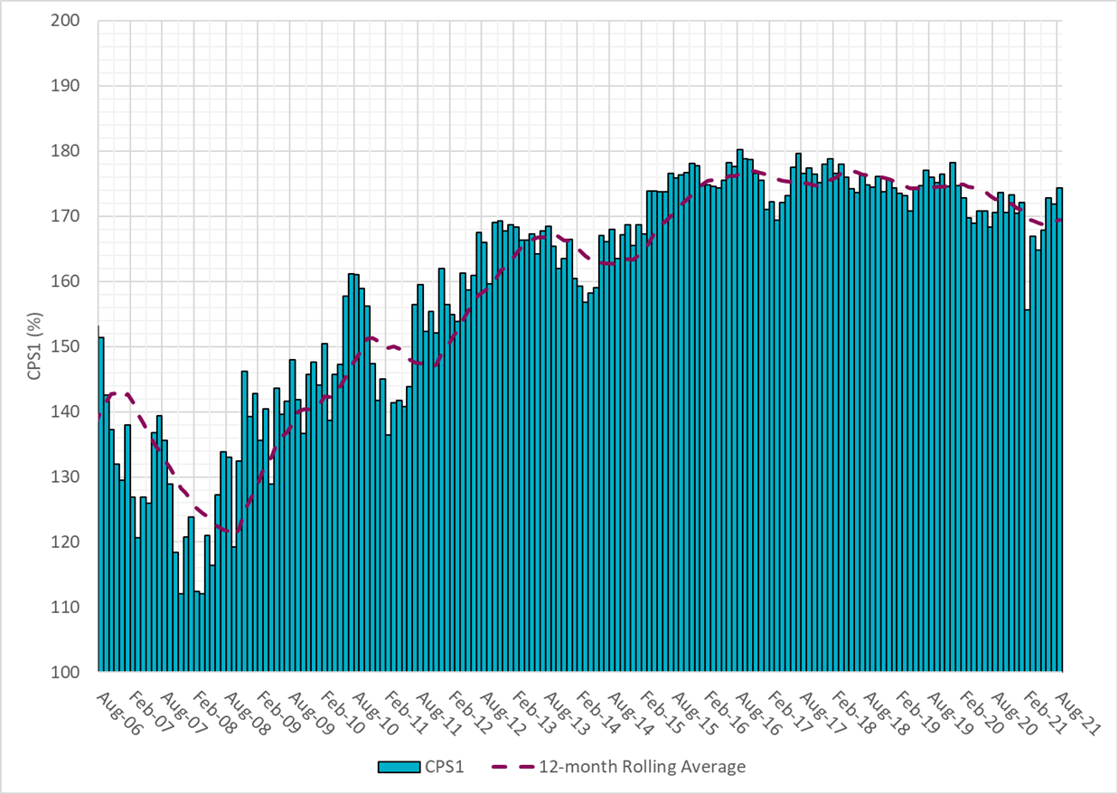
CPS1 Performance
Current 12-Month Rolling Average: 169.47%

Slide 12
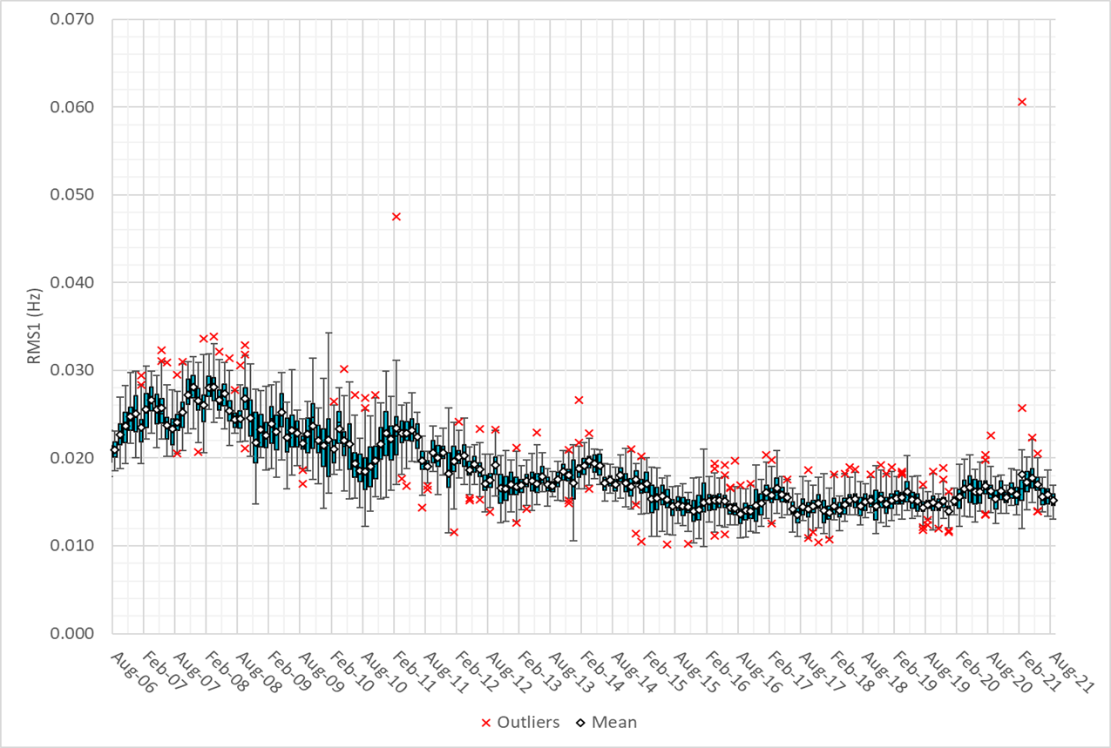
RMS1 Performance of ERCOT Frequency

Slide 13
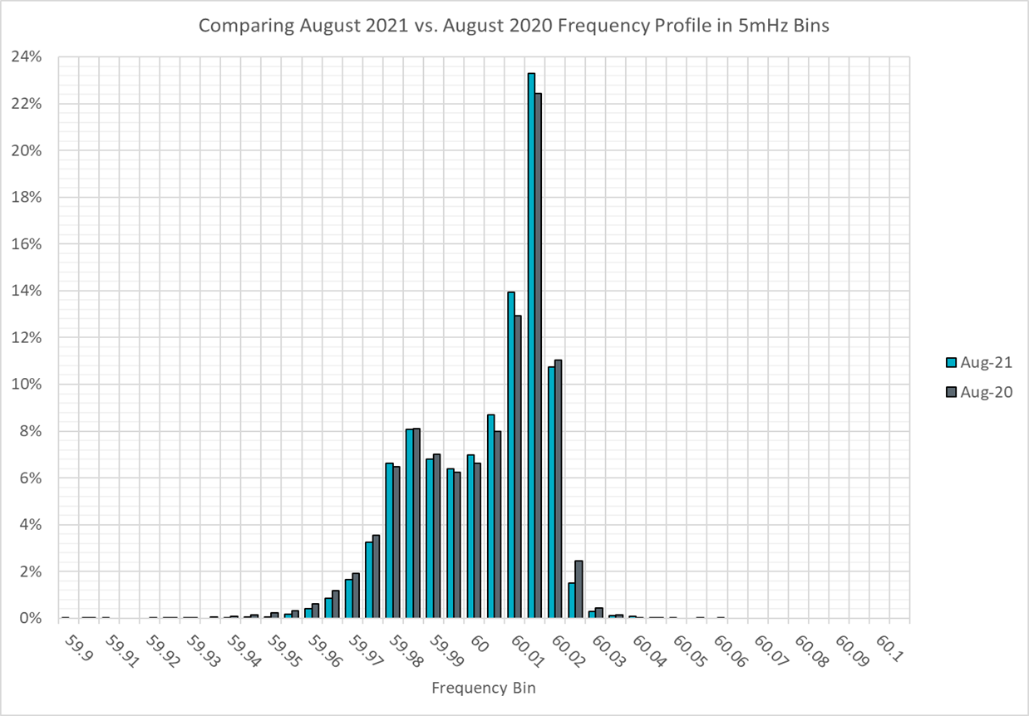
Frequency Profile Analysis

Slide 14
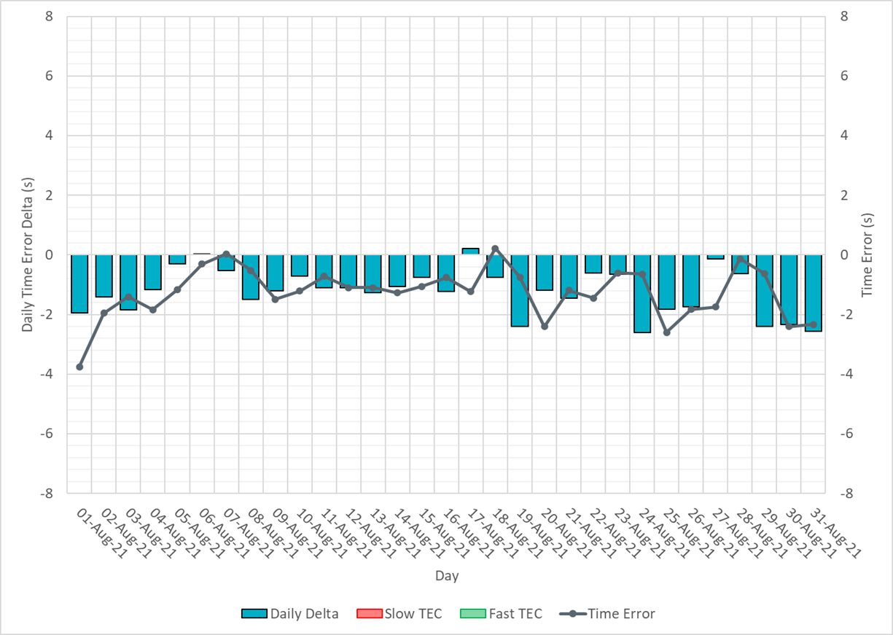
Time Error Corrections

Slide 15
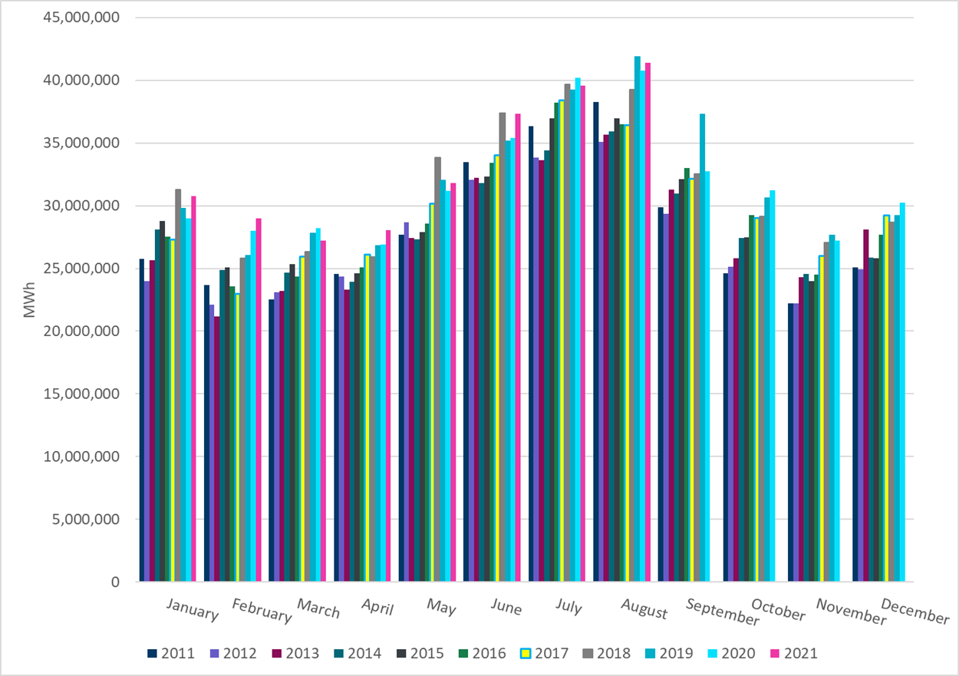
ERCOT Total Energy
Notes:
37,331,144 MWh

Slide 16
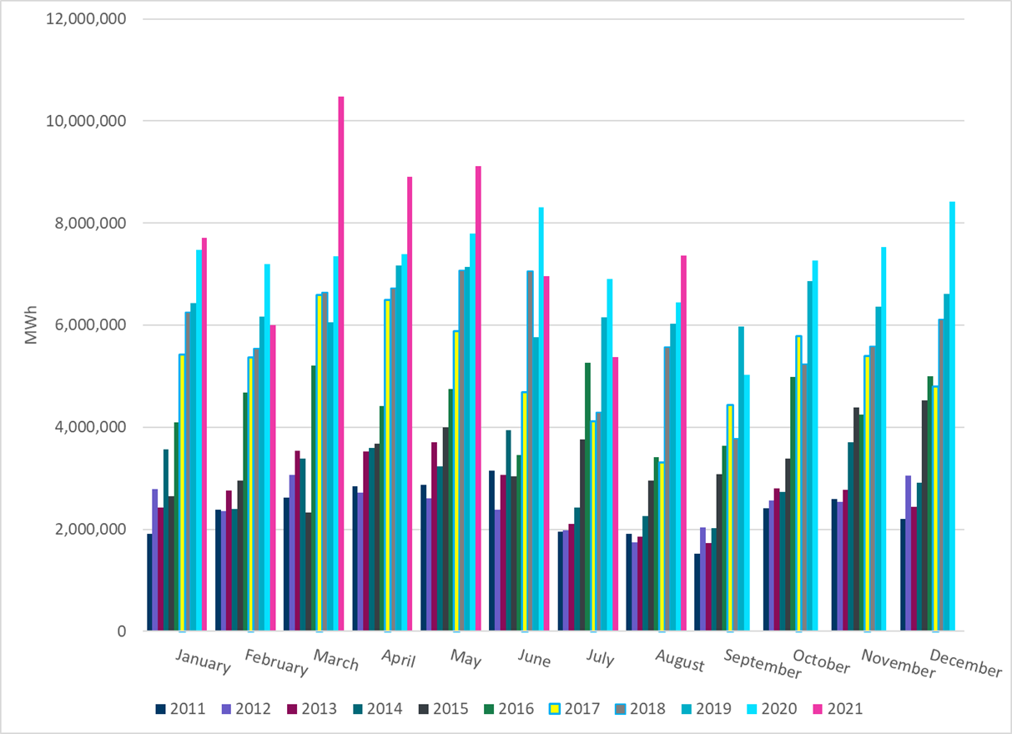
ERCOT Total Energy from Wind Generation
Notes:
6,965,821 MWh

Slide 17
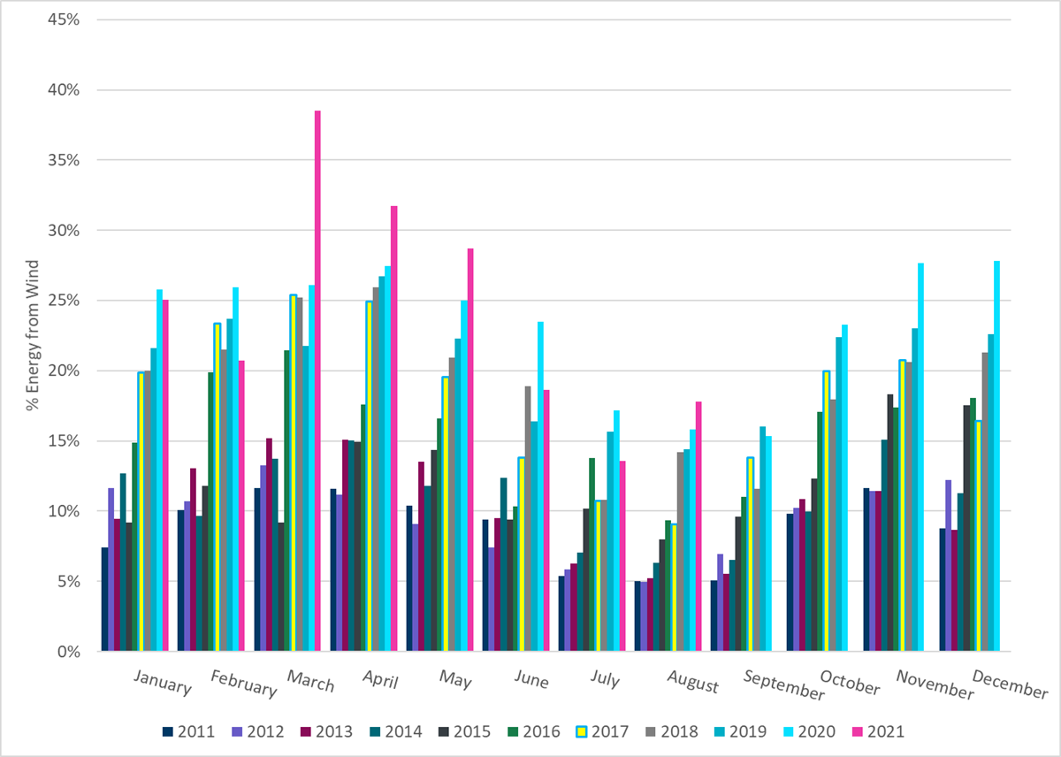
ERCOT % Energy from Wind Generation
Notes:
18.66%

Slide 18
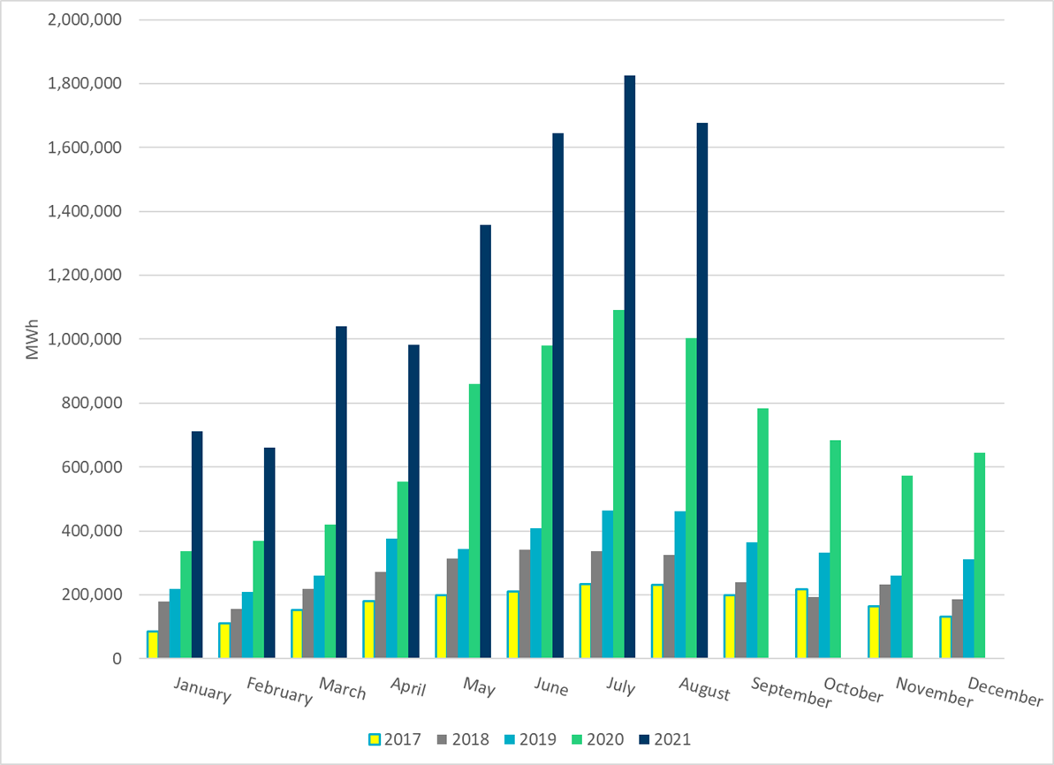
ERCOT Total Energy from Solar Generation
Notes:
1,643,972 MWh

Slide 19
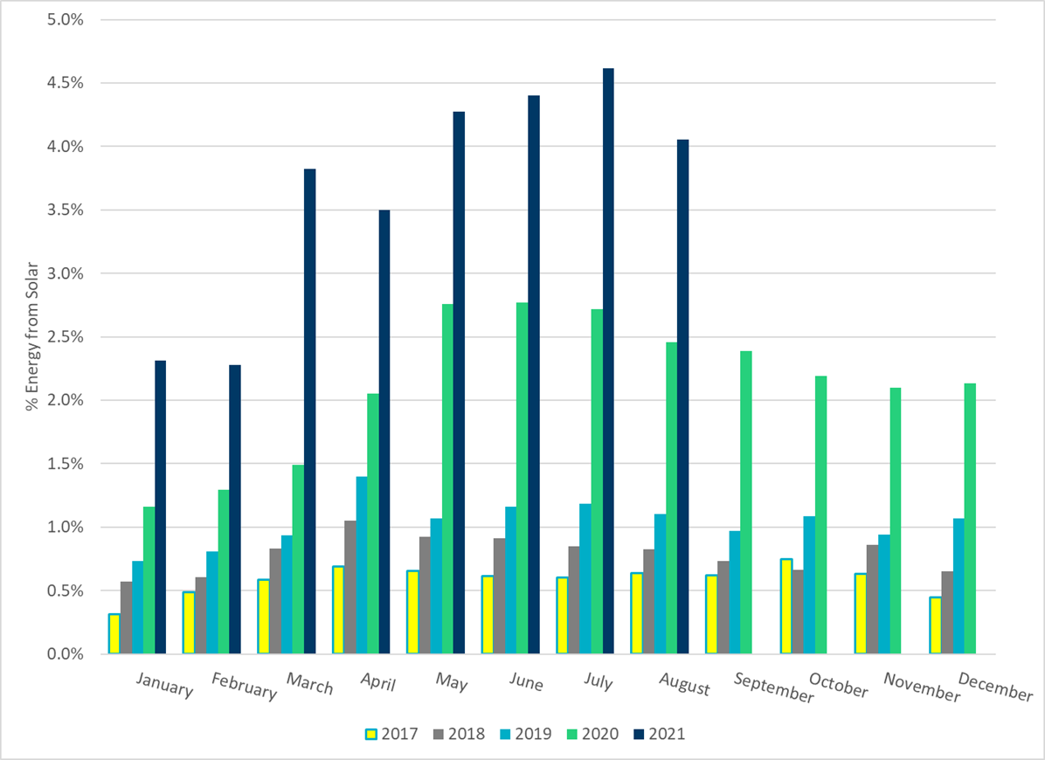
ERCOT % Energy from Solar Generation
Notes:
4.40%

