Slide 1
Retail Emergency Conditions Task Force
(RECTF)
Update to RMS
October 5th, 2021
Co-Chairs: Jim Lee, AEP & Sheri Wiegand, Vistra

Slide 2
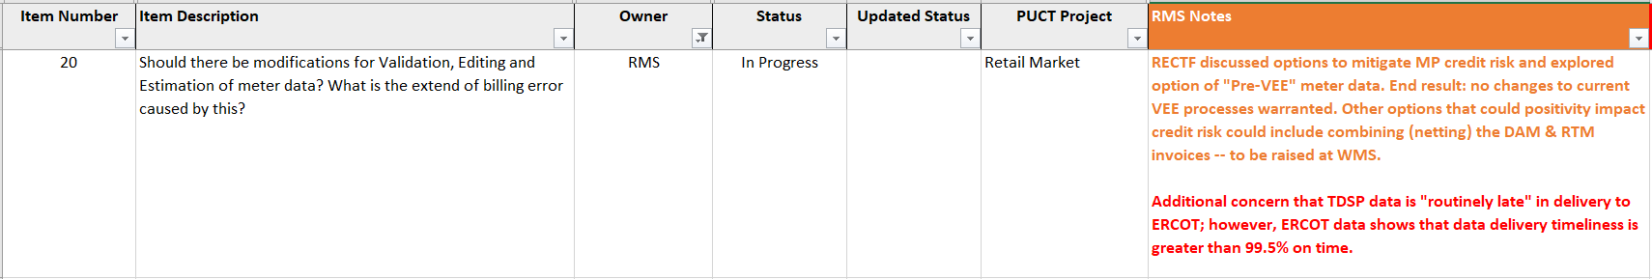
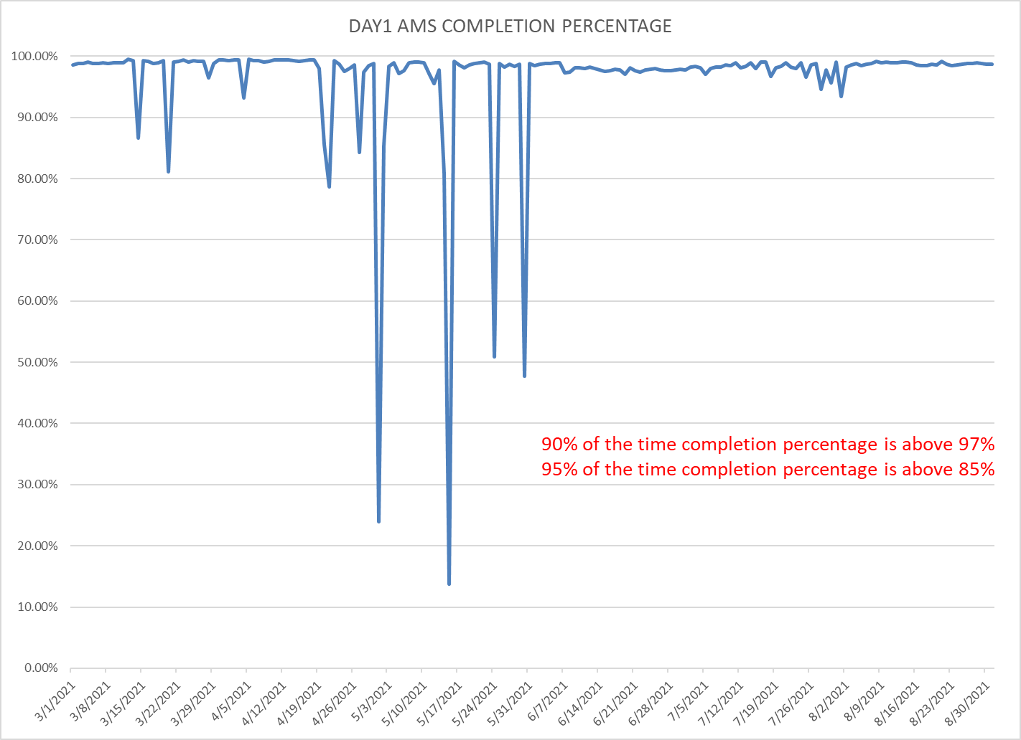
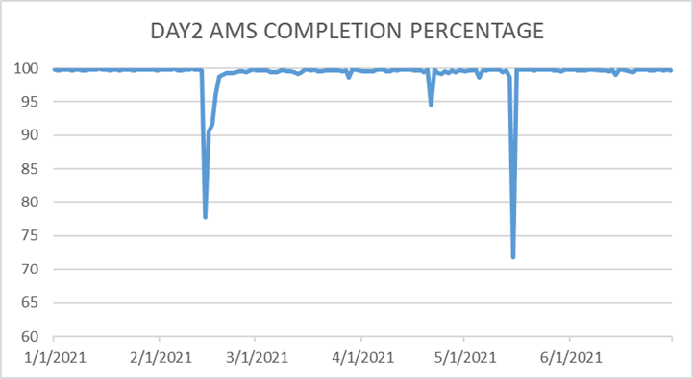
Meter Data Expectations

Slide 3
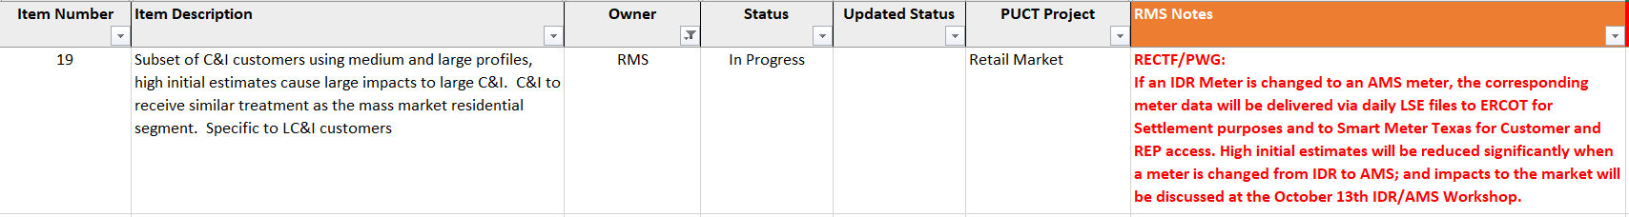
Meter Data Expectations (con’t)
Communications

Slide 4
Weather Preparedness – Q &A
TDSP AMS Data Practices
Energy Emergency Alert definition was added to matrix
Emergency Operations Plan definition was added to matrix
TDSP AMS Data Practices w/ Prolonged Widespread Outage impacts - final edits were approved

Slide 5
Winter Weather Preparedness Workshop Agenda
November 2nd , after RMS @1:30 PM
  Antitrust Admonition
  Scope/Purpose of Workshop
  ERCOT Energy Emergency Alerts (EEA)
    ERCOT Role & Responsibilities
    TDSP Role & Responsibilities
  Critical Care/Chronic Condition Customer Impacts (PUCT Subst. Rule §25.497)
  http://www.puc.texas.gov/agency/rulesnlaws/subrules/electric/25.497/25.497.pdf
    Critical Load Industrial & Public Safety
    Critical Care & Chronic Condition Residential
  Review of TDSP AMS Data Practices Matrix + EEA Matrix + EOP Matrix
  Baseline review & preparation of Mass Transition Processes (RMG 7.11)
  Q&A
  Adjourn

Slide 6
Next Meeting – October 26th @ 9:30 am
Final review of outstanding ECL items
Final review of Winter Preparedness Workshop Agenda and materials
Sunsetting of RECTF

Slide 7


