Slide 1
ERCOT Weatherization Update
Jeff Billo
GEWG
September 24, 2021

Slide 2
ERCOT Stakeholder Process Response to Uri
The Technical Advisory Committee (TAC) created a 128-item list of issues to be addressed
Item # | Abbreviated Description | Status
2 | Increase coordination between the Texas Energy Reliability Council and ERCOT’s Gas Electric Working Group to identify critical gas facilities | Public Utility Commission (PUC) projects 51839 and 51888
34 | Review availability of blackstart units and identify potential process improvements, including fuel supply or on-site storage | In progress
35 | Review communication during a natural gas supply emergency | In progress
40 | Review ERCOT’s emergency response plan and ERCOT’s role in emergency preparedness | PUC project 51841
95 | Evaluate the costs, benefits, and constraints of dual fuel and on-site fuel storage | Not started
The above is a sample from the TAC Emergency Conditions List; for the full list see: http://www.ercot.com/committee/tac

Slide 3
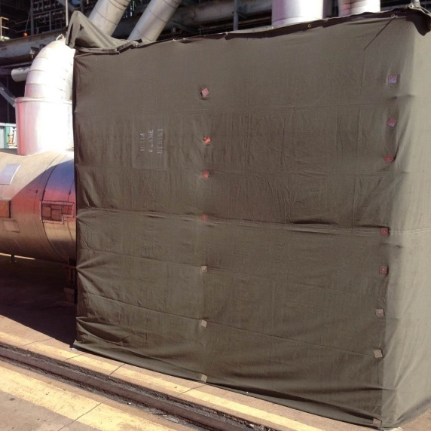
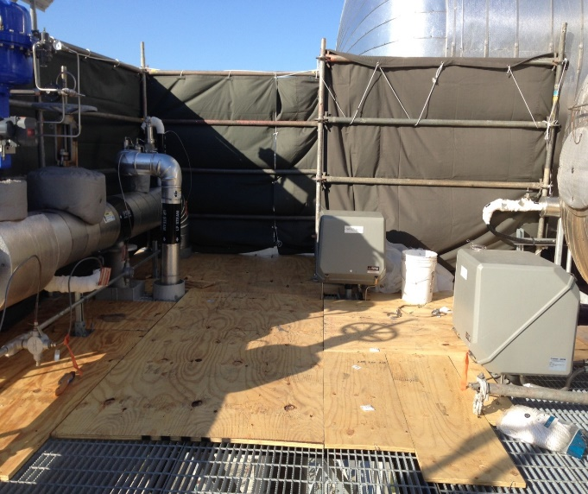
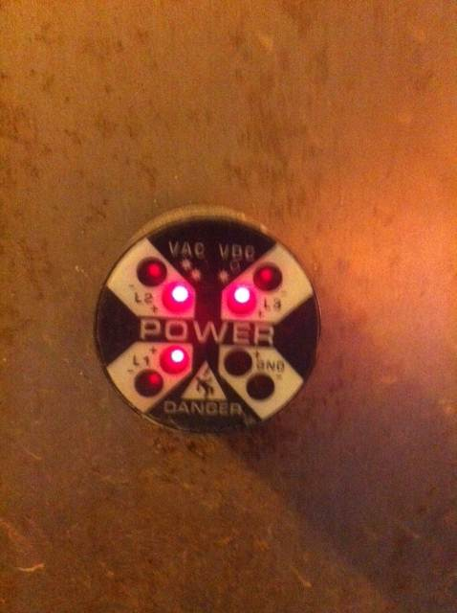
Previous Years: Winter Spot Checks
In previous years, ERCOT performed on-site visits of generation units to help plant personnel verify winter readiness and share industry best practices.
ERCOT visited approximately 80 units per year.
Spot checks occurred from approximately mid-November through the end of February.
Winter 2020-2021 visits were held virtually due to COVID concerns.

Slide 4
Regulatory Changes
Earlier this year the Legislature passed Senate Bill 3 (SB3), which was signed into law on June 8, 2021.
Among other things, SB3 requires the following:
The Public Utility Commission (PUC) to develop mandatory weatherization reliability standards for generation and transmission facilities within six months.
ERCOT, as the Independent Organization, to perform inspections of these facilities for compliance to these standards.
Failure to comply with the standards can result in a fine of up to $1 million per day.
The PUC decided to split the standard development into two phases.
On August 26, the PUC posted a “Proposal for Publication” or PFP describing the Phase 1 draft weatherization rule changes.
https://interchange.puc.texas.gov/search/documents/?controlNumber=51840&itemNumber=68

Slide 5
Highlights of Draft PUC Weatherization Rule for Phase 1
Includes Phase 1 weatherization requirements for winter 2021-2022.
Phase 2 requirements and timeline are TBD.
Requires all generators to:
Perform certain winter readiness preparations,
Submit a winter readiness report to the PUC and ERCOT by December 1, and
Submit a winter readiness attestation to the PUC and ERCOT by December 1.
Requires ERCOT to:
Report to the PUC on generator (and transmission service provider) compliance with December 1 deadline, and
Inspect generators (and transmission service providers) for compliance with preparation requirements.

Slide 6
Draft PUC Weatherization Standard for Generation
Draft PUC Substantive Rule 25.55 (c)(1):
(1) By December 1, 2021, a generation entity must complete the following winter weather emergency preparations for each resource under its control:
(A) All preparations necessary to ensure the sustained operation of all cold weather critical components during winter weather conditions, such as chemicals, auxiliary fuels, and other materials, and personnel required to operate the resource;
(B) Installation of adequate wind breaks for resources susceptible to outages or derates caused by wind; enclosure of sensors for cold weather critical components; inspection of thermal insulation for damage or degradation and repair of any damaged or degraded insulation; confirmation of the operability of instrument air moisture prevention systems; maintenance of freeze protection components for all equipment, including fuel delivery systems, the failure of which could cause an outage or derate, and establishment of a schedule for testing of such freeze protection components on an ongoing monthly basis; and the installation of monitoring systems for cold weather critical components, including circuitry providing freeze protection or preventing instrument air moisture;
(C) All actions necessary to prevent a reoccurrence of any cold weather critical component failure that occurred in the period between November 30, 2020, and March 1, 2021;
(D) Provision of training on winter weather preparations to operational personnel; and
(E) Determination of minimum design temperature, minimum operating temperature, and other operating limitations based on temperature, precipitation, humidity, wind speed, and wind direction.

Slide 7
ERCOT 2021-2022 Winter Inspections
ERCOT will inspect facilities on site and in accordance with the PUC rule.
ERCOT is targeting the following based on the draft PUC rule:
Complete all inspections between December 6-24
Complete any inspection follow-up in January
Expecting to complete approximately 250 unit inspections
Based on risk, including facilities that tripped during weather emergencies
Could include wind and solar units
ERCOT issued a Request For Proposal to obtain contractor help with timely completion of inspections.

Slide 8
Looking Ahead
The PUC is will finalize the Phase 1 weatherization rules in November and begin drafting Phase 2 weatherization rules shortly thereafter.
At the request of the PUC, ERCOT is conducting a weather study to identify historic weather statistics by region (weather zone).
ERCOT is adding staff to be able to handle a larger inspection program going forward.

Slide 9
Questions?

