Slide 1
Summer 2021
Over-forecast Analysis
ERCOT Staff
September 22, 2022
WMWG

Slide 2
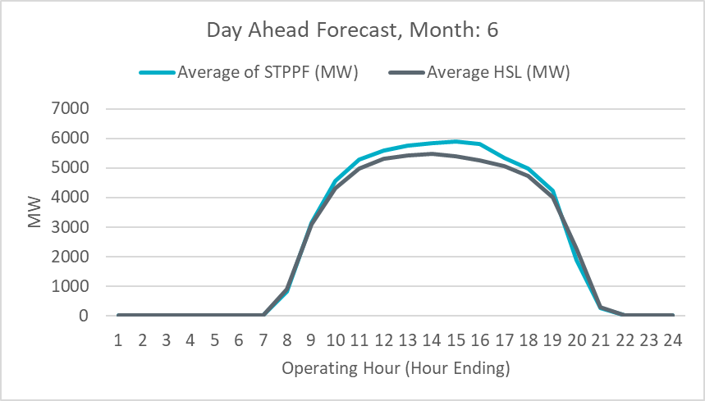
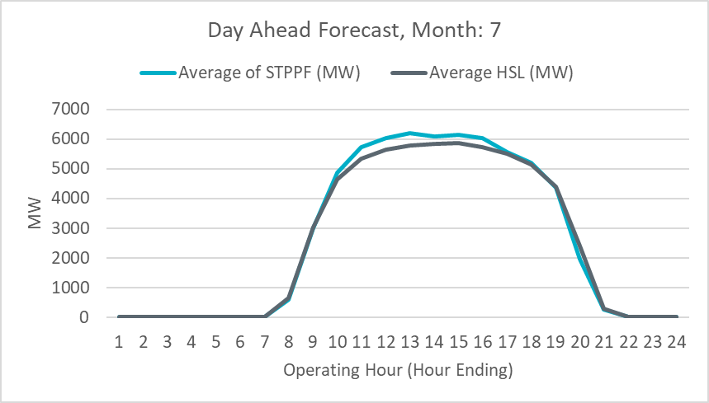
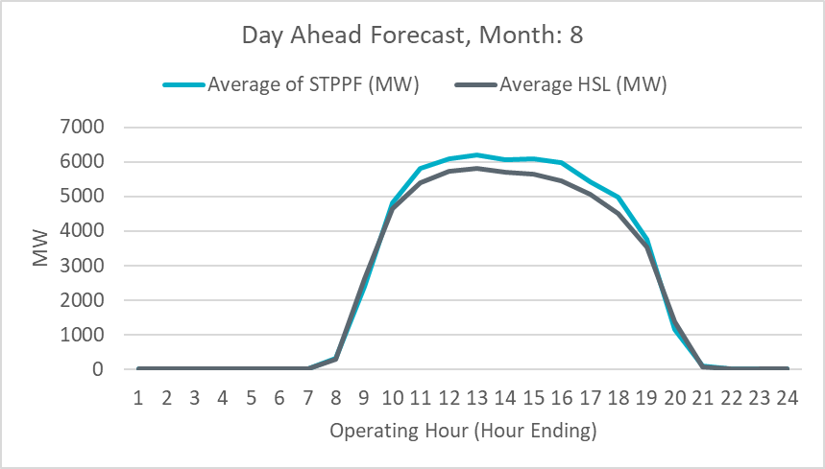
Introduction
At the last WMS meeting, ERCOT received some questions regarding an over-forecast bias in ERCOT’s hourly active Solar forecast for June, July, and August 2021.
In conjunction with the solar forecast vendor, ERCOT has analyzed individual resource forecasts vs actual HSL to understand the underlying cause for this issue.
In our assessment, two issues are likely causing the forecast models to not have accurate estimation of a few resource’s future availability and/or capability. (~14 out of 70 solar units).
Some resources failed to properly update the outage scheduler to reflect their true availability during this period (6 units)
ERCOT has been actively reaching out solar resources throughout Summer on this issue.
Some resources are demonstrating a systematic reduction in their overall capability. (8 units)
ERCOT will be reaching out to these individual resources to better understand the underlying driver for this behavior.

Slide 3
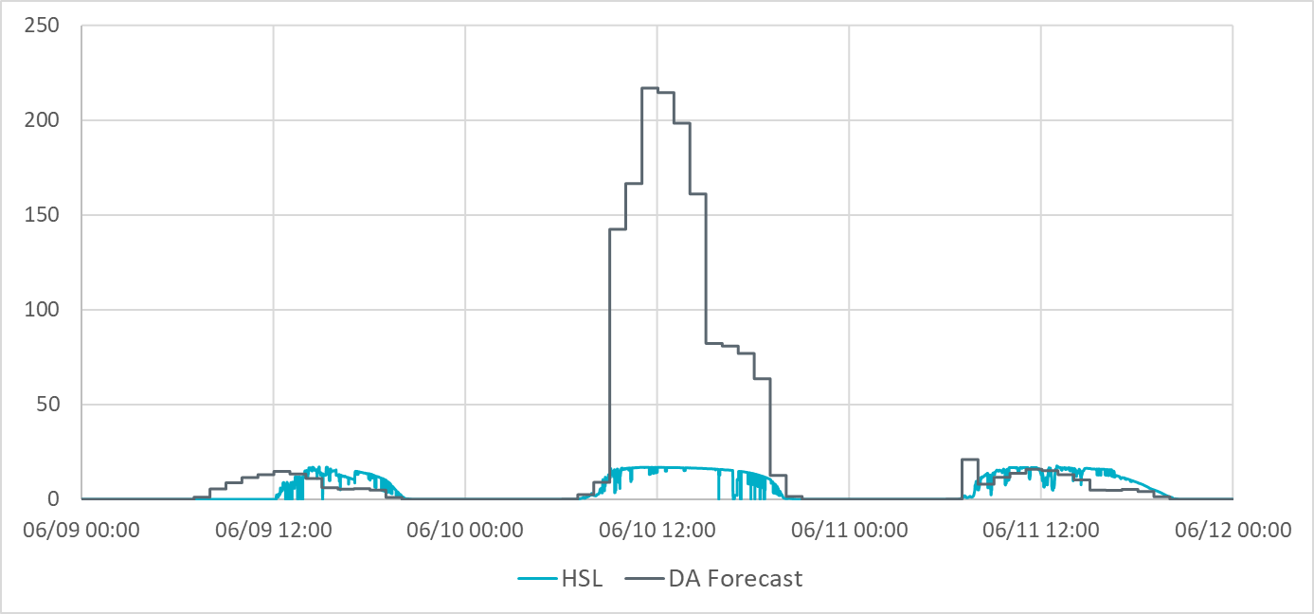
Example: Impact of Late Outage Submission on Forecast
ERCOT’s solar forecast vendor uses a snapshot of the most recent outage data submitted in ERCOT’s Outage Scheduler to determine future solar resource availability in its forecasting process.
ERCOT expects solar resources to accurately report the resource’s availability and/or capability changes in ERCOT Outage Scheduler.
Many of the units that had issues with outage submissions are new units that are still in the commissioning process.
ERCOT expects new resources to report availability and/or capability changes in ERCOT Outage Scheduler while in the commissioning phase.
Below is an example of the impact outages have on the Day Ahead solar forecast for a resource.
On 6/9 at 14:00
Day Ahead Snapshot for 6/10
On 6/9 at 16:00 a new Derate to 20 MVA Submitted
Day Ahead forecast for 6/10 built using the 6/9@14:00 snapshot assumes full availability. Results in up to ~200MW over-forecast error
On 6/10 at 14:00
Day Ahead Snapshot for 6/11
Day Ahead forecast for 6/11 captures the Outage amount in the forecast.
Notes:
ERCOT Nodal Protocols Section 3.1.2 “Each Resource Entity shall use reasonable efforts, consistent with Good Utility Practice, to continually update its Outage Schedule.”

Slide 4
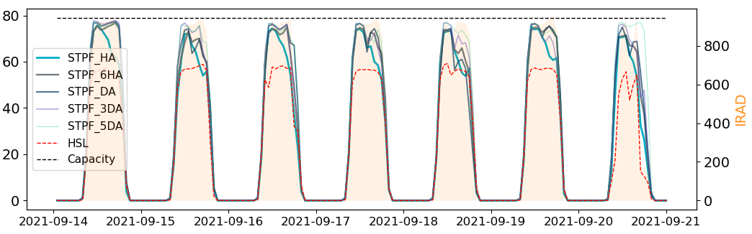
Example: Systematic Reduction in Capability
Some resources are demonstrating a systematic reduction in their overall capability.
ERCOT will be reaching out to these individual resources to better understand the underlying driver for this behavior.
ERCOT is also working with its solar vendor ensure that going forward improvements are put in place such that the solar forecast models automatically adapt to the recent resource behavior. This should help in improving the overall solar forecast performance.
Below is an example that compares the forecasts generated for a solar resource with its actual HSL on a sunny day.
MW

Slide 5
Summary & Next Steps
The over-forecast bias in the hourly solar forecast during Summer 2021 was mostly driven by inaccurate future availability and/or capability information for certain resources in the solar forecast models.
ERCOT will continue to work with its solar vendor and solar resources on this issue.
In Fall 2021, the solar vendor is planning to conduct a systematic refresh of the solar forecast models to better adapt them to the recent resource behavior. This should help in improving the hourly solar forecast performance.

Slide 6
Discussion

Slide 7
How Forecasting Impacts Operations
Current Operating Plans (COP) for Wind & Solar resources are limited to be up to their most recent STWPF/STPPF.
Used in ERCOT’s Look Ahead studies (e.g. Day Ahead Market (DAM), Day Ahead Reliability Unit Commitment (DRUC), Hourly Reliability Unit Commitment (HRUC), etc.).
The intra-hour IRR forecasts help determine the Generation to be Dispatched, provided to SCED every 5 minutes.
When renewables are over-forecast, there is a potential for insufficient resources being committed or dispatched.
When renewables are under-forecast, there is a potential of over commitment or dispatch of conventional resources, which can lead to curtailments and other market inefficiencies.
Notes:
1.ERCOT will automatically populate cop hsl from latest forecast.
2. QSE have opportunity to override.

