Slide 1
Resource Integration Topics
Jay Teixeira
ERCOT
Resource Integration Working Group
September 23, 2021

Slide 2
Quarterly Stability Assessment (QSA)
Planning Guide 5.9
Next Deadline for QSA
If a GINR is not included in QSA, its Initial Synchronization date will be automatically delayed to the next quarter
All-Inclusive Generation Resource Initial Synchronization Date | Last Day for an IE to meet prerequisites as listed in paragraph (4) below | Completion of Quarterly Stability Assessment
Upcoming January, February, March | Prior August 1 | End of October
Upcoming April, May, June | Prior November 1 | End of January
Upcoming July, August, September | Prior February 1 | End of April
Upcoming October, November, December | Prior May 1 | End of July

Slide 3
Quarterly Stability Assessment (QSA)
Planning Guide 5.9, Quarterly Stability Assessment
Issue’s seen in previous QSA’s
10 day comment period for FIS
Needs to be complete before QSA deadline
TSPs need to plan for it
Dynamic Model Review
Dependent on FIS Stability study
Need to meet PG 6.9 15 to 30 days prior to QSA deadline
PSSE Model Quality Test Required
PSCAD Model Quality Test and Unit Model Validation required for November 1, 2021 QSA
TSAT Model Required – If PSSE model is UDM, then TSAT model should be UDM by November 1, 2021.

Slide 4
Modeling Interconnection Facilities
Model Load Calendar:
Applies to both TSPs and REs
REs need to keep in mind that TSPs may need RE facilities to be submitted prior to submitting their interconnection facilities
Some TSPs are sensitive to submitting Interim Updates
Work with your TSP
Could cause one month slip in MRD/PLD

Slide 5
GINR Time Line (Fastest)

Slide 6
RIOO Technology Types for Battery Energy Storage

Slide 7
Redacted FIS Stability Report
Dynamic models should be removed from the redacted version of FIS stability reports. They are contained in
model parameters in report bodies
.dyr and .snp files attached in report appendix
ERCOT found that dynamic models were included in zipped files embedded in the appendix of redacted FIS stability reports.
Suggestions:
Avoid zipping and embedding files in report appendix
Convert the redacted FIS stability reports to PDF format

Slide 8
Curtailments Tests for IRRs
Clarification of requirement for interconnections that have already received Part 2
Procedure started in November 2020 for IRRs due to number of commissioned resources that were not able to follow basepoint with the proper telemetry
Any IRR interconnection requesting Part 3 approval after November 1, 2020 will be required to pass the curtailment test before receiving approval
Interconnections normally required to pass curtailment test before receiving Part 2 > 20 MVA

Slide 9
Resource Data Updates for Transformer Vector Group Identifiers
There are 3 new Vector Group Identifiers:
Dynyn – NEW Vector Group Identifier
Yndd – Replaces Yndd1
YNynd – Replaces YNyn0d1
There will no longer be phase shifts represented in the Resource Data (RARF and RIOO-RS)
These will cause errors and exceptions in RIOO-RS

Slide 10
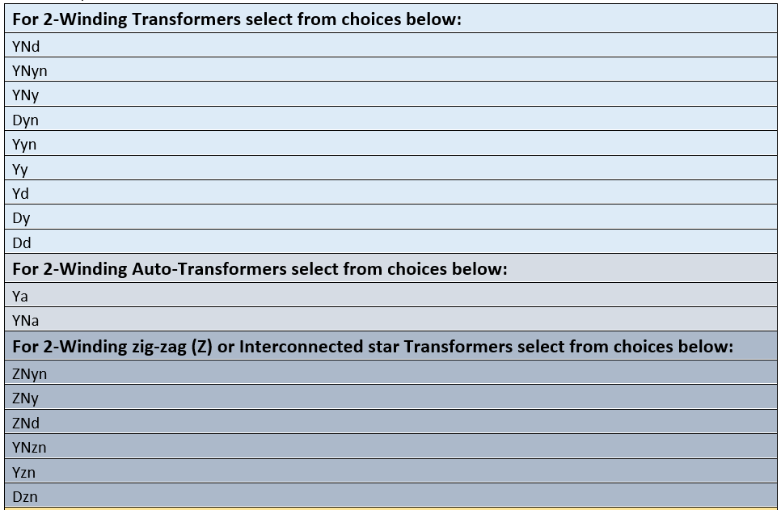
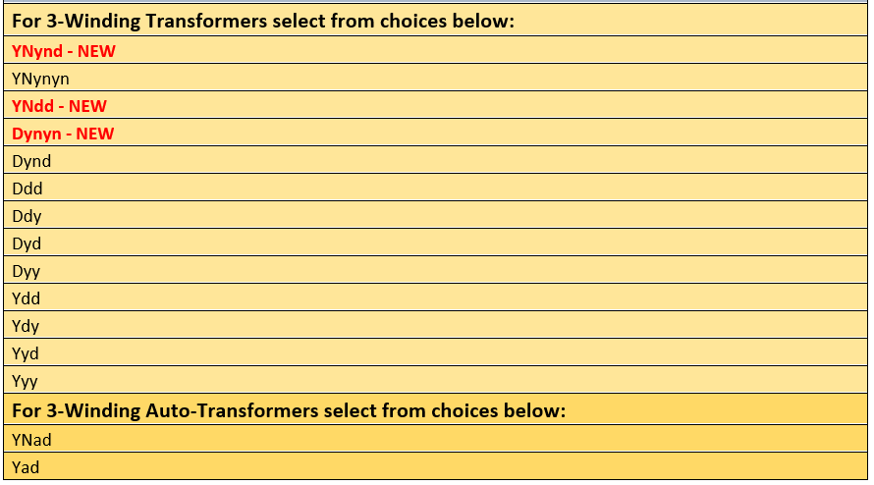
Resource Data Updates for Transformer Vector Group Identifiers
Vector Group Identifier Choices:

Slide 11
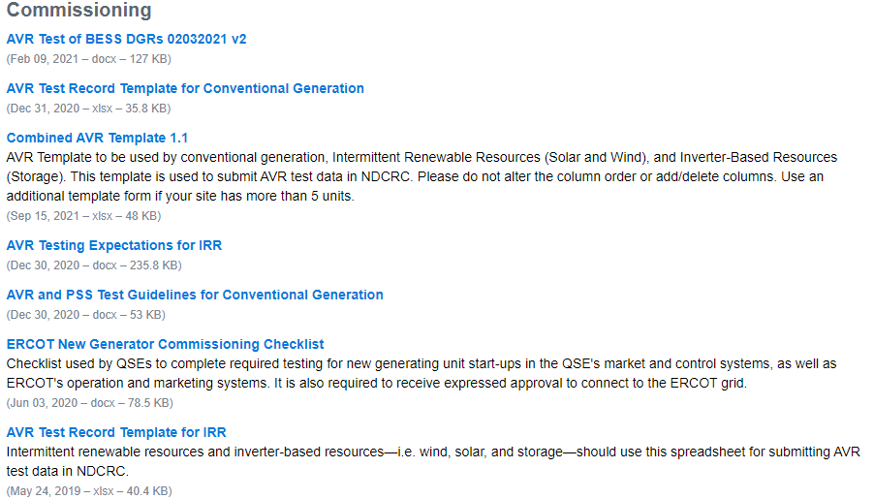
New AVR Template Posted
Combined AVR Template:
Template Location: http://www.ercot.com/services/rq/integration

Slide 12
Active RR’s
PGRR091, FIS Application Completion 60-Day Limit. Approved by PUCT 08/19/2021. Language active.
NOGRR223, Add Phasor Measurement Recording Equipment Requirement to Modified Generating Facilities in Interconnection Process. ROS IA approved 9/2/2021. Next at TAC.
NOGRR227, Add Phasor Measurement Recording Equipment Location for Main Power Transformer for Intermittent Renewable Resource (IRR). TAC approved 8/27/2021. Next at PUCT.

Slide 13
DGR Workshop XII
October 14, 2021 after PRS meeting
Topics for Discussion (Tentative)
Unboxing PGRR082 language
Timeline for lifting moratorium
What will RE’s need to have ready for January 4, 2022

Slide 14
Other contact information
ResourceIntegrationDepartment@ercot.com is distribution list for Resource Integration department
Mailing List
RESOURCE_INTEGRATION@LISTS.ERCOT.COM

Slide 15
Questions?
Thank you!

