Slide 1
Resource Integration & On-going Operations - Resources Services
(RIOO-RS)
Project Update
23 Sept 2021

Slide 2
RIOO- RS is live
All updates required to be submitted in RIOO-RS starting 11/13
  RARFs for updates to Resource Registration data will no longer be accepted.
  Exceptions may be granted in certain cases.
New Resources, SODGs, or Load Resources will continue to use the RARF spreadsheet and submit as a Service Request through the MIS
The RIOO Create phase effort has been initiated – this will allow new generators to submit their data via the on-line application

Slide 3
RIOO- RS Update
2/26 Update
  JOU ownership changes
  Combined Cycle Configuration and Transition add / delete
  New CC flag – single point of failure
4/23 Update
  View a substation without having to start a Change Request
  Export to a CVS file
    This means that users no longer need to initiate a Change Request to see their data
10/8 Update
  Defect fixes
RIOO-Create - Next major RIOO release in late 2021 / early 2022

Slide 4
RIOO Create Release
Interconnection Entities (IE) will no longer upload RARFs
IE will provide and update RARF information in RIOO-IS
  In-flight INRs information will be pre-loaded into the system using the most recent RARF found in RIOO-IS
    September RARF Attestation – Time to ensure correct information is in RIOO-IS
Existing Generator Upgrade, SODGs, or Load Resources will continue to use the RARF spreadsheet and submit as a Service Request through the MIS
TSPs will get RARF information from the Export All file found in INR attachments

Slide 5
RIOO-IS to RIOO-RS Transition
……………..…..….... Now ………..………..….... ………….. After Create Release …………..
From Initial RIOO-IS Application to PG 6.9 RARF for QSA
IE submits
RARF
RIOO-IS
IE submits
INR
RIOO-IS
For full RARF submittal to establish PLD
RE submits
RARF
MIS
RE submits
INR
RIOO-IS
After PLD, all changes/attachments made in RIOO-RS
RE submits
RSCR
RIOO-RS
RE submits
RSCR
RIOO-RS
If RIOO-RS problems prevent making a CR, provide RARF as a RIOO-RS attachment (NOT via MIS)

Slide 6
Export All

Slide 7
TSP Requirements
Need similar view as ERCOT; includes ability to export data
Capability to export attachments (multiple if possible)
Notifications by substation
Filter by TSP
Contracted TSP (DSP) vs. interconnected TSP
Ownership and operatorship

Slide 8
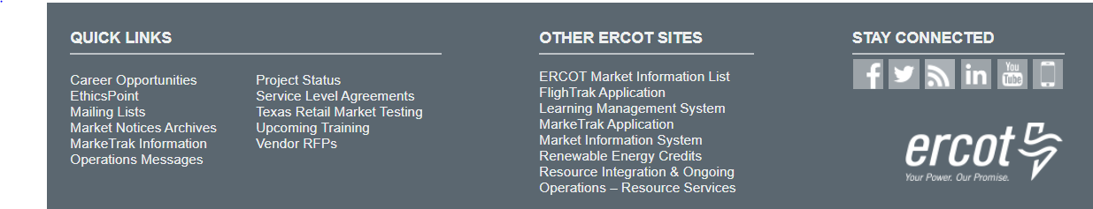
RIOO- RS FAQ
What is the link to RIOO-RS?
  The link for RIOO-RS is located on ercot.com and is: https://sa.ercot.com/rioo-rs/
Does RIOO-RS use a digital certificate?
  No.
What role do I need and how do I get it?
  Your company USA should provide the RIOO_M_Operator in order to gain access to RIOO-RS.

Slide 9
RIOO-RS FAQ
Why do I have errors on things I did not change?
  May have errors on first Change Request in the system
  Caused by update validation rules and migrated data
What do I do if I can’t see my resources?
  Check with your USA, ensure RIOO_M_Operator role has been added to desired DUNS
  May need to use two emails if have more than 15-20 DUNs numbers
  Still can’t see? Send info to RIOO-HELP@ercot.com
    Email used for accessing RIOO-RS
    DUNS number of missing resource
    We can also set up a WebEx to trouble-shoot the issue
  New generators will not see their information in RIOO-RS until the model date

Slide 10
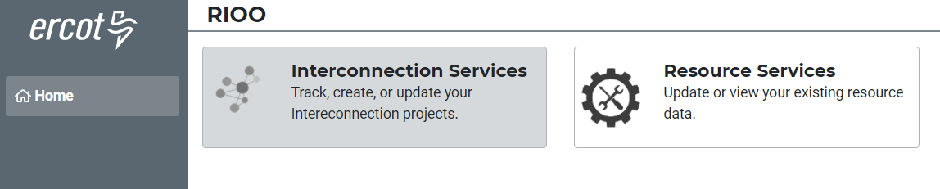
RIOO-RS FAQ
How do I know if I have access?
  This user only has access to RIOO-RS since RIOO-IS is greyed out.
I have multiple email addresses, how should my access be set up?
  If you intend to use multiple addresses then your USA has to provide the RIOO_M_Operator for each email address in addition to associating the DUNs for each Resource with the email address. Once this is done, each email account must go through the verification process.
Can Dynamic Model files be submitted via RIOO?
  Yes, RIOO has a section that accepts attachments.

Slide 11
RIOO-RS FAQ
  I have not been able to set up access, what do I do?
  Can’t access the system: Contact the Help Desk
  Questions: RIOO-HELP@ercot.com
  We can also set up a WebEx to trouble-shoot the issue
  My phone number has changed, what do I do?
  Send an email to RIOO-HELP@ercot.com; let us know your number has changed. You may also reach out to your account manager.
  The Multi-Factor Authentication (MFA) associated with your phone number will need to be re-set.
  Once MFA is reset, you will receive an email with an ENROLL YOUR DEVICE button that you click to display the ERCOT Authentication Method page and set up your MFA app and device again.
I’m getting a weird error?
  Please send a screen shot to RIOO-HELP@ercot.com.

Slide 12
RIOO Demo
Demo

Slide 13
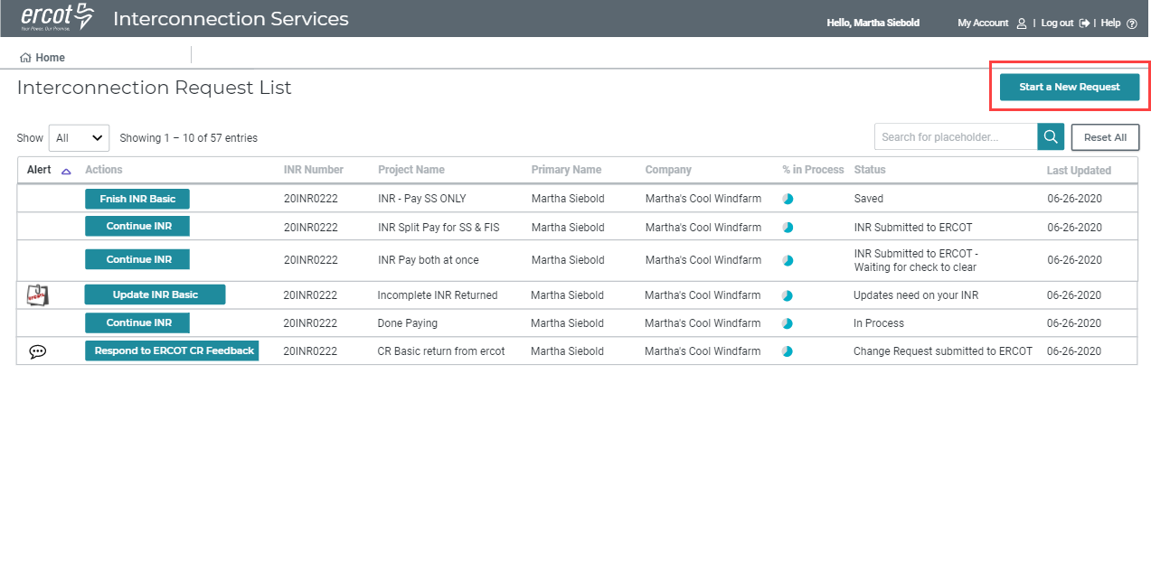
RIOO- IS Dashboard

Slide 14
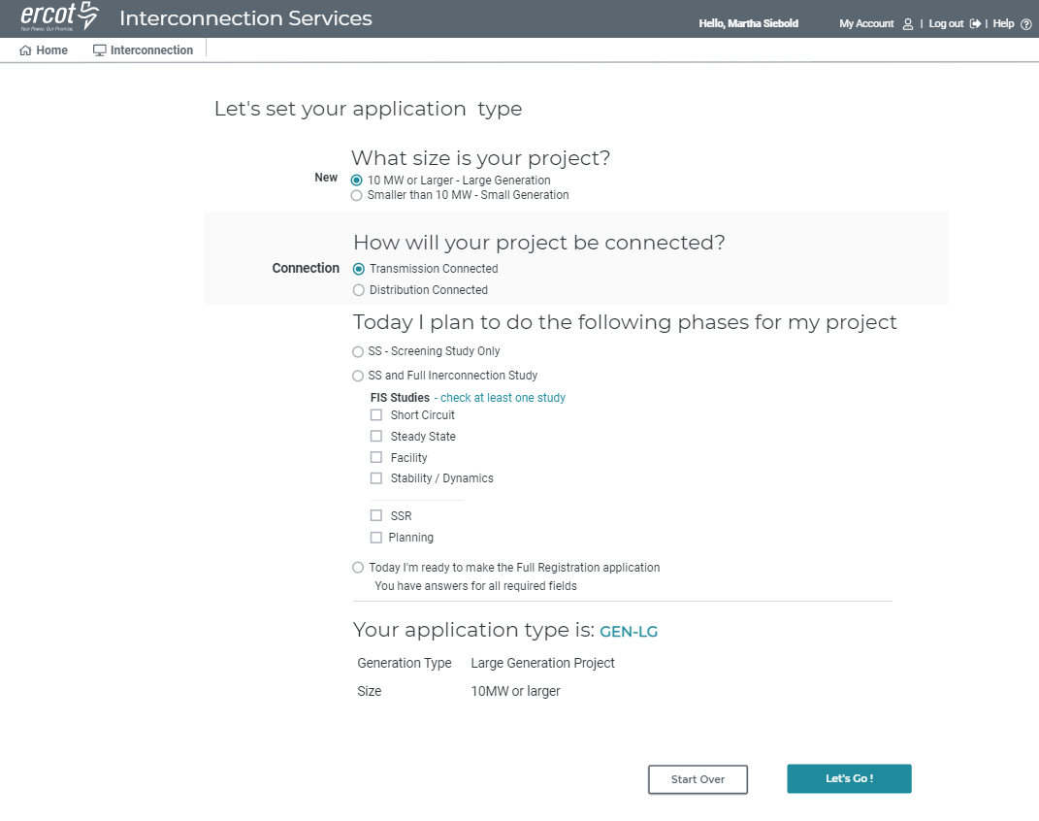
RIOO- IS Create Set Project Type

Slide 15
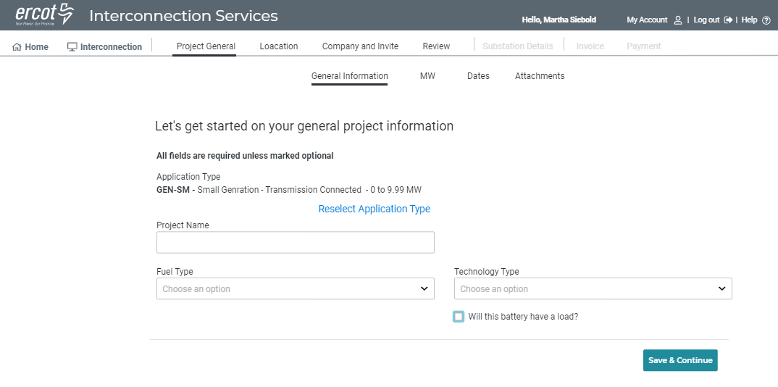
RIOO- IS - Existing Flow

Slide 16
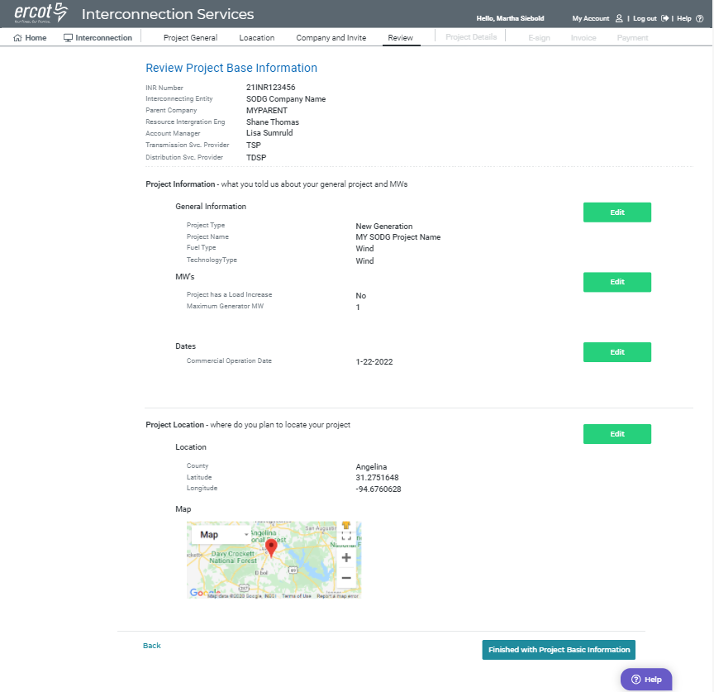
RIOO- IS - Existing Flow Review

Slide 17
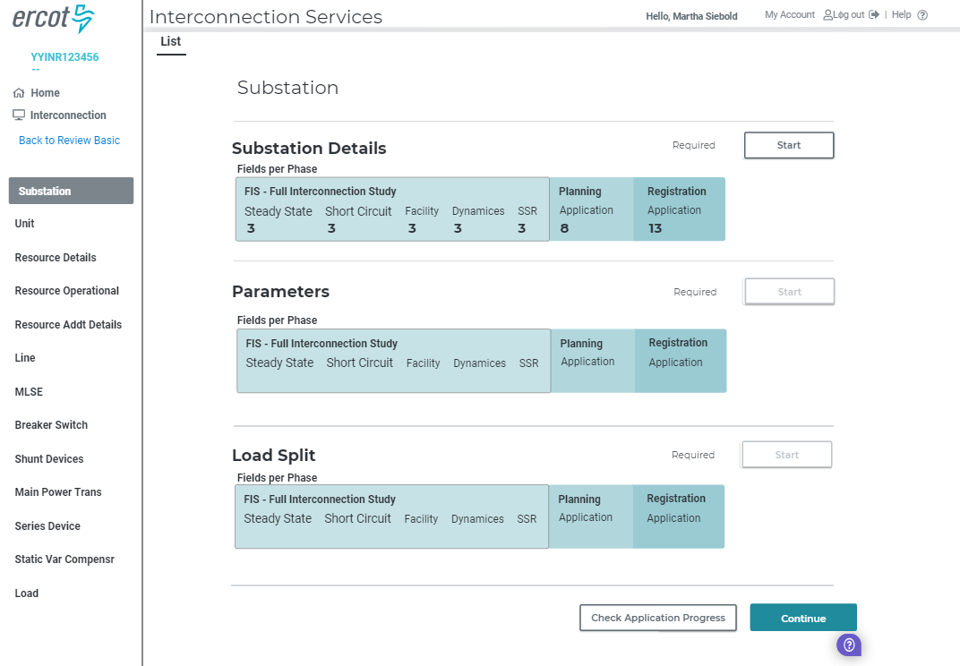
RIOO- IS - Section List

Slide 18
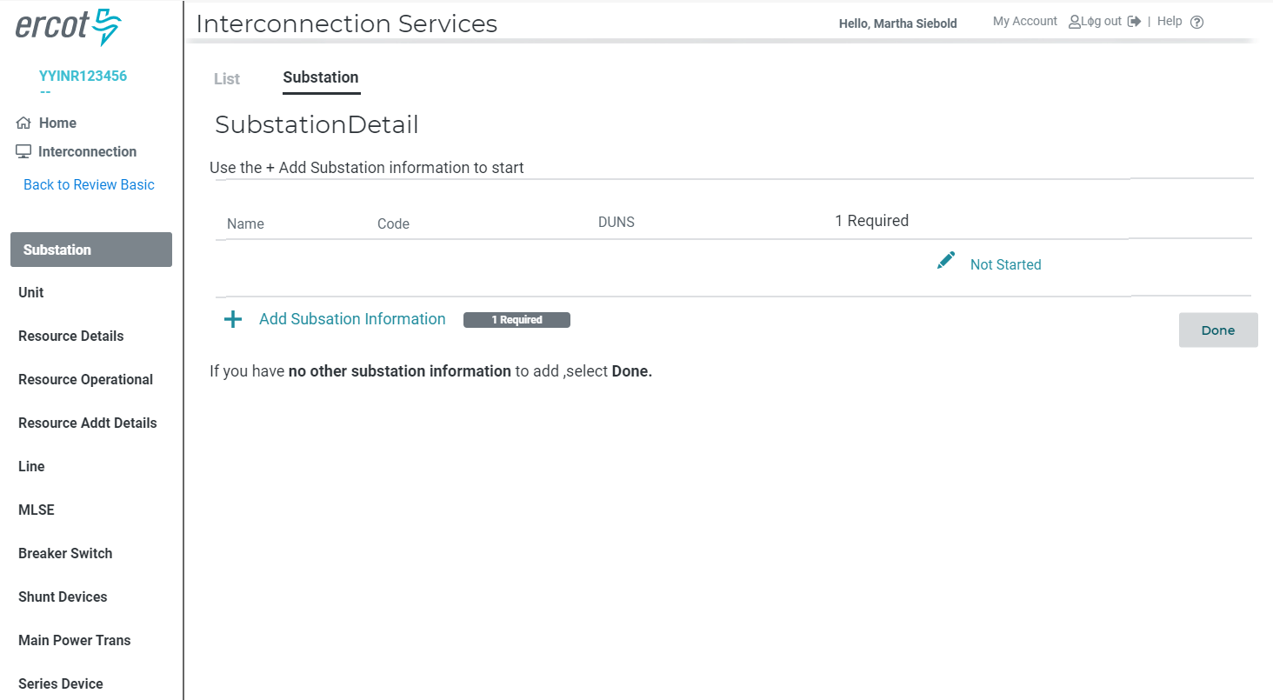
RIOO- IS - Substation Details Summary

Slide 19
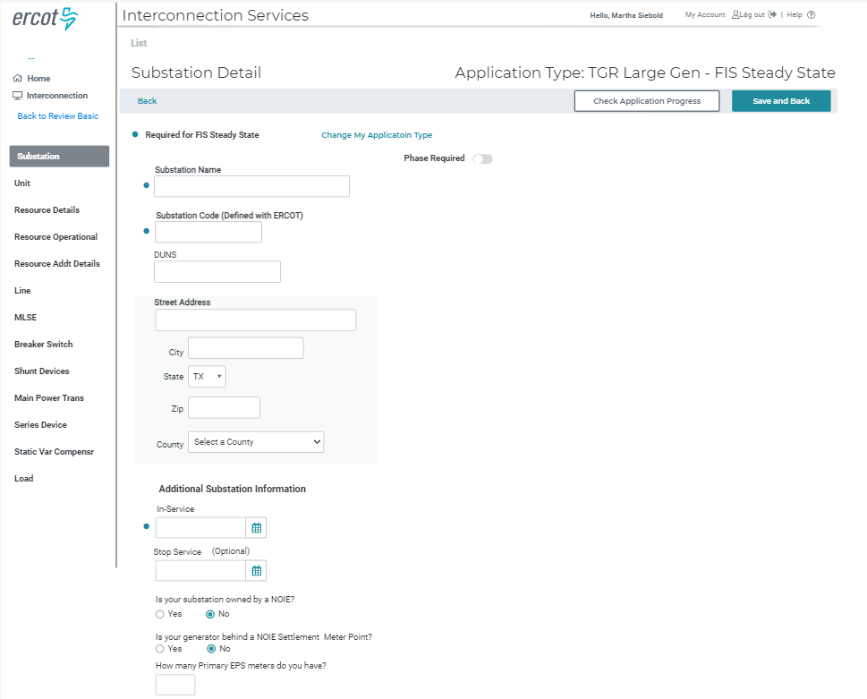
RIOO- IS - Substation - Form

Slide 20
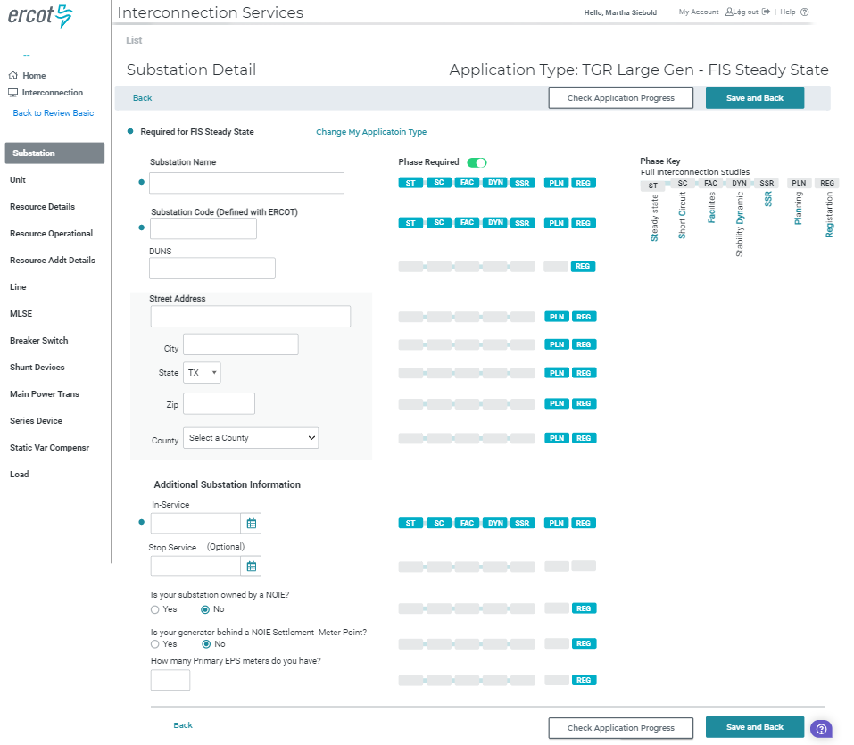
RIOO- IS - Substation – Form with Phase Key Displayed

Slide 21
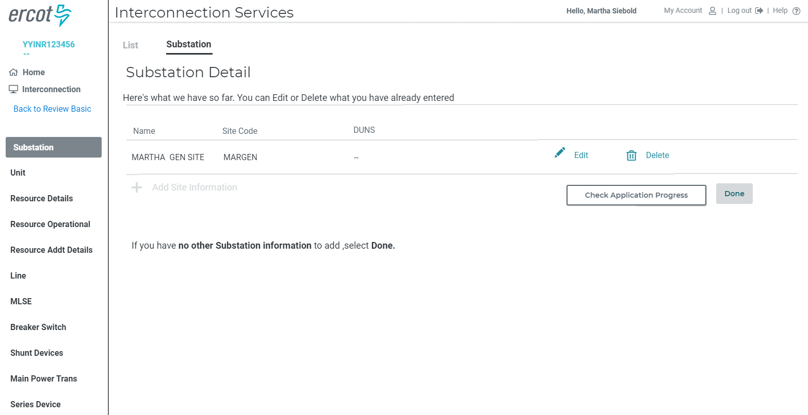
RIOO- IS - Substation Details Summary

Slide 22
Discussion
or
Questions
Backup slides follow

Slide 23
RIOO-IS and RIOO-RS
RIOO-IS – Interconnection Services (sa.ercot.com/ginr/)
  Allows users to start the interconnection process.
  Access – email / password and MFA
    Interconnecting Entities (IEs) must self-register
RIOO-RS – Resource Service (sa.ercot.com/rioo-rs/)
  Allows REs to update data for generators that are already interconnected to the ERCOT grid.
  Access - email / password and MFA (NOT a digital certificate)
    REs – Role from USA: RIOO_M_Operator

Slide 24
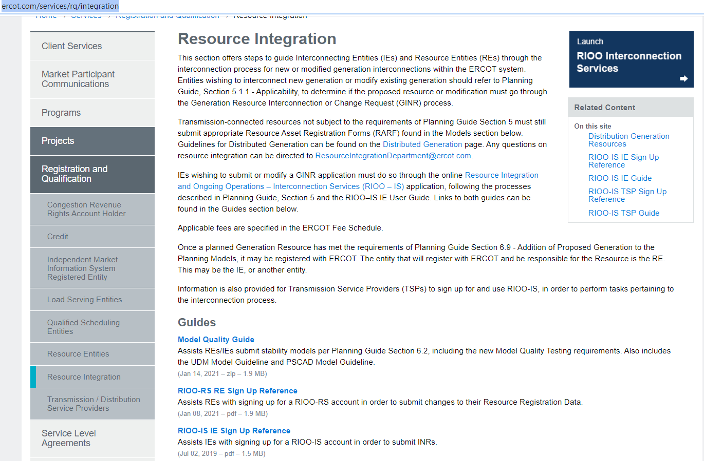
RIOO- RS is live – how do I get access?
The RIOO-RS sign-up reference is available here: http://www.ercot.com/services/rq/integration

Slide 25
How to get access - Checklist
The user:
  Gets the role “RIOORS_M_OPERATOR” from his/her USA
  Gets an email
    Clicks on “Verify my account” button
  Types in URL for the system
    Clicks “Don’t remember your password” button
  Gets a change password email
    Clicks on change my password button
  Changes his/her password
  Types in URL for the system, sign with user-id / password
  Setups authentication
    Scans code or enter mobile phone for SMS
    Saves Recovery code
    Confirms authorization method
    (Google Authenticator/ Auth0 guardian/SMS)
  Get an email
  Click on verify my account button
  Access the RIOO-RS, sign with user-id / password

