Slide 1
Follow Up on Net Load Forecast Variability Process
ERCOT Staff
September 22, 2021
WMWG

Slide 2
Introduction
Since July 12, 2021, ERCOT has been monitoring the weather forecast near Real Time and in some instances has procured up to an additional 1,000 MW of Non-Spin during periods* that were identified as having an increased potential of high forecast variability that may cause a higher net load during these hours.
  ERCOT has tagged Jul 12, Jul 28, Jul 29, Aug 1, Aug 2, Aug 14, Aug 27, Aug 29, Aug 30, and Sep 4 as days with high risk for net load variability.
  ERCOT has increased Non-Spin requirements further by 1,000 MW on Jul 29, Aug 1, Aug 2, Aug 14, Aug 27, Aug 29, Aug 30, and Sep 4*.
ERCOT provided an update on the prevalent process being used for this assessment at the August 20, 2021 WMWG meeting. Following is a summary of the action items which ERCOT is considering after that meeting,
  To clarify the metrics that are being used in the daily Net Load Forecast variability assessments to establish the low/medium/high for all forecasts;
  To consider delaying the decision to procure additional Non-Spin (ERCOT’s current practice is to make this decision two Days Ahead).
This discussion will delve on the both of the items listed above.
*Between Jul 12 and Aug 31, additional Non-Spin was applied to all 24 hours.
Beginning Sep 1, additional Non-Spin is being applied only to high-risk hours.

Slide 3
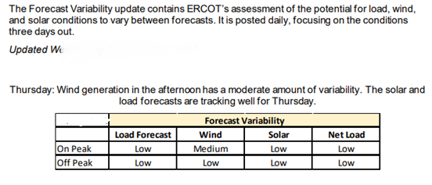
Update for Assessing Forecast Variability
Beginning Sep 1, 2021, ERCOT has updated the Forecast Variability report for the Current Day + 3 to include separate variability assessments for peak and off-peak hours. Included is an example of the new report format.
Below is a break-down of the criteria for load, wind, solar and net load forecast that is currently being used in the updated report.
Potential Error in MW
 | Load Under Forecast | Wind Over Forecast | Solar Over Forecast | Netload Under Forecast
High | >3000 | >3000 | >2000 | >4000
Medium | 1000-3000 | 1500-3000 | 1000-2000 | 2000-4000
Low | <1000 | <1500 | <1000 | <2000

Slide 4
Timeline for Triggering Additional Non-Spin Quantities due to High Net Load Variability Risk Assessment
ERCOT is considering if the step to determine whether additional Non-Spin quantities are needed can be delayed by one day.
  This will allow ERCOT to use the updated forecast from 2 days prior to the operating day. Uncertainties in the forecasts generally reduce closer to the operating day.
  However, this will also reduce the time between when the updated Non-Spin quantities are posted and when the DAM execution is kicked off.
ERCOT is seeking feedback on this approach.
 | Current Day | Current Day + 1 | Current Day + 2 | Current Day + 3
Current Practice | Post variability assessment for Current Day + 3. Determine whether increase in Non-Spin quantities are needed by end of day. | Include any increase in Non-Spin quantity for Current Day + 3 in the DAM Ancillary Service Plan report (posted ~5 am) | Use the updated Ancillary Service Plan in the Day Ahead Market run (kick off ~10 am). | Operating Day
Proposed Approach |  | Post variability assessment for Current Day + 3. Determine whether increase in Non-Spin quantities are needed by end of day. | 1) Include any increase in Non-Spin quantity for Current Day + 3 in the DAM Ancillary Service Plan report (posted ~5am) 2) Use the updated Ancillary Service Plan in the Day Ahead Market run (kick off ~10 am).

Slide 5
Summary
ERCOT is continuing to conduct the daily Net Load variability assessments to gauge the risk of having an increased potential of high forecast variability that may cause a higher net load. In response to the feedback received,
  ERCOT has made a few changes to the posted Net Load variability report to provide separate assessments for peak and off-peak hours.
  ERCOT is considering if the timeline to determine whether additional Non-Spin quantities are needed due to high Net Load variability risk assessment can be delayed by one day.
    ERCOT is seeking feedback on this approach (please send comments to Pengwei.du@ercot.com by Oct. 1, 2021).
ERCOT will continue to work with stakeholders on refining its processes.

Slide 6
Discussion

