Slide 1
Credit Exposure Update
Spoorthy Papudesi
Credit Work Group
ERCOT Public
September 21, 2021

Slide 2
Monthly Highlights July 2021 – August 2021
Market-wide average TPE increased from $ 704.3 million in July to $ 751.8 million in August
TPE increased mainly due to
Settlement disputes for ODs February 14, 2021, and February 15, 2021, included in RTM True-Up statements
Includes active short pay entities
Discretionary Collateral is defined as Secured Collateral in excess of TPE,CRR Locked ACL and DAM Exposure
Average Discretionary Collateral decreased from $2,081.8 million to $1,917.1 million
The decrease in Discretionary Collateral is largely due to increase in CRR Locked ACL and TPE
No unusual collateral call activity

Slide 3
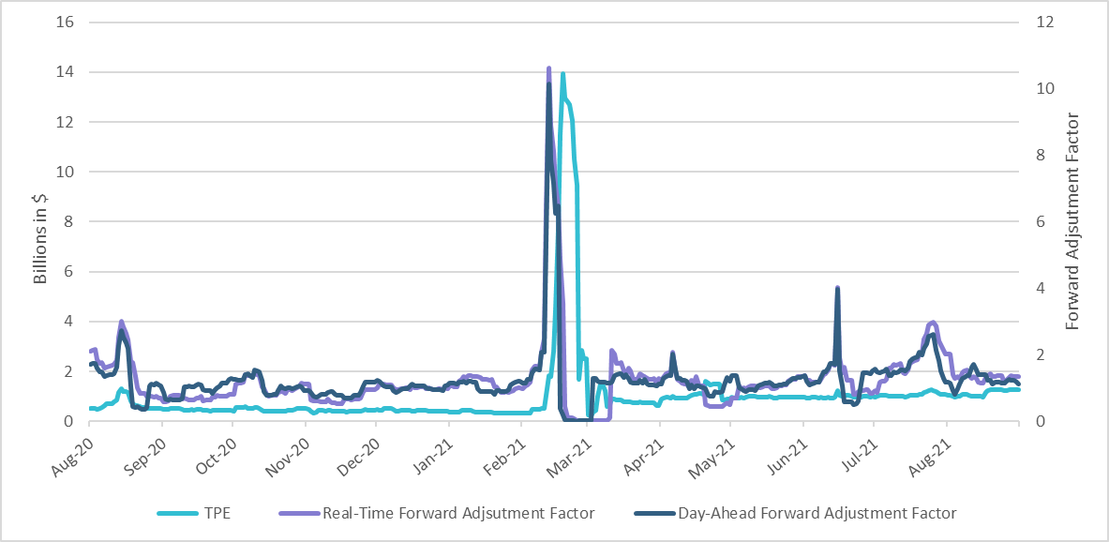
TPE and Forward Adjustment Factors August 2020 - August 2021
*TPE adjusted to exclude short pay amounts eliminating data skew

Slide 4
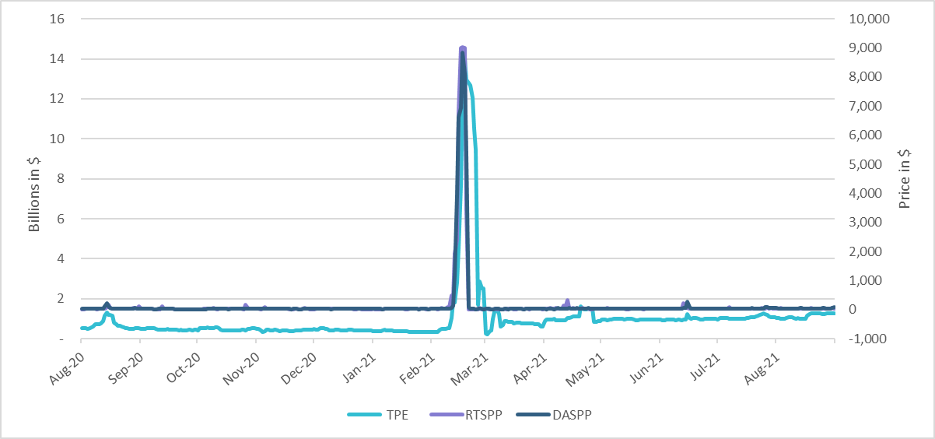
TPE/Real-Time & Day-Ahead Daily Average Settlement Point Prices for HB_NORTH August 2020 - August 2021
* TPE adjusted to exclude short pay amounts eliminating data skew

Slide 5
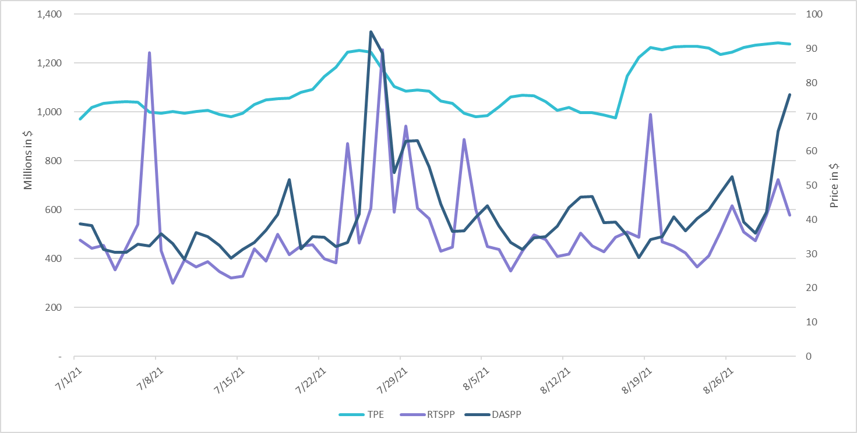
TPE/Real-Time & Day-Ahead Daily Average Settlement Point Prices for HB_NORTH July 2021- August 2021
* TPE adjusted to exclude short pay amounts eliminating data skew

Slide 6
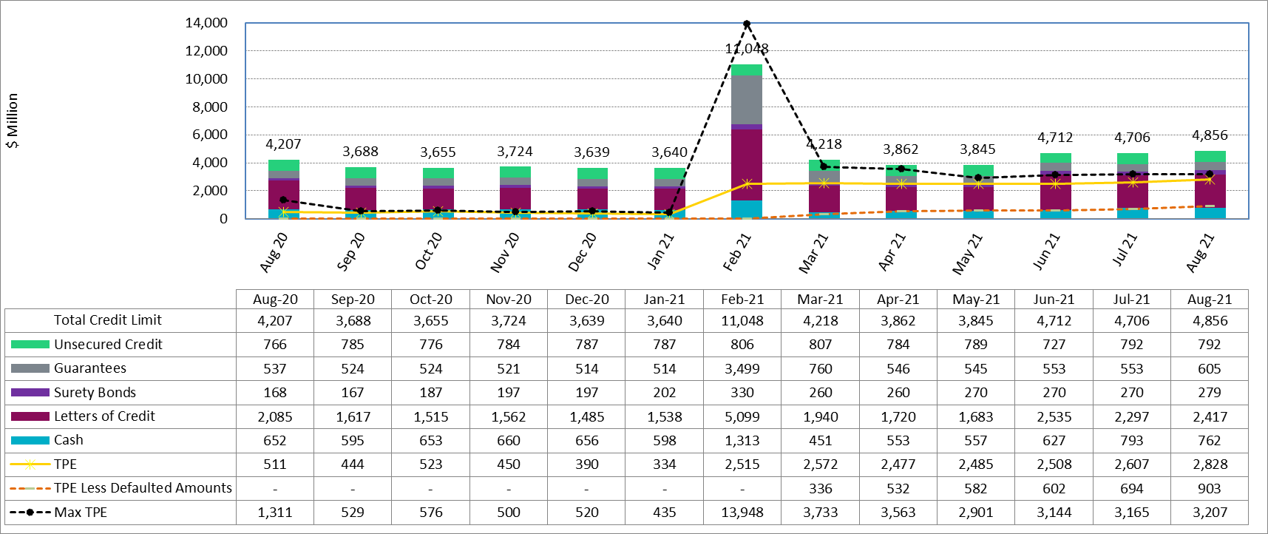
Available Credit by Type Compared to Total Potential Exposure (TPE) Aug 2020- Aug 2021
Numbers are as of month-end except for Max TPE
Max TPE is the highest TPE for the corresponding month
TPE less Defaulted Amounts: TPE – Short-Paid Invoices

Slide 7
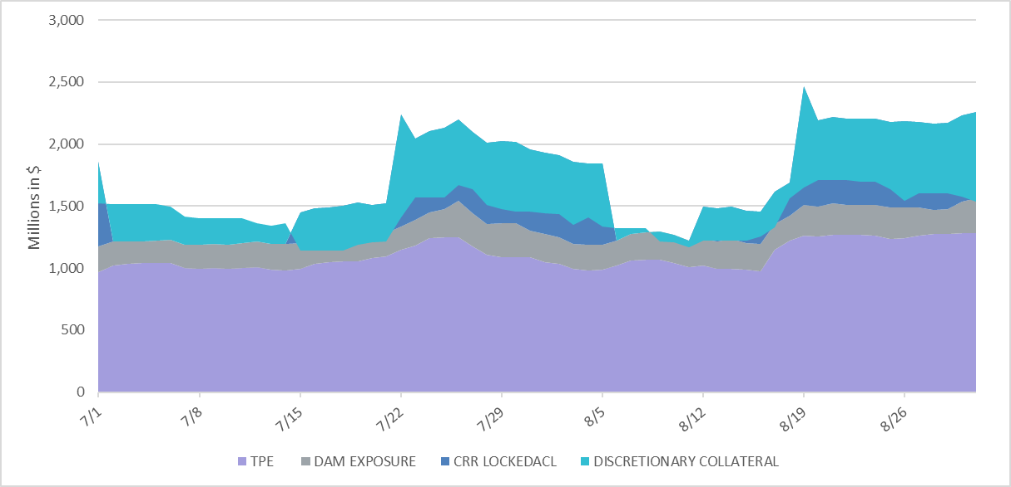
Discretionary Collateral July 2021 - August 2021
* Discretionary collateral doesn’t include Unsecured Credit Limit or parent guarantees
* TPE adjusted to exclude short pay amounts eliminating data skew

Slide 8
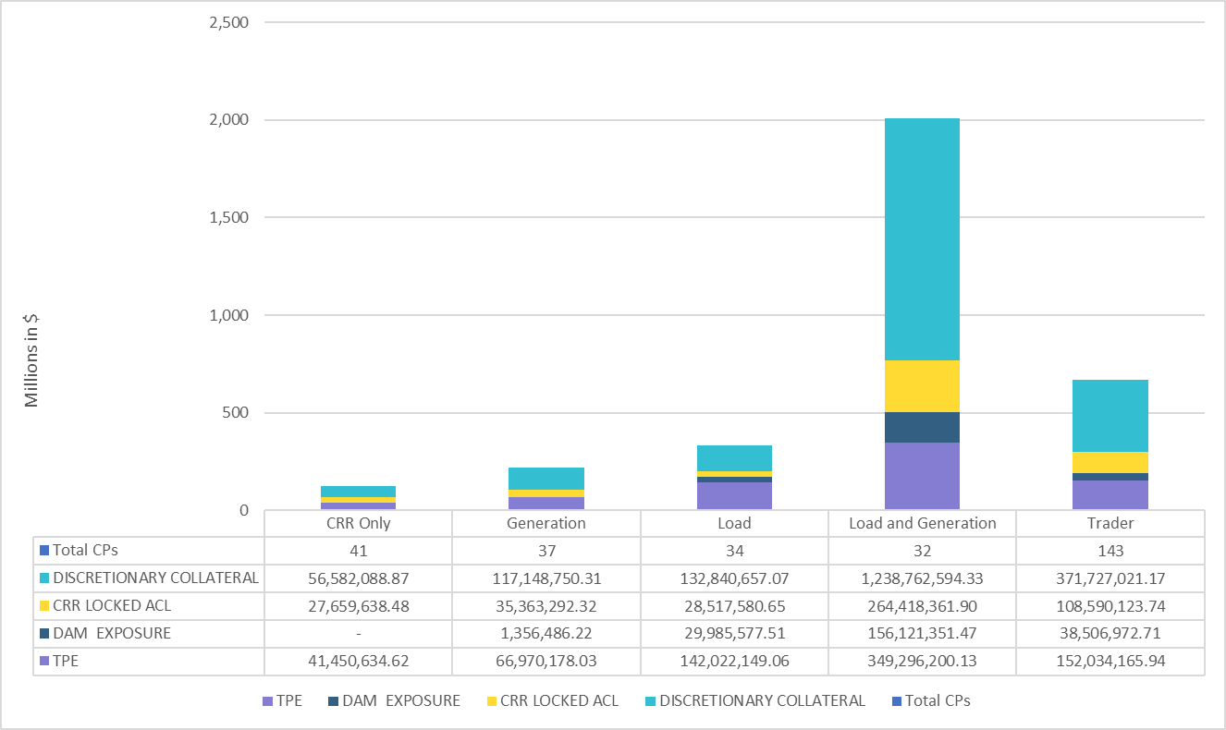
TPE and Discretionary Collateral by Market Segment- Aug 2021*
Load and Generation entities accounted for the largest portion of discretionary collateral
*Discretionary collateral doesn’t include Unsecured Credit Limit or parent guarantees
* TPE adjusted to exclude short pay amounts eliminating data skew

Slide 9
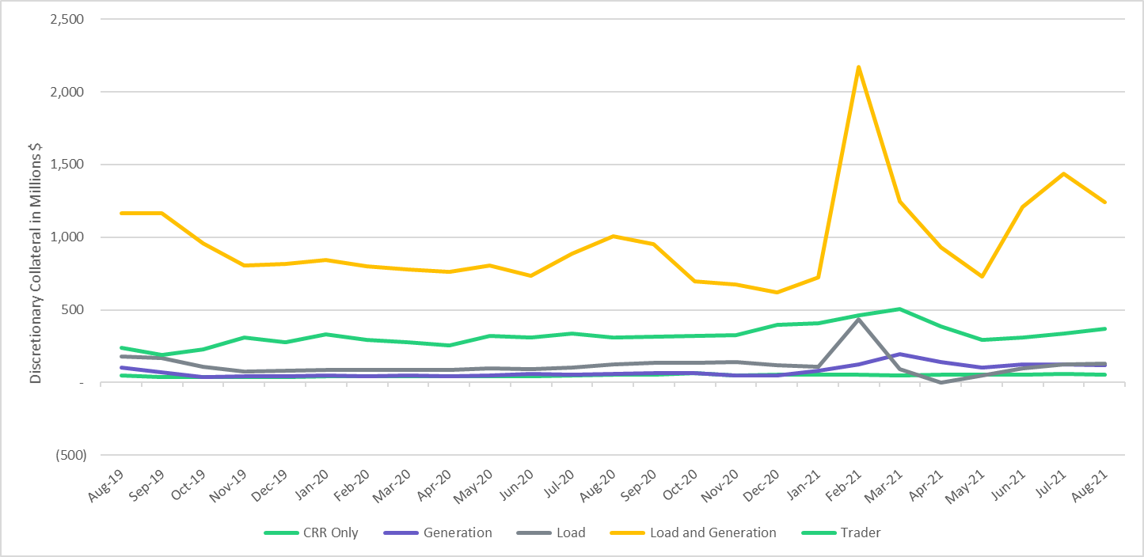
Discretionary Collateral by Market Segment August 2019- August 2021
* Discretionary Collateral adjusted to exclude short pay amounts eliminating data skew

Slide 10
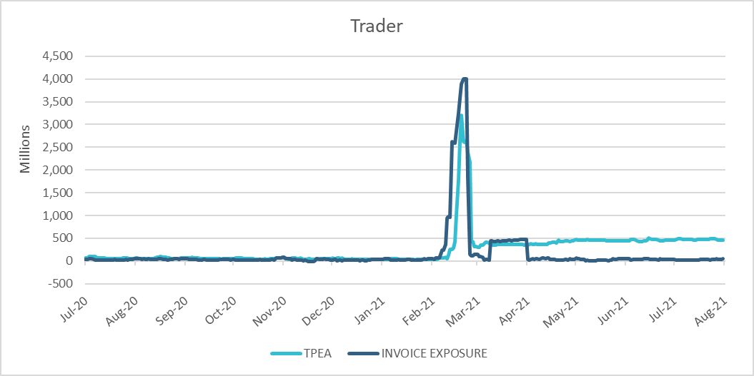
TPE Coverage of Settlements July 2020 – July 2021
*TPEA generally exceeds invoice exposure
*During the 2021 winter event, invoice exposure was slightly higher than TPEA

Slide 11
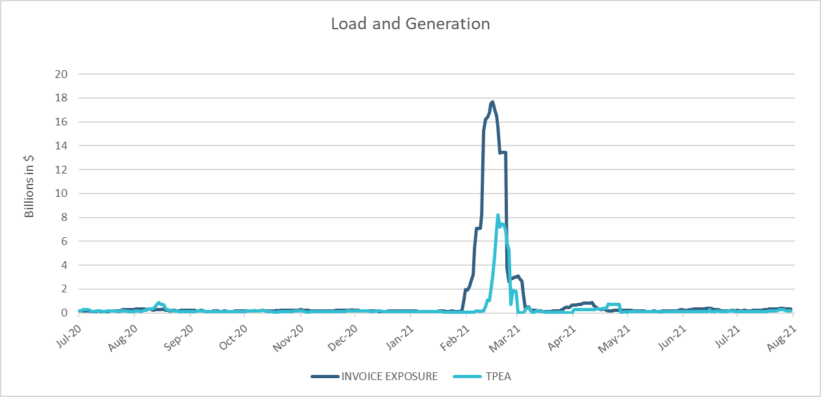
TPE Coverage of Settlements July 2020 – July 2021
*During the 2021 winter event, invoice exposure was higher than TPEA
*TPEA adjusted to exclude short pay amounts eliminating data skew

Slide 12
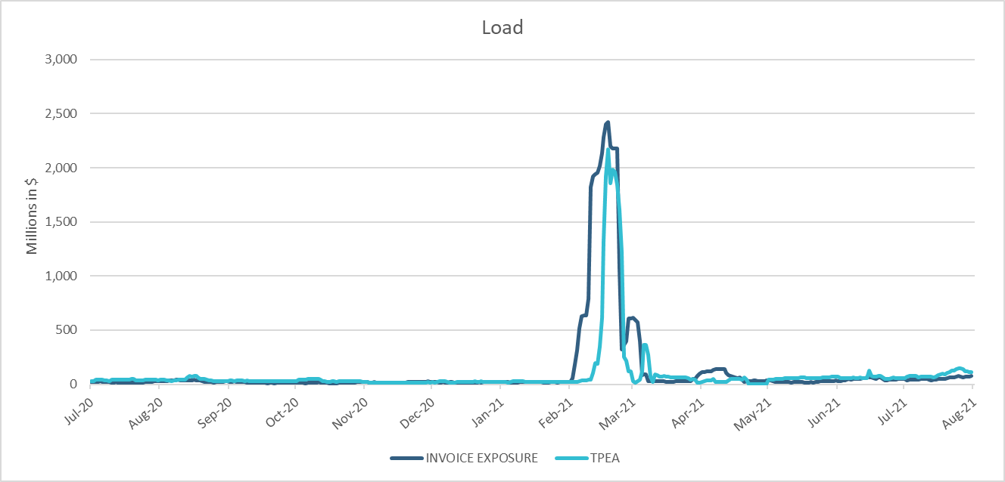
TPE Coverage of Settlements July 2020 – July 2021
*TPEA closely approximates invoice exposure except during the winter 2021 event
*TPEA adjusted to exclude short pay amounts eliminating data skew

Slide 13
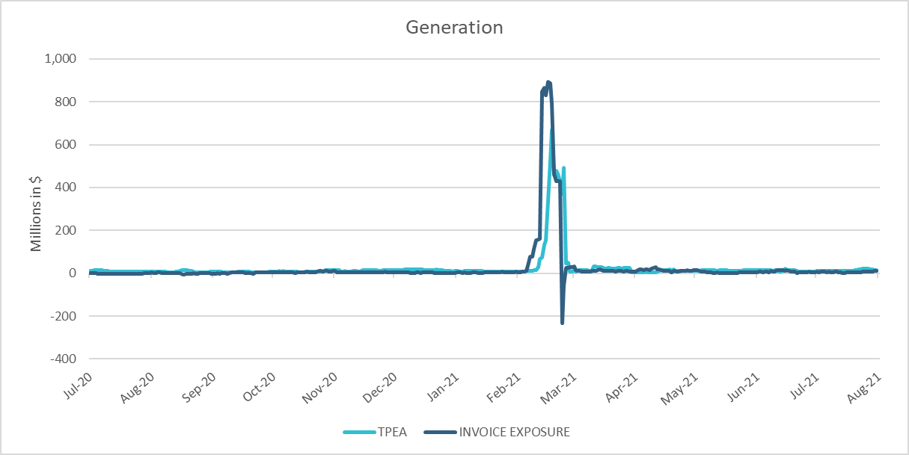
TPE Coverage of Settlements July 2020 – July 2021
*TPEA generally exceeds invoice exposure except during the 2021 winter event

Slide 14
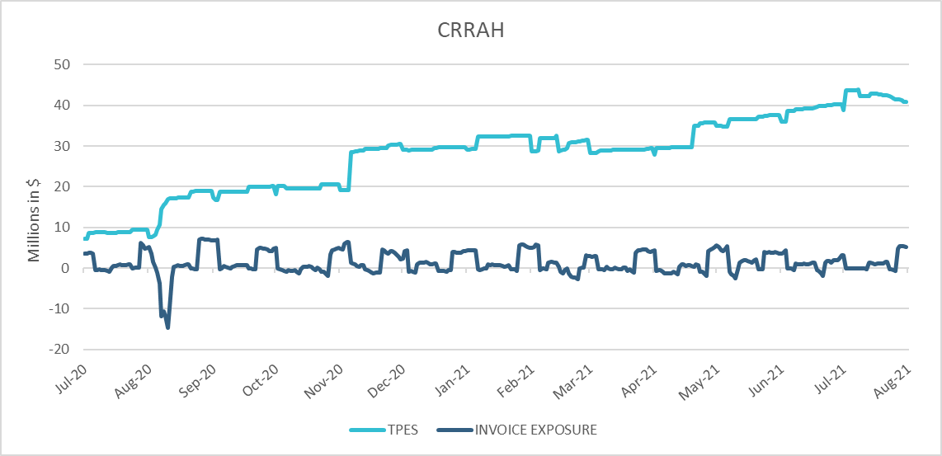
TPE Coverage of Settlements July 2020 – July 2021
*TPES mostly exceeds actual/invoice exposure

Slide 15
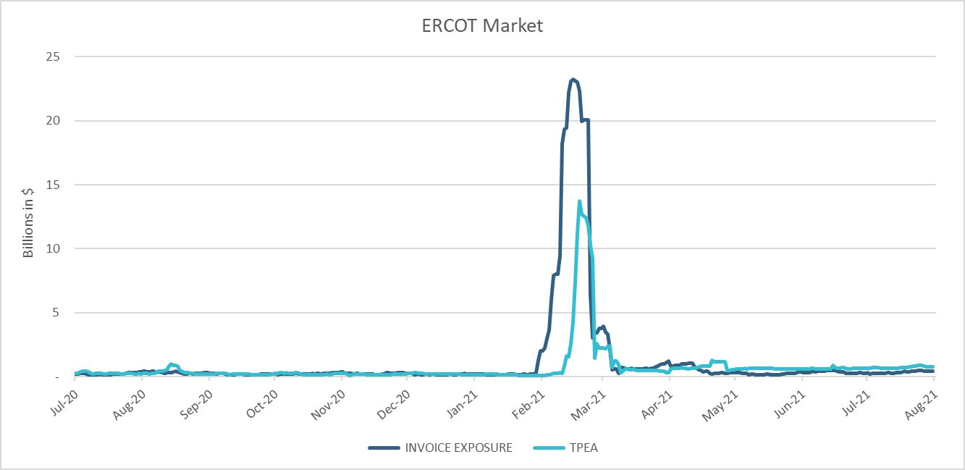
TPE Coverage of Settlements July 2020 – July 2021
*TPEA closely approximates actual/invoice exposure except during the 2021 winter event
*TPEA adjusted to exclude short pay amounts eliminating data skew

Slide 16
Appendix

Slide 17
Summary of Distribution by Market Segment*
* Excess collateral doesn’t include Unsecured Credit Limit and is defined as Collateral in excess of TPE
* TPE adjusted to exclude short pay amounts eliminating data skew

Slide 18
Summary of Distribution by Rating Group*
* TPE adjusted to exclude short pay amounts eliminating data skew

Slide 19
Distribution of TPE by Rating and Category*
* TPE adjusted to exclude short pay amounts eliminating data skew

Slide 20
Distribution of Excess Collateral by Rating and Category*
*Excess collateral doesn’t include Unsecured Credit Limit
* TPE adjusted to exclude short pay amounts eliminating data skew

Slide 21
TPE Coverage of Settlements
TPEA covers Settlement/Invoice exposure and estimated Real-Time and Day- Ahead completed but not settled activity (RTLCNS and UDAA)
The analysis was performed for the period, July 2020 - July 2021
Only Settlement invoices due to ERCOT are considered in the calculation
M1 values as of May 28th, 2020, were used for the period Feb 2020- May 2020 and M1 values effective as of each day were used since Jun 2020
Example
For business date 2/1/2020, if a Counter-Party has M1 value of 20, then all the charge invoices till 2/21/2020 including RTLCNS and UDAA as of 2/1/2020 is summed up to arrive at “Invoice Exposure”

Slide 22
Questions

