Slide 1
Lessons learned from Uri and Potential SSWG cases
Joint PLWG and SAWG meeting
September 17, 2021
Kevin Hanson
Principal Analyst

Slide 2
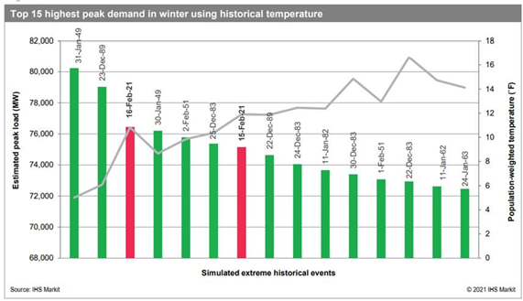
How much load could there have been?
ERCOT estimated 76,819 MW for the February 2021 event
Winter 2011 event is not in the Top 15 days

Slide 3
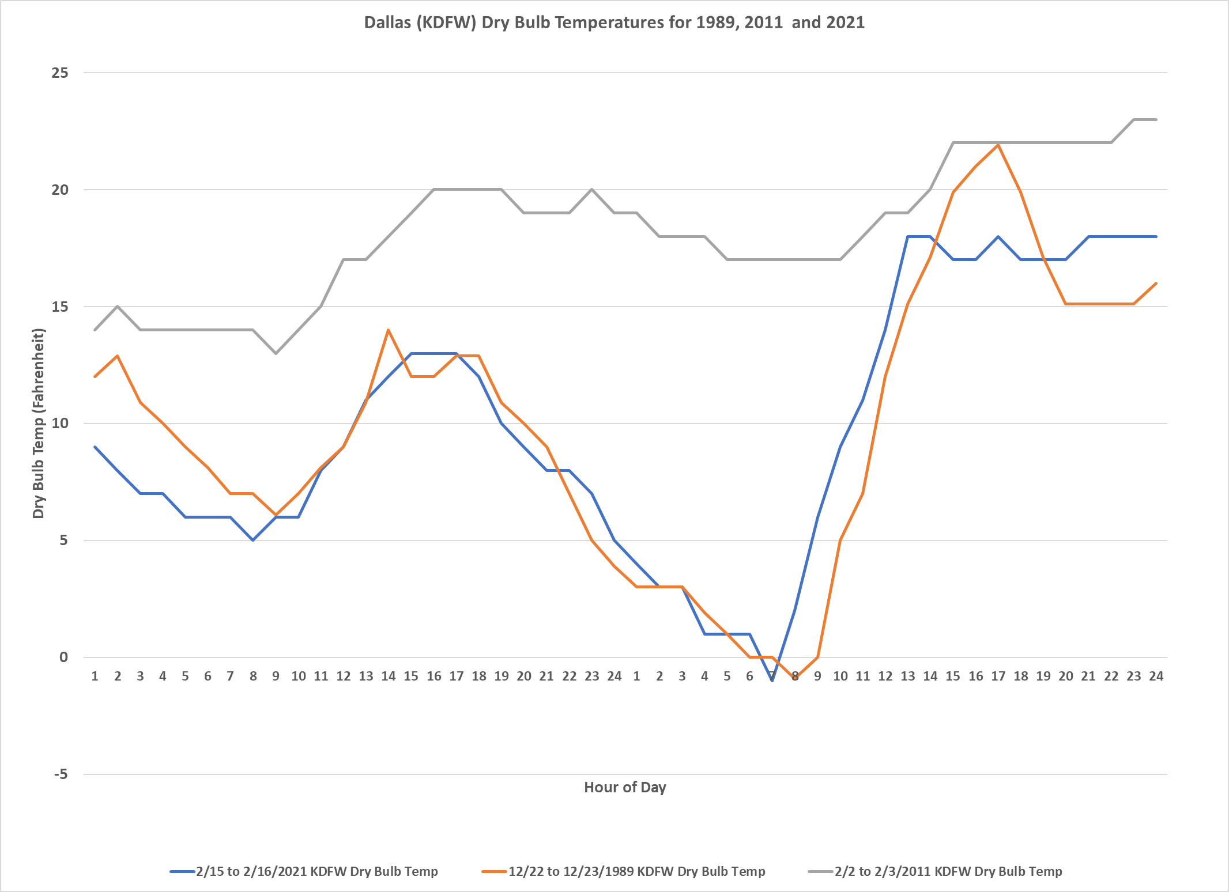
Dallas Cold Weather Days in 1989, 2011, and 2021

Slide 4
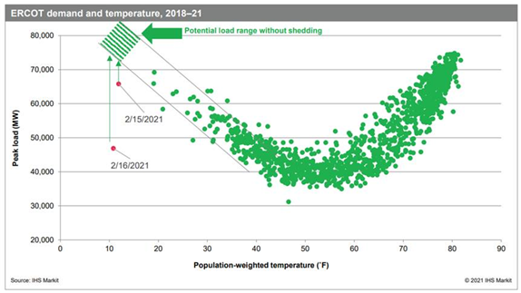
How does the temperatures impact it?
ERCOT estimated 76,819 MW for the February 2021 event

Slide 5
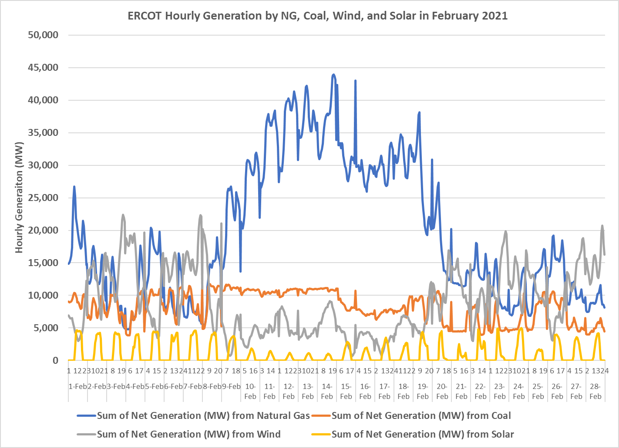
NG, Coal, Wind, and Solar Gen in ERCOT in Feb 2021
Source: EIA 930

Slide 6
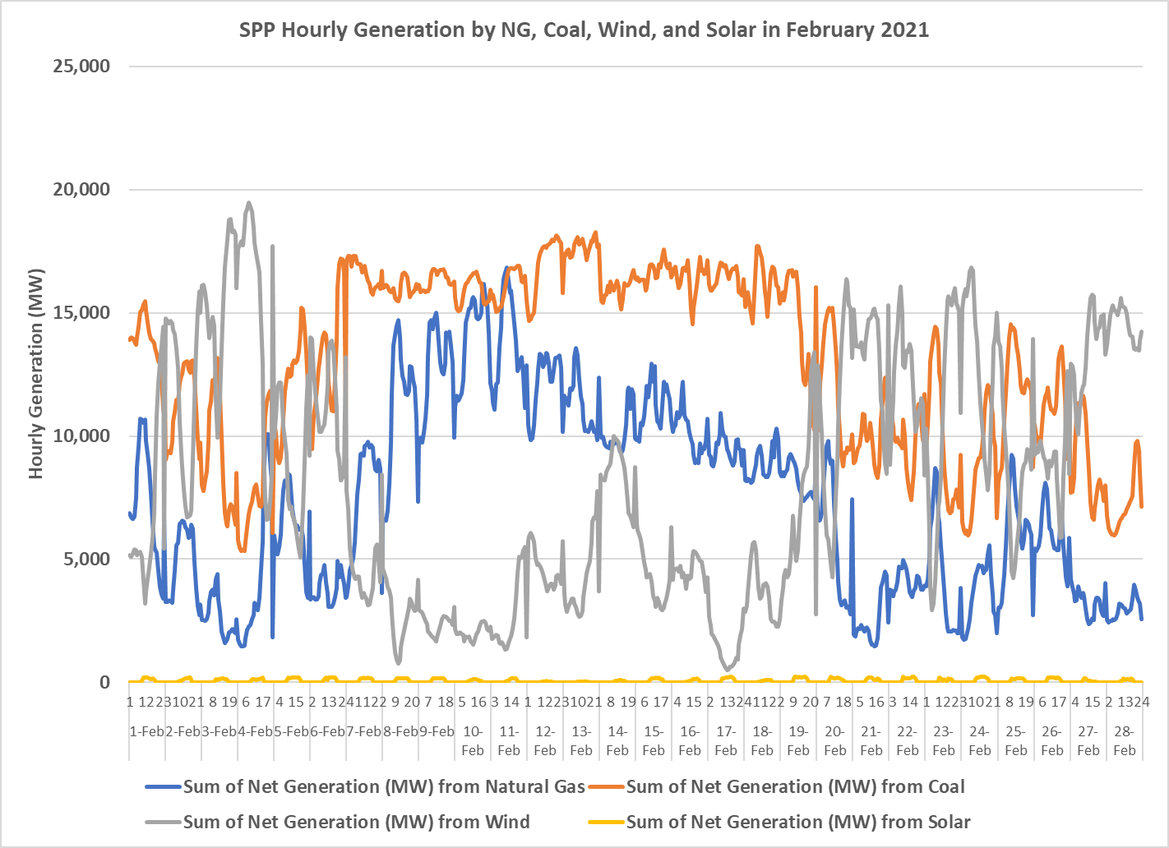
NG, Coal, Wind, and Solar Gen in SPP in Feb 2021
Source: EIA 930

Slide 7
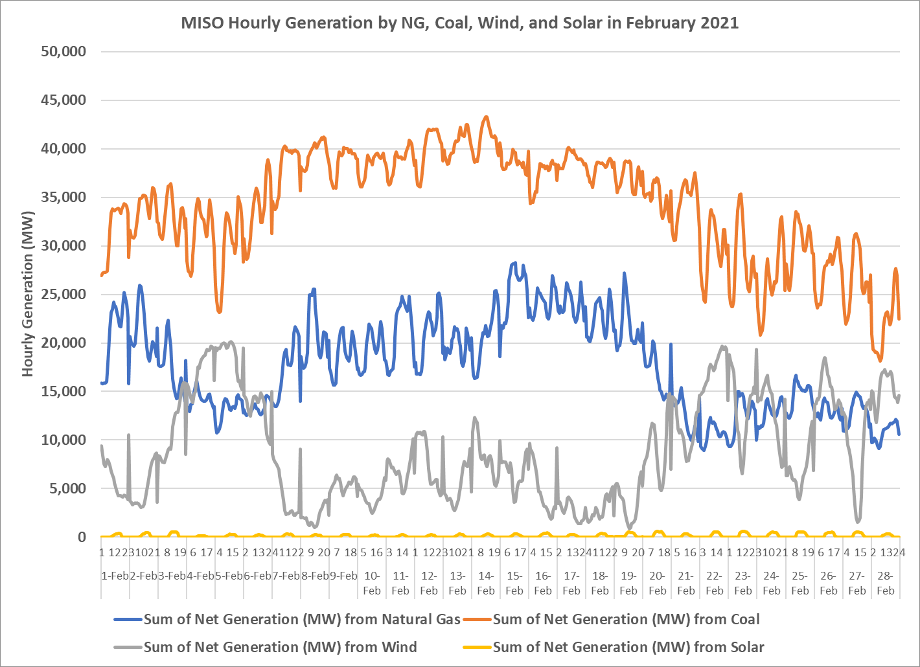
NG, Coal, Wind, and Solar Gen in MISO in Feb 2021
Source: EIA 930

Slide 8
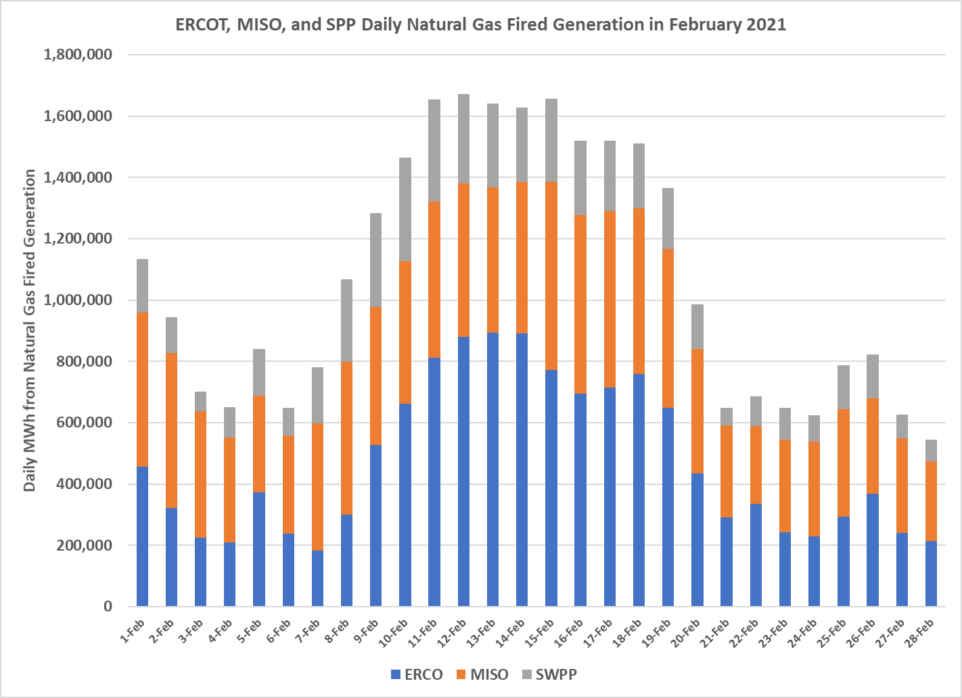
Daily NG Gen in ERCOT, SPP and MISO in Feb 2021
Source: EIA 930

Slide 9
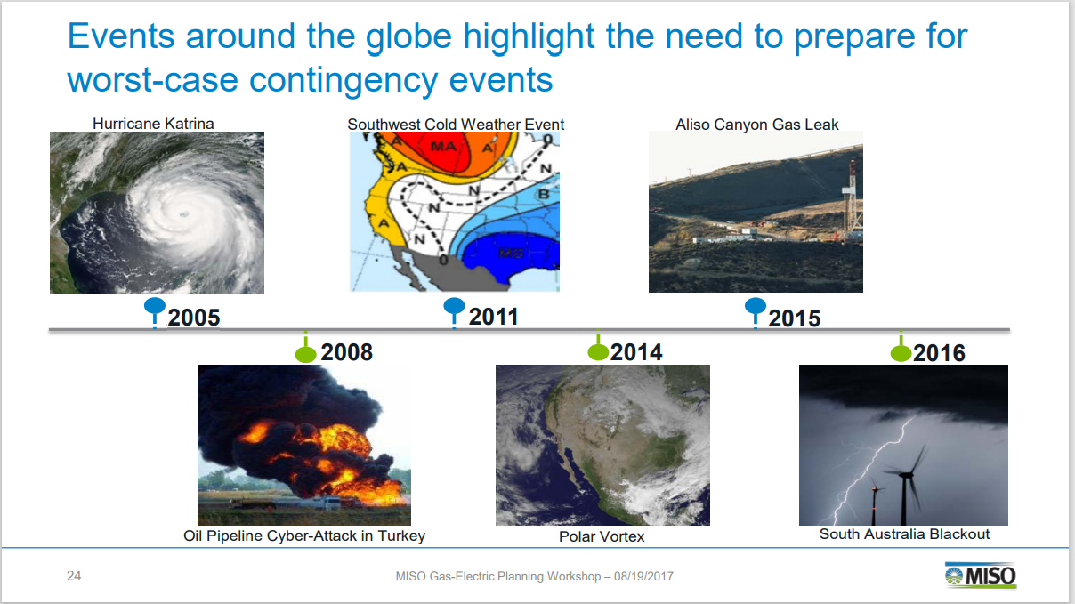
Why do we need to do something? Weather is getting more volatile.
In ERCOT, we have had:
2011 (summer was 1 in 100 event),
Three separate 500 year storms in the past 5 years (e.g. Harvey),
Uri which is somewhere between a 30 year (1989 to 2021) or a 100 year storm

Slide 10
Examples for MISO

Slide 11
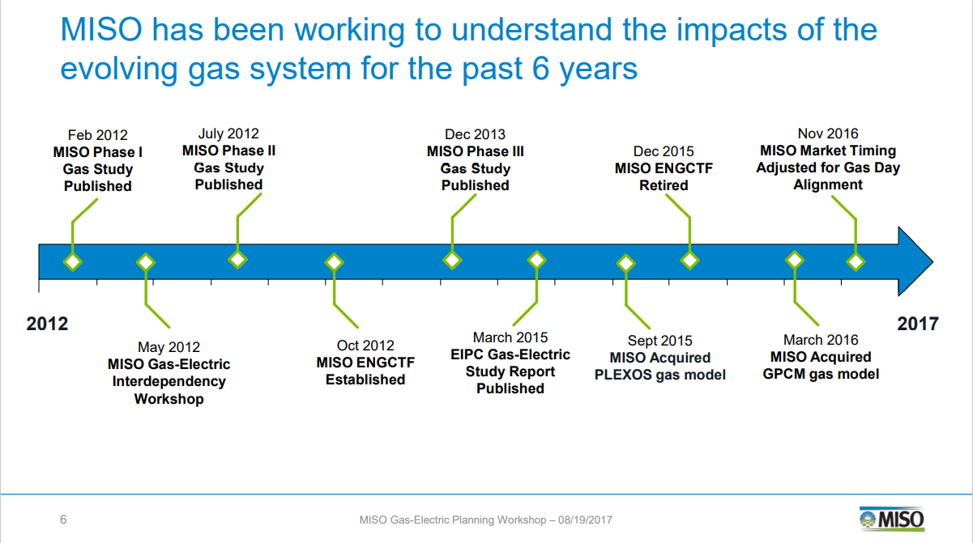
Projects Midwest ISO has done to improve the planning process
Gas Studies
Added gas models into their planning process (Plexos and GPCM gas models)

Slide 12
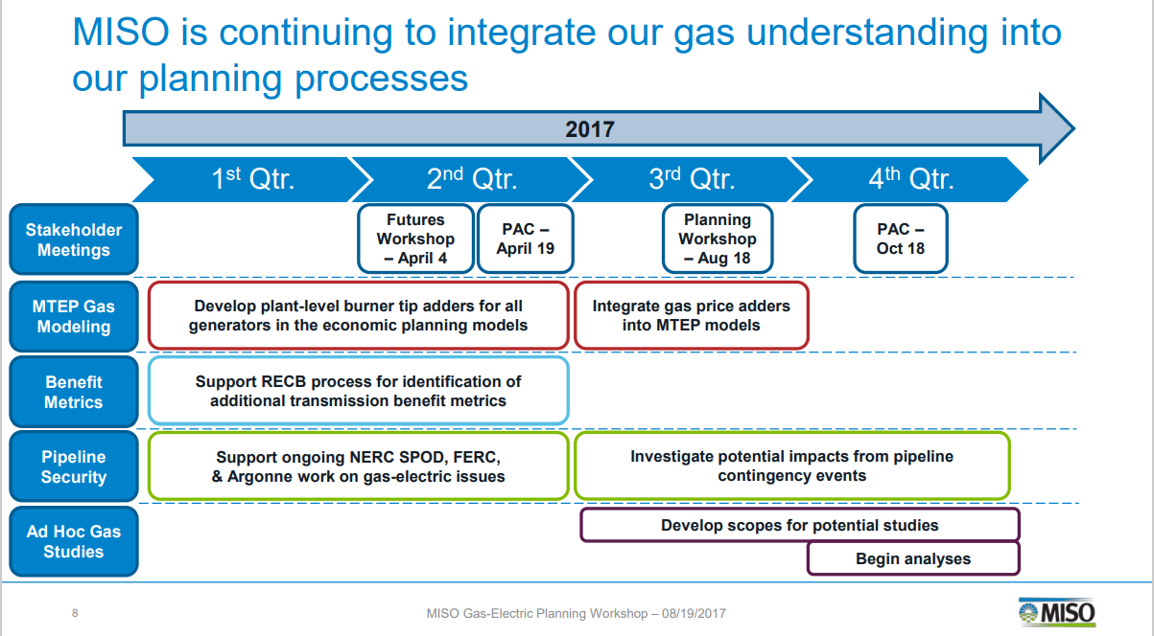
Projects Midwest ISO has done to improve the planning process
Investigating pipeline contingency events
Support ongoing work at other agencies looking at Gas-Electric Risks

Slide 13
Projects MISO has done to improve the non-planning process
MISO has improved communication & situational awareness around pipeline activities and impacts to generators
MISO’s Gas Pipeline Notifications Website provides regional insight into pipeline operating conditions
Fuel Impact Report: At Risk Units
Control Room Electric/Gas Pipeline Real Time Display
Gas Usage Profiles Project
MISO Winter Generator Survey
Generator-Pipeline Database Upgrade
    MISO now has complete database of pipeline connections and dual fuel capability for all gas generators

Slide 14
2
Ideas Presented at SAWG

Slide 15
Potential changes to the ERCOT Process initially made at the April 23, 2021 SAWG meeting
Temperature impacts on generating capability, auxiliary loads on power plants, and load forecasts
    Capabilities of power plants with HSL and LSL capabilities every 10 degrees Fahrenheit from 0 to 130
    Auxiliary load at power plants at each 10 degrees as well
    In CDR and SARA, each season would includes the span of historical temperatures from 1950 to 2021 (and ongoing) that have impact the ERCOT market. For instance, winter may be 0 to 90 degrees.
    The weighting would be based on historical locational loads per the load forecasting team at ERCOT.
    Load forecast using the temperatures and the historical weather year that represents the worst case scenarios
Powerplant access to pipelines and types of natural gas contracts
    Number of pipelines to plants and type of contracts (Firm/Interruptible) available on those pipelines
    IN CDR and SARA, incorporate details of percentage of gas power plants with none, one, or two or more pipelines with Firm contract capability

Slide 16
Example of topics for new SARA and CDR

Slide 17
3
Proposed Extreme Cases at PLWG

Slide 18
Proposed New Cases / Extreme Events
New Case | Case Description
Extreme cold | Statewide less than 20 degrees Fahrenheit
Extreme heat | Statewide greater than 105 degrees Fahrenheit
Extreme drought | Statewide extended lack of rainfall
Extreme heat and drought | Combination of extreme heat and drought scenarios
Tornadoes | More likely standalone in the North portion of the system
Hurricanes/Tropical Storms | More likely on the coastal side of the system (e.g. Ike, Harvey)

Slide 19
Extreme Winter Case
Early morning
February 15, 2021 Weather Assumptions (99/1 Winter)
    Uses a forecast developed by ERCOT
    TSPs would develop the appropriate distribution of the load forecast
Load would be not scaled down to match generation
Solar generation at 0%
Wind generation at 10%
Storage at 0%
Disable reactive capability for IRR units below 10% output
    Currently, no market exists for reactive services
One study would be a G1N1 or GXN1 analysis, where the GX is a group of generation facilities in the same physical area or with a common failure mode (e.g., gas pipeline)
Another study would be systemwide natural gas fired deration of XX% to be reflective of natural gas system not pressurized appropriately
Demand response (voluntary and involuntary) may be needed
    Reduce large Industrial loads as necessary
    If still insufficient to solve the case, reduce other loads on their system
    Involuntary demand response can also be described as energy shortages
    Involuntary demand response would be allocated based on the ERCOT method

Slide 20
Extreme Heat and Drought Summer Case
Early evening
August 2, 2011 Weather Assumptions (99/1 Summer)
    Uses a forecast developed by ERCOT
    TSPs would develop the appropriate distribution of the load forecast
Load would be not scaled down to match generation
Solar generation at 80%
Wind generation at 10%
Storage at 0%
Disable reactive capability for IRR units below 10% output
    Currently, no market exists for reactive services
G1N1 or GXN1 analysis, where the GX is a group of generation facilities with low water risks (both natural gas and coal)
Demand response (voluntary and involuntary) may be needed
    Reduce large Industrial loads as necessary
    If still insufficient to solve the case, reduce other loads on their system
    Involuntary demand response can also be described as energy shortages
    Involuntary demand response would be allocated based on the ERCOT method

Slide 21
Hurricanes/Tropical Storms/Tornadoes
Summer loads
    Both 90/10 and 99/1 weather assumptions
    Uses forecasts developed by ERCOT
    TSPs would develop the appropriate distribution of the load forecast
Load would be not scaled down to match generation
Solar generation at 80%
Wind generation at 50%
Storage at 0%
Disable reactive capability for IRR units below 10% output
    Currently, no market exists for reactive services
First study would be a G1N1 or GXN1 analysis, where the GX is a group of generation facilities within same physical area i.e. by county or study area like Houston, DFW, Valley or Corpus Christi area generators and N-X analysis removing multiple major transmission lines from service within a specific area (e.g., two 345-kV circuits into the Valley out).
Second study would be a G1N1 or GXN1 analysis, where the GX is a group of generation facilities in the same physical area (same as above) with the addition of a percentage (all or X%) of load being removed in those areas as well and N-X analysis removing multiple major transmission lines from service within a specific area (e.g., two 345-kV circuits into the Valley out).
Demand response (voluntary and involuntary) may be needed
    Reduce large Industrial loads as necessary
    If still insufficient to solve the case, reduce other loads on their system
    Involuntary demand response can also be described as energy shortages
    Involuntary demand response would be allocated based on the ERCOT method

Slide 22
4
Other items discussed at PLWG

Slide 23
Other items discussed the group
What duration of events should we be planning?
Identify evidence whether the existing ERCOT market structure is working to handle “extreme” weather scenarios
Does ERCOT have the tools they need?
Additional educational ideas
Many customers and market participants have renewables / zero carbon goals that shouldn’t necessarily be ignored as technology is available for more reliable renewable energy sources, e.g. hydrogen fired generation.

Slide 24
What duration of events should we be planning?
Do we have a “normal” expected duration that we are planning?
Storm Uri in February 2021 could be described as a 96 hour event.
Most events are locational specific (e.g. Harvey) but could also occur over a longer duration.
Most summer time events will occur for less than 4 hours. But could occur longer due to major pipelines being shutdown or extended weather lulls (e.g. low wind, fires could created cloud cover for solar generation).
Is it a small or large event? Can the outages be rotated?

Slide 25
Identify evidence whether the existing ERCOT market structure is working to handle “extreme” weather scenarios
Not a topic of PLWG
Being discussed at PUC Texas currently

Slide 26
Does ERCOT have the tools they need?
Natural gas issues
  ERCOT does not currently have natural gas analysis tools from operational to planning to model and understand the natural gas markets
  Does ERCOT need these tools?
Building a single ERCOT planning model (not segmented out)
  Can such a model be built out and solved?
  The answer may include coordinated load shed as the ultimate solution.
  Can ERCOT work with the REPs, municipals, cooperatives, and industrials to identify “orderly” load shed?
        Not a PLWG issue, but needs to be addressed by some ERCOT group
        If not, can we prepare a document identifying how load shed would be accomplished?

Slide 27
Additional education ideas
Invite MISO Gas Electric Coordinator to speak to PLWG
Invite Dr. Sinnott Murphy to present the work that he is doing with NREL regarding temperature-dependent models for generator failures and recoveries.
    He wrote a paper that shows that all generator types perform worse in very cold and very hot weather than recognized under current modeling practice.

Slide 29
Items from the “Roadmap”
#9 – Improve the assessment and communication of extreme low-probability, high-impact weather scenarios, including temperatures, durations, precipitation, humidity, and wind. Propose updated methodologies for the Seasonal Assessment of Resource Adequacy (SARA) for the ERCOT Region and other resource adequacy studies. This will improve public awareness about the potential high impacts of low-probability severe situations.
#16 – Improve and expand toolsets to manage short-supply situations. This includes facilitating additional voluntary load reductions and procuring additional ancillary or reliability services from resources with unique capabilities to operate during extreme weather conditions.
#18 – Initiate a process, both at ERCOT and the PUC, to address the Lower Rio Grande Valley transmission limitations, up to and including the construction of new transmission capacity. This will provide increased market access for resources in the Valley, improving reliability for customers during both normal conditions and high-risk winter events.
#53 – Improve system planning, including localized and regional significant growth patterns. This will improve the range of conditions considered in planning studies.
#57 – Consider on-site fuel supply including contracts with remote secured supplies.

Slide 30
Members of PLWG Extreme Cases Subgroup
John Bernecker (ERCOT)
Doug Evans (STEC)
Andrew Hamann (LCRA)
Kevin Hanson (National Grid)
Brian Hithersay (BEPC)
Harsh Naik (Oncor)
Lori Simpson (Exelon)
Mina Turner (AEP)
Monica Walker (GM)

Slide 31
Description of Initials
RARF - Resource Asset Registration Form
RIOO – Resource Integration & On-going Operations
CDR – Capacity, Demand, and Reserves Report
SARA – Seasonal Assessment of Resource Adequacy
HSL – High Sustained Limit
LSL – Low Sustained Limit

