Slide 1
Thermal Outage Uncertainty Modeling for the Winter 2021-22 Probabilistic SARA Model
Supply Analysis Working Group
Pete Warnken
Resource Adequacy Dept.
September 17, 2021
Notes:
Welcome to

Slide 2
Thermal Unplanned Outage Probability Distribution: Exceptional Winter Weather Event
Worst periods of extreme, prolonged cold impacting the entire ERCOT region occurred in 2021, 1989, 1983, 1930 and 1899
Based on the number of years of Texas weather station records, 143, the annual probability of a comparable event is 3.5% (5 events divided by 143)
Based on the mean time between events, 31 years, the probability of a comparable event in any given year is 3.2% (1 event divided by 31 years)
For the probabilistic model, assume that the probability of a Uri-type event is 3.5% for winter 2021-22

Slide 3
Thermal Unplanned Outage Probability Distribution: Exceptional Winter Weather Event
Based on the current SARA methodology, the unplanned thermal outage amount during a Winter Storm Uri event is assumed to be 26,902 MW
Maximum unplanned outages during the event, excluding PUN units and Switchable Generation Resources assumed to be fully dedicated to SPP, is 25,403 MW based on Outage Scheduler data
Incorporates a PUN adjustment of 1,499 MW based on a minimum grid injection amount of 2,050 MW during the event (3,549 MW is the estimated PUN capacity contribution for winter peak load hours)
Reflects the change in handling Unavoidable Extensions – All UEs are treated as unplanned outages

Slide 4
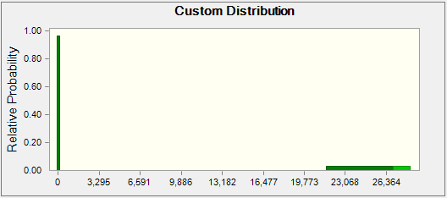
Thermal Unplanned Outage Probability Distribution: Exceptional Winter Weather Event
Assume minimum of 21,522 MW, or 20% below 26,902 MW
Maximum is 28,247 MW, or 5% higher than 26,902 MW
Assume uniform probability of 2.5% for 21,522 to 26,902 MW range, and 1% for 26,902 to 28,247 MW range – 3.5% total
Resulting probability distribution for the model:

Slide 5
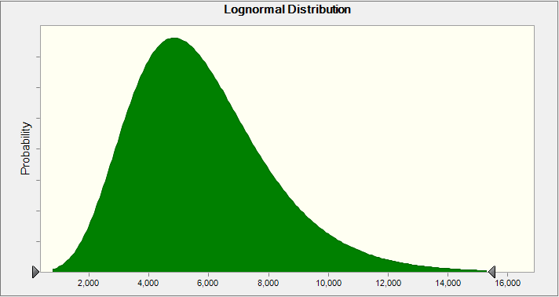
Thermal Unplanned Outage Probability Distribution: Historical Outlier Range
Fit a distribution to unplanned outages from 2010 through February 2021, excluding the period 2/13/2021 – 2/24/2021
This February date range had unplanned outages above the maximum value for the historical period, 15,340 MW
Distribution truncated at 15,340 MW

Slide 6
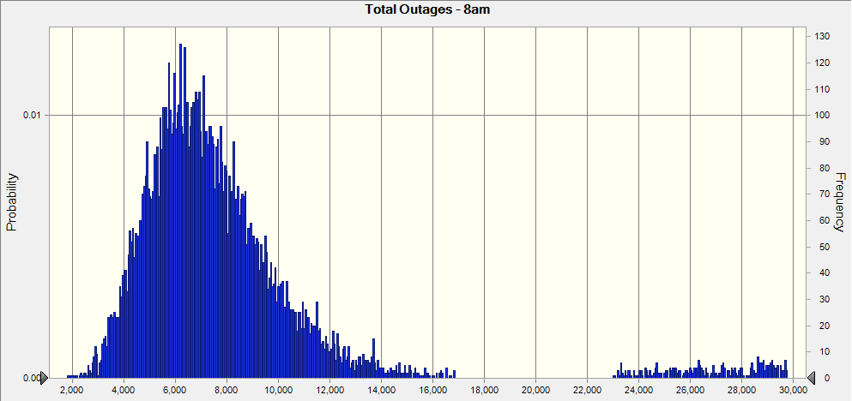
Total Thermal Outage* Forecast Example
* Includes planned outage forecast of 1,512 MW based on winter SARA methodology
10,000 trial simulation
Maximum value is 29,754 MW: 28,242 MW unplanned plus 1,512 MW planned outages

