Slide 1
Initial Analysis of the Relationship between Thermal Outages and Winter Temperatures
Supply Analysis Working Group
Pete Warnken
Resource Adequacy Dept.
September 17, 2021
Notes:
Welcome to

Slide 2
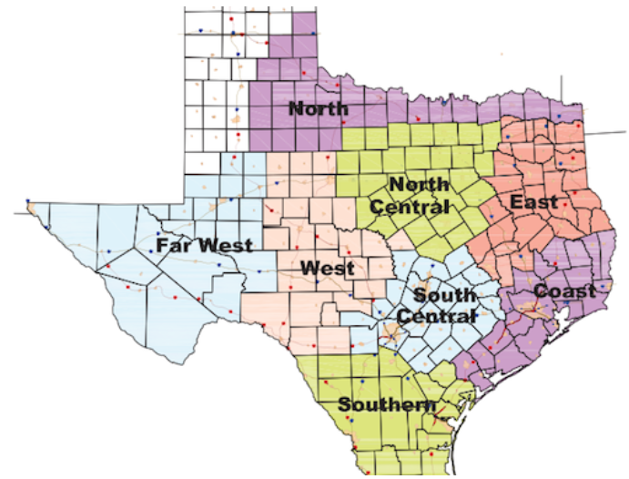
Analysis Approach
For this initial analysis, focused on:
Gas-fired combined-cycle and wind outages
Two Weather Zones for gas CCs (North Central and South Central) and one for wind (West)

Slide 3
Analysis Approach
Using Outage Scheduler data, assembled time series consisting of average hourly outages and associated average Weather Zone temperatures for all winter seasons back to 2010-11
Temperatures come from weather station readings used for ERCOT load forecast model development

Slide 4
Unplanned Outage MW vs Temperature for Combined-Cycle Units, North Central Weather Zone
Table below based on grouping observations into five-degree temperature bins

Slide 5
Unplanned Outage MW versus Temperature for Combined-Cycle Units North Central Weather Zone
Chart below is based on hourly values

Slide 6
Unplanned Outage MW vs Temperature for Combined-Cycle Units, South Central Weather Zone
Table below based on grouping observations into five-degree temperature bins

Slide 7
Unplanned Outage MW vs Temperature for Combined-Cycle Units, South Central Weather Zone
Chart below is based on hourly values

Slide 8
Unplanned Outage MW versus Temperature for Wind Resources, West Weather Zone
Chart below is based on hourly values

