Slide 1
Project Update and Summary of
Project Priority List (PPL) Activity
September 16, 2021
Troy Anderson
ERCOT Portfolio Management

Slide 2
Project Update Agenda
Project Portfolio Update
Recent / Upcoming Project Highlights
2021 Release Targets
In-Flight Strategic Projects
FFR Advancement Project Update – Nitika Mago
Securitization Update
Priority/Rank Options for Revision Requests with Impacts
Appendix
DGR/DESR Moratorium Market Notice
Location of Project Priority List (PPL): http://www.ercot.com/services/projects/index

Slide 3
Recent / Upcoming Project Highlights
2021 September Release Off-Cycle – 9/10/2021 Complete
NPRR867 – Revisions to CRR Auction Credit Lock Amount to Reduce Excess Collateral
2021 September Release Off-Cycle – 9/16/2021 Complete
NPRR1081 – Revisions to Real-Time Reliability Deployment Price Adder to Consider Firm Load Shed
Automated solution
2021 October Release Off-Cycle – 10/1/2021 In Flight
NPRR984 – Change ERS Standard Contract Terms
OBDRR023 – Related to NPRR984, Change ERS Standard Contract Terms
2021 October Release – 10/5/2021-10/7/2021 In Flight
No Revision Requests
2021 December Release – 12/7/2021-12/9/2021 In Flight
NPRR863 – FFR portion
NPRR1015 – Clarification of DAM implementation of NPRR863 Phase 2
NPRR1079 – Day-Ahead Market RRS / ECRS 48-Hour Report Clarification
NOGRR187 – Related to NPRR863
Note: Projected Go-Live dates are subject to change. Please watch for market notices as the effective dates approach.

Slide 4
2021 Release Targets – Board Approved NPRRs / SCRs / xGRRs
R1
R3
R5
February 2/2 – 2/4 | April 3/30 – 4/1 | May 5/25 – 5/27 | July 7/27 – 7/29 | October 10/5 – 10/7 | December 12/7 – 12/9
NPRR902(a) NOGRR195 NPRR1055 OBDRR023(a) NPRR1020 SCR804 | NPRR971 NPRR986 NPRR998 NPRR1024 NPRR1043 NOGRR213 VCMRR027 PGRR070 NPRR1060 | NPRR974 NPRR978(c) NPRR1048 NPRR1051 SCR811 ECMS ECMS NPRR1080 OBDRR030 NPRR1081(a) | NPRR902(b) NPRR905 SCR789 NPRR1062 RMGRR164 NPRR1031 NPRR867 NPRR1081(b) | None NPRR984 OBDRR023(b) SCR781 | FFR Advancement (NPRR863 FFR) NPRR1015 NPRR1079 NOGRR187 DGR/DESR (See next slide)
R2
R4
R6
ü
ü
ü
ü
ü
ü
ü
ü
ü
ü
ü
ü
ü
ü
ü
ü
ü
ü
ü
ü
ü
ü
ü
E
E
E
E
E
ü
1/1
7/14
10/1
ü
E
E
7/23
2/1
Replace NoticeBuilder
ü
ECMS – Nov.
Infrastructure replace
New navigation
2022 R1 (Feb.)
6/25
3/15
5/1
8/1
ü
ü
New public version of ERCOT.com homepage
ü
7/1
9/10
RIOO – Q4 2021
RARF Add Functionality Go-Live
4/22
6/1
ü
ü
ü
9/16
E
E
TBD Items | NPRRs: 484, 825(b), 826, 829, 841, 857, 879, 885, 904, 918, 930, 935(b), 936, 939, 941, 945, 962, 965, 1004, 1006, 1019, 1023, 1030, 1032, 1034, 1040, 1057 SCRs: 799, 800, 805, 809, 812 Market Guides: PGRR066, PGRR076 Other Binding Docs: OBDRR009
Go-live dates can differ from Protocol effective dates – Please refer to market notices for more details
APPENDIX
Red Text: New additions and target release changes
Strike-Through Text: Previous target release
(a), (b), etc.: Multiple phase release
Project Status Codes
NS = Not Started
I = Initiation
P = Planning
E = Execution
H = On Hold
NPRR902(a) – ECEII Market Participant MPIM role
NPRR902(b) – MIS links updated for ECEII reports
NPRR978(c) – Forecast Zone scope
NPRR1081(a) – Manual implementation
NPRR1081(b) – Automated solution
OBDRR023(a) – ERS Expenditure Limit
OBDRR023(b) – 4 Standard Contract Terms/Year
Release targets are subject to change

Slide 5
In-Flight Strategic Projects
ESR: Energy Storage Resource
DGR: Distributed Generation Resource
BES: Battery Energy Storage
PR325-01 Fast-Frequency Response (FFR) Advancement (Gated to Execution on 6/22/2021)
Planned go-live for 2021-R6 (December 2021)
NPRR863, NPRR1015, NOGRR187
PR354-01 DGR/DESR Implementation (Gated to Execution phase on 7/30/2021)
Target go-live 2022-R1 (February 2022)
NPRR917 – Nodal Pricing for SODGs and SOTGs
NPRR1016 – Clarify Requirements for DGRs and Distribution Energy Storage Resources
NPRR1052 – Load Zone Pricing for Settlement Only Storage Prior to NPRR995
NPRR1065 – Implementation Adjustment for NPRR917
PGRR082 – Revise Section 5 and Establish Small Generation Interconnection Process
Related RRs – NOGRR212, RRGRR026
PR353-01 BES Combo Model Implementation – potential for multiple go-lives
Target go-live TBD (core project On Hold until resources are available after FFR and DGR/DESR)
NPRR963 – Base Point Deviation Settlement & Deployment Performance Metrics for ESRs (Combo Model)
NPRR987 – BESTF-3 ESR Contribution to Physical Responsive Capability and RT On-Line Reserve Capacity Calcs
NPRR989 – BESTF-1 ESR Technical Requirements
NPRR1002 – BESTF-5 ESR Single Model Registration and Charging Restrictions in Emergency Conditions
NPRR1026 – BESTF-7 Self-Limiting Facilities and Self-Limiting Resources
NPRR1038 – BESTF-8 Limited Exemption from Reactive Power Requirements for Certain ESRs
NPRR1069 – Align Ancillary Service Responsibility for ESRs with NPRR987
Related RRs – NOGRR204, NOGRR208, OBDRR017, PGRR081, RRGRR023
Blue text: ERCOT considering removing from project for earlier delivery

Slide 6
PR325-01 FFR Advancement Project Update
PR325-01 Fast-Frequency Response (FFR) Advancement (Gated to Execution on 6/22/2021)
Planned go-live for 2021-R6 (December 2021)
NPRR863, NPRR1015, NOGRR187, NPRR1079
Revision Request | Section | Notes / Comments
NPRR863 | 3.9.1​ | Management Activities for the ERCOT System
NPRR863 | 6.5.7.5 (1) (m) (PRC3) (type agnostic)​ | Adjustment Period and Real-Time Operations
NPRR863 | 6.5.9.4.2 | Adjustment Period and Real-Time Operations
NPRR1015 | 3.9.1 | Management Activities for the ERCOT System
NPRR1015 | 4.4.7.1 (9) | Day-Ahead Operations
NPRR1015 | 4.4.7.2 (3) | Day-Ahead Operations
NPRR1015 | 4.4.7.3 (4) | Day-Ahead Operations
NPRR1015 | 4.4.7.3.1 (1f) | Day-Ahead Operations
NOGRR187 | NOG 2.3.1.2 (8) for ONRR | System Operations and Control Requirements
NPRR1079 | Replaces NPRR1015 3.2.5 (3) (e) (f) (g) | Needed for the reporting clarification for NPRR1015
NPRR1015 | This Section removed from scope of FFR 3.2.5 (3) (e) (f) (g) Will be included in the ECRS project | Will remain grey boxed for FFR and will be done with ECRS project

Slide 7
PR325-01 FFR Advancement
High Level Summary of Changes
RRS Offers in & Awards from DAM, RRS AS Obligation in COPs and Self-Arranged RRS AS submissions will split by subtype namely, RRS-PFR, RRS-FFR and RRS-UFR.
An ESR-Gen and ESR-CLR will be able to offer, get awarded and provide* Regulation, RRS-PFR, and (online) Non-Spin simultaneously with RRS-FFR (assuming the ESR-Gen or ESR-CLR is qualified for the AS or AS sub-type it is offering or providing).
A NCLR will be able to offer, get awarded and provide** either RRS-FFR or RRS-UFR (assuming the NCLR is qualified for the RRS sub-type it is offering or providing).
In Real Time each RRS subtype will have a dedicated RRS AS Responsibility and RRS AS Schedule telemetry for provision of each sub-type of RRS.
There will be changes to some reports to include information breakdown by RRS subtype.
A workshop to provide an overview of the changes in this project will be conducted on October 27, 2021. ERCOT will send Market Notices providing additional details on this workshop.
Market Participant testing in Market Operations Test Environment (MOTE) will begin on October 27, 2021.
Updates to relevant Business Practice Manuals to align them with the changes from this project will be posted on November 5, 2021.
*ESR-Gen will be required to use ONFFRRRS resource status to provide RRS-FFR in Real Time.
** NCLR will be required to use ONFFRRRSL resource status to provide RRS-FFR or ONRL resource status to provide RRS-UFR in Real Time.
Notes:
Acronyms
AS - Ancillary Service
COP - Current Operating Plan
DAM - Day Ahead Market
ESR - Energy Storage Resource
ESR-Gen – ESR Generation Resource
ESR-CLR – ESR Controllable Load Resource
FFR - Fast Frequency Response
NCLR - Non-Controllable Load Resource
RRS – Responsive Reserve Service
UFR - Under-frequency Relay
Some affected reports
Total AS Offers,
QSE AS Capacity Monitor,
2 Day AS disclosure,
60 Day disclosure reports (SASM Generation/Load Offers/Awards, COP, DAM Generation Resource Data, DAM Generation/Load Resource AS Offers, AS Obligation and Responsibility, SCED disclosure – QSE self arranged AS) and
Aggregated Ancillary Service Offer Curve.
Planned Market Notice schedule for the workshop
60 Days before: 8/30
30 Days before: 9/27
10 Days before: 10/15
1 Day before: 10/26

Slide 8
Securitization Update
Projects underway to automate critical aspects of Securitization M and N
Full scope of work won’t be known until PUCT order in October
Initial effort is focusing on elements ERCOT is confident will be included
Examples: New invoice types and collateral
Multiple delivery phases are expected
First phase go-live is targeted for early 2022 (specific date not yet known)
Focus on uplift invoicing
Disbursement of funds for both M and N expected to be done manually
Second phase will address remaining functions not completed in first phase
Significant impact on resources in Settlements and Credit areas

Slide 9
Priority / Rank Options for Revision Requests with Impacts
Options for…
Revision Request | Description | Priority | Rank | Comments
NPRR1082 | Emergency Response Service (ERS) Test Exception for Co-located ERS Loads | N/A | N/A | <$5k O&M – no project required
NPRR1093 (if urgency is approved) | Load Resource Participation in Non-Spinning Reserve | 2021 | 3195 | $300k-$500, 8-12 months Impacted Systems: MMS, EMS, S&B, Reporting Candidate for 2021 start but must be assessed for resource availability with other critical projects
PGRR094 | Clarify Notification Requirement for Generator Construction Commencement or Completion | 2022 | 3540 | $10k-$20k, 1-2 months Impacted Systems: RIOO Add functionality to RIOO after current effort to include “add” capability is complete Worked with ROS on Priority/Rank
PPL Rank Information
Next available 2021 Rank in Business Strategy = 3360
Next available Rank in Regulatory = 320

Slide 10
Appendix

Slide 11
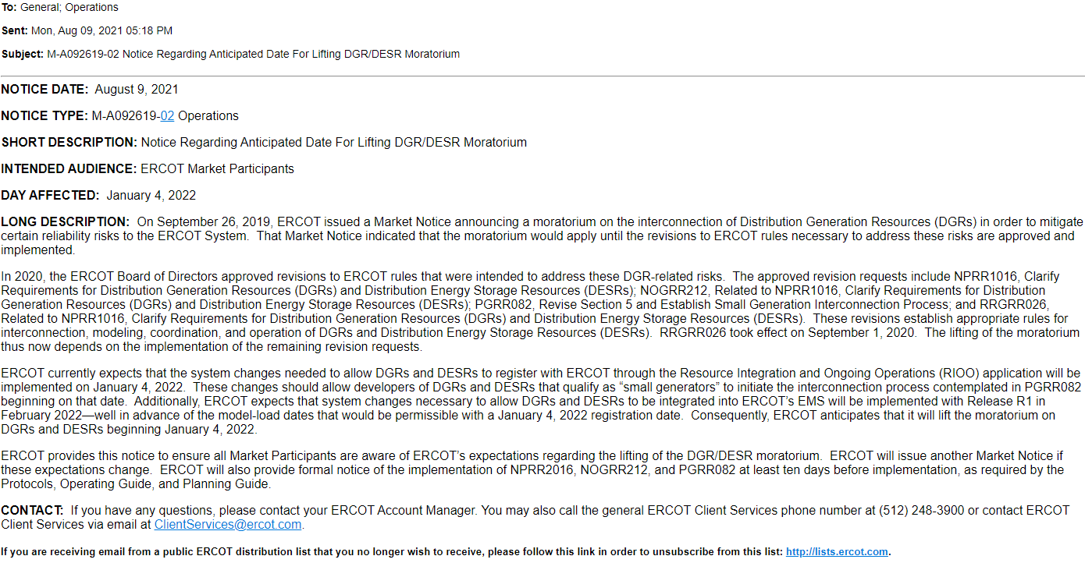
DGR/DESR Moratorium Market Notice – 8/9/2021

