Slide 1
RMS Emergency Conditions Issues List RECTF Update to RMS
September 14, 2021
Sheri Wiegand – RECTF Co-Chair

Slide 2
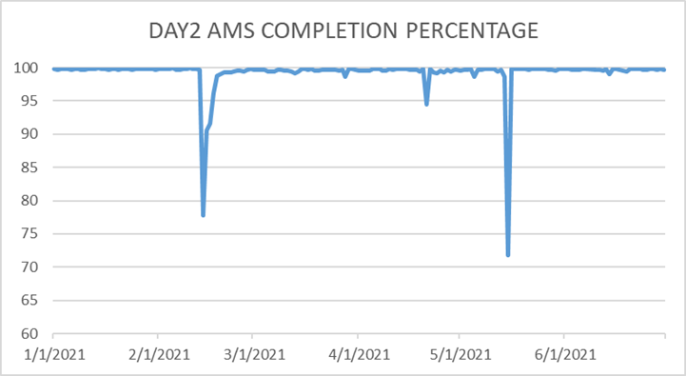
Meter Data Expectations
Notes from 8/31 RECTF:
#20 – Graph below shows Day 2 AMS Completion Percentages of TDSP AMS Data delivery timeliness according to ERCOT Data Loading & Aggregation. TDSP data is not “routinely late”.

Slide 3
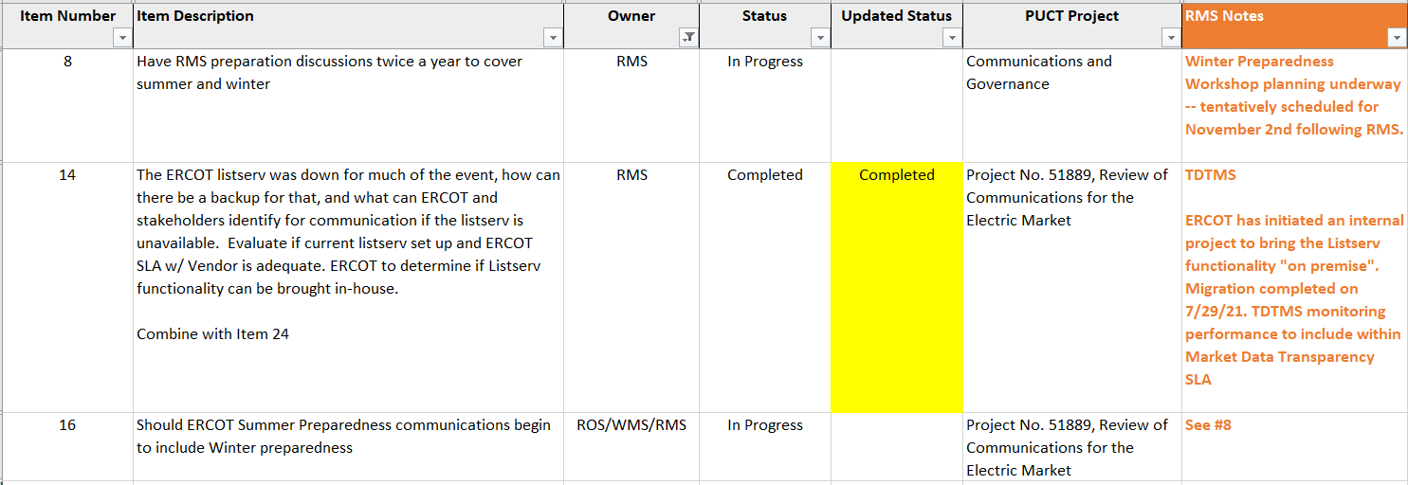
Communications

Slide 4
Mass Transition/ Acquisition

Slide 5
Awaiting Regulatory/Legislative

Slide 6
August 31st Meeting Docs
1) TDSP AMS Data Practices Matrix – Combined w/ Addendum for Prolonged, Widespread Outages
Summer & Winter Emergency Operating Plan (EOP) Procedures
Summer & Winter ERCOT EEA Procedures
Emergency Conditions Issues List (as of 8/31/21)

