Slide 1
ERCOT Frequency Events
August 2021
ERCOT
Operations Planning
PDCWG | September 8th, 2021

Slide 2
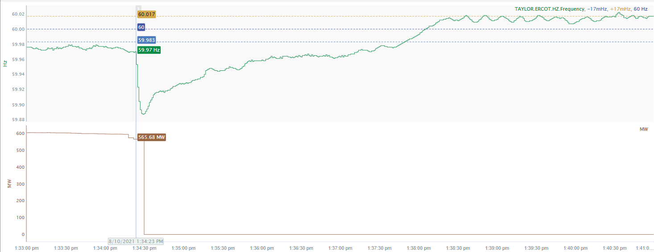
8/10/2021 13:34:23 (NON FME)
Notes:
Unit tripped offline while carrying 564 MW.
Starting Frequency: 59.97 Hz
Minimum Frequency: 59.887 Hz
A-C Time: 6 seconds
Recovery Time (back to deadband): 3 minutes and 20 seconds
RRS Deployed: 624.28 MW
Trip Reason: Boiler air excursion.
Contextual Information: A total of 402 MW of regulation up was deployed during the event.
No Selection Reason: The starting frequency fell below low deadband.

Slide 3
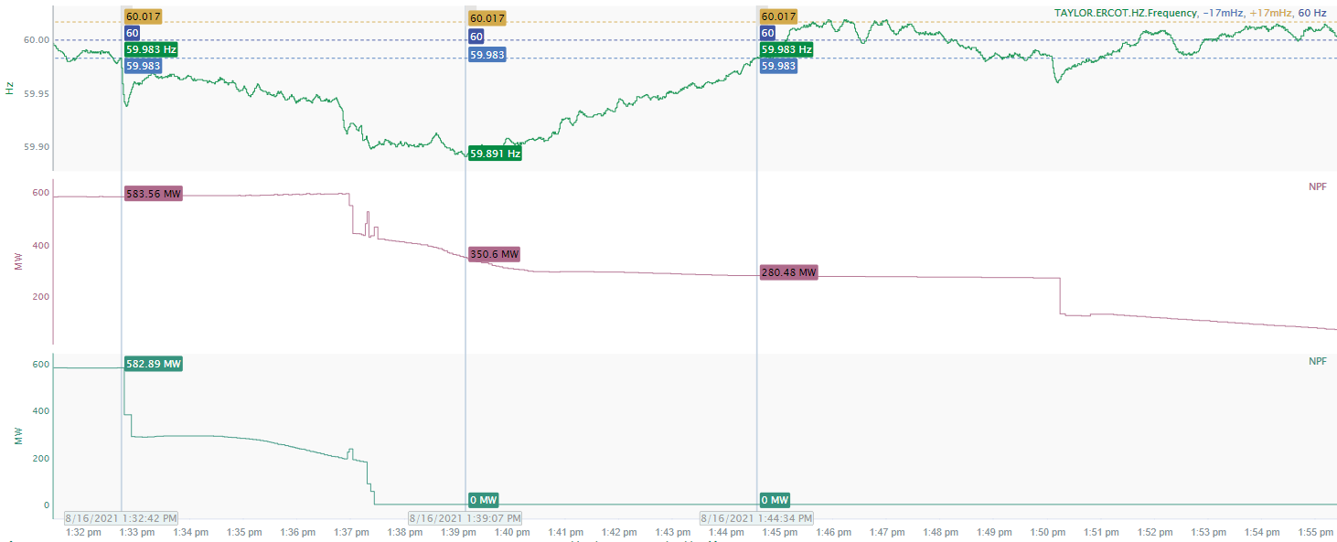
8/16/2021 13:32:41 (NON-FME)
Notes:
Two combined cycles experienced partial trip followed by runback for total loss of approximately 1100 MW.
Starting Frequency: 59.983
Minimum Frequency: 59.891 Hz
Recovery Time(back to deadband): 11 minutes and 52 seconds
RRS Deployed: 796.54 MW
Trip Reason: Lightning strike
Contextual Information: A total of 402 MW of regulation up was deployed and manual offset of 400 MW was applied during the event.
No Selection Reason: The unit trip is not instantaneous.

Slide 4
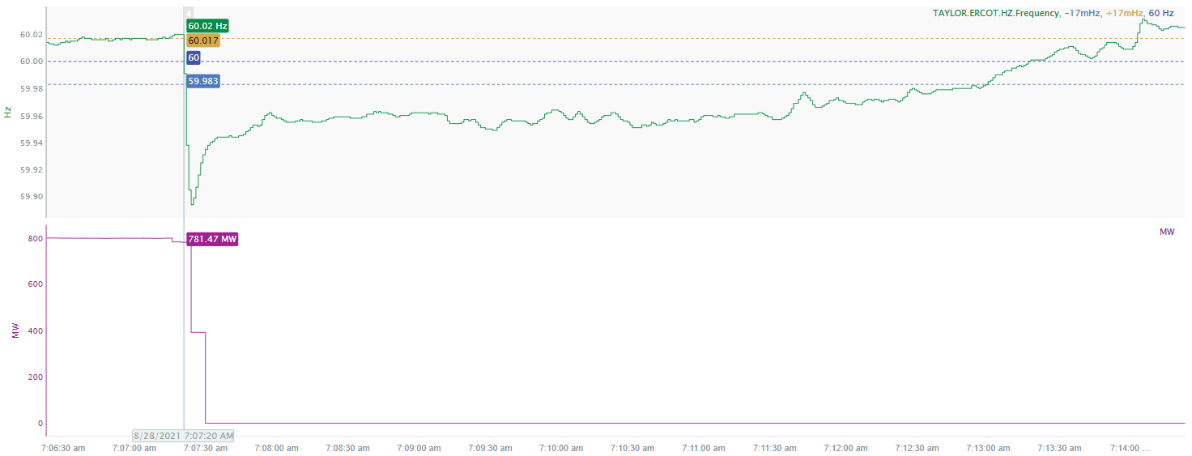
8/28/2021 07:07:20 (FME)
Notes:
Unit tripped while carrying 781 MW.
Starting Frequency: 60.02
Minimum Frequency: 59.894 Hz
A-C Time: 4 seconds
Recovery Time(back to deadband): 5 minutes and 33 seconds
RRS Deployed: 0 MW
Trip Reason: Preliminary investigation showed problems with the generator bushings for ISO phase.
Contextual Information: A total of 296 MW of regulation up was deployed during the event.

Slide 5
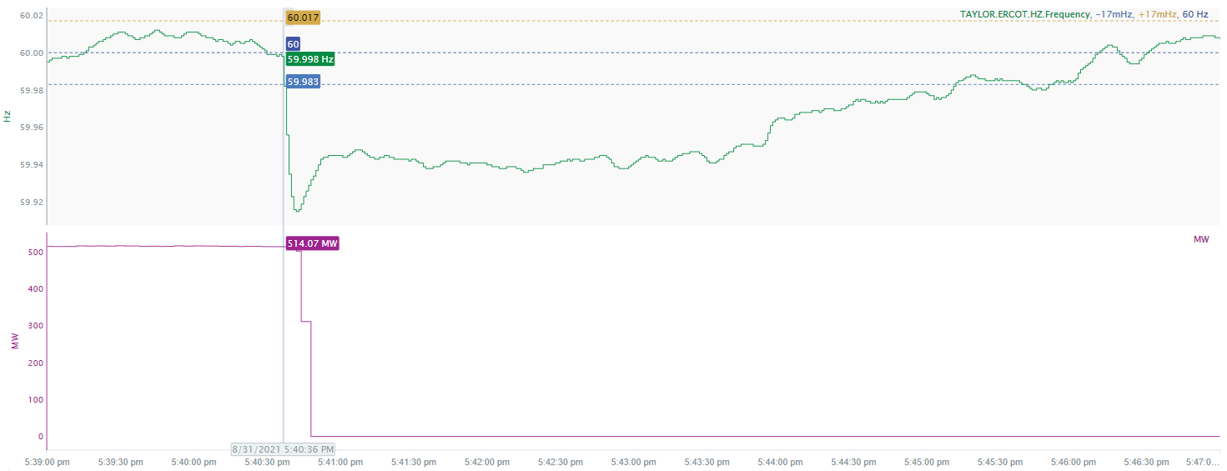
8/31/2021 17:40:36 (FME)
Notes:
Unit tripped while carrying 502 MW.
Starting Frequency: 59.998 Hz
Minimum Frequency: 59.915 Hz
A-C Time: 6 seconds
Recovery Time(back to deadband): 4 minutes and 35 seconds
RRS Deployed: 0 MW
Trip Reason: Drum level transmitter issue.
Contextual Information: A total of 193 MW of regulation up was deployed and manual offset of 250 MW was applied during the event.

Slide 6
Questions?
Thank you!

